Slide 1
FREIGHT FORWARDER
&
INTERMODALITE
in Pan-European Region
Kayıhan Turan
UTIKAD Board Member

Slide 2
UTIKAD
UTIKAD – Association of International Forwarding and Logistics Service Providers
National and International Transportation:
Road, Air, Sea, Rail and Combined Transportation
Logistics Services
Approx. 400 Members & 50,000 Direct Employment & 5 USD Billion Turnover
95 % of Air Transport
70 % of Road Transport
60 % of Sea Transport
20 % of Rail Transport
carried out by our members in Turkey

Slide 3
NATIONAL & INTERNATIONAL PLATFORMS
VOICE OF INDUSTRY IN TURKEY
VOICE OF INDUSTRY IN THE WORLD

Slide 4
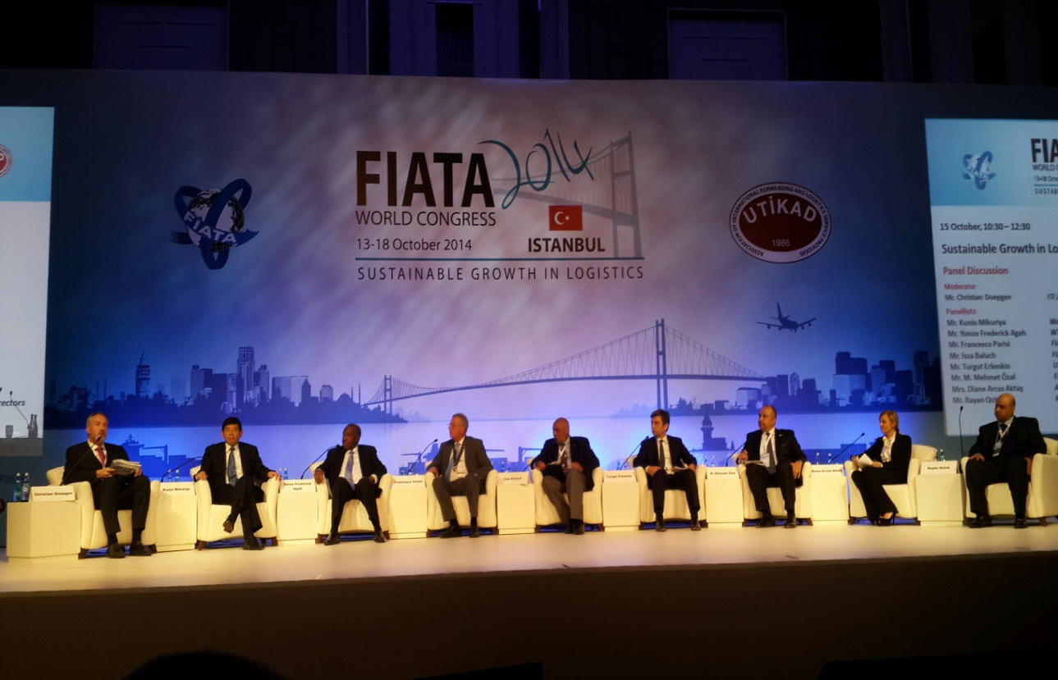
FIATA WORLD CONGRESS – 2014 / ISTANBUL
From 95 Countries,
More than 1000 Participants
came together

Slide 5
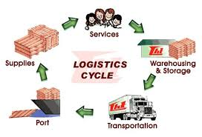
FREIGHT FORWARDER
The Intermediary Who Arranges For The Carriage Of Goods
and/or
Associated Services, on Behalf of a Shipper/Consignee

Slide 6
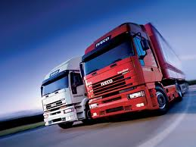
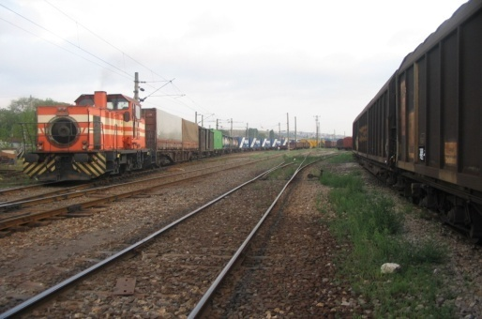
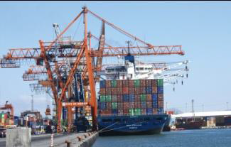
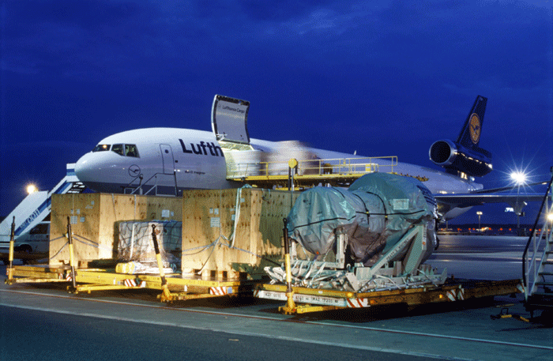
FREIGHT FORWARDER & INTERMODAL
Role of Freight Forwarder is to unite and inform and guide all stakeholders in the combined & intermodal transport chain based on best practices, market and customer demands and worldwide new technologies and innovations.

Slide 7
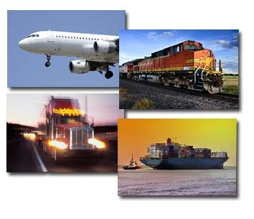
MULTIMODAL , COMBINED , INTERMODAL
MULTIMODAL TRANSPORT
COMBINED TRANSPORT
The Carriage of goods by two
or more modes of transport.
INTERMODAL TRANSPORT
*Intermodal transport
*Major part of the journey
by rail, inland waterways
or sea
*Initial & final legs carried
out by road
One and same loading
unit/road vehicle
Successive two or more
transport mode
No physical handling of
goods in changing modes.
INNOVATION & INCENTIVES & INFRASTRUCTURE

Slide 8
INTERMODAL TRANSPORT
System of Transport
whereby two or more modes of transport are used
to transport the same loading unit or truck in an integrated manner,
without handling the goods themselves in changing modes,
in a ‘Door To Door’ transport chain
INTERMODAL TRANSPORT
ACCOMPANIED
UNACCOMPANIED
The Whole Truck With Semi-trailer
Loaded On The Railway Wagon
Loose Units (Container or Semi-Trailer)

Slide 9
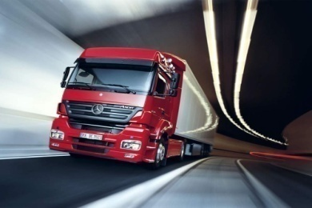
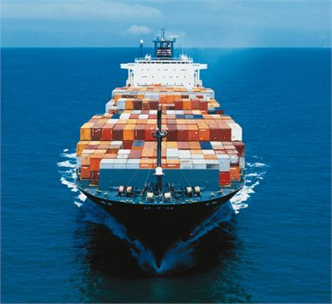
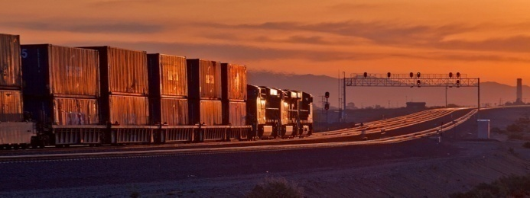
INTERMODAL TRANSPORT
Seamless intermodal
transport operations
-economically viable
-ecologically sustainable
-integral part of global
& regional logistics
supply & distribution
chains.
Effective national and international cooperation and harmonization of technical, legal and transport policy informations.
Intermodal transport road connecton is not more than 300-500 km.

Slide 10
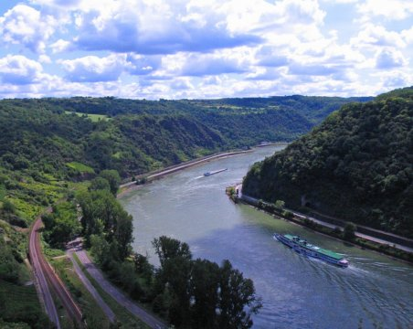
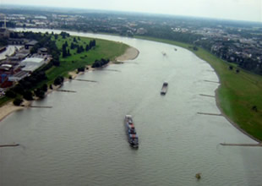
INTERMODAL TRANSPORT
Today, Over 100 European Companies Transport Annually Around
18 Million TEU In Intermodal Road-Rail Transport Operations
17 million TEU as unaccompanied (containers, swap-bodies, semi-trailers)
1 million TEU in accompanied traffic (complete trucks).
On the river Rhine around 2 millions TEU of containers are transported annually and thus alleviate congestion along the very important North-South European road and railway corridors

Slide 11
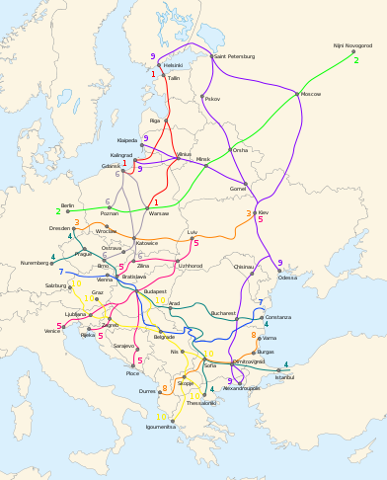
INTERMODAL TRANSPORT in PAN-EUROPEAN
The Pan-European region extends
from the Atlantic to the Pacific,
to the Central Asian
the Mediterranean Sea
to the Arctic Ocean
total 54 countries

Slide 12
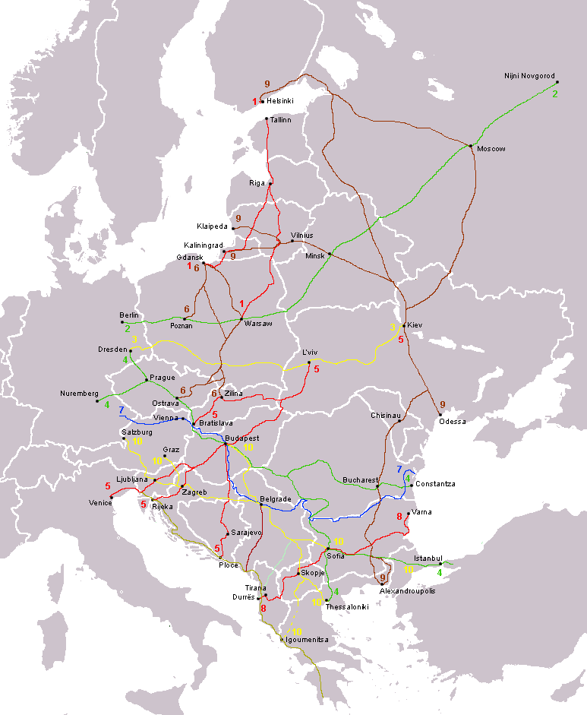
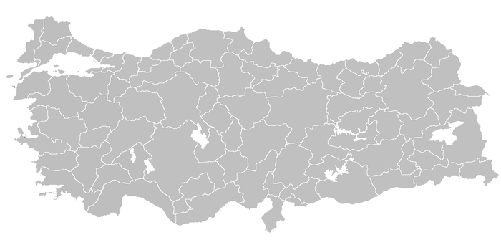
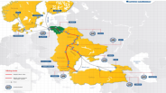
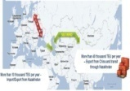
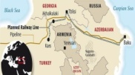
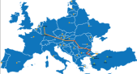
TURKEY in PAN – EUROPE REGION
‘Pan – European Corridor
can be more stronger
with the projects of related Turkey which connect Asia, Middle East and Europe, through corridor IV’
3rd Bridge in Bosphorus
Eurasia Rail Tunnel
TRACECA
Viking Train
Silk Wind
Baku-Kars- Tblisi Railway
Marmaray
3rd Airpot in Istanbul
BALO Project

Slide 13
INTERMODAL TRANSPORT in PAN-EUROPEAN
To improve the intermodal transport in
Pan European Region we need;
Operational Solutions
Technological Solutions
Legal Solutions

Slide 14
OPERATIONAL SOLUTIONS
Enhance network interoperability
Built sufficient and sustainable infrastructure
Remove regional and economical barriers
Harmonization and standardization of intermodal loading units
Use the Common CIM/SMGS Consignment Note

Slide 15
TECHNOLOGICAL SOLUTIONS
Improve innovative technologies for freight terminals, traffic management and intermodal transport
Deployment Intelligent Transport Systems (ITS)
Design innovative intermodal terminals (using automated handling equipments etc.)
Development of the European Air Traffic Management (ATM) system, the European Rail Traffic Management System (ERTMS), the European Vessel Traffic Management and Information Services (VTMIS) and Radio Frequency Identification (RFID) technology

Slide 16
LEGAL SOLUTIONS
Governments Need To Set & Maintain The Institutional Framework
Regulations should be prepared for safety of combined & intermodal transport operations
Create a single extensive Pan – European legislation
Liberalization in rail market
Incentive regulations in the rail sector

Slide 17
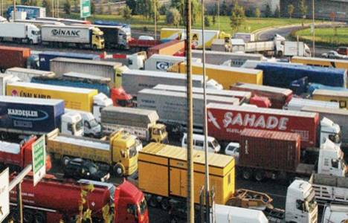
FINAL WORD
The Combined & Intermodal Transport Chain Deserves To Be Taken More Seriously
“It Is The Only Solution To The Growing Problem Of Transport Infrastructure Congestion”
Increasing number of vehicles
Decreasing possibilities for creating enough new resources
Road trafﬁc comes to a grinding halt.
Railways, inland waterways and ocean shipping will avoid the chaos
Different modes of combination creates sustainable and efﬁcient transport system

Slide 18
FINAL WORD
The Only Way To Establish A Proper Balance
Among The Different Modes of Transport;
Understand its complex ramiﬁcations
Designing the future transport system by ;
-- Transport enterprises
-- Customers,
-- Politicians
-- Scientists
-- Researchers

Slide 19
FINAL WORD
More Than Ever, We Need Intelligent Combined & Intermodal Transport Chains That
Optimise cost,
in the internal market and worldwide.
Minimize environmental impact,
Speed up of delivery of products in the same shape
at production point,
Tracing of goods in transit from origin to destination
We belive that working together with all stakeholders,
the economically and environmentally sustainable solutions will be realized and executed in a correct way.

Slide 20
CONTACT DETAILS
ASSOCIATION OF INTERNATIONAL FORWARDING AND LOGISTICS SERVICE PROVIDERS
President : Mr. Turgut ERKESKIN
General Manager : Mr. Cavit UGUR
E-mail Address : utikad@utikad.org.tr
Web Site : www.utikad.org.tr
Phone : + 90 212 663 62 61
Fax : + 90 212 663 62 72
Address : Senlikkoy Mahallesi, Saci Sokak,
No:4/F, Florya 34153
Bakirkoy – Istanbul / TURKEY

Slide 21
Thank You
Kayıhan Turan
UTIKAD Board Member

