Slide 1
The Trans-Siberian Route: ways to increase competitiveness of railway freight transportation
Транссибирский маршрут: пути повышения конкурентоспособности перевозок грузов железнодорожным транспортом.
Working Party on Rail Transport
Geneva, November 25-26, 2014

Slide 2
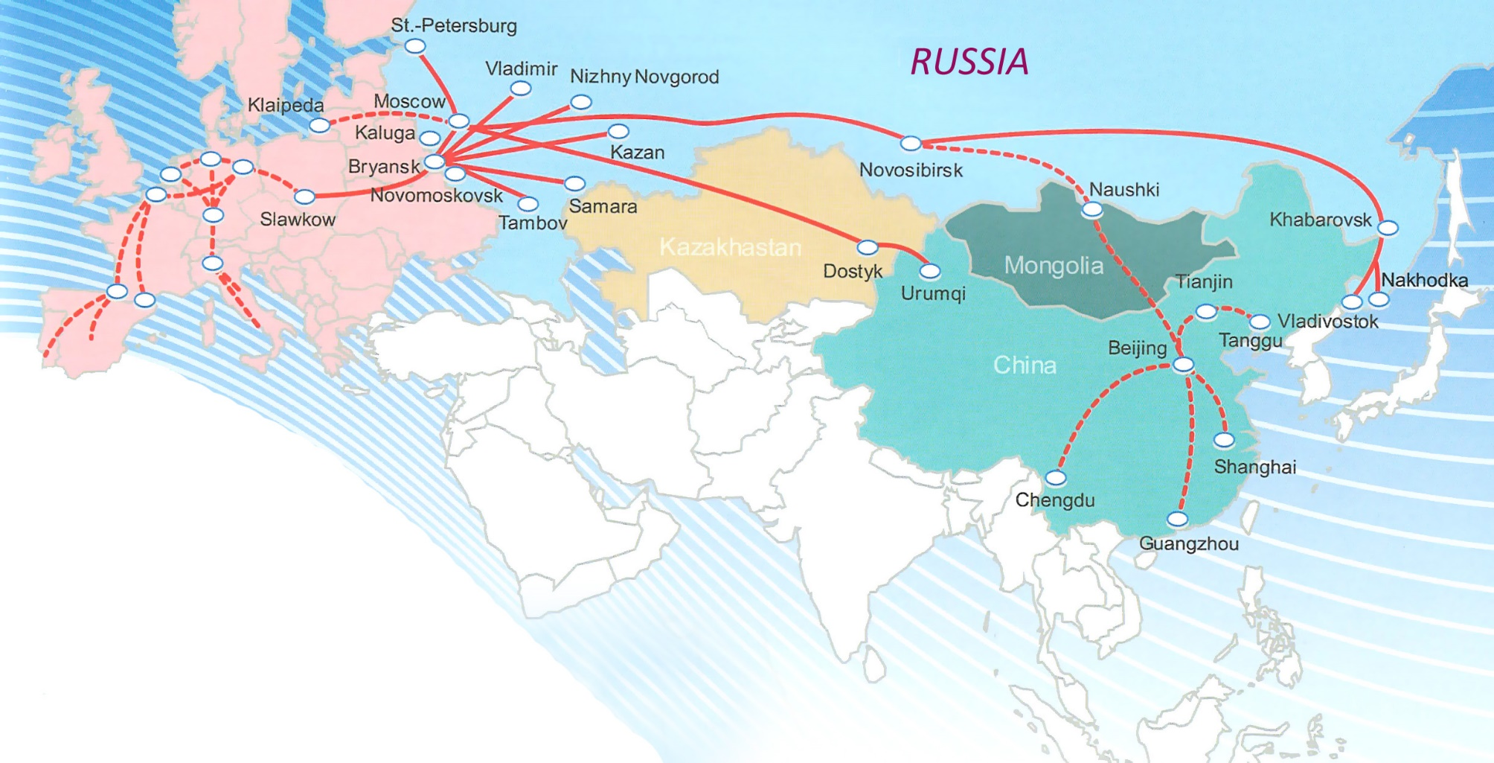
The Trans-Siberian Route: ways to increase competitiveness of railway freight transportation
TSR: integrated multimodal network
ТСМ: интегрированная мультимодальная сеть
Integrated multimodal services connect sea ports and terminals of Europe, Russia and the Asia-Pacific Region and can deliver a container from North Atlantic shores to the Pacific.

Slide 3
The Trans-Siberian Route: ways to increase competitiveness of railway freight transportation
Transit container transportation dynamics on TSM,
1999-2013, TEU
Volumes of container cargo transportation between Russia and Asia-Pacific,
January-October, 2013 – 2014, TEU
Volumes of international container transportation on TSM,
January-September 2013-2014, TEU
+15,22%
-12,10%
Export
Import
Export
198 673
240 029
228 912
Import
210 996
Transit
86 958
Transit
+13,39%
98 598

Slide 4
The Trans-Siberian Route: ways to increase competitiveness of railway freight transportation
Container turnover of Russian sea ports in January-September 2013 and 2014 Контейнерооборот морских портов России за январь-сентябрь 2013 и 2014 гг.
Source: Morcenter-TFC

Slide 5
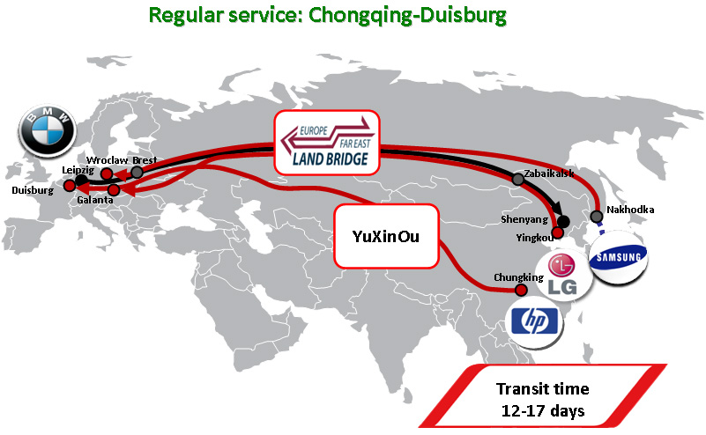
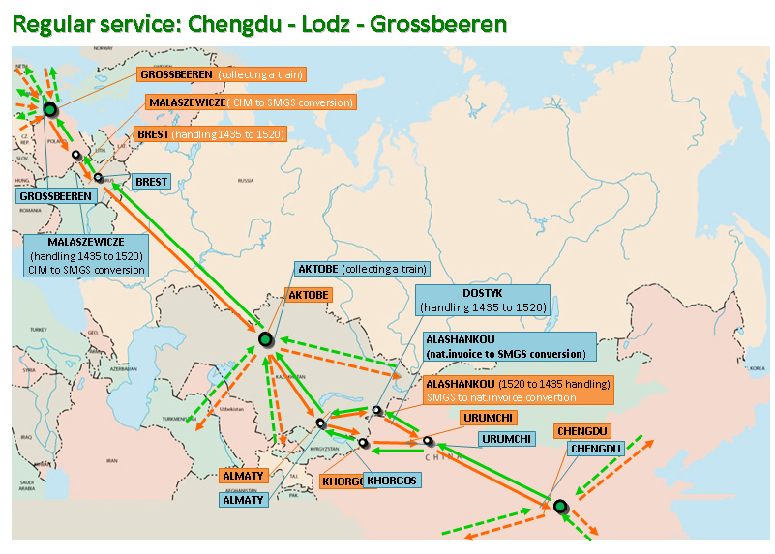
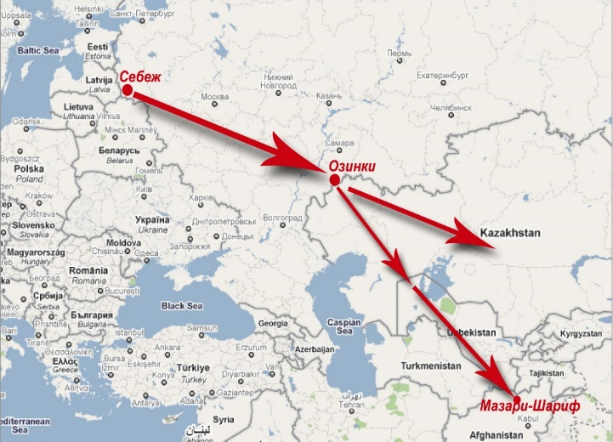
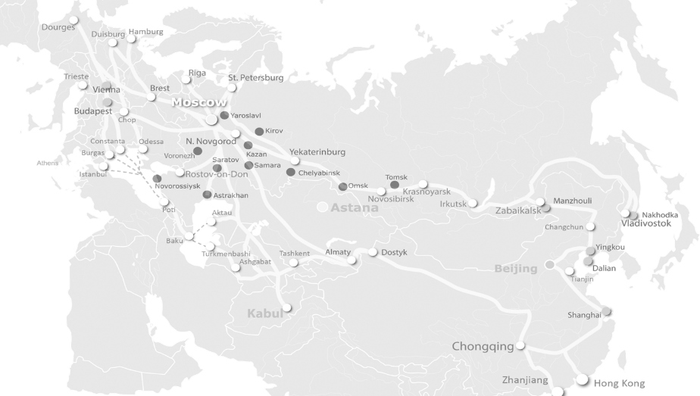
The Trans-Siberian Route: ways to increase competitiveness of railway freight transportation
Transport products on TSR
Транспортные продукты на ТСМ
BALTIC TRANSIT
Suzhou– Warsaw
Варшава
FIT
Сучжоу

Slide 6
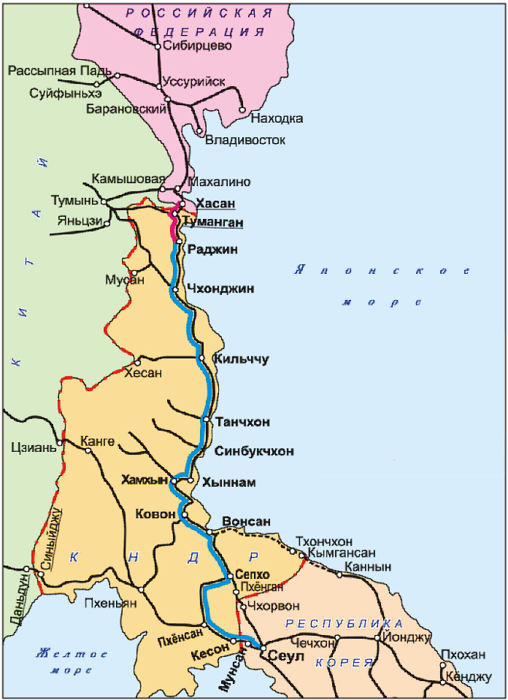
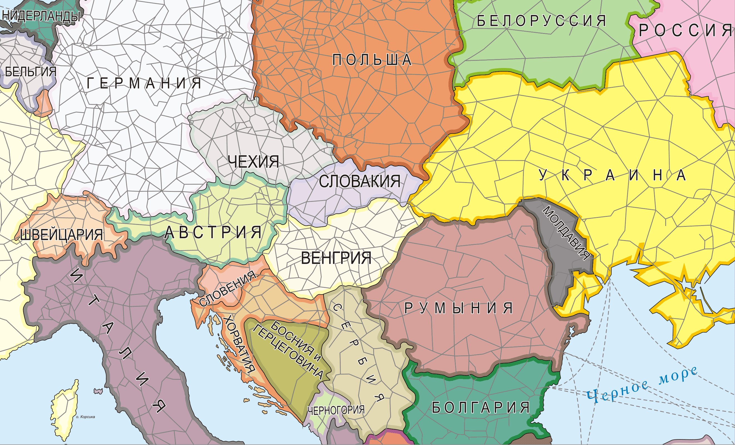
The Trans-Siberian Route: ways to increase competitiveness of railway freight transportation
I. Broadening infrastructure possibilities
I. Расширение инфраструктурных возможностей
Берлин
Прага
Киев
ФРАНЦИЯ
Берн
Вена
Братислава
Будапешт
Любляна
Загреб
Протяженность линии (route length) ≈ 390-430 км (km)
Перспективный объем (potential volume) 16÷24 млн. тонн (mln.tons)
Railway route construction project with a 1520 rail gage till Bratislava-Vienna
Проект строительства железной дороги с шириной колеи 1520 мм до Братиславы-Вены
The project on Trans-Siberian and Trans-Korean mainlines connection
Проект соединения Транссибирской и Транскорейской магистралей

Slide 7
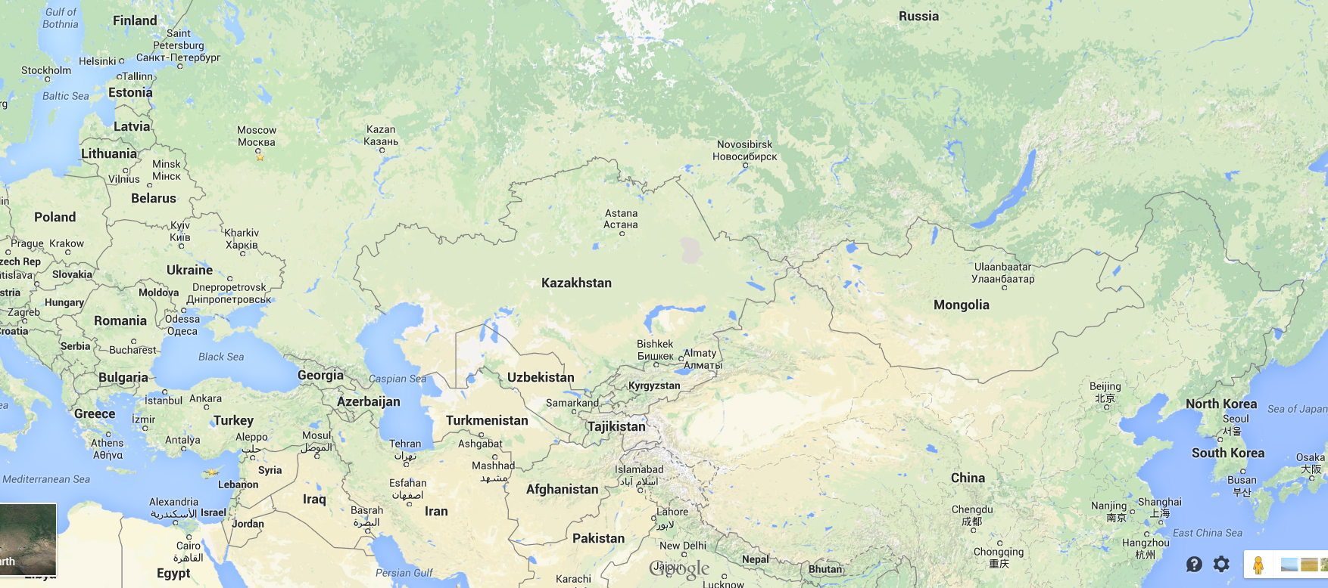
The Trans-Siberian Route: ways to increase competitiveness of railway freight transportation
II. Stable transit time guarantee
II. Гарантия стабильного транзитного времени
Nakhodka
Nakhodka – Moscow (7 days)
FESCO Moscow Shuttle: Moscow – Vladivostok (11 days)
China – Poland (13-15 days)
China – Germany (14-16 days)

Slide 8
The Trans-Siberian Route: ways to increase competitiveness of railway freight transportation
Factors of transit time reduction
Факторы, влияющие на сокращение транзитного времени
Container block-trains organization.
Simplification of customs procedures.
Border crossing facilitation (including advance presentation of cargo information to customs).
Introduction of innovative technologies and electronic document management.
Fixed train paths.
Организация контейнерных маршрутных поездов.
Упрощение таможенных процедур.
Облегчение пересечения границ (включая предварительное информирование таможни о грузе).
Внедрение инновационных технологий и электронного документооборота.
Движение поездов по твердым ниткам графика.

Slide 9
The Trans-Siberian Route: ways to increase competitiveness of railway freight transportation
1
4
5
2
3
III. Stable and competitive end-to-end tariff
III. Стабильный и конкурентоспособный тариф
I. By railway transport.
1. Railway infrastructure tariffs: Railways of China, KTZ, RZD, BCh, PKP, DB.
2. Container flatcar rent
3. Security
4. Additional charge (handling, customs control, station charge etc.)
5. Operator’s commission
1
4
5
2
3
6
7
8
II. Intermodal transport on the TSR the through Far East ports (sea + railway).
1. Sea freight
2. Stevedore's charges
3. Terminal services
4. Railway infrastructure tariffs.
5. Container flatcar rent
6. Security
7. Additional charge (handling, customs control, station charge etc.)
8. Operator’s commission

Slide 10
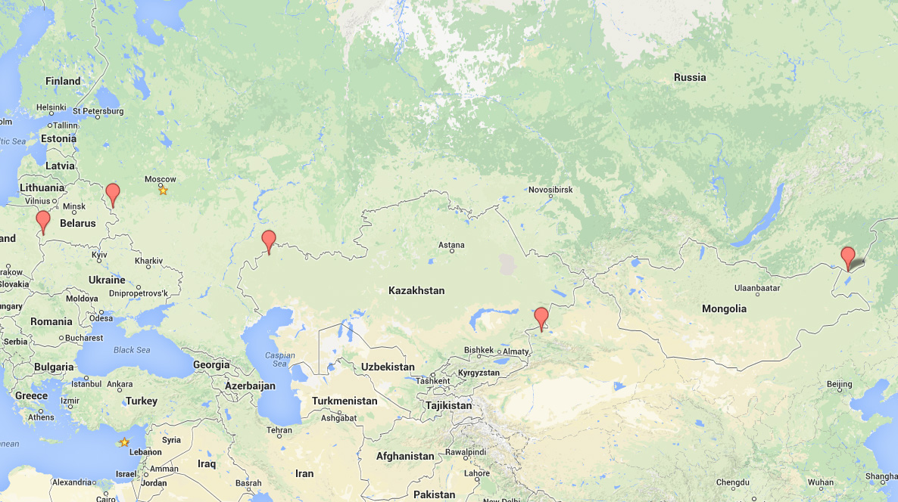
The Trans-Siberian Route: ways to increase competitiveness of railway freight transportation
Tariff policy for freight transport by container trains between China to Europe (40’ own)
Формирование тарифной ставки для контейнерных поездов между Китаем и Европой (40’)
7 069 km
Osinovka/Krasnoe
Brest
2 058 km
Kanisai/Iletsk
Zabaikalsk/ Manzhouli
609 km
3 025 km
Dostyk/Alashankou
Zabaikalsk – Krasnoe (1 044 CHF) Krasnoe – Zabaikalsk (464 CHF) Osinovka – Brest or return (230 CHF) Dostyk – Iletsk or return (859 CHF) Kanisai – Krasnoe or return (576 CHF)
China

Slide 11
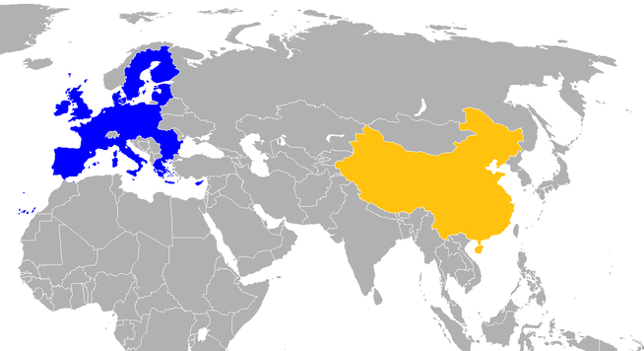
The Trans-Siberian Route: ways to increase competitiveness of railway freight transportation
IV. Freight flow balance
IV. Сбалансированность грузопотоков
40’ containers
(60% of total traffic)
EUROPE
CHINA
20’ containers
(40% of total traffic)

Slide 12
The Trans-Siberian Route: ways to increase competitiveness of railway freight transportation
V. Single legal framework
V. Единый правовой режим
Integrated?
Single!

Slide 13
The Trans-Siberian Route: ways to increase competitiveness of railway freight transportation
VI. Cargo safety
VI. Обеспечение сохранности грузов

Slide 14
The Trans-Siberian Route: ways to increase competitiveness of railway freight transportation
Service regularity
Improvement of the regulatory framework
Stable and competitive tariff
TARGET PRIORITIES
OF A MODERN TRANSPORT PRODUCT
Security
Introduction of new technologies
New infrastructure opportunities

Slide 15
Thank you for your attention!
Спасибо за внимание
CCTT Deputy Secretary General
Mrs. Natalia Stepanova, PhD
info@icctt.com

