Slide 1
Increasing railways‘ competitiveness
UNECE workshop
Deutsche Bahn AG
Maria Sack, LL.M.
Head of Unit International Associations
Geneva, 25 November 2014

Slide 2
Railways in Europe are an essential means of transport with a substantial economic footprint
1.1% of GDP

Slide 3
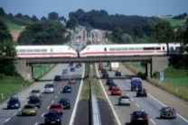
Transport policies must set the right course to ensure the competitiveness of rail transport
Challenges
Levers for positive development of rail transport
Ensure sufficient financing for existing network
Avoid foreseeable capacity bottlenecks by upgrading and expanding the network
Infrastructure
policy
Ensure competitiveness of rail transport: harmonisation of the framework conditions between different modes of transport to ensure fair intermodal competition
Competitive position of rail transport
Technical framework
Reducing technical market entry barriers
Empowerment of the ERA – an extension of its tasks and its responsibilities to include cross-border vehicle authorization + issuing of safety certificates
Set a framework to attract private investments and innovation
Sufficient European regulation for rail is reached – now the focus should be on implementation
Regulatory
framework

Slide 4
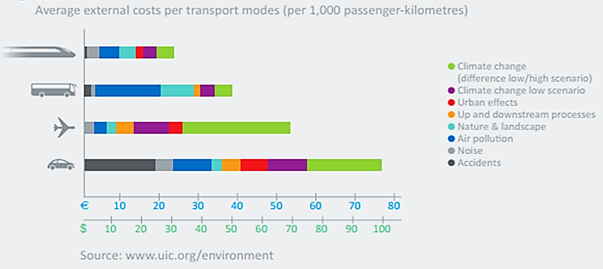
Rail transport is still disadvantaged in many ways compared with other modes of transport
Re-balancing of inter-modal conditions
VAT regime
Infrastructure charging
In EU, 100% of rail network is tolled – but only 0.9% of the road network
Internalisation of external costs

Slide 5
Rail is the only transport mode without uniform rules for international long distance traffic
One legal regime for road: CMR (Convention on the contract for the international carriage of goods by road)
One legal regime for sea: Hague/Visby-rules
One legal regime for inland waterway: CMNI (Convention on the contract for the carriage of goods by inland waterway)
One legal regime for air: Warsaw / Montreal convention
Two legal regimes for rail:
1. COTIF /CIM (Convention concerning international carriage by rail / Uniform rules concerning the contract for international carriage of goods by rail)
2. SMGS (Agreement on International Goods Transport by Rail)

Slide 6
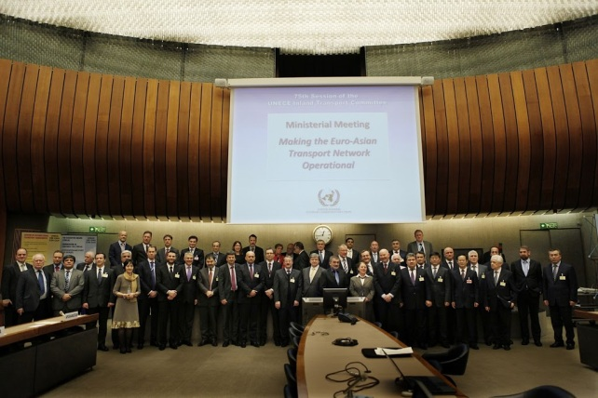
UNECE - International Rail Cooperation Unified Railway Law
Joint declaration towards Unified Railway Law
Geneva, 26 February 2013
Signed by Transport Ministers of 37 states
Armenia
Azerbaijan
Belarus
Belgium
Bosnia and Herzegovina
Bulgaria
Croatia
Cyprus
Czech Republic
Estonia
Finland
France
Germany
Greece
Italy
Kazakhstan
Kyrgyzstan
Latvia
Lithuania
Malta
Mongolia
Netherlands
Pakistan
Poland
Portugal
Moldova
Romania
Russian Federation
Serbia
Spain
Sweden
Switzerland
Tajikistan
The former Yugoslav Republic of Macedonia
Turkey
Ukraine
Uzbekistan

Slide 7
UNECE declaration - parallel and complementary approach for Unified Railway Law
UNECE-Declaration Unified Railway Law (26 February 2013)
Governments
Industry
Development of a single legal regime from Atlantic to Pacific
Elaboration of optional modal rules for Euro-Asian rail contracts
7
7
Notes:
7

