Slide 1
Fresh fruit and vegetable exports from Greece: challenges
Findings based on BPAs

Slide 2
Programme of the day
Time | Subject
09:00-09:15 | Welcome - Representative UN ECE Presentation of participants
09:15-09:30 | Purpose and scope of the meeting Dr Heiner Lehr
09:30-10:00 | Mapping / Presentation of the fresh fruit and vegetable supply chain. Dr Heiner Lehr
10:00-10:50 | Electronic export processes (Joint presentation) for Fresh Fruits and Vegetables Pre customs : Electronic quality certification processes with Meno 2.0 Representative MRDF Customs :Electronic processes with ICISnet Representative Customs
10:50-11:00 | Coffee break
11:00-11:30 | Findings based on BPAs: Kiwi ,Olive Oil , Peach ( export chain with basic timeline) Dr Heiner Lehr
11:30-14:00 | Discussion of export chain and identification of challenges Facilitator: Dr Heiner Lehr
14:00-14:30 | Light Lunch
14:30-15:30 | Presentation preliminary competitiveness analysis Dr Heiner Lehr
15:30-17:00 | Identification of crucial influencing factors towards (a) Time to Export (b) Cost to Export Discussion possible solutions / Next Steps Facilitator: Dr Heiner Lehr
17:00 | Closure Representative UN ECE

Slide 3
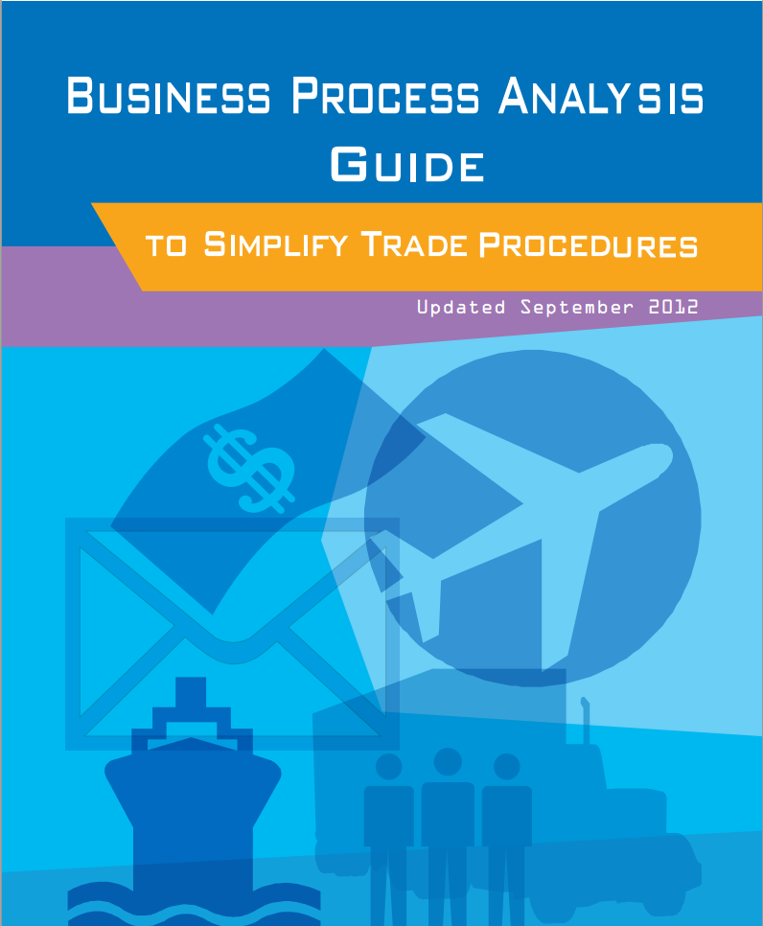
What is a Business Process Analysis
BPA = Business Process Analysis
A trade business process is a chain of logically connected activities to move goods and related information across borders from buyer to seller and to provide related services
unnext.unescap.org/pub/tipub2558new.pdf

Slide 4
BUY – SHIP- PAY

Slide 5
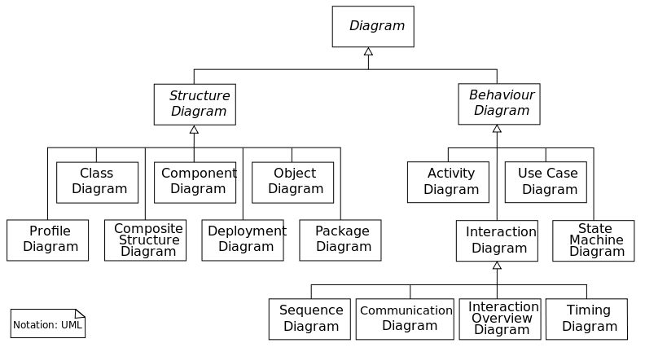
UML
BPA uses the Unified Modelling Language (UML) to describe business processes
UML is a general-purpose modeling language in the field of software engineering, which is designed to provide a standard way to visualize the design of a system
UML is an ISO standard
Main tools employed:
Use case description
Sequence diagrams

Slide 6
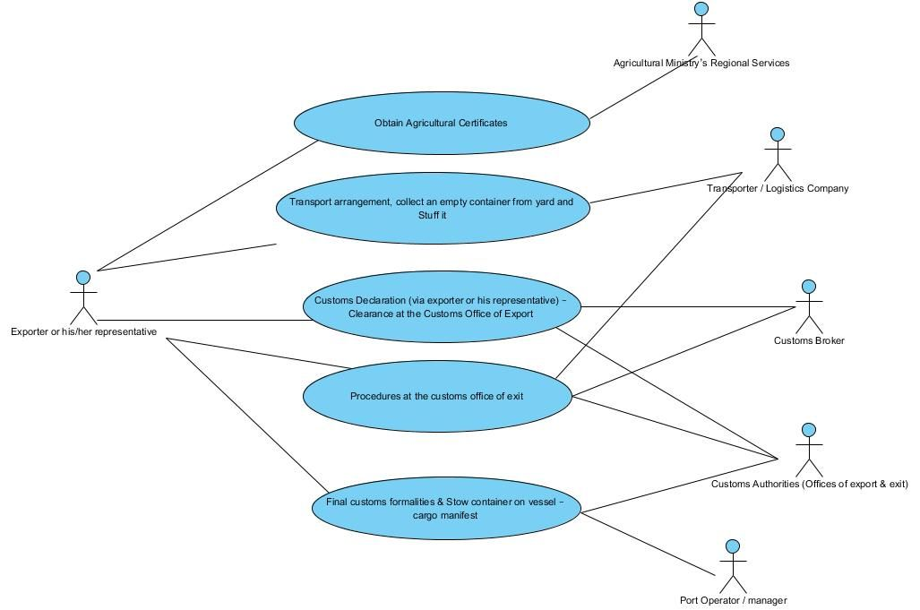
Use cases

Slide 7
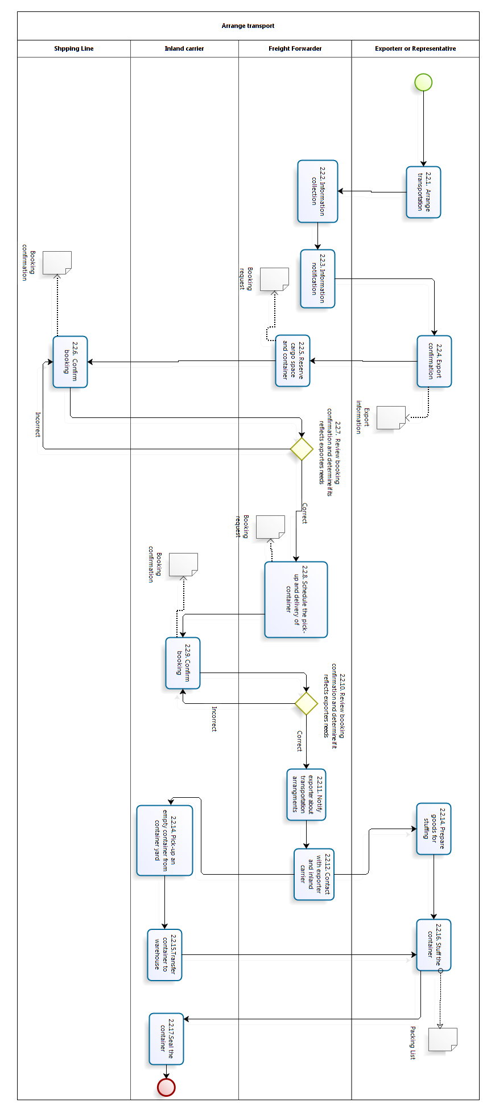
Example sequence diagram
Process: Transport Arrangement via an intermediary company

Slide 8
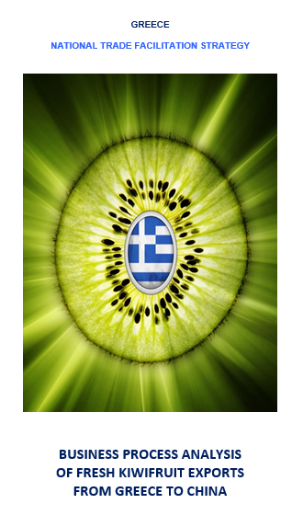
Main findings kiwifruit
A BPA study was made in December 2012-February 2013 on kiwifruit from Greece to China via ship
BPA Team
Ministry of Finance, Ministry for Development, Competitiveness, Infrastructure, Transport and Networks and Ministry of Rural Development and Food
Guidance and support from TFGR
Technical assistance of UNECE
Consultancy and scientific guidance of the University of Athens.

Slide 9
Conclusions
The average time required for the completion of the shipping process of kiwifruits from Greece to China is approximately six days
the estimated time relates only to the five sub-processes analyzed
The cost incurred for shipping a 20 ton container amounts to 4,500 Euros, excluding annual fees for acquiring an export permit (500 Euros) and the fee of AEO permit (500 Euros).
The shipping cost of kiwifruits per ton is 225 Euros which represents 15% of their selling price. The problems associated with the shipping process can be classified into the following four categories:
process operations,
broader operational issues of the public sector,
structural problems of the public sector, and
issues related to international (Greece-China) commercial agreements
The identified problems affect the required time as well as the incurred costs and therefore the redesign of the shipping process should aim to the alleviation of these problems.

Slide 10
Next steps
The following steps are envisaged for completing the first phase of the pilot:
process mapping validation,
process analysis,
development of recommendations for process improvement, and
implementation of proposed changes.

Slide 11
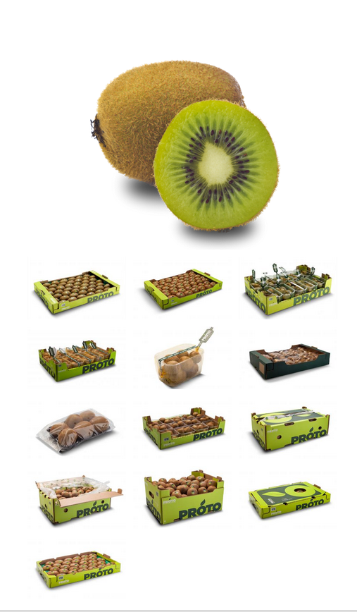
Validation activity
Visit Protofanousi SA, Thessaloniki 26th March 2014
The company is a large world-wide exporter of fruits and specialise in kiwifruits, cherries and plums, but also export apples, oranges, strawberries and other fruit. The company seeks competitive edge by supplying fruits to those markets where its transport costs are lower in peak harvesting time.
Protofanousi is an approved trader for kiwi from the headquarter packing house, but not an approved economic operator (AEO).
Protofanousi sells kiwis mostly to
Russia
European Union
China
Other destinations
© Protofanousi S.A.

Slide 12
Kiwi business @ Protofanousi
In spite of long term agreements with buyers world-wide, contracts are subject to quick and unpredictable changes.
Customers might both reduce the amount of fruit wanted or increase it on very short notice.
Given this variable nature of the order flow and the small operating margin for ship transports to China (shelf-life – shipping time is about 5-7 days only), companies rely on efficient customs procedures.
On time delivery of the merchandise is a key differentiating factor; in case of delays, clients may very well cancel orders.
Companies operate 7 days per week in peak season
In terms of key performance indicators of the export process, Protofanousi stated in order of importance
Reliability/predictability
Total time, resulting in greater flexibility for changes in destination/orders
Cost

Slide 13
Competitive advantages and weaknesses
Russia
Positive attitude towards Greek products
In Jan-April shorter transport ways than fruit exporting countries and therefore lower transport costs
Central Europe
Greece has not recovered from a period of low quality exports, so Greek fruits do not have a strong brand image and are treated as inferior
For selected countries like Germany, Protofanousi is competitive because of low transport cost
For cherries, Spain has earlier harvesting period. Turkey is the main competitor, but Greece has shorter transport ways.
For oranges competition from Spain is too strong. Therefore, Protofonosi exports them to Romania.
China
Very demanding customers
China has large own production, but also a heavy pollution problem.

Slide 14
Documents delivered to Customs
Packing list
Phytosanitary certificate
Sales invoice
CMR (road transport only)
Greek transport authorization (road transport only)
EUR1 (Country of Origin certificate, obtained by Chamber of Commerce)
Export declaration

Slide 15
Cost of export
Inspection costs
30€ per phytosanitary certificate
Distance based overtime cost (about 25€ for Protofanousi)
Customs
11€ per export afterhours charge.
NOTE: there is, however, no cashier present after office closing hours.
Transport costs
Russia: about 4,500€ per lorry
UK: 3,800€ per lorry
DE: 2,000€ per lorry
China: 2,000USD per container
Cost of waiting for inspection
Energy for refrigeration
Reduction in useful shelf life
Financial cost (delay of income, credit costs, etc)

Slide 16
Financial aspects of the export
European customers are typically covered by credit insurers, but for 3rd countries (in particular Russia) obtaining credit information is very difficult. This is significant, because Russia is a very large trading partner.
Invoices are usually paid 30 days after reception of goods.
Attempts are being made to switch to cash advance systems with customers from some countries
Customers sometimes use quality claims as a means to not receive goods (if demand has changed for example).
This happens particularly often with Russian customers.
Chinese customers usually have more reliable claims
Good claim data from European customers.

Slide 17
Key issues identified in verification
Key finding #1:
Arrangement of land transport takes about 1-2 days, whereas arrangement of ship transport takes about 2-3 days.
Key finding #2:
Planning of inspections in advance would cut down the waiting time. This could be a fixed window or an order dependent arrangement. DAOK officials could e.g. schedule a visit every day at a suitable time and inspect whatever is ready to be inspected. Or, the company could pre-notify the likely time when they will be ready for inspection (2-3 days ahead) and then DAOK officials could plan their schedule to be there at that pre-arranged time.

Slide 18
Timeline
Transport by lorry
Transport by ship

Slide 19
Critical processes
Transport arrangements
Opening hours of DAOK in particular on weekends
Opening hours of Customs office
The need for physical inspection for the phytosanitary certificate. (Use of risk-based methodologies should be investigated.
The need for checking the transportation means for the phytosanitary certificate. If 3PLs were certified for “clean” transport containers or had other means of showing the aptitude of their lorry/container, the physical inspection could be done when packing and before the actual transportation means has arrived on the premise.
Need for 100% documentary checks for fresh fruit and vegetable exports which requires physical visit to the customs office in any case.
To a lesser extent time critical are the need to visit DAOK to pick up the phytosanitary certificate and the need for some TIR-related documents during the documentary check.

Slide 20
Identified issues
Agricultural certificates
There is no chance any more for performing local visits and issuance of agricultural certificates outside of the formal working hours. This seems to be due to the fact that agriculturalists are not paid, when they work beyond official office hours, so they avoid working overtime. The exporter chooses the transactions with DREVM to be done during the regular working hours.

Slide 21
Identified issues
Customs Procedures
More than 95% of exports are submitted by customs brokers, even though the electronic submission of customs declaration started on April 2012
In the case of a declaration of the goods, there is no reason for the trader to come twice to the customs office. The exchange of information can be implemented using messages only.
For medium and high risk goods that have obtained the corresponding agricultural certificates and document, a second check should not be done.
The additional “DETE” fees cost, for services delivered not in the working hours (7:30 to 15:30)
The back up process which has to be applied when customs declaration electronic system goes down.
Some laboratory tests should be performed before the arrival of the goods to the customs. There is a difficulty in the identification of the goods.
Should this extra check not be performed; there will be a reduction in the cost (15% of the DETE fees)
If there is a need for chemical analysis, due to lack of chemical laboratory in the area, the sample has to be transferred to the nearest laboratory resulting in a waste of time. The chemical services have been asked to be transferred within the area of the port.
There is no need for the exporter or his/her representative to come twice to the customs office in the cases where there is a declaration of the goods. Accompanying documents should be printed by operators

Slide 22
Identified issues
Other issues related to customs procedures
Lack of information of the shipping companies and uncertainty when IE547 message should be sent.
A message of loading, similar to the IE547 message, must be created as soon as possible, so that there should be no need to collect such a large number of paperwork.
The message IE590 that is sent by the local authorities must be established as a message that will be submitted by the manager of the band.
There must be an electronic Interface between the customs Office and port/terminal operator so that he is informed immediately upon the time the IE529 message is issued.
All the flow should be implemented in an electronic way, paperless. In the Customs office of export there are only transport documents. It is expected that the customs IT system (ICISnet) will be able to provide electronic submission of supporting (to customs declaration) documents by June 2013.
There must be collaboration with the 33rd Directorate of the Ministry of Finance so that the requirements of the other Ministries are included. A better coordination is required between customs and other agencies involved, is required.
The site of the customs service should provide information in a more organized way.

Slide 23
Other considerations
Working hours of Agriculturists
The services of Regional Units of Directorate of Rural Economy and Veterinary Medicine, should allow the exporters to apply and obtain the certificates (certificate of conformity, and phytosanitary certificate), and fruits’ sensors calibration document any time and day, regardless of the formal public services working hours.
Certificate of Origin
The Certificate of Origin is a document, which is required by some importers. The issuance of such certificate is done by local chambers of commerce and costs around 15€. This cost is not considered as high. The problem referred here is the time required for the issuance of this certificate which in most of the cases is at least 1 day. A suggestion proposed is that the exporter should be able to create and transmit it electronically (and/or print it), by his own.
Simplification of “cold treatment” procedures
The cold treatment equipment could be examined to be left to the exporter to decide to install it before the packaging process, which is not allowed until now by Chinese authorities. It is estimated that this will cut off around 500 Euros of each shipment. It is mentioned also, that Italian exporters are pushing for the same simplification
Maritime Transport Company, fixed in advance
According to the Chinese requirements there is a mandatory obligation to the Greek exporters to predefine the maritime transport company and make it known in advance to Chinese authorities before each shipment. This undue requirement and commitment eliminates any possibility to Greek exporters to make any adjustments or choose another maritime transport company when it is necessary.
Port of Thessaloniki
It is estimated that the use of Port of Thessaloniki as port of departure will cut off the costs of internal transportation to 4/5 comparing it with transport costs to Port of Piraeus, in the case that the premises of the exporter are established to the prefectures of northern Greece (e.g. Pieria, Thessaloniki)

Slide 24
Other considerations
Export Promotion
The costs of joining a mission for international fairs participation via HEPO (Hellenic Foreign Trade Board) are considered too high. These costs are higher than the case that the exporter arranges such a participation by himself.
Lack of cooperation with Universities and research Centers
It seems that there is a gap of applied research in Greece in the field of kiwi cultivation. Greek exporters finance Italian research centers for new kiwifruits varieties, instead.
Lack of information
The relevant information regarding exporting procedures and existing legislation is solely taken by SEVE (Greek international Business Association, ex. Northern Greece). It would be very useful for all Greek exporters to access such information by an official site in which all the relevant information should be available.
Border controls for unfair trade
State controls for fruit / vegetable cargos passing borders mostly by private vehicles should be strengthened to avoid illegal trade with doubtful quality of agricultural products that have not paid any taxes and/or without any accompanying documents.
International Transportation
The problems that are linked with the liberalization of international transportation licensing are considered as a factor that affects cost of surface transportation to other European countries (mainly Russia which is a major kiwi export destination). This also leads some transporters to choose neighbor countries (e.g. Bulgaria) as place of establishment.

Slide 25
Discussion
Suggestions
Process
Time to export
Cost of export
Administrative cost
Transport cost
Other financial aspects

Slide 26
Thank you for your attention!
Dr Heiner Lehr
Syntesa Partners & Associates
heiner@syntesa.eu

