Slide 1
Simplification and automation for Greek Fresh Fruit and Vegetable Exports - Athens, May 2014-

Slide 2
UNECE: Who we are and what we do
UN Economic Commission for Europe (UNECE): North America, Europe, Central Asia, Western Asia and Caucasus
Focal point in the UN system to develop standards and best practice for trade facilitation
The United Nations Centre for Trade Facilitation and electronic Business (UN/CEFACT) develops policy recommendations, standards, guidelines
Simplified and harmonized trade documents, processes and information flows throughout the supply chain
Notes:
Energy, housing, transport, road safets, agriculture goods , water management , …trade and trade facilitation and electronic business.,

Slide 3
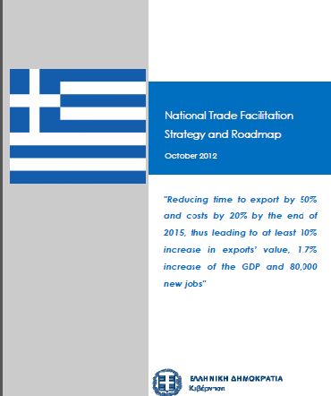
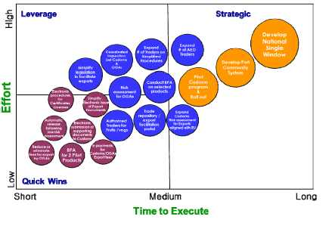
UNECE: How we support Greece
Greek Trade Facilitation Roadmap 2014: Holistic, nation wide and ambitious trade facilitation effort by the Greek administrations and enterprises
Global policy objective, 25 specific actions, key performance indicators and timelines
Institutional support: Ministries and Industry associations through Operational Steering Committee, working groups and top level policy support
UNECE supports the Greek Gouvernent in the implementation of the Roadmap
Project funded by the European Commission and coordinated with the TFGR
Focs areas: Project management support, BPA, Single Window and paperless trade, Customs reform through WCO, agriculture Trade Facilitation

Slide 4
Roadmap facilitating Greek Agriculture Exports
Specific support for Agri-food exports (lead: MRDF)
Approved agri-food exporter scheme
Electronic exchange of information between MRDF and Customs (SW) for electronic CC
Busines Process Analysis (Kiwi, Feta, Olive,..)
Simplification of business processes and legislation
Change managment: Dialogue between stakeholders, workshops and study tours
Support for all exports
Customs: Automation (ICISNet), reduced and targeted inspections, simplified procedures, document dematerilzation, ..
Policy support for TF, collaboration between Government Agrencies and private sector..

Slide 5
The Greek Roadmap does deliver!
Greek Express Carriers: “We have seen more change in the last 1 1/2 years than in the 20 years before”
World Bank DoingBusiness.org: Greece international ranking in trade facilitation competitiveness improved 17 ranks in one single year*
World Bank LPI: Greece international ranking in logistics comeptence improved from 68 to 40 and in Customs from 68 to 27**
Greece is doing better but there is still a long way to go!!
* Source: WB DoingBusiness.org 2013 report; http://www.doingbusiness.org/data/exploreeconomies/greece
** Source: WB Logisitcs Performance Index (LPI): comparison 2011 to 2014 http://lpi.worldbank.org/international/scorecard/radar/200/C/GRC/2014/I/OEC/2014/C/ITA/2014

Slide 6
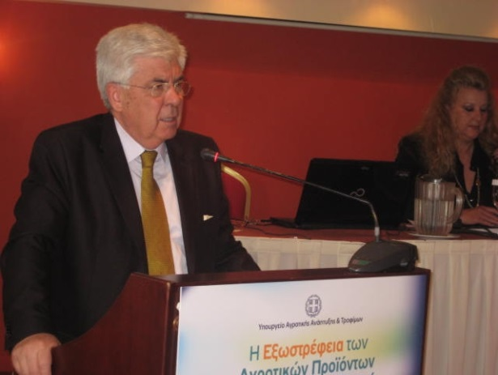
Minister Tsaftaris on policy objectives for Greek Agriculture
«Openess of agriculture trade supply chains is a strategic choice for Greece»
A main pillar for growth and employment in Greece
Synergies between Agriculture and Tourism
The Minister highighted tools and achievements of the trade facilitation reform:
Approved trader scheme, risk based controls, Business Process Analysis, automation and electronic data exchange withcustoms
Source: 24 April 2014; http://www.minagric.gr/index.php/el/the-ministry-2/grafeiotypou/deltiatypou/2353-dt240414b
Notes:
With this better understanding on the current state of implementation and the future needs
We turned our attention to the question : Can we scope the evolution vision of how Infomration in cross border supply chians trade will be managed in the future.
This is the core of the quation the the background paper to this conference handles,
background paper for the management of supply chain management information management in Europe : Europe an incuperator/living lab for new concepts on SC management
After the conference was that we picked up on these two conclusions that were presented and discussed in Geneva and asked ourselves: how will this influence the future development of information exchange in international supply chains? Can we identify possible trends and evolution? This was a core question that we focussed on in the background paper.
We focussed out attention to the situation in Europe that for certain reasons can be seen as a living lab for new ideas on information management in cross border trade.
So when we
Must explain what IOS is: IOS: A system for collaboration and information exchange among independent stakeholders in international trade
Not only an ICT platform but also describes the standards that are used, the agreements, business processes and organizational structure.
Platforms that enable collaboration and information exchange between stakeholder, using ICT. Goes far beyond a simple softwate platform but also describes the legal, managerial and organizational framework of this collaboration
Safesenet, maritime SW, Short Sea, Motorways of the Sea
IATA eFreight, DHL
Port Community systems of Amsterdam, Rotterdam, Hamburg and Bremen
Maritime SW, Highway of the Seas, EU eManifest, ICS, ECS
SC in advanced economies are complex ➔ require many different and highly specialised systems.

Slide 7
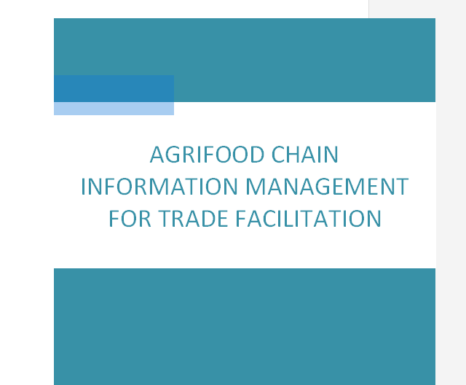
Outlook: UNECE strategy for a Smarter Food Single Window
UNECE Concept of a Smarter Food Single Window:
Increase competitiveness and market access for agriculture exports through use of state of the art Information Technology, logistics concepts and trade facilitation standards.
Pillars:
Holistic national agrifood facilitation strategy
Electronic information exchange and management
Business Process Analysis of the supply chain
Risk management techniques
collaboration between the stakeholders

Slide 8
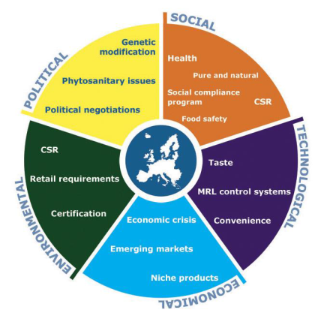
Notes:
Grafic: Wageningen/UK Government/EU http://www.cbi.eu/system/files/marketintel_platforms/2013_cbi_trendmapping_for_fresh_fruits_and_vegetables.pdf

Slide 9
One step at a time..
Currently working on:
electronic exchange of CC between MRDF and Customs using the new MRDF risk managment tool
Potential for improvment of the Greek FF&V exports in comparison with practice in other EU member states
Main objectives of todays workshop:
Information: Were are we? What is current state of activities?
Bottlenecks: What are the bottlenecks in the export process? Where do we loose time and create costs? Were are the risks for traders and Governments?
Solutions: What could we do to improve? Were is the best cost/benfit ratio? How can we realize synergies?
Best practice: How do other EU member states address these issues?

Slide 10
Thank You
Markus Pikart, UNECE
Markus.Pikart@unece.org

