Slide 1


FFV conformity control
SPANISH organization

Slide 2

FFV Legal Basis
EU Regulations
- R(EC) 1308-2013 Common market organisation
- R(EC) 543/2011 Implementing rules for fruit and vegetables regime
Spanish Regulations
- R.D. 1456/2005, administrative regulation for Regional and Provincial Departments of Foreign Trade.
- O. PRE/3026/2003 y O. ITC/2869/2009 inspection and control rules for Regional and Provincial Departments of Foreign Trade.
- Regional Regulations

Slide 3
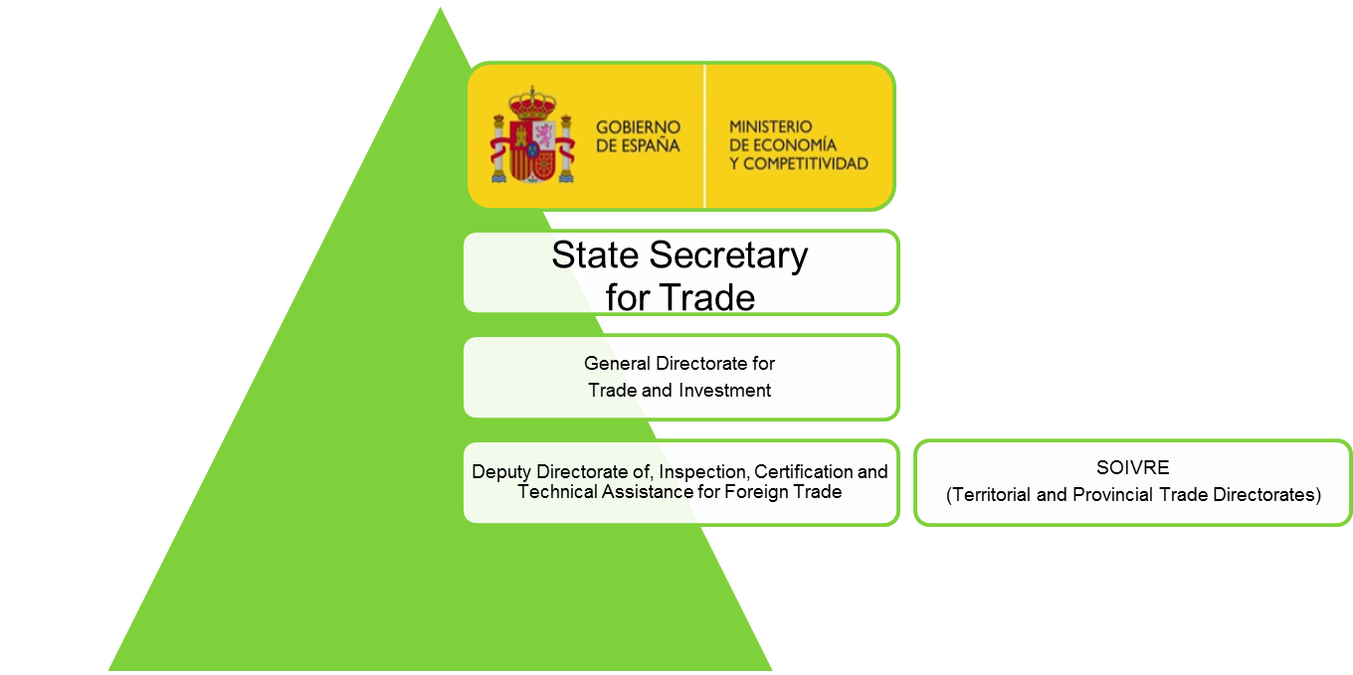
Spanish conformity control organization
Coordination authority.
General Directorate of Trade and Investment is the single, competent authority responsible for coordination in the area of checks on conformity to marketing standards (R EU 543/2011).

Slide 4
Spanish conformity control organization
Quality conformity controls are carried out by
Central Government
  SOIVRE Central Inspection body.
17 Regional Governments and 2 Autonomus cities
  Regional Ministries of Agriculture.
  Regional Ministries of Health and Consumption.

Slide 5
Regional Inspection bodies
FFV distribution of tasks: Autonomous Communities
The inspection bodies of the Autonomous Communities carry out conformity controls at:
  expedition and distribution level: producers and packers and wholesalers (Regular controls by the Regional Ministries of Agriculture).
  retailer level (occasional controls by the Regional Ministries of Health and Consumption and the Municipalities).

Slide 6


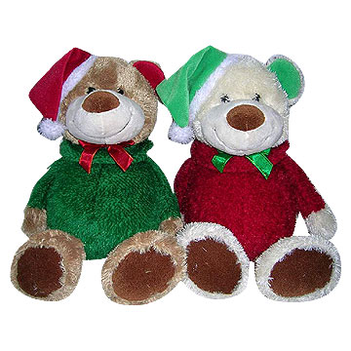

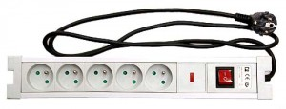
SOIVRE
Central Inspection Body
Responsible for:
  - Inspection and conformity of Commercial Quality Food.
  (Agricultural, fish, olive oil, canned food, Organic products, Hemps seeds…)
  Import: Industrial Security Control
  (Toys, protective equipment, electrical equipment, clothes, shoes)
  CITES (Management Authority).
  Technical Assistance to traders.

Slide 7

Central inspection body
Organization
-Appointed by Spanish government
(1934 to support Spanish citrus exports).
Structure
- Central Services (State Secretariat of Foreign Trade)
Peripheral network: 31 Technical Offices
(checkpoints over 140) so called
“Border facilities for Goods and Foods Control”.
- Connected to international commercial network
(Spanish overseas Economic and Trade Offices). (Paris, Düsseldorf, London, Brussels, Roma, Warsaw, Beijing, Washington, Mexico, Brasilia, Rabat).

Slide 8
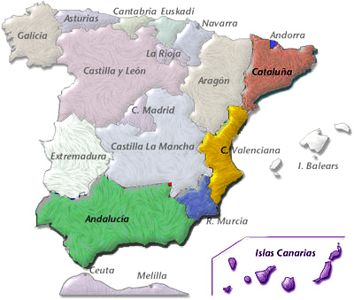
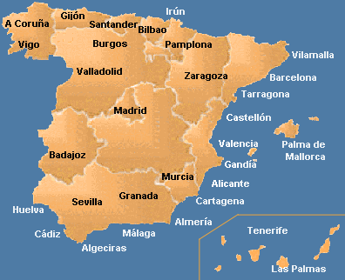
SOIVRE: Central Inspection Body
FFV production areas
31 SOIVRE offices

Slide 9
SOIVRE Inspection Body
Staff
Technical staff (2013):
Inspectors 50
Technical inspectors 84
Both of them are civil servants with an university degree. They must pass public examinations.
Laboratory analysts, administrative and support staff complete the human resources.

Slide 10
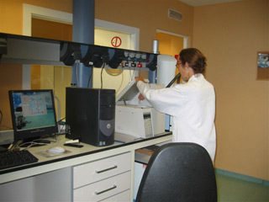
SOIVRE: Central Inspection Body
Laboratory network
Main laboratories are certified according to ISO 17025 standards to carry out analysis such as
  Pesticides residues for fruit and vegetables.
  Heavy metals.
  Oils identification
  Chemical substances in toys.
  Others.

Slide 11

SOIVRE: Central Inspection Body
Technical Assistance
Information
  Export / Import Technical requirements.
  International Prices information for F&V.
  Publications
Network of laboratories is available to traders
Conection to Economic and Commercial Offices

Slide 12

Objetives
To facilitate trade under fair conditions,
To keep products of unsatisfactory quality off the market,
To guide production to meet consumer demand,
To guarantee high quality level of inspections with independency, integrity and high efficiency level.

Slide 13
TRADER DATABASE

Slide 14

QI-FV. Trader database
(Regulation EU 543/2011)
- Spanish government set up a database on traders involved in the marketing of fruit and vegetables (their activities can cover distance selling, export /import to/from third countries…)
- Database is under control of Soivre as coordinating authority.
- Soivre ensures database registers, its elements and their updating are uniform and are done using information collected during conformity checks.
- Database information is shared with regional authorities at different level.

Slide 15
Trader database
There are four types of traders included in the Spanish database:
Packers.
Wholesalers at origin.
Wholesalers at destination.
Importers.
Retailers are neither included in the database nor in the control programmes.
Notes:
CCAA with agreements feed the data base.

Slide 16
Trader database
Notes:
As expected in a producing country, packers represent the majority (85%)

Slide 17

Risk analysis

Slide 18

Risk Assesment
Clasification of traders acording to risk factors
Company (Type, size, activity, quality department)
Produce (SMS /GMS)
Campaing (Volumen, evolution)
Traders fall into red, amber or green categories or
“Exempted trader” (Auditing system)
Programme of visits
Different visit frequencies
Inspectors give priority to high risk traders
Inspection records entered directly into SOIVRE database system
Problems found on visits to traders are taken into account in trader clasification.
Surveillance based on signal, dissapointing results.

Slide 19
The risk analysis: a double risk classification
The criteria considered to assess risk are:
(initial check frequencies)
  Position of traders in the marketing chain.
  Efficiency of the self checking systems.
  Size of the traders (volume marketed).
(final check frequencies)
  Findings made during previous checks.
  Exceptional circumstances.
Notes:
Other parameters (the nature of the product, production conditions,…

Slide 20
The risk analysis: the size classification
Traders are classified in three groups, based on the annual volume of commercialized products (estimated marketing capacity):
Less than 3.000 tm/campaign or per year.
Between 3.000 and 25.000 tm/campaign or per year.
More than 25.000 tm/campaign or per year (higher level of risk).

Slide 21
The risk analysis: self checking system classification
The existence and efficiency of a self checking system determines four levels of risk:
Type A. Minimum risk. (Approved traders)
Type B. Unapproved traders with quality control department which permits documentary auditing.
Type C. Unapproved traders with an appointed head of quality control.
Type D. Other traders: unapproved or non registered traders, or traders without an appointed head of quality control (high risk).

Slide 22
Conformity check programme according to risk level
Five levels of risk determining five frequencies of checks:
Minimum, 1 visit per year.
Greatly reduced, 1 visit every 6 months.
Reduced, 1 visit every 3 months.
Medium, 1 visit per month.
High, 1 visit every 15 days.
Notes:
For the assignment of check frequencies, we have taken into account the experience and the statistic data of the official conformity checks that we have carried out in previous years. This includes factors such as the evaluation carried out of the system requirements to implant, and the personal, technical and material capabilities of the official inspection bodies.

Slide 23
The risk analysis: changes in the initial frequency
  Internal factors: trader’s particular record (situations that only affect a single trader).
  External factors: specific situations which affect to one or more products and/or specific markets.

Slide 24
The risk analysis: changes in the initial frequency
  External factors that affect the produce:
Initial or closing periods of the campaign
Specific problems related to a product or to a specific origin (pesticides, negative publicity campaigns, etc.)
Adverse climatic circumstances in origin (frosts, intense rains, heat waves, etc.)
Pest and diseases which seriously affect the quality
Serious problems at the destination markets (oversupplying, decline in consumption, etc.)
Problems with transport and/or distribution (strikes…)
Notes:
Commercial problems or abnormal situations

Slide 25
The risk analysis: changes in the initial frequency
  Internal factors (trader’s particular record):
  If there have been the following findings of NCN,
    2 or more NCN (< than 3000 tm/campaign)
    4 or more NCN (3000 – 25000 tm/campaign)
    6 or more NCN (> than 25000 tm/campaign)
  the trader involved will pass to the check frequency immediately above.
Notes:
These situations fundamentally refer to the results of the official conformity checks carried out with the company (trader’s record), regardless of whether they come from the competent inspection body at origin or in the destination markets, whether these are national, community or third country markets.
Are excluded to this general rule the following findings of non conformities:
Those which the competent inspection body establishes as non computable, based on the type or degree of the checked defect or deficiency, or to the size or tonnage of the non-conforming lot.
Those checked in the first visit of control derived from the change to a new frequency of control, whatever number of findings of conformity checks are carried out within the same trader.
These exceptions will be applied by the competent inspection body where they consider them appropriate and are not repetitive or fraudulent.

Slide 26
The risk analysis: return to the initial frequency
  The trader will return to the previous initial frequency:
  automatically, when 3 or more conformity checks without negative results have occurred, or
  through a motivated decision by the competent inspection body:
    at an individual or collective level, or
    when the marketing campaign has been concluded.

Slide 27
Conformity controls at export - import level
  The conformity certificate is compulsory for customs clearance, both for import and export from/to third countries.
  But it is not possible to check every consignment for conformity.
  As a general rule, the basic check frequency is:
 | Import | Export
Minimum % of conformity checks (physical) | 80 % | 50 %

Slide 28
Conformity controls at export level
  The initial minimum frequency of physical controls is based on the type of trader according to its self checking quality system:
Minimum % of consignments for conformity checks (physical)
Frequency of visits allocated to the trader | Type A (Approved traders) | Types B, C, D (Unapproved traders)
Minimum Greatly reduced Reduced | 60% | 70%
Medium High | 70% | 100%

Slide 29
Conformity controls at export level
  The final frequency of physical controls is based on the type of product:
Minimum % of consignments for conformity checks (physical)
 | High perishable | Perishable | Less perishable
Products with specific marketing standard | 90% | 70% | 60%
Products with general marketing standard | 80% | 60% | 50%

Slide 30
Conformity controls at import level
  The criteria to asses the risk include the country of origin and the type of product.
  Regarding the country of origin, the existence of a conformity certificate issued by a third country where the conformity checks have been approved by the Commission (art. 15), is a factor that reduces the risk of non conformity.
 | Approved country + certificate | Other
Minimum % of conformity checks (physical) | 80 % | 100 %

Slide 31
Conformity controls at import level
  The final frequency of physical controls is based on the type of product:
Minimum % of consignments for conformity checks (physical)
 | High perishable | Perishable | Less perishable
Products with specific marketing standard | 95% | 85% | 75%
Products with general marketing standard | 85% | 75% | 55%

Slide 32

RISK ANALYSIS
Software support tools

Slide 33
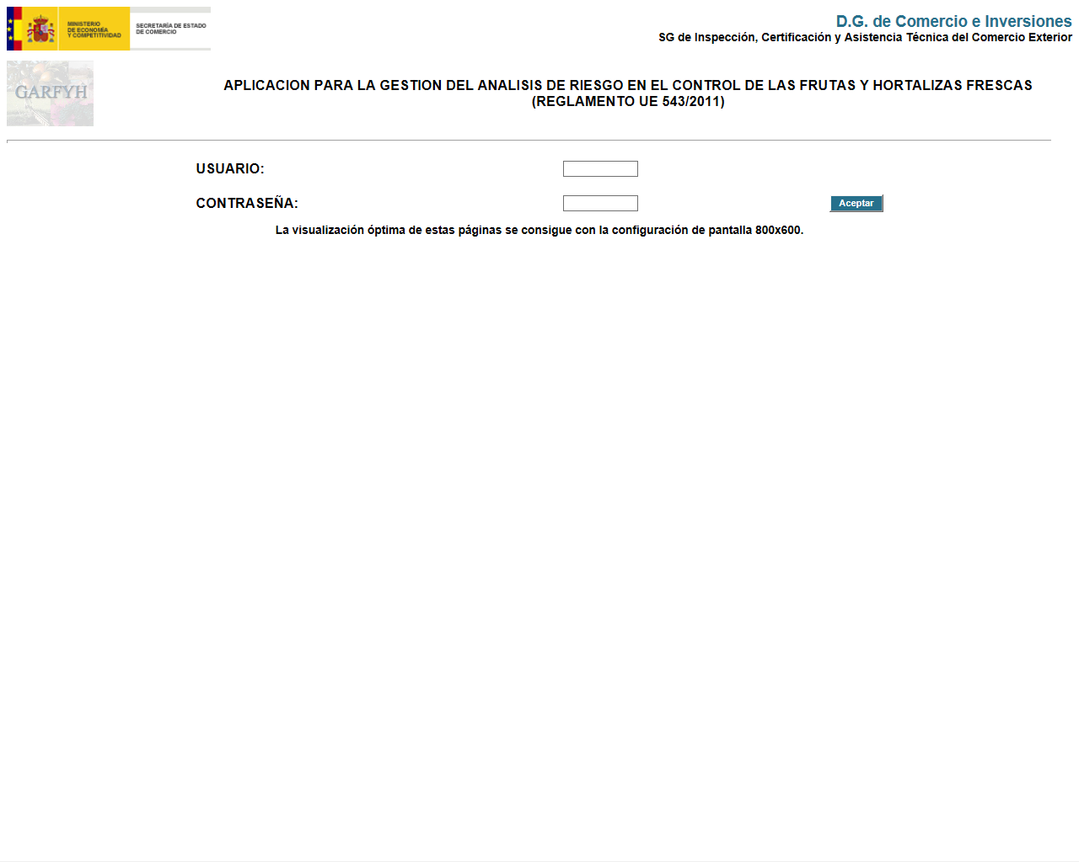
Software support tools
GARFYH: the Risk Analysis application

Slide 34
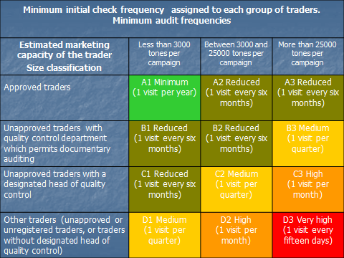
The risk analysis: risk level and frequency of checks
Notes:
The risk level and frequency checks may summed ip in a table like this where the green colour stands for the lowest frequency (A1- 1 visit per year to approved trader with less htan 3000 tons per campaign) and the highest would correspond to traders without designated quality control and more than 25000 tons per campaign (D3 - 1 visit every 15 days)

Slide 35
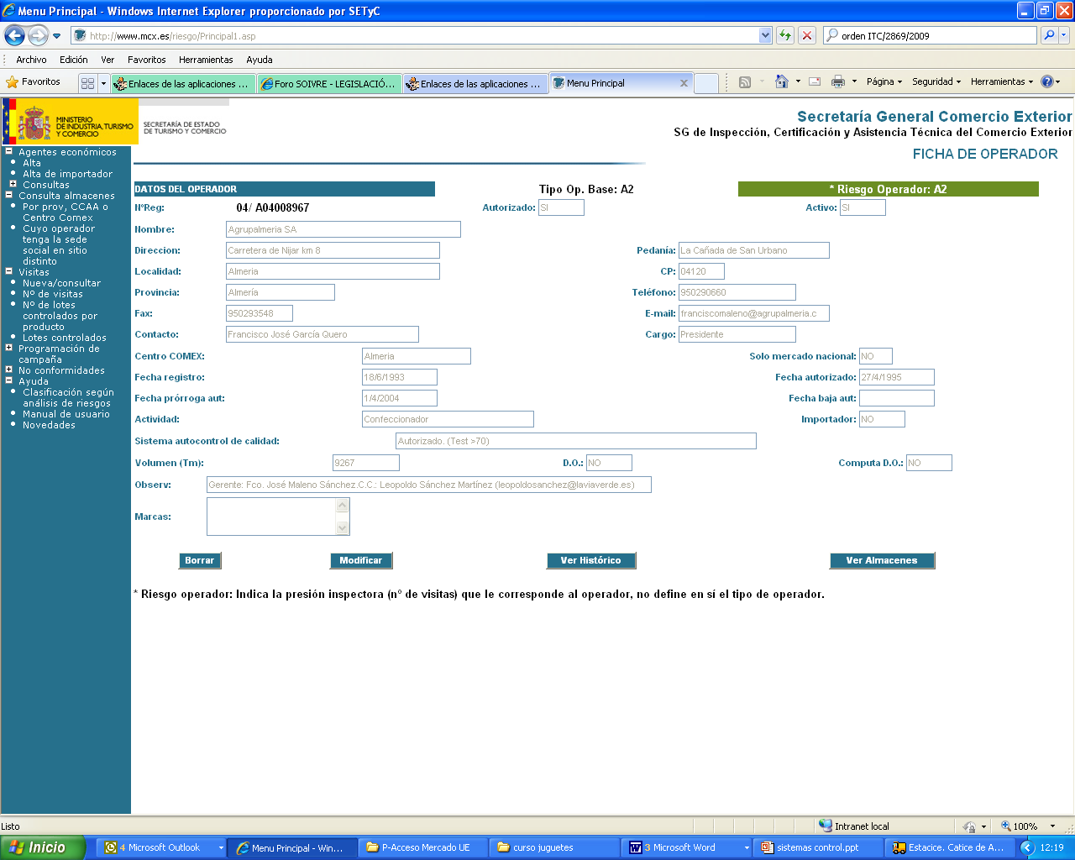

Slide 36
CONFORMITY checks

Slide 37

Checks on conformity
Checks on conformity to marketing standards will be carried out at all marketing stages, in order to verify that products are conformed to MS.
The conformity checks are carried out selectively, based on a risk analysis, and with appropriate frequency, so as to ensure compliance with the marketing standards.

Slide 38
Conformity Check Programme
according to Risk Analisys System
Responsibility
EU and Internal Market Inspection
.
- Responsibility: shared by Soivre and Regional Inspection Bodies.
- Place: Pack stations (Companies)
Third countries inspection (export – import)
- Responsibility: Soivre.
- Places: Pack Stations and Border Inspection Points.

Slide 39
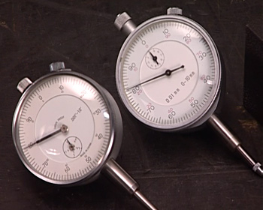
Marketing standards
  EU Standard R(EC) 543/2011
  - Specific Marketing Standard
  (10 products: apples, citrus, kiwi, lettuces-endivias, peaches-nectarines, pears, strawberries, sweet peppers, table grapes, tomatoes)
  - General Marketing Standard
  UNECE
  56 FV Standards (not compulsory)

Slide 40

What checking? FFV
- EU marketing standards compliance
- Documents
(Identity/marking: origin, classification, amount, dispatcher)
- Products (FFV Marketing Standard).

Slide 41

Whom?
Traders’ Database
Packers.
Wholesalers at origin.
Wholesalers at destination.
Importers.

Slide 42

Conformity Check Programme
Different visit frequencies
Priority to high risk traders
Inspection records are entered into traders database system
Problems found on visits to traders are taken into account in traders classification.
Surveillance based on signal, disappointing results.
Frequency

Slide 43
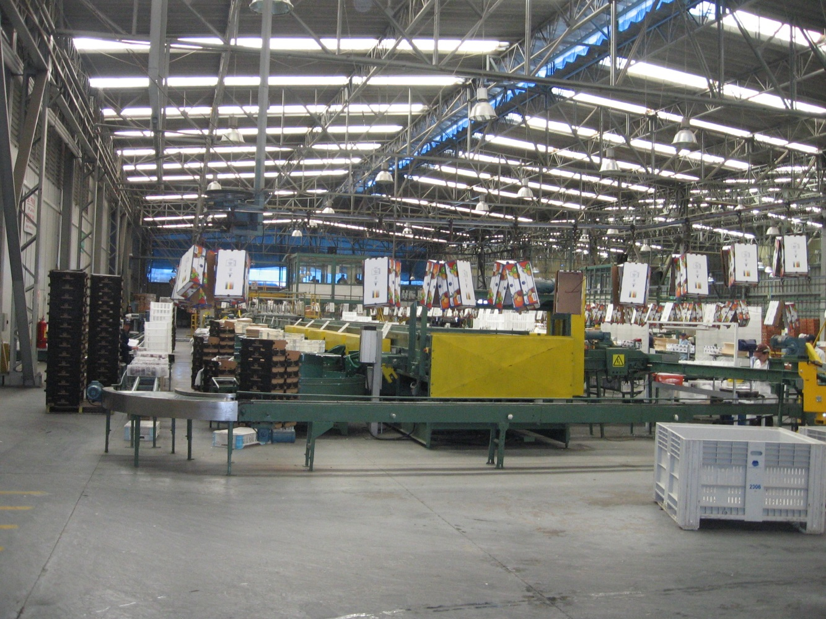
Where?
Pack Stations

Slide 44
Pack Station
Inspection
Act

Slide 45
Labelling
Presentation
Quality
Category
Size

Slide 46
Pack Station
Approved traders
Member States may authorise traders classified in the lowest risk category and providing special guarantees on conformity to marketing standards to use a logo in the labelling of each package at the stage of dispatch and/or to sign the conformity certificate.

Slide 47
Third countries conformity checks
- The Commission may approve checks on conformity to specific marketing standards carried out by that third country prior to import into Union.
- The approval may only apply to products originating in the third country concerned and may be limited to certain products.
- The third countries approved, and the products concerned, shall be set out in Official Publications of Comission.
- The approval will be considered as a criteria of low risk.

Slide 48
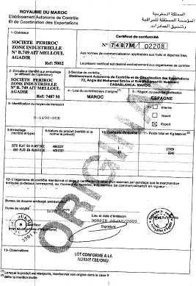

Slide 49
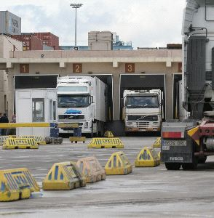
Where?
Border Inspection Points
(Ports, Airports)
BIPs Official Services in charge
- Custom Service
- Human Health Official Service
- Plant Health Service
- Livestock Health Service
- Soivre

Slide 50
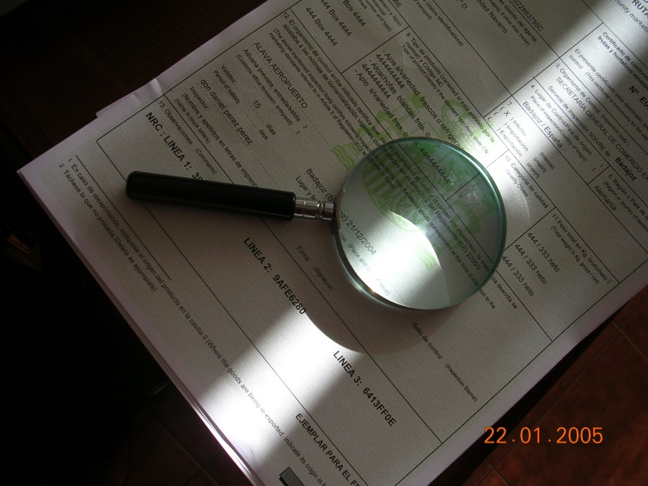
Why?
Certificate of conformity
The Certificate of conformity is the compulsory document in foreign trade of FFV according to R(EU) 543/2011
Certificates of conformity can only be issued by a competent authority to confirm that the products concerned conform to the relevant marketing standard.
The certificates may be issued either in paper format with original signature or in verified electronic format with electronic signature.

Slide 51
Inspection Process
Human Health
Lot
Inspection
SOIVRE
Plant Health
DISPATCH CODES
CUSTOM INSPECTION

Slide 52
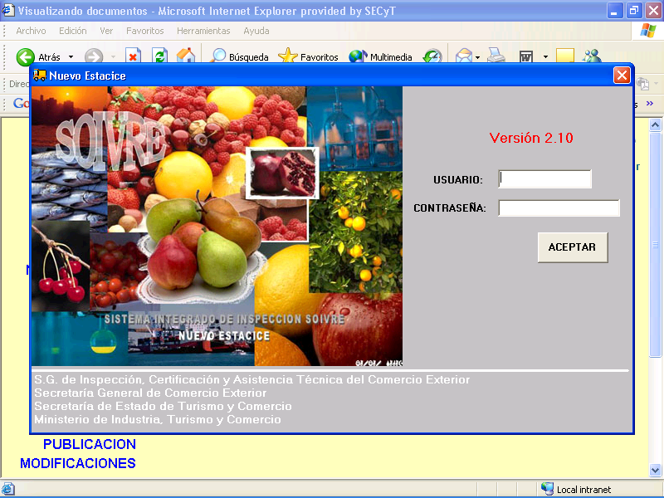
Integrated Inspection System ESTACICE
Notes:
Importers and exporters (from/to third countries) have to request quality inspection for all import and export lots. They send the request via Internet through a specific electronic application named ESTACICE, to the SOIVRE regional office where the import/export is going to be done.

Slide 54
SOIVRE Custom Clearance System

Slide 55

Re-inspection
Company differs in opinion with SOIVRE inspector report.
Head inspector must be informed.
Performing of new inspection based upon the marked samples of the first inspection and a new sample to obtain a higher accuracy.

Slide 56

Acceptance of declarations by customs
Customs may only accept export declarations and/or declarations for release for free circulations for the products subject to specific marketing standards.
The competent inspection body has informed the customs authority that the lots concerned have been issued a conformity certificate or they do not need to be checked in the light of risk assesment.

Slide 57
sampling
How?

Slide 58
Sampling procedure

Slide 59
UNE 66020-1:2001 SAMPLING PROCEDURES FOR INSPECTION BY ATTRIBUTES. PART 1: SAMPLING SCHEMES INDEXED BY ACCEPTANCE QUALITY LIMIT (AQL) FOR LOT-BY-LOT INSPECTION.
Acceptable Quality Level (AQL) is limit of a satisfactory process average at particular quality level when a continuing series of lot is considered
  Acceptance quality limit (AQL) 10 %
  Packaging - Labelling
  Quality – Sizing
  Requierements
  Acceptance quality limit (AQL) 6.5 %

Slide 60
SAMPLING PROCEDURE
Lot: 25.000 units ----- 1st sample: 5 units
2nd sample: When 1 faulty unit is detected in 1st sample, a 2nd sample of 5 units is taken.
Rejection: Faulty units ≥ 2 units out (units total sample).
Tamaño del Lote | Muestra | Tamaño de la muestra | Tamaño acumulado | NCA 6,5% |  | NCA 10%
 |  |  |  | Ac | Rc | Ac | Rc
2 a 150 | Primera | 2 | 2 | 0 | 1
151 a 500 | Primera | 3 | 3 | 0 | 2 | 0 | 2
 | Segunda | 3 | 6 | 1 | 2 | 1 | 2
501 a 35.000 | Primera | 5 | 5 | 0 | 2 | 0 | 3
 | Segunda | 5 | 10 | 1 | 2 | 3 | 4
35.001 en adelante | Primera | 8 | 8 | 0 | 3 | 1 | 3
 | Segunda | 8 | 16 | 3 | 4 | 4 | 5

Slide 61
Inspection system
Software support tools

Slide 62
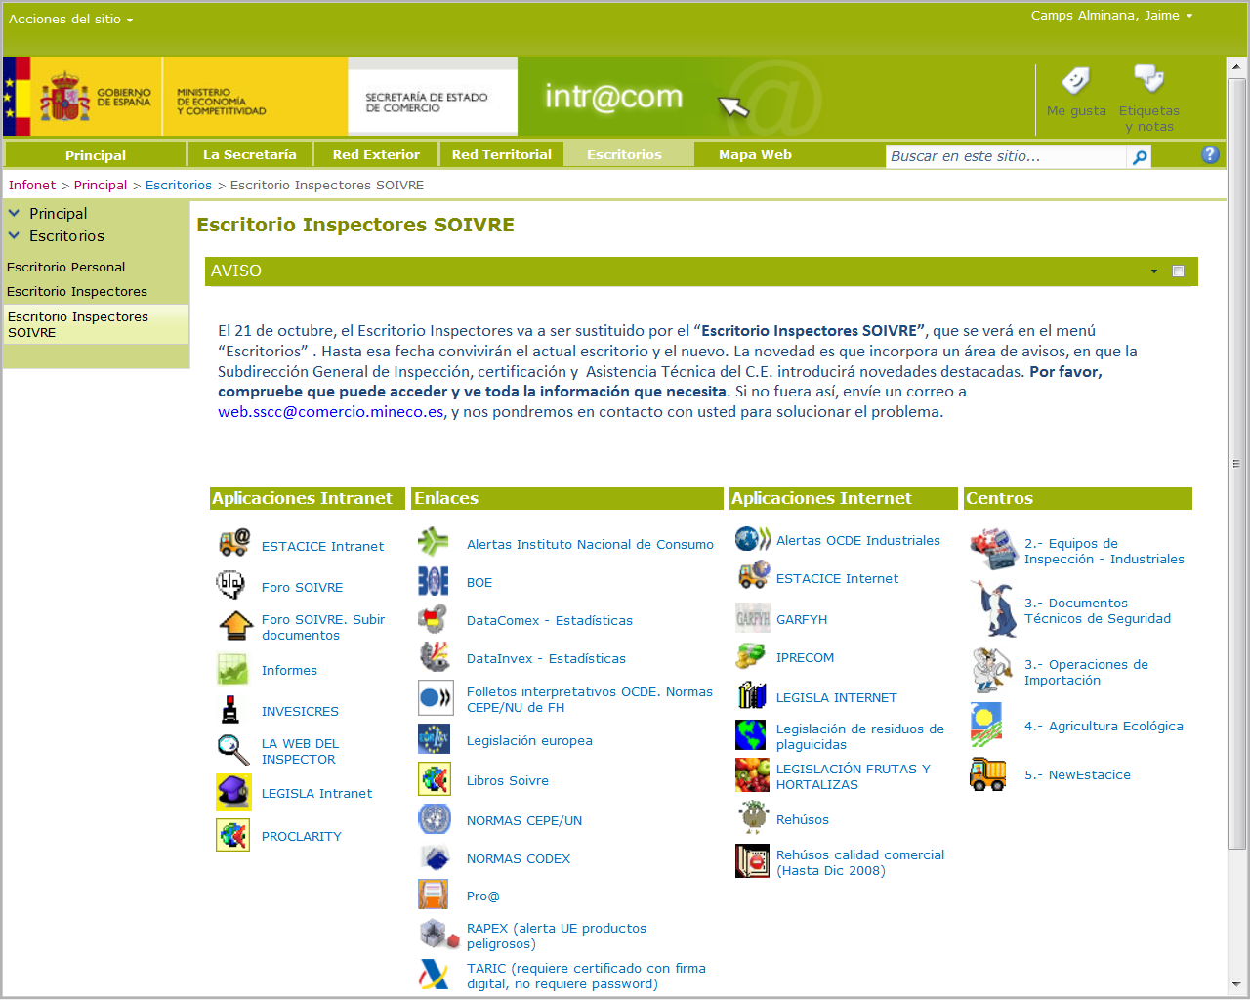
Inspection software support tools
The Inspectors’ Desk

Slide 63
Inspection software support tools
Integrated Inspection System ESTACICE
Notes:
Importers and exporters (from/to third countries) have to request quality inspection for all import and export lots. They send the request via Internet through a specific electronic application named ESTACICE, to the SOIVRE regional office where the import/export is going to be done.

Slide 64
SOIVRE Custom Clearance System

Slide 65
Others
Software support tools

Slide 66
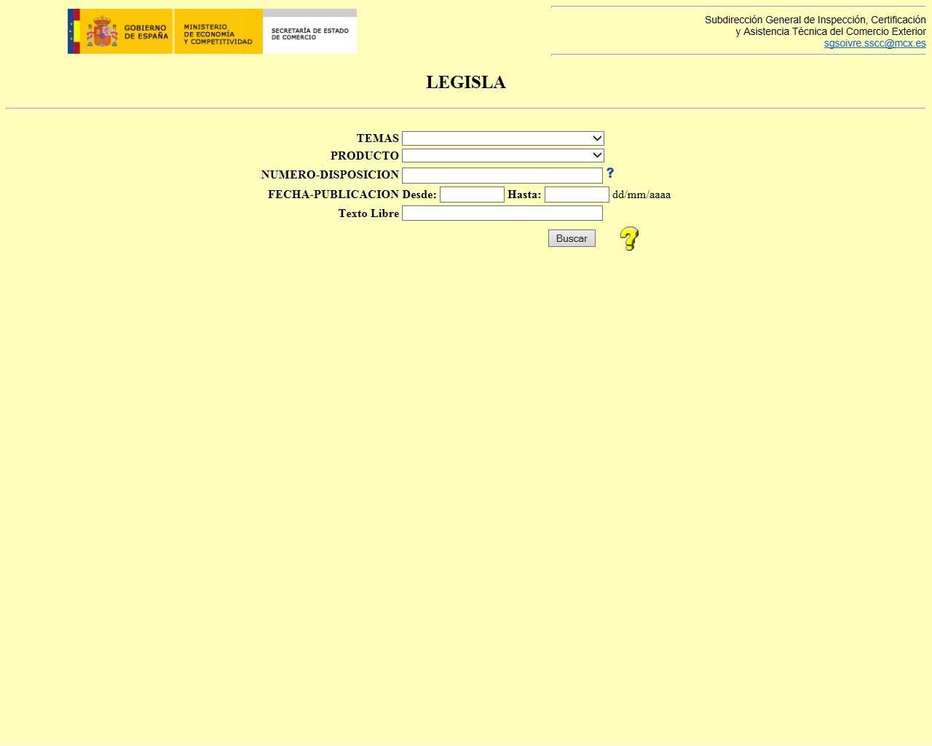
Software support tools
LEGISLA
A database of specific legislation, standards, instructions, newsletters, campaigns reports

Slide 67
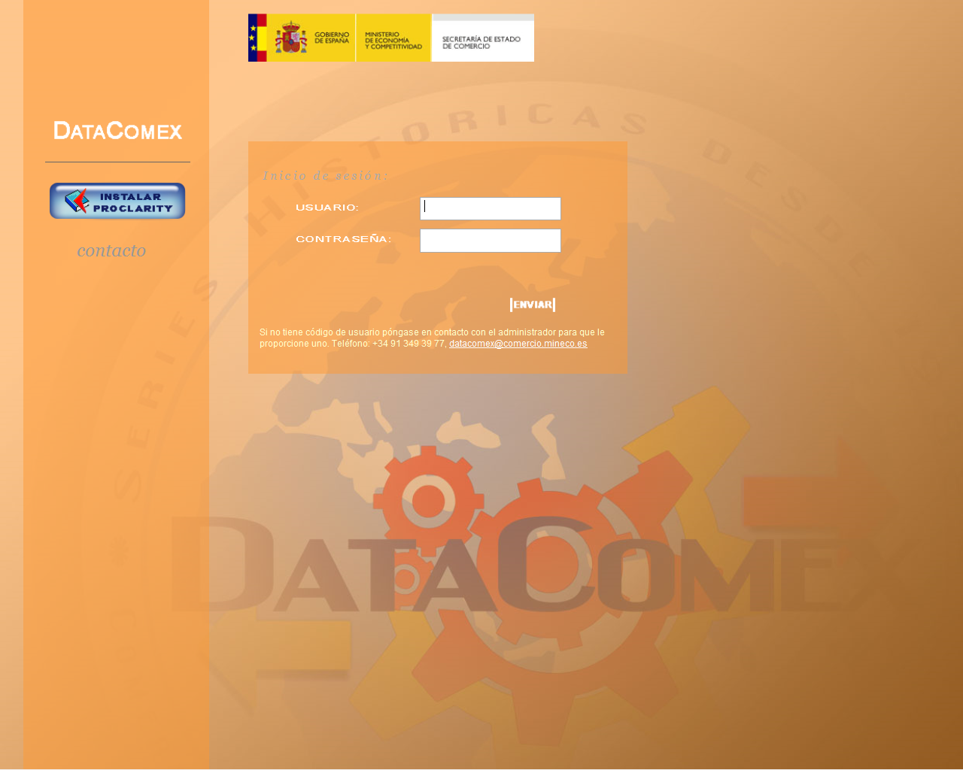
Software support tools
PROCLARITY - Datacomex
Statistic tool

Slide 68
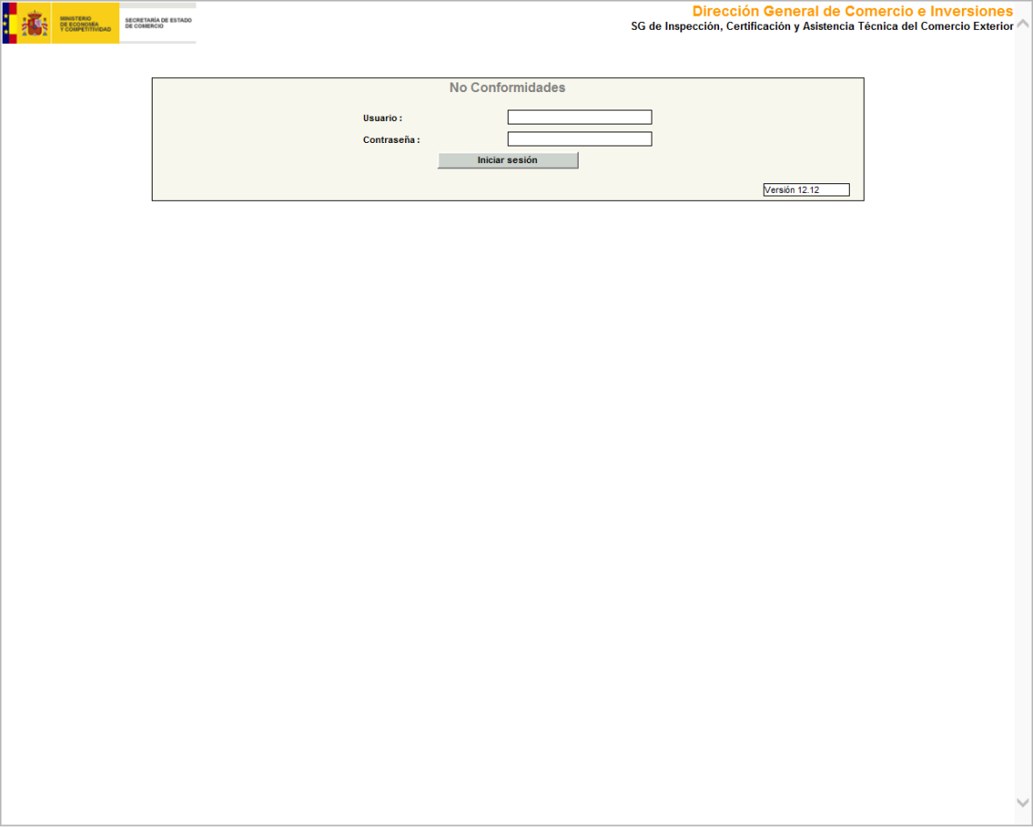
Software support tools
Non conformity notifications

Slide 69
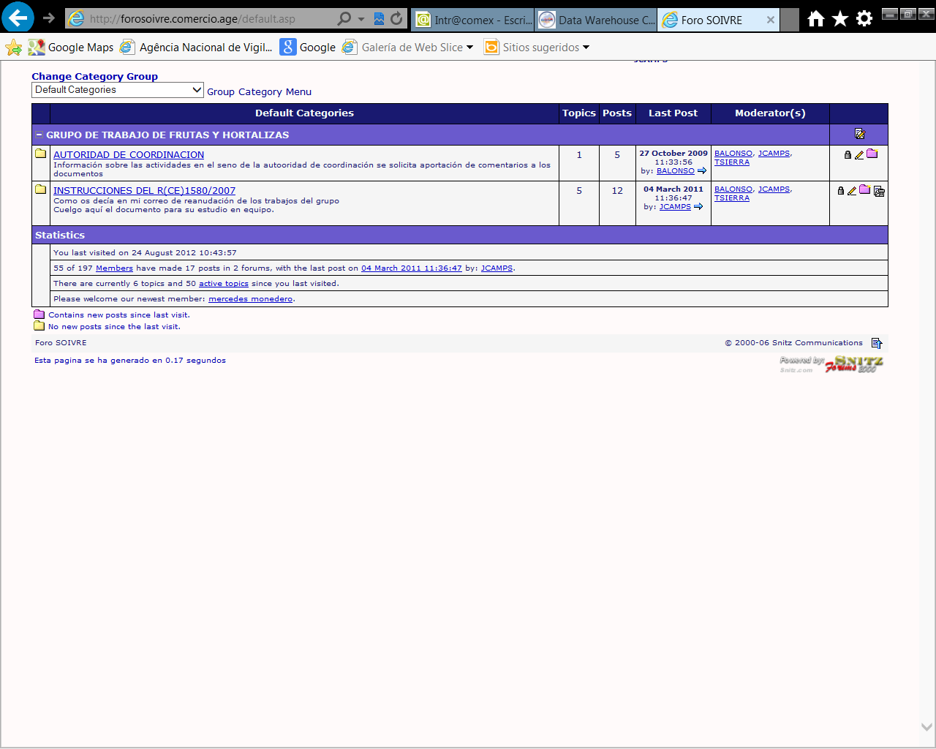
Software support tools
Inspectors’ forum
Notes:
forum through the Web where doubts and consultations may be posted and answers become harmonized actions

Slide 70
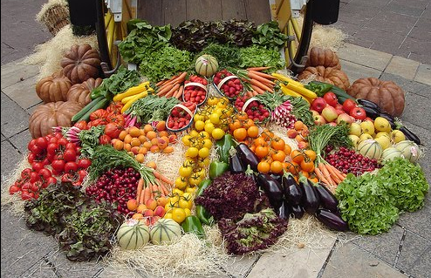
Thank you for your attention.
SOIVRE

