Slide 1
Greece National Trade Facilitation Platform
Late 2012
Trade Facilitation Roadmap
Q1&2 2013
OSC
Project Plans
Process Analysis
Q3&4 2013
Risk Management
AE
eConformity
AEO
ICISNet
Q1&2 2014
SW pilot
Integrated Risk Managment Process (Customs - MRDF)

Slide 2
Greece National Trade Facilitation Platform
Q4 2012
Trade Facilitation Roadmap
Q1&2 2013
OSC
Project Plans
Process Analysis
Q3&4 2013
Risk Management
AE
eConformity
AEO
ICISNet
Q1&2 2014
SW pilot
Integrated Risk Managment Process (Customs - MRDF)
Q3&4 2014

Slide 3
Workshop on Fresh Fruit and Vegetable Exports from Greece: Opportunities and Solutions - Athen, June 2014-

Slide 4
Greek National Trade Facilitation Roadmap
Q4 2012
Trade Facilitation Roadmap
Q1&2 2013
OSC
Project Plans
Process Analysis
Q3&4 2013
Risk Management
AE
eConformity
AEO
ICISNet
Q1&2 2014
SW pilot
Integrated Risk Managment Process (Customs - MRDF

Slide 5
Facilitating Greek Agriculture Exports
What we have done for Greek Agriculture
export
Business Process Analysis (Kiwi, Feta, Olive,..)
Authorized Exporter (Customs)
Automated Risk Managment System (Customs)
Electronic Customs Managment System (ICISNET)
Approved agri-food exporter scheme (MRDF)
Automated electronic quality certificate System (MENOS)
Improved availability of inspectors (DAOK)
ePayment system
..still going strong..

Slide 6
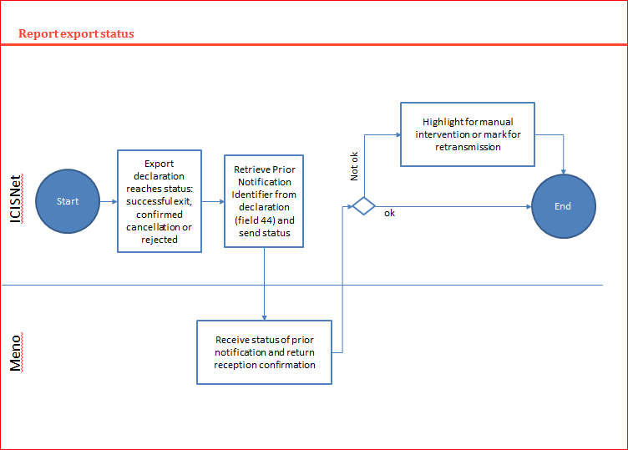
Completed yesterday
Specification for the
Electronic exchange of agriculture conformity certificates and integrated risk management for agriculture Exports: Interface MENO - ICISnet
quality certificate
Fully automated information exchange between MEDF and Customs
Integrated risk managment
Electronic Better controls
Better statistics
Significantly less controls
For the exporter: Better produce for less costs arriving faster at your buyers premesis
It’s a specification. We still need to implement it!

Slide 7
Greek National Trade Facilitation Roadmap
Q4 2012
Objectives & Mandate
Q1&2 2013
Organization
Q3&4 2013
Intra-
Agency
Q1&2 2014
Inter-Agency
Q3&4 2014
?

Slide 8
Greece National Trade Facilitation Platform
Q3&4 2014 Towards iGreece
Trade Facilitation provides basis for export capacity
TF is an enabler, not a game changer
What can be the game changer for Greece?
- Trade Facilitation
- Logistics
- Electronic information management
- Product/Service proposition
- Greece

Slide 9
UNECE strategy for a Smarter Food Single Window
Smarter Food Single Window:
Increase competitiveness and market access for agriculture exports through use of state of the art Information Technology, logistics and trade facilitation standards.
Pillars:
Holistic national agri-food facilitation strategy
Electronic information exchange and management
Business Process Analysis of the supply chain
Risk management techniques
collaboration between the stakeholders

Slide 10
Todays Workshop
Opportunities for export of Greek Fresh Fruit and Vegetables
How are we working today: Business Processes and collaboration of stakeholders
Our strength and weaknesses in the export process
Can we learn lessons from other European countries?
Looking ahead: Can we do things better?
Moving forward: What can we do next?

Slide 11
Thank You
Markus Pikart
United Nations, Economic Commission for Europe (UNECE)
Markus.Pikart@UNECE.org

