Slide 1
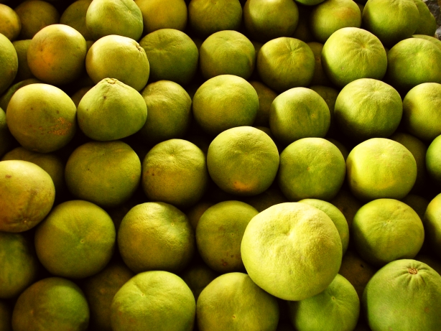
The smarter food vision: inclusive, safe, traceable
Dr Heiner Lehr
heiner@syntesa.eu

Slide 2
Programme of the day
Time | Subject
09:00-09:15 | Welcome - Representative UN ECE Presentation of participants
09:15-09:30 | Purpose and scope of the meeting Dr Heiner Lehr
09:30-10:00 | Summary of initial workshop and identified challenges Dr Heiner Lehr
10:00-11:00 | International good practice as benchmarks for Greece Part I EXPORT PROMOTION BOARDS COOPERATIVES as models to get economies of scale Dr Heiner Lehr
11:00-11:30 | Coffee break
11:30-13:00 | International good practice as benchmarks for Greece Part II EXTENSION SERVICES ELECTRONIC SUPPY CHAIN TRANSPORT AUTOMATION AND SCHEDULING OF INSPECTIONS Dr Heiner Lehr
14:00-14:30 | Light Lunch
14:30-16:00 | Discussion of solutions Dr Heiner Lehr
16:00-16:20 | The smarter food vision Dr Heiner Lehr
16:20 | Closure Representative UN ECE

Slide 3
Some simple facts: the origin of food
The global food trade is estimated to be worth about 1.45 trillion USD
Src: Global Imports of Food, WTO

Slide 4
One example: the European Union
The world’s largest importer and exporter is the Europe Union
36% of global imports
38% of global exports
The source is... the world

Slide 5
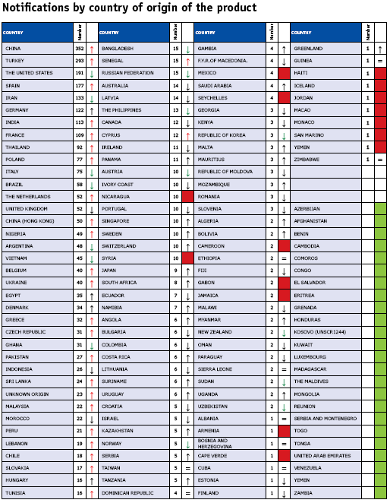
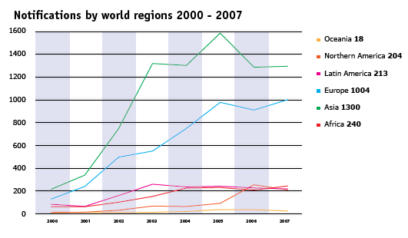
The source of incidences
Food is a sensitive commodity
directly related to human health
spoils quickly
As a result, countries monitor food trade closely and reject what is not fit to eat
The source of reported incidences in Europe is again... the world!
Source: RASFF

Slide 6
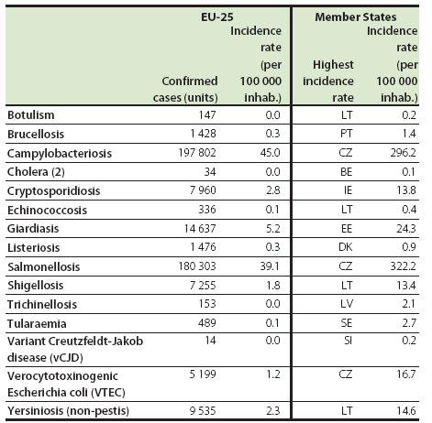
Has food safety improved over time?
Nagging questions:
Has the General Food Law improved food safety?
Has increased traceability resulted in safer food?
Do consumers feel safe and capable of making well-informed decisions?
If not, why not?
Number of cases and incidence rates of various foodborne and waterborne diseases, 2005 (1) Source: EUROSTAT

Slide 7
Information is not equal information
Paper-based systems
Paperless systems
Easy to implement
Time resilient
Not scalable; limited by capacity of personnel and physical transportation
Cannot be re-used
Usually not accessible; filed in physical location
Information chains impossible to construct
Library of Congress
Require technical capacity
Subject to data format compatibility issues
More scalable; can be (semi)automated
Easy to copy and exchange; no transportation time
Easily accessible
An information chain can be established
Google

Slide 8
The smarter food vision
smarter food
inclusive
traceable
70% of food globally is produced by smallholders, most of which are excluded from the global food chain. Information technology is used to integrate small-holders in international supply chains.
safe
Consumers want to make informed choice of the food they buy for religious, environmental or health reasons or simply for preference. Traceable food is food of which information is recorded along its elaboration process. Consumers can access such information and eat in accordance to their needs.
Food has to be safe to produce and safe to consume. Safe food uses information technology to improve controls over environ-mental and social impact of its production as well as its safety to be consumed.

Slide 9
How electronic traceability can help
smarter food
inclusive
Smallholders are not part of global supply chains for a number of reasons
Lack of good practice and human capacitation
Lack of acceptable food production standards
Lack of understanding global trade requirements and mechanics
On the other hand, global buyers have no access to consistent product offering coming from smallholders
Increased sourcing effort
Increased certification effort
Increased brand risk
Information technology based on e-traceability can provide a platform for training, keep track of food safety measures, connect buyers to sellers and assist with global trade mechanics.

Slide 10
How electronic traceability can help
smarter food
safe
Food needs to be safe to produce and safe to eat.
Food safety is a basic right for citizens and part of the International Covenant on Economic, Social and Cultural Rights. Governments have the mandate to ensure food safety both for internal consumption as well as for trade. Nevertheless, food borne diseases have major impact on public health and the public economy.
With 9 billion people to feed in 2050 and little land to expand agricultural production, food production also needs to be safe to produce. Roughly one-third of food produced for human consumption, about 1.3 billion tonnes per year, gets lost or wasted globally.
e-Traceability can help by optimising supply chain, calculate shelf-life dynamically, alert to breaks in the cold chain and optimise feed consumption.

Slide 11
How electronic traceability can help
smarter food
traceable
Food is an essential part of our life, our health and our beliefs. Consumers must be given the tools to live a life according to their convictions, their religious rules and their lifestyle.
Consumers with food-related health issues (e.g. gluten intolerance) find it hard to buy corresponding products in the supermarkets. Muslims face gelatine-based products, unable to decide whether they are Halal. Fish-lovers look at the offering wondering: is that really sustainable?
E-traceability and mobile technology can ensure that a food product adheres to certain standards, give detailed information to those who want or need it, assist consumers with their responsible purchasing.

Slide 12
Main benefits when achieving the vision
Countries implementing the vision will receive the following benefits:
Boost of market access for the industry
Better offering
Increase of trust of business partners
Decreased income resilience through smallholder access
Decrease of food safety problems
Improved public health
Less incidences in exports
Better supply chain efficiency
Improved sourcing
Less waste

Slide 13
Steps to start implementing the vision
Establish industry-government partnership
Choose a good case study
Good candidate food item: high value, linked to fraud
Make a sufficiently large pilot
Perform cost-benefit analysis to build a business case for industry and government
Build necessary legislative and regulative framework
A mix of incentives and disincentives is likely to work best
Secure mix of public and private funds to build the full infrastructure
Deploy the system sector by sector
Secure buy-in from industry association

Slide 14
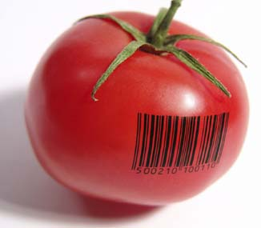
Funding
Food safety
More trust
Avoidance of animal diseases
Improved market access
Access to high-value markets
Differentiation in the marketplace
Taxes
PUBLIC PRIVATE PARTNERSHIPS
Increased supply chain efficiency
Better sourcing
Levies
Better marketability
Consumer interaction
Direct marketing
Fraud avoidance
Greater total market

Slide 15
Thank you for your attention!
ACKNOWLEDGMENTS: The author would like to acknowledge contributions by Francisco Blaha and Gwynne Foster, Xifrat Daten AG, FoodReg and Yakin IT Sdn Bhd. Financial support from the European Commission for research projects is gratefully acknowledged. This deck of presentations was made possible by SATNET and UN ESCAP and the author is very thankful for this opportunity.
DISCLAIMER: this presentation expresses the view of the presenter only. In particular, it does not express necessarily the views of cited international bodies and firms.

