Slide 1
Skills for Green Jobs
Mercedes Durán-Haro
Skills and Employability Department
International Labour Organization

Slide 2
ILO framework for skills development
In 2008, ILC Conclusions on:
“Skills for improved productivity, employment growth and development”
For the green economy:
Meet new skill needs as part of mitigation and adaptation efforts
Support a fair transition to more sustainable production
Sustain a dynamic development process: Adjust training supply to demands of new technologies, products, energy efficiency, etc.

Slide 3
Research projects
ILO-Cedefop study:
“Skills for Green Jobs. A global View”
Forthcoming.
On-going Joint project ILO-EC:
Methods of Identification of skill needs
Occupations & skills in renewable energy
Occupations & skills in green building
End of the project July 2011.
All part of the Green Jobs Program of the ILO

Slide 4
Drivers of skills change
Change in the natural or build environment (for instance in agriculture, adapting workers’ skills to prolonged dry or rainy seasons)
Policy or regulation
New technologies
Markets for green industries (competitive advantage) and consumer habits

Slide 5
Green structural change
Additional jobs will be created.
Some employment will be substituted
Certain jobs may be eliminated without direct replacement
Many existing jobs will be redefined
New jobs created will offset those lost
But those who will get green jobs are not necessarily those who will have lost their jobs
Retraining
matters

Slide 6
Navarre’s successful shift to renewable energies (Spain)
End 2010, Navarre :
produced 65% of electrical energy consumption from RE sources,
had the second lowest unemployment rate in Spain
was the first region to have a positive GDP growth rate after the crisis

Slide 7
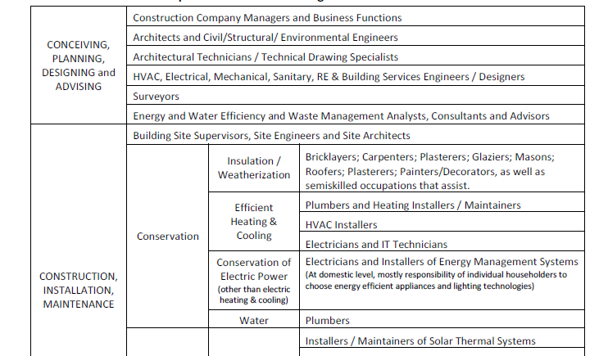
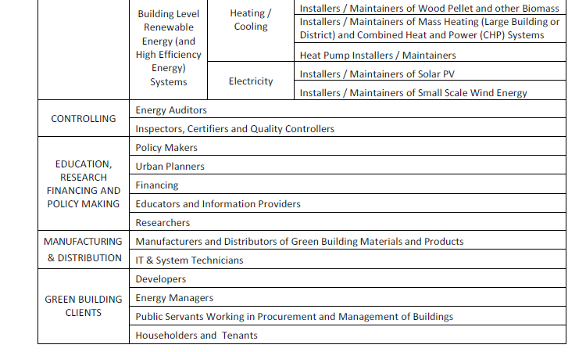
Green building – core occupations
Research on 32 countries –including 19 European
A wide range of existing occupations are affected, but in some cases new occupations are created
Core occupations grouped in 6 different occupational clusters along the value chain

Slide 8
Green building – skill needs
Technical skills
environmental regulations, schemes etc.
understanding of the environmental, social, economic issues to design effective policies
passive design & RE in buildings
energy efficiency analysis
water conservation techniques
insulation techniques
Solar PV and thermal systems installation and maintenance
recycled materials
upgrade and replacement HVAC systems
preventive maintenance, etc.
Soft skills
environmental awareness
innovation and leadership
interdisciplinary skills and team work
risk management
understanding market needs
communication
analytical skills
marketing skills, etc.

Slide 9
Skills and occupational changes
A wide range of existing occupations are affected, but in some cases new occupations are created
The impact on skills needs can be quantitative and/or qualitative
Generic and core skills are equally important
Skills shortages already pose a major barrier to green transitions and job creation

Slide 10
Training response
At different levels:
Enterprise level response
Industry response (associations of employers, sector skills councils, joint bipartitie or tripartite initiatives)
Government solutions come mostly through the formal education and training system
Universities usually responsive, private and public
NGOs and donors deliver skills where formal systems don‘t reach out – mostly developing countries.
Stronger in higher education and weaker in TVET

Slide 11
Policy coherence: The case of France: A comprehensive policy framework
Grenelle de l’Environnement
government, unions, employers, NGOs and local authorities.
Social dialogue!!
National Strategy for Sustainable Development 2009-2012 where training is included!!
Mobilization Plan for Green Jobs
Eleven Sectoral Committees: analysis on skills and training needs in the green economy
Collaborative work between stakeholders at all levels Coordination!!

Slide 12
Some general conclusions
The green change is happening → identification of skills needs and adequate provision of skills are required
The success in response measures depends on:
policy coherence and the inclusion of a training component in policies for greening
coordination among various actors and levels: social dialogue!!

Slide 13
http://www.ilo.org/skills/
Thank you for your attention!
Mercedes Durán-Haro
ILO Skills and Employability Dept,
duran@ilo.org

