Slide 1
ASEP / RD-ASEP Study
Submitted by the experts of OICA
Informal Document GRBP-79-45
79th GRBP, 6-9 February 2024
Agenda Item 3.
Study performed by UTAC on behalf of ACEA / OICA

Slide 2
ASEP / RD-ASEP Study
OICA-ACEA Interim Report to 79th GRBP February 2024

Slide 3
Study on ASEP and RD-ASEP Monitoring - outlines
UTAC was initially tasked by ACEA/OICA to perform a study on ASEP and RD-ASEP implementation.
Work Package 1: implementation of ASEP
Literature review on ASEP ☑ the reasons of ASEP implementation and to identify the changes since the ASEP introduction.
Recognition and implementation of the ASEP ☑ Questionnaires send to CPs and OEM on ASEP implementation
ASEP Impact ◻ Outdoor test campaign on 8 vehicles (4 veh. before 2016 (UNR51.02) and successors).
Work Package 2: RD-ASEP monitoring (July 2023 to June 2024)
RD-ASEP implementation ◻ Questionnaire included in RD-ASEP monitoring datasheet:
to qualify the RD ASEP process,
to identify potential difficulties encountered
to highlight the ways of improvement.
Database analysis ◻ statistical analysis, impact of the RD ASEP (correlation, trends, ways of improvement…)
Joint study of CPs and Automotive Industry
France, Germany, Japan, The Netherlands, OICA (ACEA)
*Previous study’s presentation, questionnaires details: GRBP-78-34
RD-ASEP Monitoring Data Delivery Document: GRBP-77-15-Rev.3
Notes:
UTAC has been commissioned by ACEA to conduct a comprehensive study focusing on the ASEP and RD-ASEP initiatives. This study comprises two distinct work packages aimed at addressing specific objectives:
Work Package 1: The primary objective of this phase is to assess whether the existing implementation of ASEP has resulted in any modifications to the design process in vehicles. This involves a thorough examination of the impact of ASEP on design changes.
Work Package 2: In this phase, the focus shifts towards the RD-ASEP program. The key task is to gather pertinent data from the RD-ASEP monitoring process and subsequently carry out a preliminary analysis. The input will be supplied to the IWG on RD-ASEP.
This study is a collaborative endeavor involving the active participation of critical stakeholders, including France, Germany, Japan, The Netherlands, as well as OICA (ACEA). The concerted efforts of these entities reflect a joint commitment to advancing the field of Vehicle exterior noise.

Slide 4
WP1.1. Literature review

Slide 5
Literature review : ASEP during development (2005-2009)
OICA proposal
F/D proposal
Slope-Assessment
Model-based approach
Detecting non-linearities, cycle-beating, cheating.
Engineering method based on a linear regression determined individually per vehicle.
Engine speed based.
Based on linear sound behaviour.
Establishing limit curves based on fixed slopes.
Combination of F/D and OICA proposals.
Critics/limitations:
The engine speed, as only explicative variable, limits the gear ratios to k ≤ i (for limiting the influence of the rolling noise).
No Not-to-exceed limit (No worst-case).
Slope-Assessment could allow noisier vehicles than R51.02.
Not-To-Exceed approach
Netherlands proposal
Ref. Sound Assessment
L_{urban}-Assessment
Establishing limit curves.
Method not based on a physical noise model but geometrically built from both the anchor point and a N-T-E point at the maximum engine speed.
Dealing with the worst-case, but the slope could be artificially flat, especially for vehicles with high rated engine speed.
Preserving the benefits of R51.02.
Operating conditions close to 61 km/h and 1.9 m/s².
Defining a vehicle of concern using L_{urban} as metric.
Classifying method empirically established from dataset.
The assumptions make difficult to understand the physical noise behaviour of the vehicles.

Slide 6
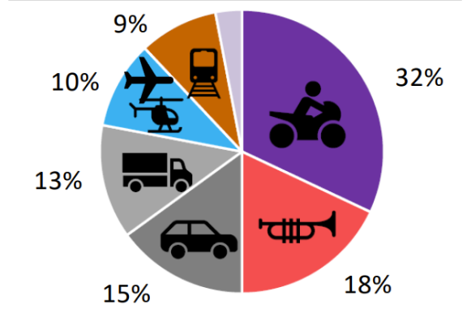
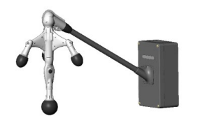
Literature review : Vehicle annoyance versus ASEP
Administration’s view: citizens’ complaints (from environment groups)
The sound emitted by M1 cars is perceived as annoyance but less important compared to other sources.
Administration’s action: noise abatement
Installation of automated noise camera to monitor sound from passing vehicles
Such monitoring can be used to gain an overview about nature, number and timing of any kind of noise events (sirens, horns, street sweepers, garbage trucks, modified vehicles, reckless driving, buses, trucks and more).
Manufacturer view: sound enthusiast customers (from press releases)
The sound’s character of cars is often perceived as pleasantness.
The ASEP provisions triggered a thorough redesign of the powertrain.
Press’ observation
The sound of newer car models seem to be less emotional.
Customers report that new cars were “disappointing compared to previous models”.

Slide 7
WP1.2. Recognition and implementation of ASEP

Slide 8
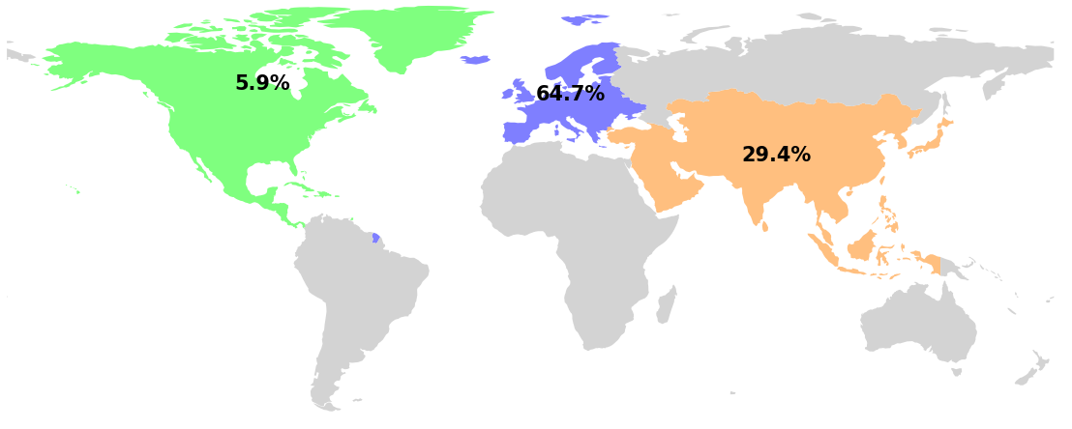
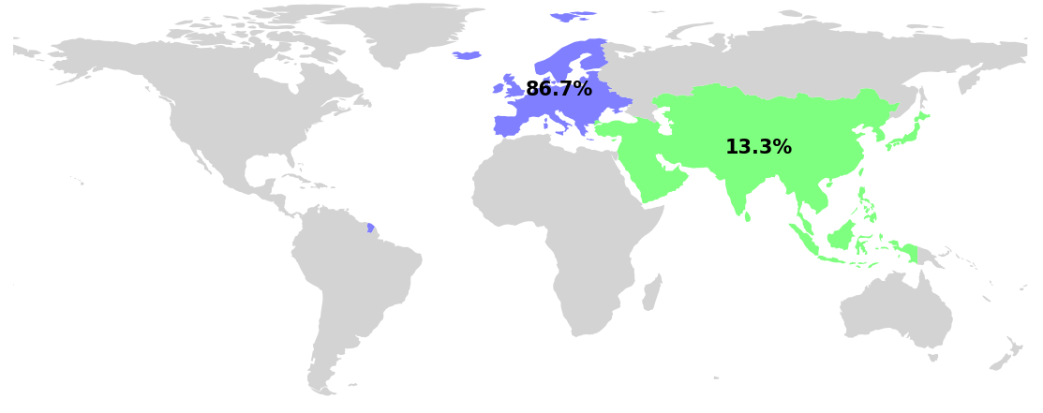
Questionnaire survey
We crafted two distinct questionnaires, specifically designed for OEMs and CPs.
We collected feedback from a total of 17 OEMs and 15 CPs.
Geographic distribution of OEMs (top) and CPs (bottom), categorized by their respective regions.
Good representativity, particularly in the European region.
OEMs feedback (%)
CPs feedback (%)
Notes:
UTAC has been commissioned by ACEA to conduct a comprehensive study focusing on the ASEP and RD-ASEP initiatives. This study comprises two distinct work packages aimed at addressing specific objectives:
Work Package 1: The primary objective of this phase is to assess whether the existing implementation of ASEP has resulted in any modifications to the design process in vehicles. This involves a thorough examination of the impact of ASEP on design changes.
Work Package 2: In this phase, the focus shifts towards the RD-ASEP program. The key task is to gather pertinent data from the RD-ASEP monitoring process and subsequently carry out a preliminary analysis. The input will be supplied to the IWG on RD-ASEP.
This study is a collaborative endeavor involving the active participation of critical stakeholders, including France, Germany, Japan, The Netherlands, as well as OICA (ACEA). The concerted efforts of these entities reflect a joint commitment to advancing the field of Vehicle exterior noise.

Slide 9
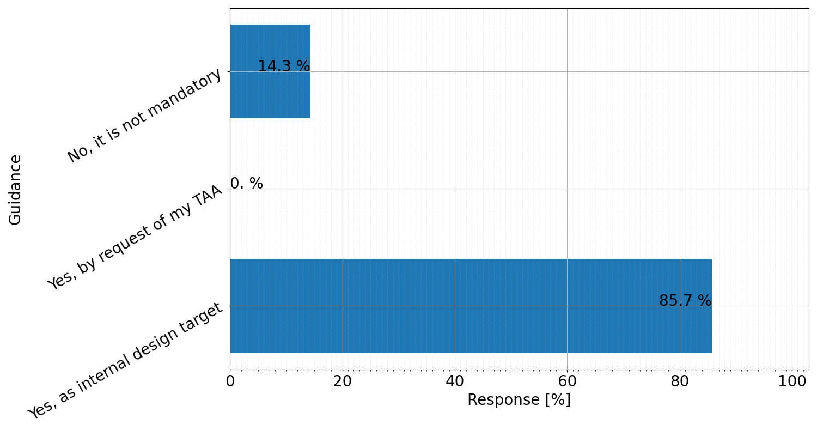
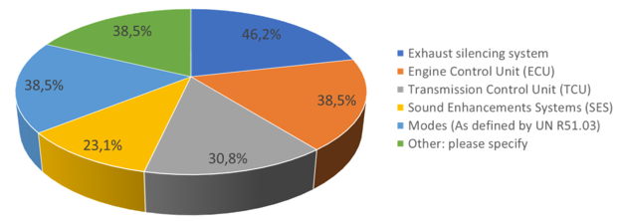
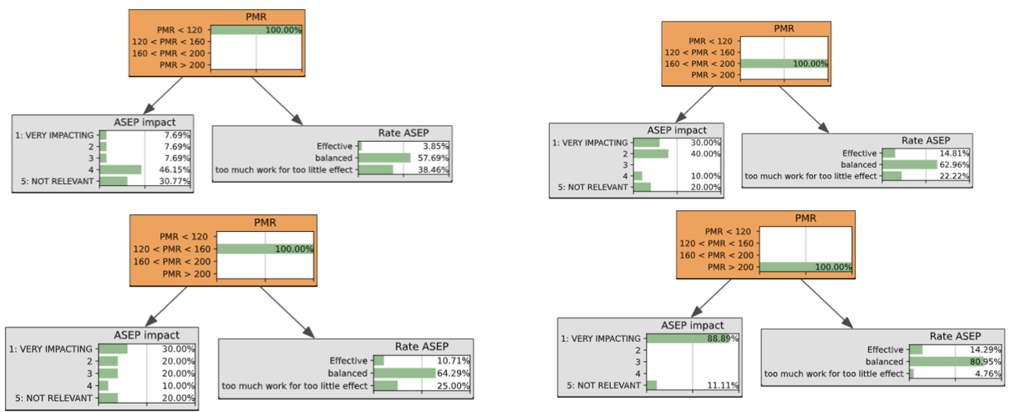
Key findings from OEMs questionnaire
Most manufacturers apply the guidance of the GRB-68-03 voluntarily.
Correlation between the PMR and the impact of the ASEP.
Most manufacturers of vehicles with low PMR are little impacted by ASEP.
Most manufacturers of low PMR vehicles consider ASEP too time-consuming with minimal impact.
Most manufacturers of high PMR vehicles rate ASEP as being balanced.
ASEP has an impact, especially on exhaust system, ECU and TCU.
Notes:
UTAC has been commissioned by ACEA to conduct a comprehensive study focusing on the ASEP and RD-ASEP initiatives. This study comprises two distinct work packages aimed at addressing specific objectives:
Work Package 1: The primary objective of this phase is to assess whether the existing implementation of ASEP has resulted in any modifications to the design process in vehicles. This involves a thorough examination of the impact of ASEP on design changes.
Work Package 2: In this phase, the focus shifts towards the RD-ASEP program. The key task is to gather pertinent data from the RD-ASEP monitoring process and subsequently carry out a preliminary analysis. The input will be supplied to the IWG on RD-ASEP.
This study is a collaborative endeavor involving the active participation of critical stakeholders, including France, Germany, Japan, The Netherlands, as well as OICA (ACEA). The concerted efforts of these entities reflect a joint commitment to advancing the field of Vehicle exterior noise.

Slide 10
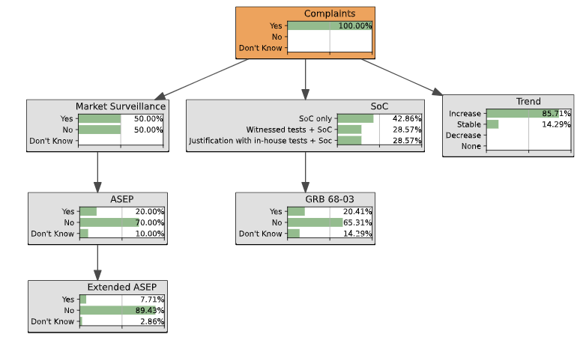
Key findings from CPs questionnaire
The trend of citizens’ complaints increases could be linked to more awareness of environmental noise issues (after Covid 19, with home office, …).
The Market Surveillance is not systematically applied (only half of CPs answering to the questionnaire applies MaS for noise).
ASEP is rarely tested
Low assessment or information regarding the ASEP effectiveness in reducing single vehicle noise.
Conclusions:
At least, the EU system allows enough enforcement for noise abatement
Recommendation to
Systematically use the MaS
Reinforce in-use controls and PTI

Slide 11
WP1.3. Test campaign

Slide 12
Next steps
Tests according to
UNR51.03 and
ASEP based on the test program outlined by the IWG RD-ASEP in 2017/2018
except stationary sound measurement and
adding tyre rolling noise
8 vehicles targeted of which 4 tests are in the pipe.
When possible, twin pairs of vehicles
one approved acc. to UNR51.02
its successor under UNR51.03
Single vehicles might be tested as well, if they are interesting.
Vehicles selection is based on press reports and outcome of questionnaires.
Target to complete all tests by end of June 2024
Presentation to be done at next GRBP session (Sept 2024)

Slide 13
WP2. RD-ASEP Monitoring

Slide 14
RD-ASEP monitoring: database
UTAC made a data-exchange platform available
For TAAs and for OEMs (on voluntary base)
For mandatory data (type approval) and for other sets of data or for other kinds of vehicles (PEV, …)
Other data than TA data can be updated (even “FAIL” one) → identify it in the file name and in the sheet “(0) data tracking”
Process of access to the platform
Confirmation of email address of the person(s) in charge to send data for RD- ASEP (email exchange with UTAC)
Registration code given to upload data to server/registration form
Upload of data in confidentiality per TAAs and per OEMs
RD-ASEP Monitoring Data Delivery Document
Documents for reference only | UNECE: GRBP-77-15-Rev.4
This document was updated since last GRBP → ensure you’re using the latest version → do not modify it
Includes also a short survey to TAAs on the RD-ASEP implementation → ensure you have filled it
ONLY the datasheet to upload (not the pdf file)

Slide 15
RD-ASEP monitoring: first data
RD-ASEP monitoring according to UNR51.03:
Numbers of registered CPs: 8 (7 TAAs, one with 2 TS)
Number of data set received: 18
Request from some OEMs to submit data on voluntary base
Numbers of registered OEMs: 2
Number of data set received: 0
Post processing of data will be done separately
To be included in the RD-ASEP data evaluation
TA-data will also be assessed independently

Slide 16
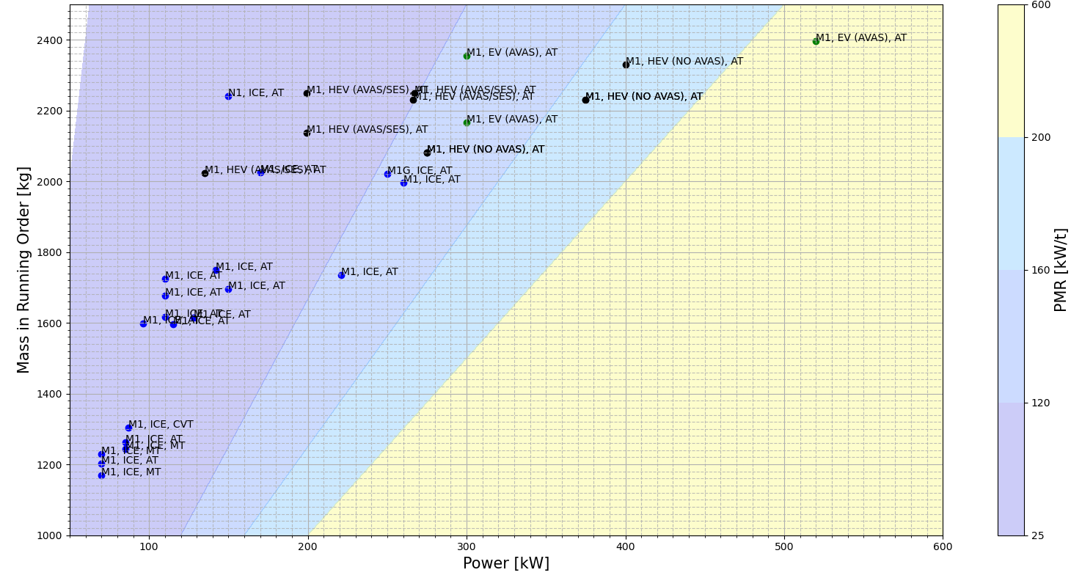
RD-ASEP monitoring: vehicles characteristics
Legend and Abbreviations:
Vehicle Category M1-a
Vehicle Category M1-b
Vehicle Category M1-c
Vehicle Category M1-d
HEV: Hybrid Electric Vehicle
AVAS: Acoustical Vehicle Alerting System
SES: Sound Enhancement System (supplement to AVAS)
ICE: Internal Combustion
Engine
AT: Automatic Transmission
CVT: Continuous Variable Transmission
EV: (Pure) Electric Vehicle

Slide 17
Next steps
Contribution to IWG RD-ASEP
Interim presentation to be done at next GRBP session (Sept 2024)
Final presentation of the data analysis at GRBP session (Feb 2025)

