Slide 1
New design C3 SRTTs Additional Explanations update of GRBP-78-28e-Rev.1
Informal document GRBP-79-36
79th GRBP, 6-9 February 2024
agenda item 7 (d)

Slide 2
From GRBP-78-28e-Rev.1
Background - regulatory framework & reason for changing the current C3 SRTTs
Rib design of the tread pattern of current C3 SRTTs with limited snow performance capabilities → High performance variation depending on the track surface conditions during testing
high performance variations in the evaluation of candidate tyres
poor correlation between different test providers and/or proving grounds
Need to improve reproducibility of the Snow Grip test results (i.e., reduce the uncertainty of the test) while not deteriorating the Wet Grip reproducibility

Slide 3
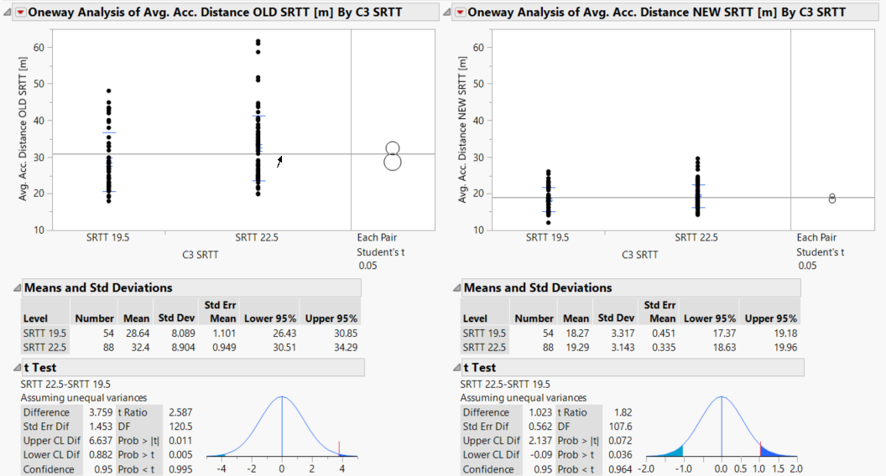
(*) additional data, missing in previous analysis, are considered
Analysis of Test Results – Conclusions (all valid results)*
Current SRTTs
New SRTTs
New SRTT 22.5 and 19.5 are equivalent in their performance → only one correlation factor
2.
2.
Very high variation of current SRTT could lead to very positive candidate performance
1.
3.
Performance variation of NEW SRTT is significantly reduced → good stability → high reproducibility → higher challenge to pass Threshold
Updated correlation factors: SRTT19.5 → 1.57 (instead of 1.53)
SRTT22.5 → 1.68 (instead of 1.67)

Slide 4
Analysis of Test Results – Conclusions considering all valid results
The NEW SRTT 19.5 and 22.5 are now equivalent with much higher performance stability → Continuation of interchangeability of both NEW SRTT for candidate testing
Equivalence of NEW SRTT → Same correlation factor needs to be applied due to interchangeability
Higher challenge to exceed threshold vs. the NEW SRTTs due to lower test variation of NEW SRTTs (strong reduced influence of test conditions on candidate snow index) → No benefit expected when testing 19.5 and 17.5 candidates due to higher stability of the NEW SRTT

Slide 5
Summary
What is the background for implementation of new C3 SRTT design?
- Too high variation of current SRTT leads to a poor reproducibility
What is the reason for a unique correlation factor for both SRTT sizes?
- Improved equivalence of both NEW SRTTs based on test result analysis
Why is the final updated calculated factor 1.68 the right choice?
- Covering all current candidate tyres which were tested vs. old SRTT 22.5 (a lower coefficient than 1.68 will lead to a global tightening)
- Best fit for covering all local conditions including local market shares
- For candidates tested against SRTT19.5, it will be compensated by the reduced variability of test results because the stability of new SRTT will prevent very positive results due to SRTT poor performance only

Slide 6
From GRBP-78-28e-Rev.1
Overview
3 years testing
Different conditions (temp., track friction, vehicle)
9 testing companies / locations
More than 70 tests results

Slide 7
From GRBP-78-28e-Rev.1
Coefficient of variation of Current C3 SRTT and New Design C3 SRTTs (BFC or mu) are similar
→ stability on wet is maintained
Current and New SRTTs are not so distant in terms of wet performance: the available data show anyhow a slight improvement of new design SRTTs
→ Proposed correlation factor was 1.04 for both 19.5 & 22.5, for both trailer and vehicle methods

Slide 8
Interchangeability of the C3 SRTTs
The choice of the C3 SRTT to be used for the Wet Grip index test is currently prescribed by regulation depending on the nominal section width of the Candidate tyre (Narrow and Wide families)
For C3 tyres
Narrow Family S_{NOMINAL} < 285 mm | Wide Family S_{NOMINAL} ≥ 285 mm
SRTT 19.5 | SRTT 22.5
S_{NOMINAL} = Tyre nominal section width
In some cases, this approach has significant limitations:
Dimensional problems (Possibility to fit reference and candidate tyres on the same vehicle)
Load problems (Difficulty in testing in the load conditions required by the regulation)

Slide 9
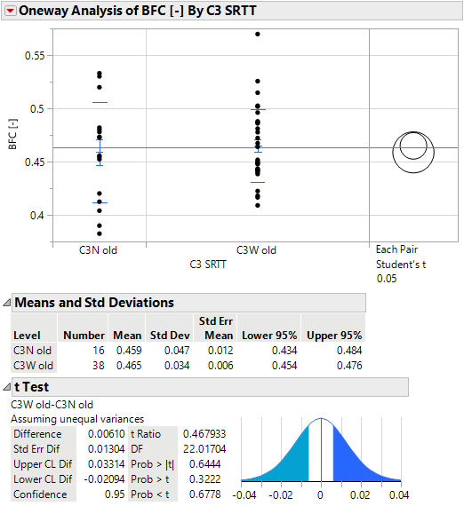
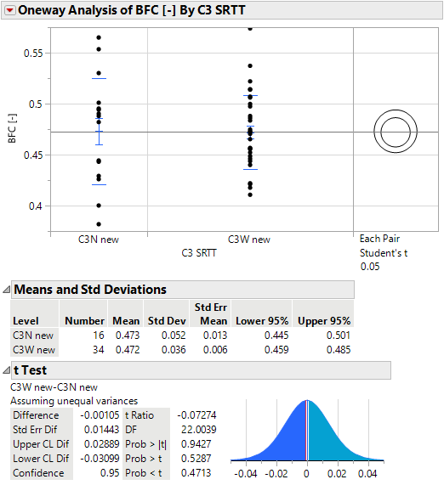
Interchangeability of the 2 C3 SRTTs – Vehicle method
Current SRTTs
New SRTTs
P-value > 0.05 ➔ On average the difference between C3N & C3W (both Current & New) is not statistically significant.

Slide 10
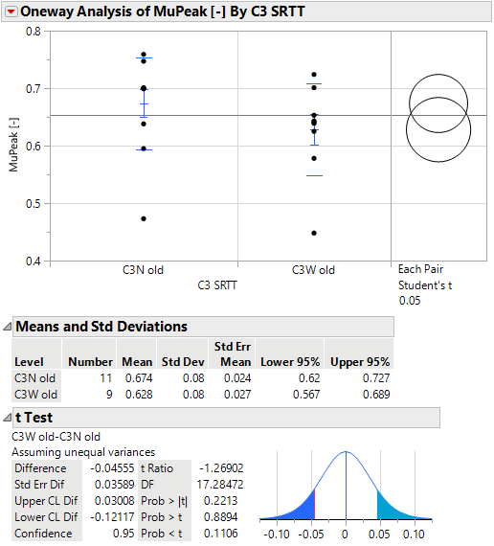
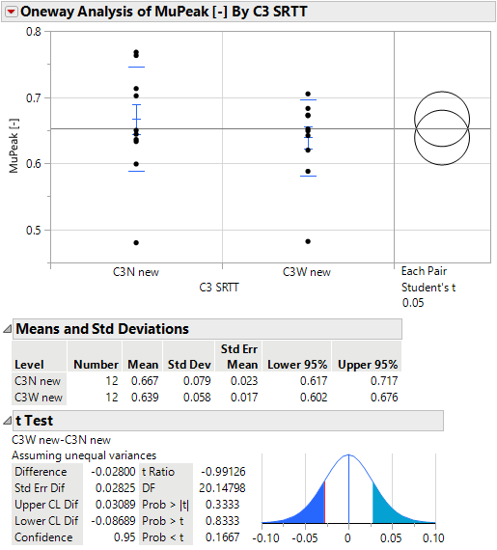
Interchangeability of the 2 C3 SRTTs – Trailer method
Current SRTTs
New SRTTs
P-value > 0.05 ➔ On average the difference between C3N & C3W (both Current & New) is not statistically significant.

Slide 11
Interchangeability of the 2 C3 SRTTs – Conclusions
ETRTO proposes to adopt for the wet grip index test the same approach in force for Snow grip index test:
Eliminating the unnecessary constrain of the SRTT selection depending on the section width of the candidate tyre
Not anymore complexity in testing with benefits in logistics, vehicles’ choice and setup
No change of reference tyre will be, in practice, applicable for most of the candidate tyres, while – only for the candidate tyres sizes which, as of today, are difficult to be tested - a direct comparison with the proper reference tyre will become possible
making the two SRTTs 19.5 and 22.5 equivalent for the WGI determination
→ ETRTO agree with GRBP-79-10, proposing a unique correlation factor f = 1.02 for both trailer and vehicle methods (average value of the 4 correlation factors, the difference falling within the standard deviation found during the test campaign)
Same load range (60% – 100%) is applied also to the SRTT, as already the case for the candidate tyre → Fair comparison between candidate and reference tyres

Slide 12
According to UN Reg. 117 & ISO 15222:2021, the characterization and validation of tracks for C2/C3 WGI tests is currently performed using the C1 trailer method & the C1 SRTT16 μpeak,corr= [0.65, 0.90].
This provision is operationally complex and not effective
Requires to drive a C1 trailer fitting the C1 SRTT on C2/C3 tracks
Does not allow a contextual check of the track during the test session.
As anticipated by the informal document GRBP-78-28-Rev.1, ETRTO investigated the possibility to characterize and validate the tracks using the same method (i.e., vehicle or trailer) and the same reference tyres (SRTT16C, SRTT19.5 or SRTT22.5) used in the evaluation of the candidate tyre, using the same approach as C1 tyres wet grip index procedures.

Slide 13
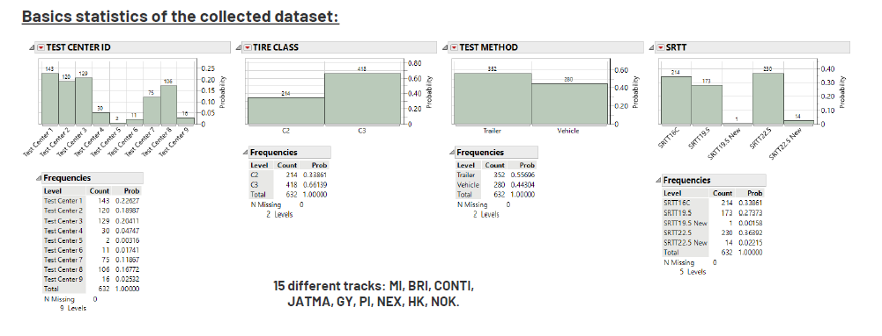
Data collection
Anonymous data collection of UN Reg. 117 compliant tracks, for SRTT C2/C3 (μ_{peak} & BFC)
(historical data that were tested under R117.02 Suppl. 13 on compliant track surfaces)
2. Definition of ranges based on these data

Slide 14
Data analysis and processing
SRTT C2/C3 (μ_{peak} & BFC) anonymous data collection of tracks compliant to the latest version of UN R117 (since the Entry Into Force of the R117.02 Suppl. 13 (of 2021)).
Being majority of data available for current C3 SRTTs, ranges of current C3 SRTTs were defined first
Since not all data are normally distributed, the min & max of the collected data of all test centers has been considered, rounding to the nearest 0.01 digit.
Given the equivalency of the 2 C3 SRTTs (C3N and C3W), the largest range between the C3 SRTTs was applied
for Vehicle Method SRTT C3: added a security margin of ± 10% around the min-max range (up to ~ 10% difference could be observed on BFC SRTT (C3) during back-to back vehicle comparison test with all other test conditions almost identical)
Used correction factor of 1.02 to derive the ranges for the new C3 SRTTs
For Vehicle C2 (BFC SRTT16C), not enough data points → Average with same range as Trailer proposed (i.e,. 0.526 ± 0.326 /2)

Slide 15
Proposal
 |  |  | SRTT BFC or μ
Tyre class | Test method | SRTT | N | Mean | Min | Max | Range
C2 | Trailer | SRTT16C | 209 | 0.595 | 0.44 | 0.766 | 0.326
 | Vehicle | SRTT16C | 5 | 0.526 | 0.495 | 0.564 | 0.069
C3 | Trailer | SRTT19.5 | 52 | 0.594 | 0.511 | 0.665 | 0.154
 |  | SRTT22.5 | 91 | 0.565 | 0.512 | 0.628 | 0.116
 | Vehicle | SRTT19.5 | 121 | 0.472 | 0.4 | 0.534 | 0.134
 |  | SRTT22.5 | 139 | 0.466 | 0.39 | 0.555 | 0.165
Tyre class | SRTT | Trailer method μ_{peak} range | Vehicle method BFC range
C2, C3 | SRTT16 | 0.65 – 0.90 | -
C2 | SRTT16C | 0.44 – 0.77 | 0.36 – 0.69
C3 | SRTT19.5 SRTT22.5 | 0.51 – 0.67 | 0.35 – 0.61
C3 | SRTT19.5 siped SRTT22.5 siped | 0.52 – 0.68 | 0.36 – 0.62
f = 1.02
Is it possible to have the table and not the picture?

Slide 16
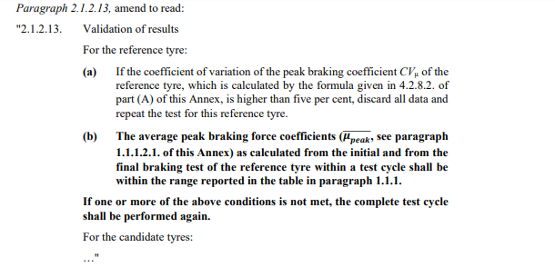
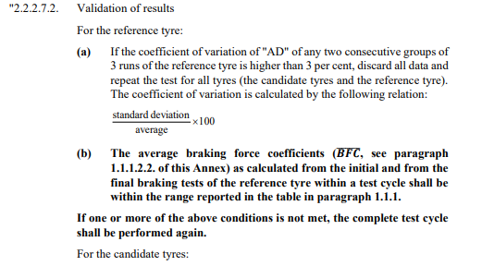
Test validation
It is proposed to validate both the C2 and C3 track surface and the tests results of each test session using the same method and the same reference tyres used in the evaluation program itself.

Slide 17
Thank You

