Slide 1
GRBP-79-10
Agenda item 7 (d)
Japan proposal for
GRBP-2024-06, -07, -09
6-9 February 2024

Slide 2
0. Outlines
Background
Consideration of correction factors based on GRBP-78-28-Rev.1
Japan proposal to amend GRBP-2024-06, -07, -09
Justification

Slide 3
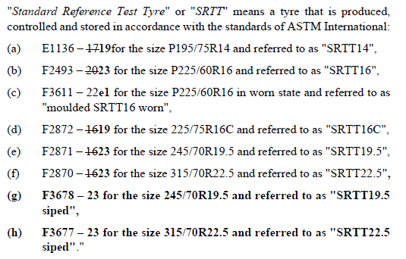
1. Background
Document : ECE-TRANS-WP.29-GRBP-2024-06, -07, -09
ETRTO submitted the proposal
for adopting the new design C3 SRTTs,
and introducing correction factors to
the calculation of the wet grip index and
to the calculation of the snow grip index.
Proposal：Paragraph 2.18.

Slide 4
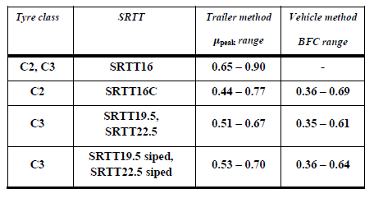
1. Background
Proposal ：Wet grip (Annex 5)
Part (B), Paragraph 1.1.1.
Part (B), Paragraph 2.1.2.14.
4/14

Slide 5
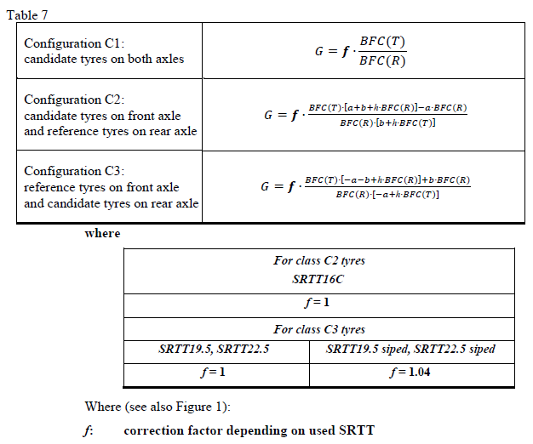
1. Background
Proposal ：Wet grip (Annex 5)
Part (B), Paragraph 2.2.2.7.5.
5/14

Slide 6
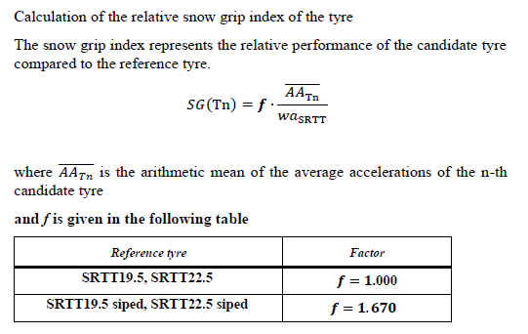
1. Background
Proposal ：Snow performance (Annex 7)
Paragraph 4.8.4.
6/14

Slide 7
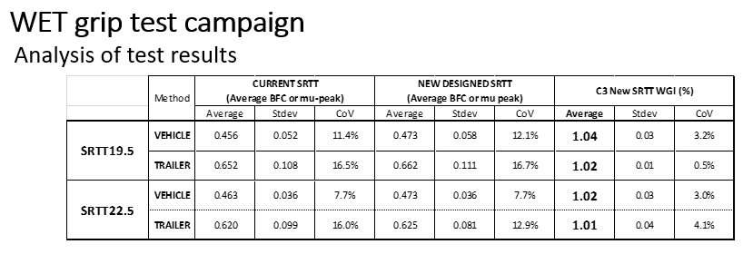
2. Consideration of correction factors based on GRBP-78-28-Rev.1
Japan respects ETRTO proposal for the new design C3 SRTTs.
However, according to the test results which is reported in informal document GRBP-78-28-Rev.1, the correction factor (f) for the wet grip index in new state (G) has variation depending on used SRTT and test method;
From 1.01 for SRTT22.5 trailer method to 1.04 for SRTT19.5 vehicle method.
GRBP-78-28-Rev.1
：Slide 11

Slide 8
2. Consideration of correction factors based on GRBP-78-28-Rev.1
In order to minimize the relaxation or tightening of requirement, the correction factor (f) depending on used SRTT for the wet grip index in new state (G) should be replaced to 1.02 instead of 1.04, for both of vehicle method and trailer method.
Proposal：Correction factors for the wet grip index(G)
For class C3 tyres (vehicle method and trailer method)
SRTT19.5, SRTT22.5 | SRTT19.5 siped, SRTT22.5 siped
f = 1 | f = 1.02

Slide 9
2. Consideration of correction factors based on GRBP-78-28-Rev.1
According to the test results which is reported in informal document GRBP-78-28-Rev.1, two different correction factor (f) depending on used SRTT for the snow grip index (SG) could be considered;
1.53 for SRTT 19.5 and 1.67 for SRTT 22.5.
GRBP-78-28-Rev.1
：Slide 7

Slide 10
2. Consideration of correction factors based on GRBP-78-28-Rev.1
In order to avoid any relaxation or tightening of requirement, two different correction factor (f) depending on used SRTT for the snow grip index (SG) should be introduced as following table.
Proposal：Correction factors for the snow grip index(SG)
Reference tyre | Factor
SRTT19.5, SRTT22.5 | f=1.000
SRTT19.5 siped | f=1.530
SRTT22.5 siped | f=1.670

Slide 11
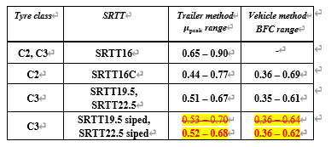
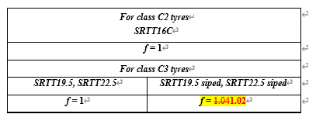
3. Japan proposal to amend GRBP-2024-06, -07, -09
Document : GRBP-79-07, GRBP-79-08, GRBP-79-09
Proposal : Wet grip (Annex 5)
Part (B), Paragraph 1.1.1.
Part (B), Paragraph 2.1.2.14.

Slide 12
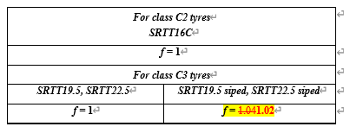
3. Japan proposal to amend GRBP-2024-06, -07, -09
Document : GRBP-79-07, GRBP-79-08, GRBP-79-09
Proposal : Wet grip (Annex 5)
Part (B), Paragraph 2.2.2.7.5.

Slide 13
3. Japan proposal to amend GRBP-2024-06, -07, -09
Document : GRBP-79-07, GRBP-79-08, GRBP-79-09
Proposal : Snow performance (Annex 7)
Paragraph 4.8.4.

Slide 14
4. Justification
(1) Annex 5 “Correlation factor for the wet grip index”
According to the test results which is reported in informal document GRBP-78-28-Rev.1, the correction factor (f) depending on used SRTT for the wet grip index in new state (G) should be replaced to 1.02 instead of 1.04 in order to minimize the relaxation or tightening of requirement.
(2) Annex 7 “Correlation factors for the snow grip index”
According to the test results which is reported in informal document GRBP-78-28-Rev.1, two different correction factor (f) depending on used SRTT for the snow grip index (SG) should be introduced in order to avoid any relaxation or tightening of requirement.
Reference tyre | Factor
SRTT19.5, SRTT22.5 | f=1.000
SRTT19.5 siped | f=1.530
SRTT22.5 siped | f=1.670

