Slide 1
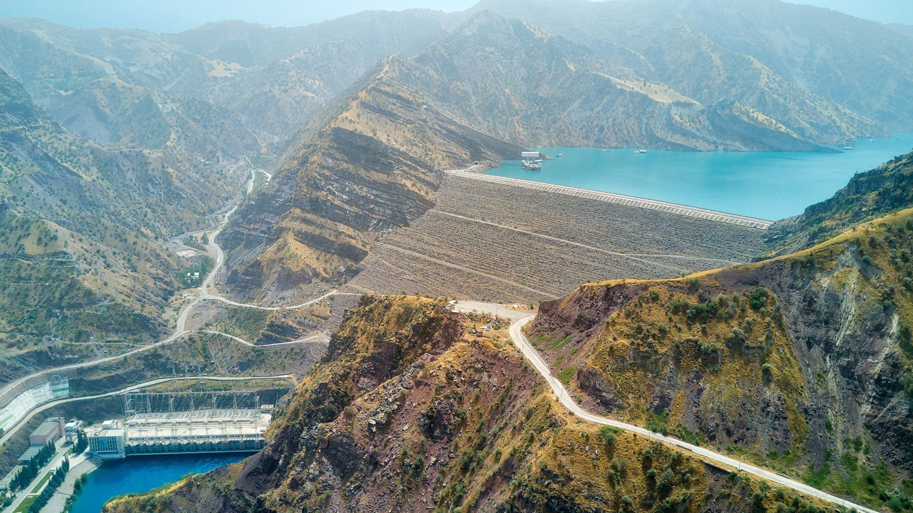
#TEAMEUROPE
Global Gateway Team Europe Initiative on Water, Energy and Climate Change in Central Asia
Working together for a sustainable and just blue and green transition
Almaty, 15 Nov 2022

Slide 2
What is Team Europe?
Team Europe consists of the European Union, the EU Member States — including their implementing agencies and public development banks —, as well as the European Investment Bank (EIB) and the European Bank for Reconstruction and Development (EBRD).

Slide 3
What are Global Gateway Team Europe initiatives?
Global Gateway is about increasing investments promoting democratic values and high standards, good governance and transparency, equal partnerships, green and clean, secure infrastructures and that catalyse private sector investment
Flagships of the Team Europe approach, guided by the political and policy priorities of the EU
Invest in international stability and cooperation and demonstrate how democratic values offer certainty and fairness for investors, sustainability for partners and long-term benefits for people around the world
Deliver concrete results for partner countries, in line with their strategic and national priorities
Team Europe Initiatives focus on identifying a critical priority (bottleneck) that currently constrains development at country and regional level, where a coordinated and coherent effort by Team Europe would ensure results with a transformative impact

Slide 4
The Team Europe Initiative on Water, Energy and Climate Change in Central Asia is established to develop complementarities with ongoing projects and boost the blue and green transition.

Slide 5
Strategic objectives
Expected results

Slide 6
Improved regional cooperation and governance effectively supports sustainable development in Central Asia
Water cooperation for sustainable development increased
Transition to renewable energy accelerated
Climate and environmental governance improved
2. Increased investment in a regionally integrated blue and green transition in Central Asia
More efficient and effective drinking water supply and sanitation
Greener and more integrated energy sector
More action on climate change and the environment

Slide 7
Indicative list of activities
Ongoing and forthcoming initiatives by Team Europe members

Slide 8
Already approved EU initiatives
Possible EU initiatives
Regional Support to Sustainable Energy Connectivity in Central Asia (SECCA).
Tajikistan Support to Energy Sector Reform Programme.
Regional
IFAS Reform
National Policy Dialogues on IWRM
Dam Safety
Main Intake Automatization in the Amu Darya basin
Energy Efficiency and Renewable Energy
Support to EU-Central Asia Platform on Water, Energy and Climate Change
Uzbekistan Support for UN Multi-Partner Human Security Trust Fund for the Aral Sea Region (co-funded by Finland, Latvia and others)
Global, Regional, Tajikistan Dushanbe Water Conferences (follow-up, biennial cycle, possibly with MIP contribution, partnering with the Netherlands and implemented by UNDESA or UNDP).
Tajikistan Drinking Water Supply and Sanitation in Rural Areas (proposed, possibly with MIP contribution and implemented in partnership with the World Bank)
+ EU Member States and Development Banks Initiatives
In total around EUR 700 Mill. Incl guarantues 2021-27

Slide 9
EU Member States initiatives
Finland (Finnish Environment Institute, Geological Survey of Finland, Finnish Meteorological Institute)
KG, TJ Surface Water and Groundwater Quality Monitoring (water authorities and civil society)
KG, TJ, UZ Strengthening the Mastering of Natural Resources for National Welfare
KG, TJ, UZ Meteorology Project
UZ Support for UN Multi-Partner Human Security Trust Fund for the Aral Sea Region (co-funded by the EU, Latvia and others)
France (AFD)
UZ Water and Sanitation Project UZ Drinking Water Project (new, under the TEI UZ)
UZ Hydropower Development
Germany (GIZ, universities)
CA Green Central Asia Initiative
CA Climate Risk Management
CA Climate Sensitive Water Resource Management
CA Climate Sensitive Land Use
KG, UZ, TJ Improve the energy efficiency of the global building supply chain and its products to deliver highly efficient building
KG, TJ Technology based adaptation to climate change in rural areas (IKI)
CA CLIENT II International Partnerships for Sustainable Innovations
KZ, UZ FELICITY II East
CA Regional Strategic Infrastructure Planning Asia
TJ Hydropower Sebzor/Tajikistan
UZ, KZ Ecologically Oriented Regional Development in the Aral Sea Region
CA Energy-Water-Land Use Nexus in Central Asia
CA Innovative Small HPP (Hydro4U)
Latvia (Cleantech, LatviaSunGIS)
UZ Support to a modern and sustainable agri-food sector and resilient livelihoods programme
UZ, KZ Capacity building of industry associations serving engineering companies
UZ Prototype of portal for the publication and public discussion on the general plan for residential areas
Romania
CA Supporting Regional Cooperation on Transboundary Water Management (ongoing, yearly cycle, implemented in partnership with UNRCCA)
Slovakia
CA Supporting the International Water Assessment Centre (IWAC) (ongoing, implemented in partnership with UNECE)
CA Strengthening of trans-border water management and improving the dam safety system (new, implemented in partnership with IWAC)
KZ Capacity building in the area of automation and early warning systems for dam safety, hydrometeorology and flood protection

Slide 10
Development Banks initiatives
UZ, KZ Climate Action and Environment Facility: Water Framework Loan, Energy Efficiency Project, SME Support Project, etc.
CA, UZ, KZ Forest Plantation on the Aral Seabed and Regional Eco-Development
New initiatives (under consideration)
CA, TJ Rogun HPP
UZ, KZ Reduction of Energy Intensity in Residential Buildings
UZ, TJ Solar Power Support
KZ, TJ Drinking Water Supply, Sanitation and Waste Management
UZ Decarbonization of the Energy Sector
KG Climate Resilience Water Supply (Irrigation), Drinking Water and Sanitation
KG, TJ Renewable Energy and Energy Efficiency
CA Energy PIP
CA Resilience PIP

