Slide 1
Urban economic resilience: building and promoting recovery from the COVID-19 pandemic and natural and man-made disasters
Gulnara Roll, Regional Advisor
UNECE Forest, Land and Housing Division

Slide 2
Overall Objective
Building Urban Economic Resilience during & after COVID-19
The project will contribute to planning for more resilience cities and local governments better able to withstand shocks such as COVID-19 and urban systems’ stresses likely to reoccur in a predominantly urban world. Implementation will consider linkages with other dimensions of urban resilience of specific relevance to the different social, spatial and governance contexts of each region.
Capacity Building
16 cities globally
Resilient – Sustainable – Inclusive
COVID-19 economic and financial recovery plans

Slide 3
Urban Resilience Diagnostic Tool - Performance Indicators
RA1: Resilience of local business environment
Analysis of the capacity of local businesses (including the public sector) sustain growth and respond to demographic, technological and market conditions.
RA2: Resilience of local labour market
Analysis of the capacity of the local labour market to adjust to changes in economic activities and reallocate labour while minimizing unemployment.
RA3: Resilience of local financial system
Analysis of the capacity of the local financial system to maintain adequate and continuous supply of finance to economic activities with appropriate instruments.
Urban economic resilience
RA4: Resilience of economic governance
Analysis of the capacity of local economic governance to plan, allocate and mobilize resources and coordinate public and private economic activities
RA5: Resilience of basic service infrastructure and connectivity
Analysis of the capacity of basic service infrastructure and connectivity systems to enable and facilitate continued operation of the other four components of urban economy under stressful conditions

Slide 4
Urban Resilience Diagnostic Tool – Result
A | B | C | D | F
performance associated with a very strong capacity to ensure economic and financial resilience. | sound performance associated with a healthy capacity but a rung below the best performing cities. a low to moderate impact and a relatively quick recovery. | average performance low to moderate levels of impact and a somewhat longer recovery period. | performance associated with a capacity that falls way below the best performers. strong impact and a long recovery period. | lack of own resilience capacity such that without substantial support from the central government a city would experience a very strong shock (possibly an economic collapse) and a long recovery period.

Slide 5
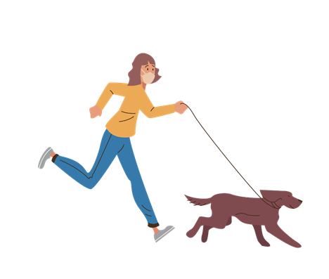
Main Activities & Deliverables
Urban Economic Recovery and Resilience Diagnostic and Planning Tool
Regional Policy Briefs on Urban Economic Recovery and Resilience
Economic Resilience Building Plans
Information packages of sources for financial support to cities for each city
e-learning course on urban economic and financial recovery and rebuilding

Slide 6
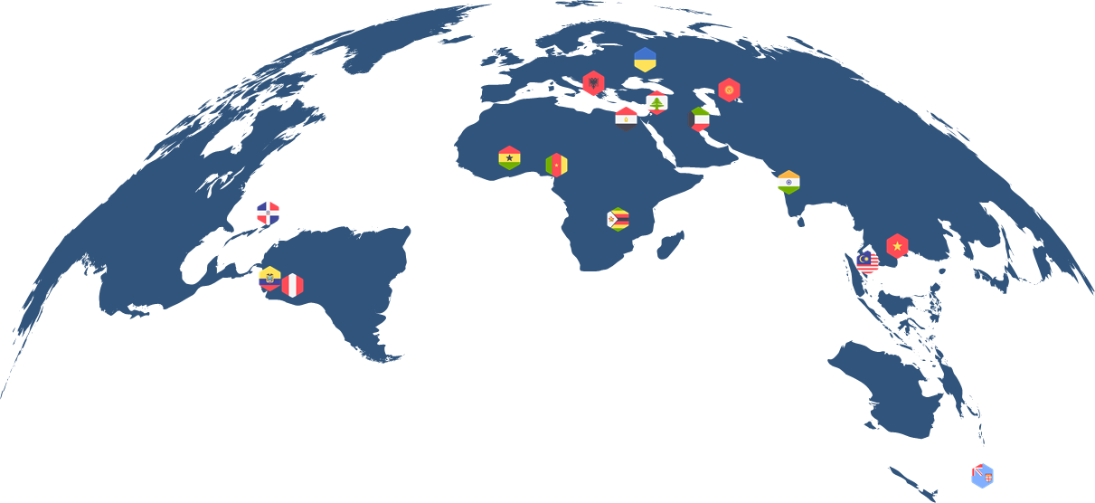
Policy recommendations - Bishkek
Building Urban Economic Resilience during & after COVID-19
Pursue compact urban development
Invest in low-carbon public transport infrastructure
Improve the water and sanitation infrastructure. Deliver water and sanitation infrastructure to informal settlements.
Improve the lifespan of the existing water and sanitation infrastructure by investing in its renovation.
Increase the volume of waste recycled and decrease the amount of waste put into open-air dumps, incinerated, burned, or disposed of into landfills.
16 cities

Slide 7
THANK YOU
urbaneconomicresilience.org
Building Urban Economic Resilience during and after COVID-19
25th session of the SPECA Working Group on Water, Energy and Environment, 14 Nov 2022
15 November 2022

