Slide 1
Outcomes of the Ninth Environment for Europe Ministerial Conference (Nicosia, Cyprus, 5-7 October 2022)
Zaal Lomtadze
Environment Division UNECE

Slide 2
Environment for Europe: History
EfE process launched in 1991
Has been supporting countries’ efforts to advance in environmental governance
Unique partnership of the UNECE Member States, United Nations system organizations, other intergovernmental organizations, Regional Environmental Centers, NGOs, Private sector, other major groups
UNECE serves as its secretariat; UNECE Committee on Environmental Policy is responsible for preparing the Ministerial Conferences (since 2009)
The process continues to provide the framework for the development of:
governance policies and initiatives
legal instruments and policies
practical actions and tools

Slide 3
31 years of EfE process: Outcomes
The ECE Programme on Environmental Performance Reviews;
The ECE programme on Environmental Monitoring and Assessment;
The Pan-European Biological and Landscape Diversity Strategy;
The Convention on Access to Information, Public Participation in Decision-making and Access to Justice in Environmental Matters (Aarhus Convention);
The Protocols on Heavy Metals and Persistent Organic Pollutants to the Convention on Long-range Transboundary Air Pollution;
The Pan-European Strategy to Phase-out Leaded Petrol;
The ECE Strategy for Education for Sustainable Development;
The Protocol on Strategic Environmental Assessment to the Convention on Environmental Impact Assessment in a Transboundary Context;
The Protocol on Pollutant Release and Transfer Registers to the Aarhus Convention;
The Protocol on Civil Liability to the Convention on the Transboundary Effects of Industrial Accidents and the Convention on the Protection and Use of Transboundary Watercourses and International Lakes (Water Convention);
The Environment Strategy for Eastern European, Caucasian and Central Asian countries;
The Framework Convention on the Protection and Sustainable Development of the Carpathians;
Political initiatives, e.g. the latest:
Astana Water Action (AWA) – 2011-2016
Batumi Initiative on Greening the Economy (BIG-E)
Batumi Action for Cleaner Air (BACA)
a series of guidelines and recommendations to Governments.

Slide 4
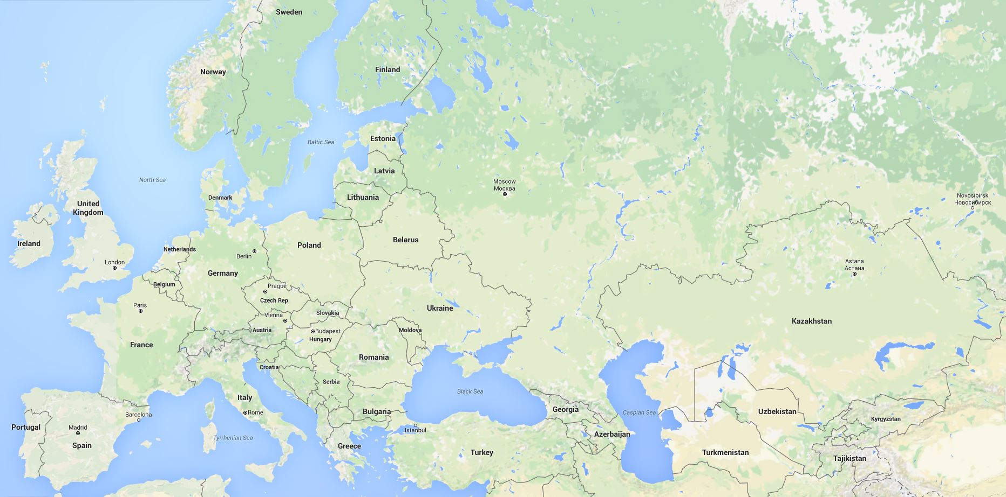
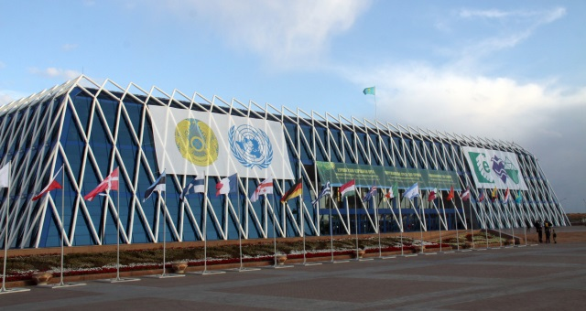
EfE: 9 Ministerial Conferences
1991-2022
1998
1991
2003
2011
1993
2007
1995
2016
2022

Slide 5
9th EfE Ministerial in Nicosia: Figures
Held 5-7 October 2022 in Nicosia, Cyprus
899 participants attending
Participants from 62 countries + European Commission
Government delegations from 53 countries + EC (42 UNECE countries and 11 other States)
Gov. delegates from 5 SPECA countries
NGOs, academia, business
38 side-events (number had to be limited due to the decision not to run side-events in parallel to the Conference sessions)

Slide 6
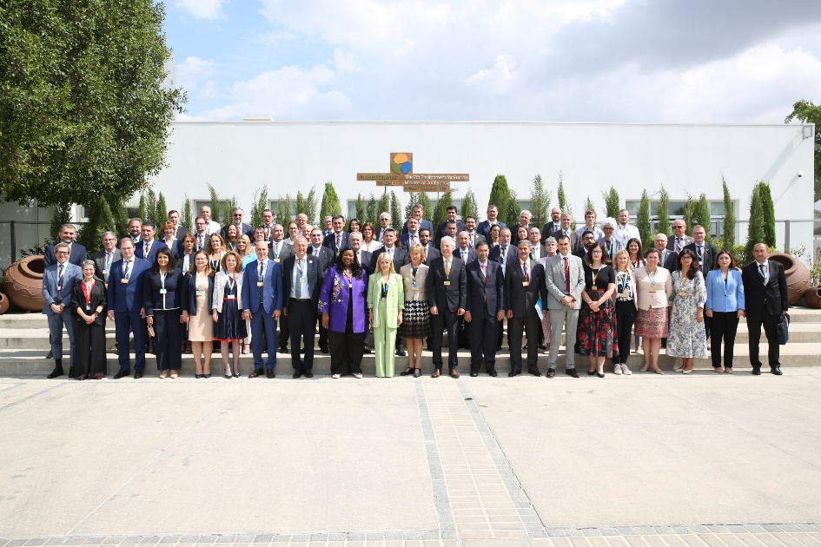
9th EfE Ministerial:
Themes & outcomes
themes 1. Greening the economy in the pan-European region: working towards sustainable infrastructure. 2. Applying principles of circular economy to sustainable tourism Also: Third High-level Meeting of Education and Environment Ministries
Parallel Ministerial Meeting on Education for Sustainable Development (ESD)
key outcomes
Ministerial Declaration
Pan-European Strategic Framework for Greening the Economy & Batumi Initiative on Green Economy (BIG-E) – Progress report and the Nicosia Call
Batumi Action for Cleaner Air (BACA) – Final report
Nicosia Ministerial Statement on ESD
Framework for the future implementation of the UNECE Strategy for ESD 2021-2030
Co-Chair’s Summary

Slide 7
Outcomes: Ministerial Declaration
https://unece.org/sites/default/files/2022-10/ECE_NICOSIA.CONF_2022_L.1_E.pdf
11. We will support efforts to reduce water and energy use and greenhouse gas emissions from tourism, particularly from high-impact subsectors (including cruise liners, aviation and accommodation), as well as to improve efficiency in the use of …water. We also commit to improving wastewater treatment and waste management, including food waste and plastics, in the tourism sector, and to applying circular economy principles across the tourism value chain. …
16. We acknowledge the importance of regular, indicator-based environmental assessments, and confirm our commitment to keeping the pan-European region under regular review in support of sustainable development and the transition to a circular, green and sustainable economy. We take note of the key findings of the seventh pan-European assessment, produced by ECE and the United Nations Environment Programme, and the urgent need in particular to:
Pursue integrated water resources management, transboundary water cooperation and integrated coastal zone management.
Reverse the degradation of coastal waters, marine ecosystems and seas, and enhance efforts to achieve the global targets of protection and conservation of at least 30 per cent of terrestrial, inland water, coastal and marine areas across the region by 2030.
Prevent pollution to air, water and soil to drive towards a pollution-free planet.

Slide 8
Outcomes: Batumi Initiative on Green Economy (BIG-E) – Progress report and the Nicosia Call
https://unece.org/big-e
BIG-E total:
191 Commitments from:
32 countries (incl. AZE, KAZ, KGZ, UZB)
13 organizations (incl. CAREC)
Of it, Nicosia Call:
68 Commitments from:
19 countries (incl. AZE, KAZ)
6 organizations (incl. CAREC)
More information at:
www.unece.org – UNECE secretariat

Slide 9
Thank you for attention!

