Slide 1
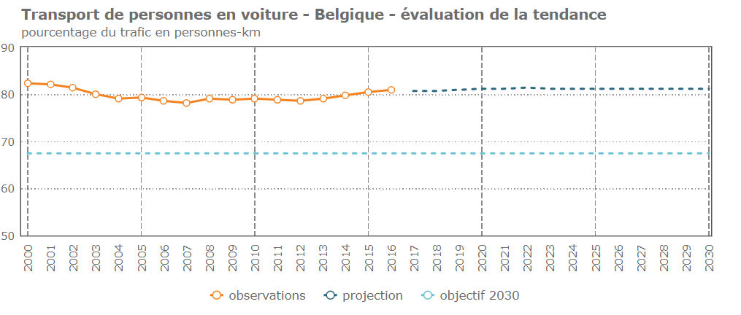
UNECE Work on SDG 9.1.2: Passenger and Freight Volumes
ECE/TRANS/WP.6/2020/1 ECE/TRANS/WP.6/2020/2 ECE/TRANS/WP.6/2020/3
Relevant documentation:

Slide 2
SDG 9.1.2
“Passenger and freight volumes, by mode of transport”.
What does this mean? Is it a modal split indicator, or something else? What does progress look like?
Can we compare inland modes with maritime and aviation meaningfully?

Slide 3
Custodian Agencies and UNECE Role
Within SDG Monitoring Framework, Custodian Agencies lead data provision and methodology work for each indicator.
Until recently, no official statistics for inland modes under 9.1.2 were included, no compilation guidance, no metrics for progress.
What can UNECE (a partner agency) do?
Increase awareness.
Collate national reporting examples.
Develop a guidance framework on questions relating to inland transport data, for countries to use if relevant.

Slide 4
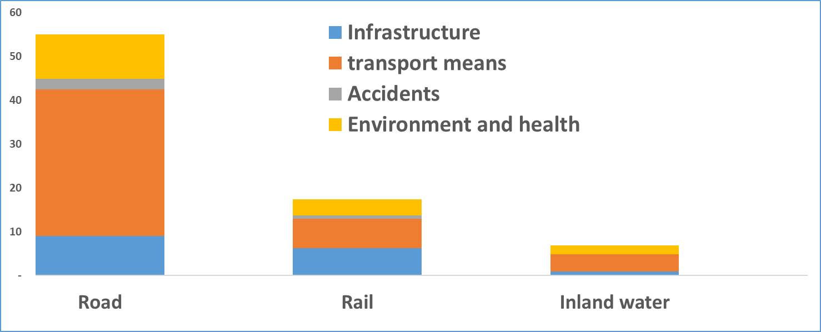
Why care About (Inland) Modal Split?
Cost of goods transport in Switzerland, cents per tonne-km.
https://www.bfs.admin.ch/bfs/fr/home/statistiques/mobilite-transports/couts-financement.assetdetail.812-1600.html

Slide 5
Statistical considerations
Residency or territorial principle for road freight? For European countries not calculating their own territorial figures, is using Eurostat territorialized data the easiest option?
Source: Eurostat https://ec.europa.eu/eurostat/statistics-explained/index.php/Freight_transport_statistics_-_modal_split

Slide 6
Statistical unit and gender questions
What is the most important public transport mode in my country?
UK: Men make 6% fewer trips than women, but travel 15% longer. Women take 10% more walking trips and 33% more bus trips.
France: two-thirds of public transport users are women.
Policy impact: women make more “trip chains” (e.g. home>school>work), which tend to be short. These rely on good walking and cycling environments, frequent PT connections etc.
Statistics impact: measuring both trip numbers and passenger-km are important for a full understanding of transport.

Slide 7
Indicator 9.1.2
(Passenger and freight volumes)
Inland freight modal split, available ECE countries (residency not territory)
7

Slide 8
Our Approach
Helping countries monitor SDG progress is important part of the UNECE Inland Transport Committee strategy to 2030.
Collated national reporting examples tiny.cc/912ECE. Includes national indicators that countries use for tracking sustainable transport. Most countries concentrated on inland modal split.
We drafted guidance on how to measure 9.1.2 at the national level. Guidance considers proxy indicators to use when e.g. passenger-km data are not available.
Comments on the draft guidance are very welcome, will then be released as an informal publication later in 2020.

Slide 9
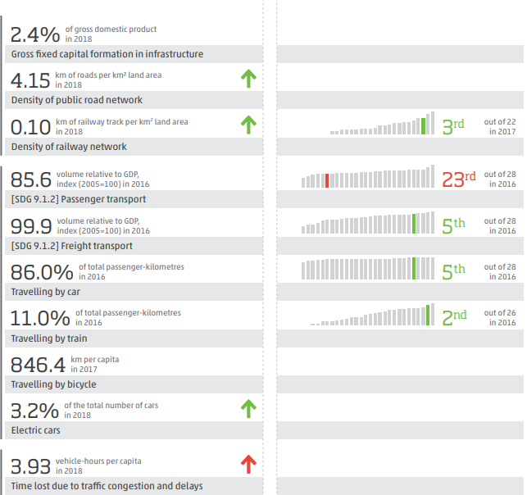
What Next?
We want to continue the discussion about modal split specifically, and sustainable transport in Voluntary National Reviews and on National Reporting Platforms.
Do you use a modal split indicator? Any other related indicators for tracking transport? Are any coming from admin data or other easy to produce sources?
POST LOCKDOWN
9.1.2 is an “oven-ready” indicator for monitoring changes in travel patterns as countries move out of lockdown.
Integrating cycling and walking into existing monitoring frameworks is particularly pertinent given temporary space reallocation in many cities.
Indicators do not need to be “complete” pictures of national mobility.

