Slide 1
Avoidance criteria for cut-in situation
Informal document GRVA-05-44 5th GRVA, 10-14 February 2020
Agenda item 4(a)

Slide 2
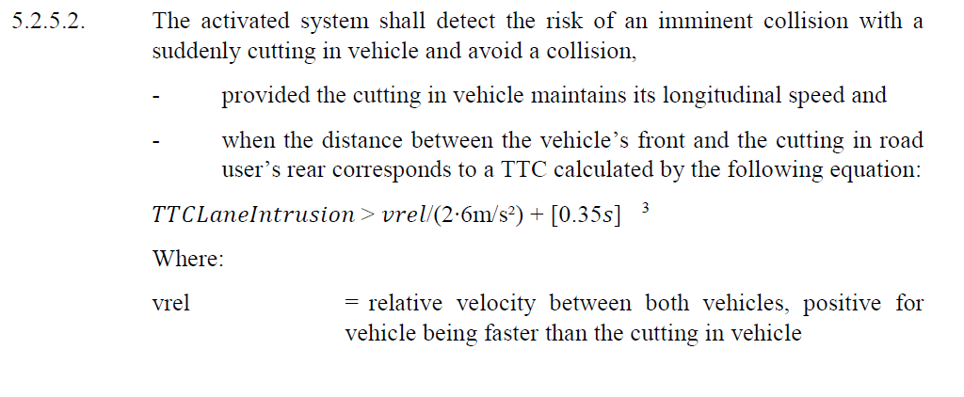
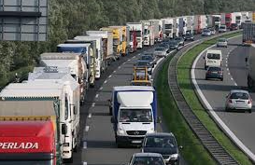
What does the current proposal regarding avoidable cut-in scenarios mean?
v_ALKS | v_cut-in | v_relative | Resulting cut-in distance
60 km/h | 50 km/h | 10 km/h | 1,6m
60 km/h | 60 km/h | 0 km/h | 0m
There should be a minimum cut-in distance.
a vehicle that cuts out of this line of trucks, will not have been observed by the ALKS system previously
Therefor greater detection time than 0,1s is needed to determine the behaviour of the cut-in vehicle.

Slide 3
Example calculation of required latency
No. | Current State of the art |  |  |  | Name | Description
 | Time process(ACC) |  | Time process(AEB)
 | Total | Process | total | Process
1 | 100ms | 100ms | 100ms | 100ms | Information in the front end | Occurrence of event till information is available in the Imager/Receiver of sensor
2 | 200ms | 100ms | 200ms | 100ms | Receiving of signal | Signal to be send to the signal processing unit
3 | 500ms | 300ms | 1000ms | 800ms | Detection | 3 cycles (for ACC) 8 cycles (for AEB) | Detection function with confidence estimation , starting object tracking and classification(8 cycles)
4 | 600ms | 100ms | 1100ms | 100ms | Single-sensor-object-list | Single-sensor-object-list to be checked for plausibility with other sensor-object-lists
5 | 700ms | 100ms | 1200ms | 100ms | Planning of reference-trajectory | Prediction of situation and estimation of a reference-trajectory of the object
5’ | 800ms | 100ms | 1260ms | 60ms | Planning of ego vehicle trajectory and speed
6 | 820ms | 20ms | 1280ms | 20ms | Deriving signal for actuator | Determination of the reference control value for the vehicle movement(e.g. deceleration signal)
7 | 1320ms | 500ms | 1488ms | 208ms | Reaching target value | Actuator triggering by deceleration signal until target braking value is reached
When Cut in vehicle’s lateral speed is 1.5 m/s,
820ms (Latency from detection and signal processing ) + 250ms (Half the latency from the pressure build-up ) = 1070ms → 1.1sec

Slide 4
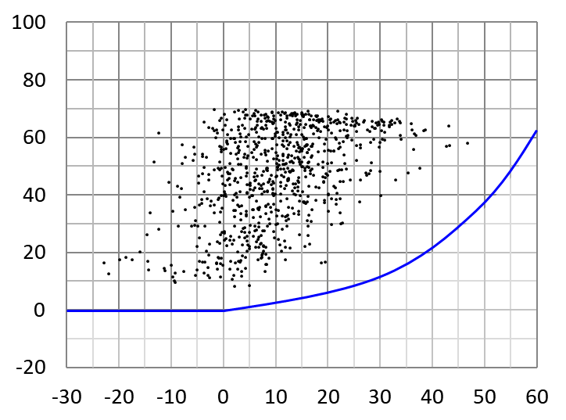
Actual traffic observation data of Cutting-in
There were no cut-in maneuvers observed at a cut-in distance below 5m.
Industry propose to introduce a lower cut-in threshold of 5m distance between the two vehicles.
Longitudinal distance[m]
Relative velocity [m/s]
（Ego-Leading vehicle）

Slide 6
Alternative proposal for definition of avoidance criteria for cut-in situation:
5.2.5.2. The activated system shall detect the risk of an imminent collision with a suddenly cutting in vehicle and avoid a collision,
provided the cutting in vehicle maintains its longitudinal speed and
When the distance between the vehicle’s front and the cutting in road user’s rear at the point in time when the outside edge of the respective front tyre of the intruding vehicle has crossed the inner edge of the lane marking of the ego lane by at least 30 cm is at least 5m.
when the distance between the vehicle’s front and the cutting in road user’s rear corresponds to a TTC calculated by the following equation:
𝑇𝑇𝐶𝐿𝑎𝑛𝑒𝐼𝑛𝑡𝑟𝑢𝑠𝑖𝑜𝑛 > 𝑣𝑟𝑒𝑙/(2∙6m/s²)+[1,1𝑠]
Where:
vrel = relative velocity between both vehicles, positive for vehicle being faster than the cutting in vehicle
TTCLaneIntrusion = The time-to-collision value when the outside edge of the respective front tyre of the intruding vehicle has crossed the inner edge of the lane marking of the ego lane by at least 30 cm.

