Slide 1
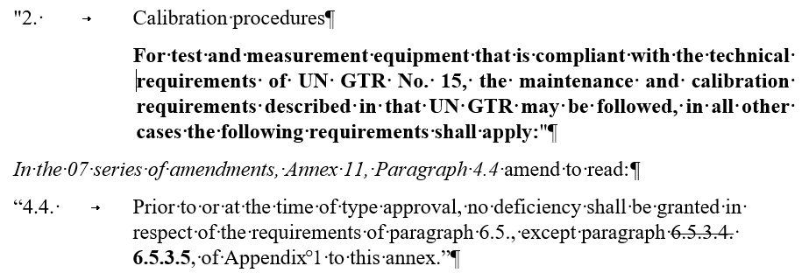
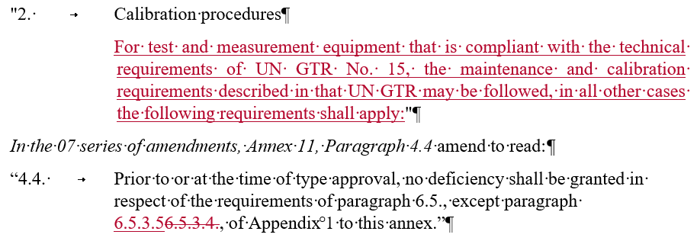
Working Party on Pollution and Energy (GRPE) General information
Note by the secretariat
Informal document GRPE-81-25
81st GRPE, 9-11 June 2020
Agenda item 1
Participants/Address list
Based on registrations to the session, a provisional list of participants has been prepared; It will be crossed checked with the persons connected.
At the end of the session, we will circulate the list of participants by email.
Next session
The next (82nd) session will be held on 12-15 January 2021, TBC
Proper session starting on Wednesday 13 June, 2.30 pm
The deadline for the submission of official working documents is 20 October 2020, TBC
Request from the Secretariat
All proposal for amendments should be submitted in track changes instead of Bold/strikethrough
Aim is to save preparation and processing time for stakeholders and secretariat (eg GRPE-81-21)

