Slide 1
Transmitted by the Chair and Secretary of VIAQ
Informal document GRPE-80-23
80th GRPE, 14-17 January 2020
Agenda item 12
Status Report of the
VIAQ (Vehicle Interior Air Quality)
Informal Working Group
Geneva, January 14-17th 2020
Chair: Andrey KOZLOV, Russian Federation
Co-Chair: Jongsoon LIM, The Republic of Korea
Secretary: Andreas WEHRMEIER, BMW

Slide 2
Background
During 173rd WP.29 session in Geneva (14-17 November 2017) Proposal for a new Mutual Resolution (M.R.3) for of the 1958 and the 1998 Agreements concerning Vehicle Interior Air Quality (VIAQ) was adopted (ECE/TRANS/WP.29/2017/136).
Final text of Mutual Resolution M.R.3 was published at UNECE site on 1 of November 2018 as the document ECE/TRANS/WP.29/1143
Notes:
2

Slide 3
ToR for the Second Stage
Terms of reference
Identify and collect the information and research data on interior air quality and its relevance for vehicles, taking into account the activities being carried out by various governments, and non-governmental organizations.
Identify and understand the current regulatory requirements with respect to vehicle interior air quality in different markets.
Identify, review and assess existing test procedures suitable for the measurement of harmful substance into the vehicle cabin (including test modes, sample collection methods and analysis methods, etc.)
Develop provisions and test procedures in a recommendation by including Part 3 in the Mutual Resolution No. 3.
Notes:
3

Slide 4
ToR for the Second Stage
Timeline
2018 2019 2020
1 2 3 4 5 6 7 8 9 10 11 12 1 2 3 4 5 6 7 8 9 10 11 12 1 2 3 4 5 6 7 8 9 10 11 12
WP.29
GRPE
VIAQ
180
181
182
76
77
78
79
80
81
VIAQ Madate
Informal
document
formal
document
11
12
13
14
15
16
17
18
19
20
Half of working items almost closed
Make a drafting grup
Develop provisions and harmonized test procedures.
VIAQ recommendation (a new part of M.R.3)
January 2020: Submit the draft document to GRPE
June 2020: Adoption of the draft document by GRPE
November 2020: Adoption of the draft document by WP.29
Notes:
4

Slide 5
VIAQ IWG Meetings since the 79th GRPE sessions
17th VIAQ IWG Meeting
  Munich, Germany, November 6-7th 2019
  Two days
Notes:
5

Slide 6
Working Items
Vehicle Category
Test Vehicle age/millage
Substances to be Measured
Meteorological Conditions
General Test Conditions
Test Modes
HVAC Modes
Test Procedure
Measurement Methods
Sampling Points
Sampling Method
Test Protocol
Notes:
6

Slide 7
Draft of M.R.3 (Revision 1) on VIAQ
During last two years by Informal Working Group was developed new Revision 1 of Mutual Resolution 3 on Vehicle Interior Air Quality. The main updates in new Revision are
Updated the part I for technical rationale and justification taking into account emissions from tested vehicle entering to the cabin with exhaust gases
Updated the description of existing regulations and standards in part I
Added the part III describing the test procedure for emissions entering to the vehicle cabin with exhaust gases
Added 2 annexes describing Idle test setup and the form of the test report
NO changes in part II describing test procedure for emissions from interior materials are made.
Draft of Revision 1 of Mutual Resolution No. 3 is in the informal document GRPE-80-21
and with track changes in the informal document GRPE-80-22
Notes:
7

Slide 8
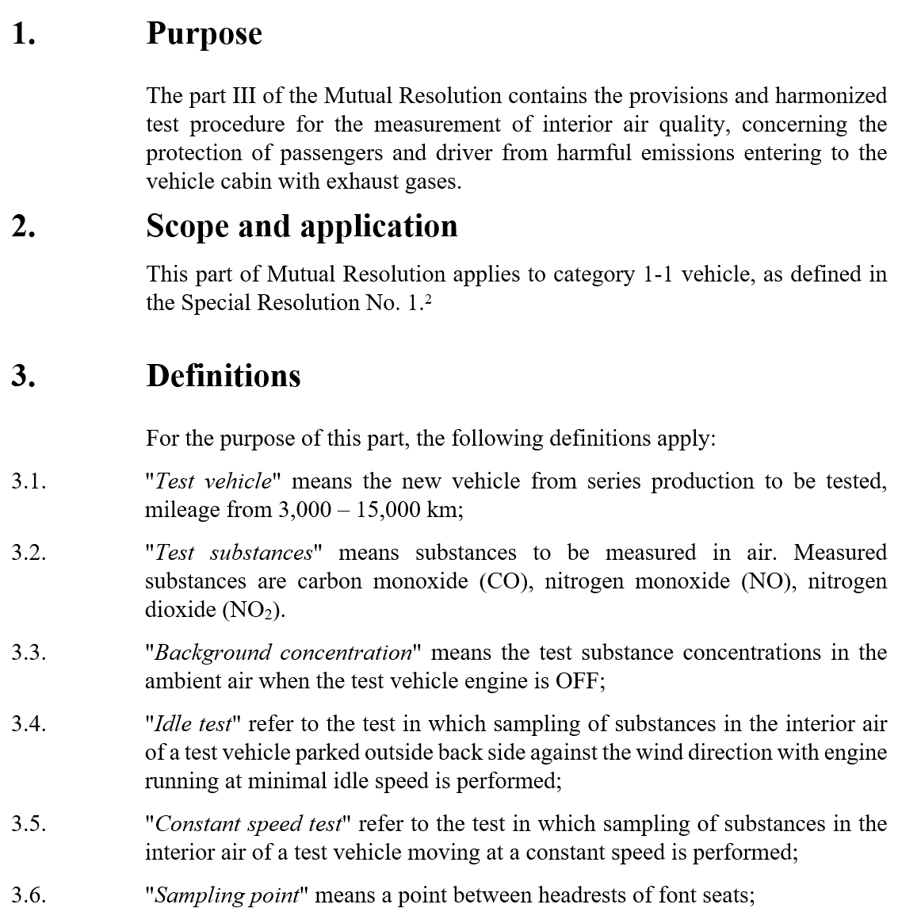
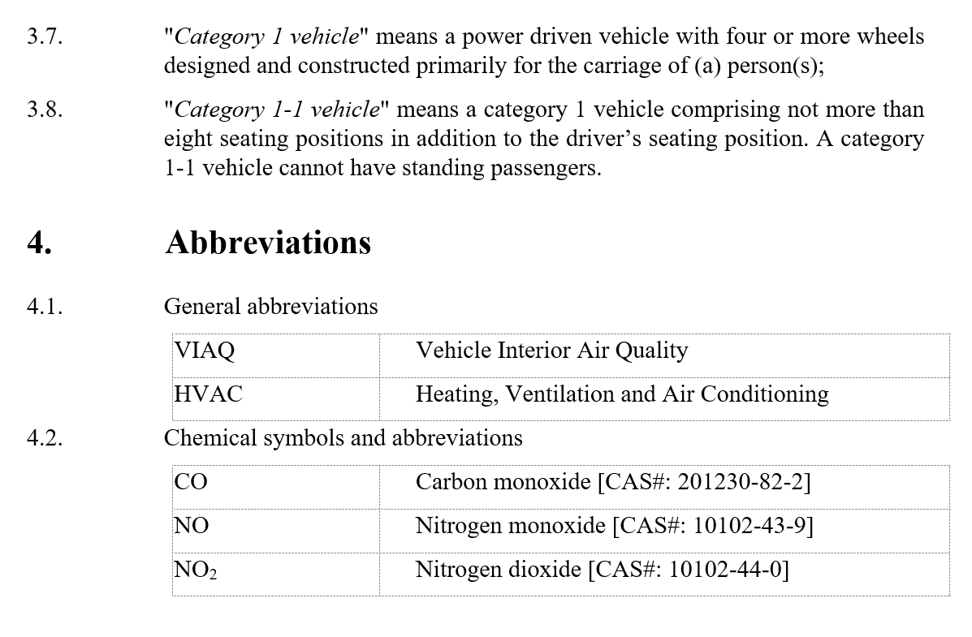
Part III of M.R.3 (Revision 1) on VIAQ
Notes:
8

Slide 9
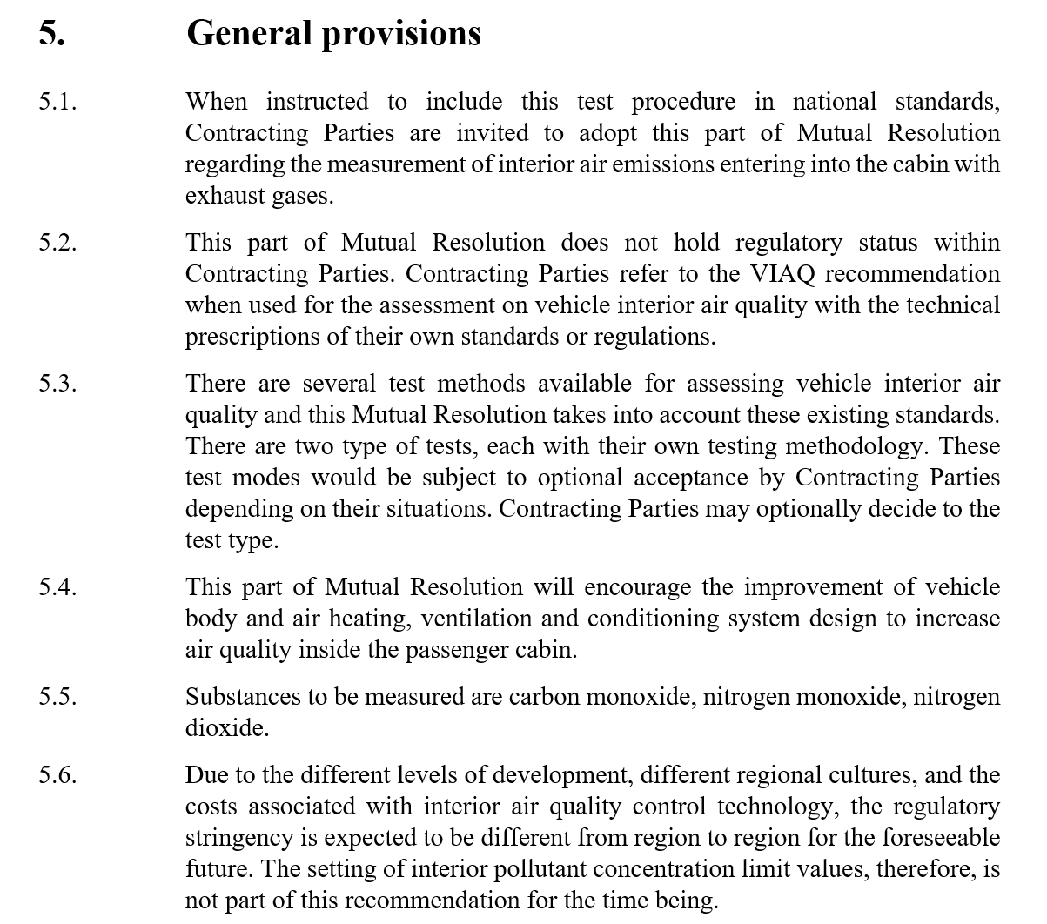
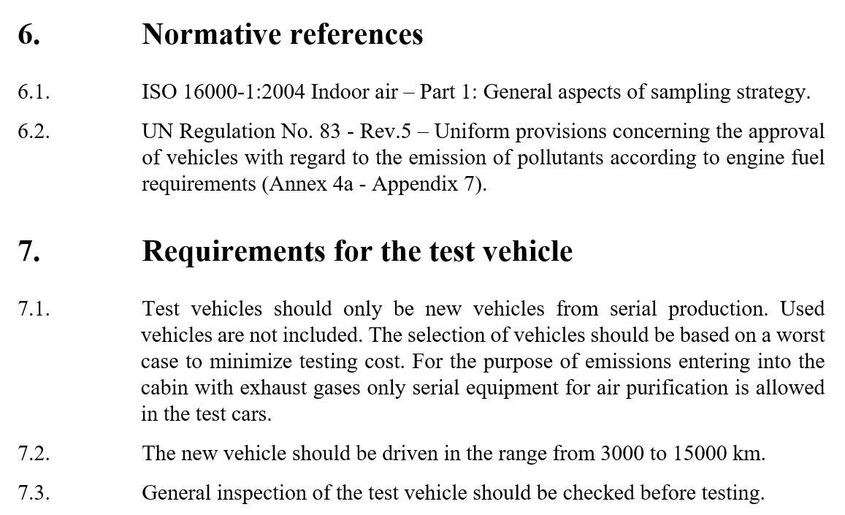
Part III of M.R.3 (Revision 1) on VIAQ
Notes:
9

Slide 10
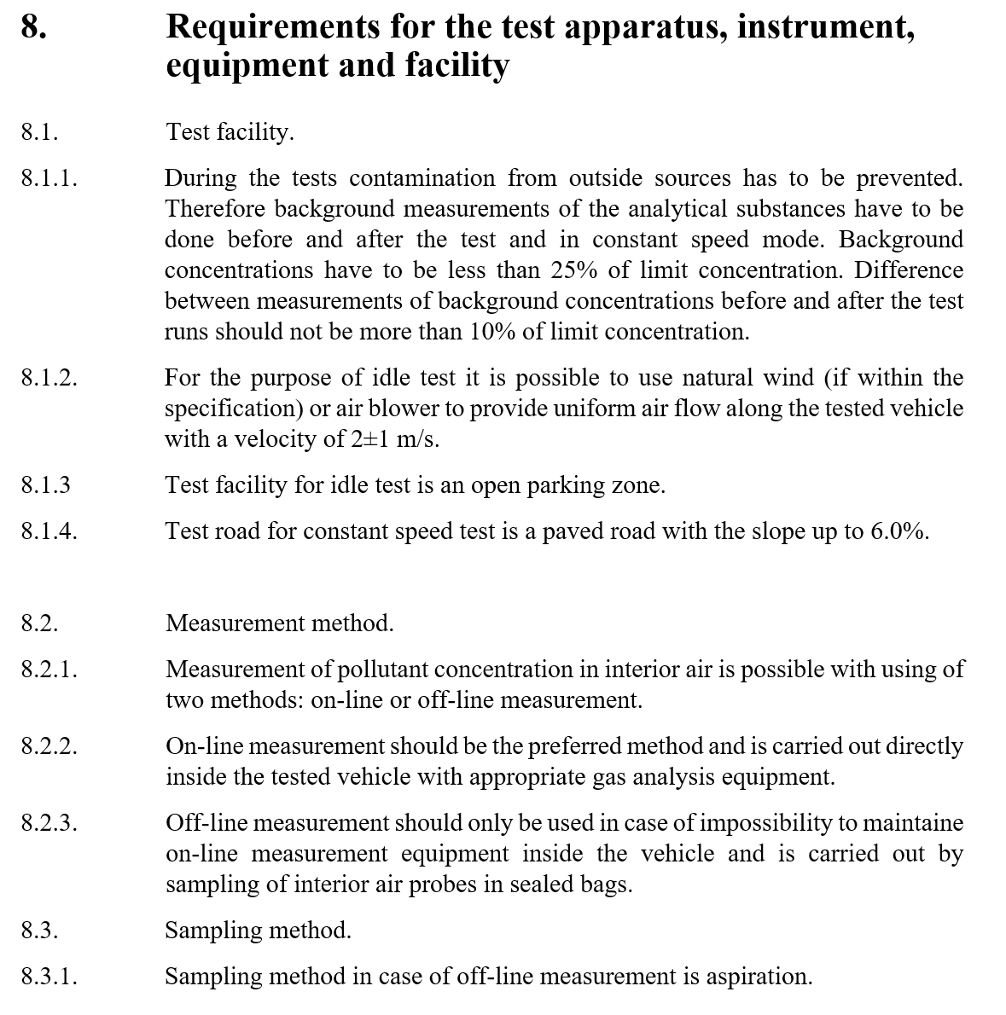
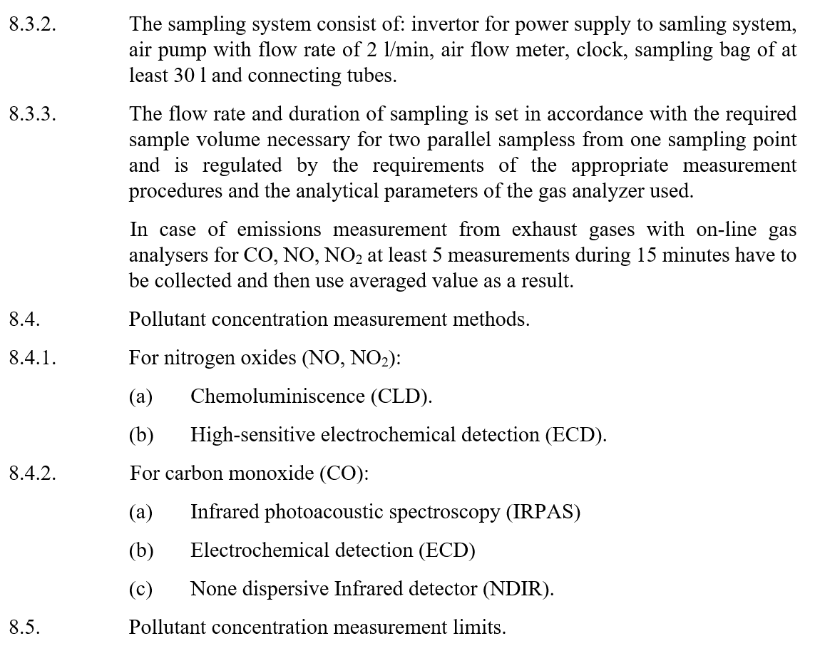
Part III of M.R.3 (Revision 1) on VIAQ
Notes:
10

Slide 11
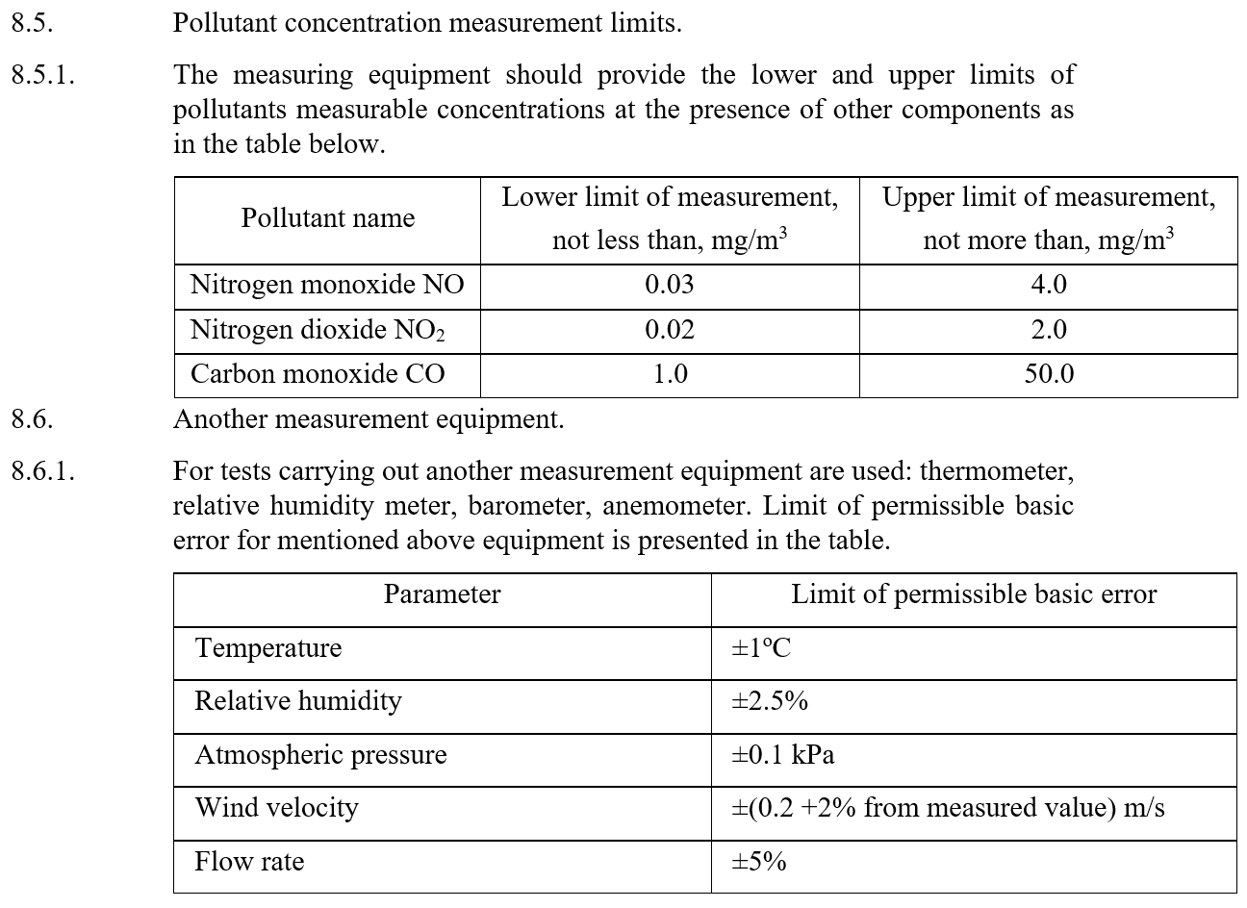
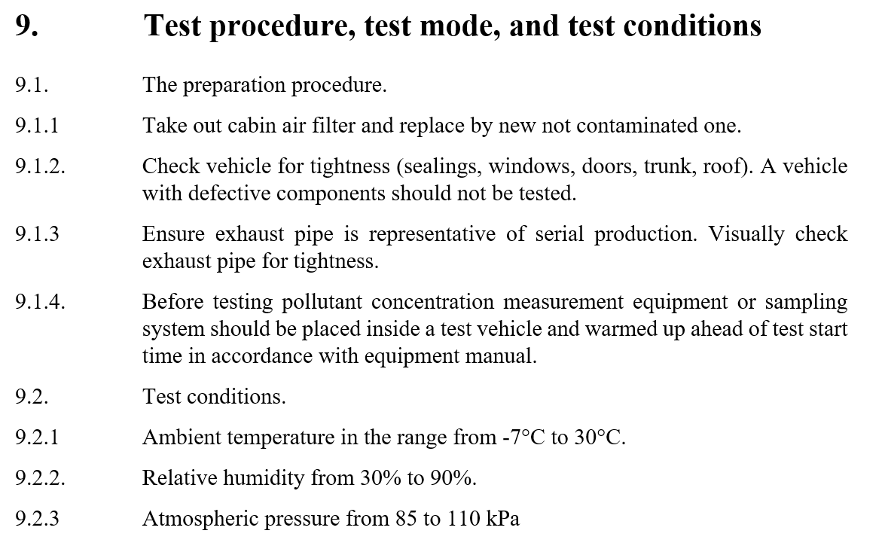
Part III of M.R.3 (Revision 1) on VIAQ
Notes:
11

Slide 12
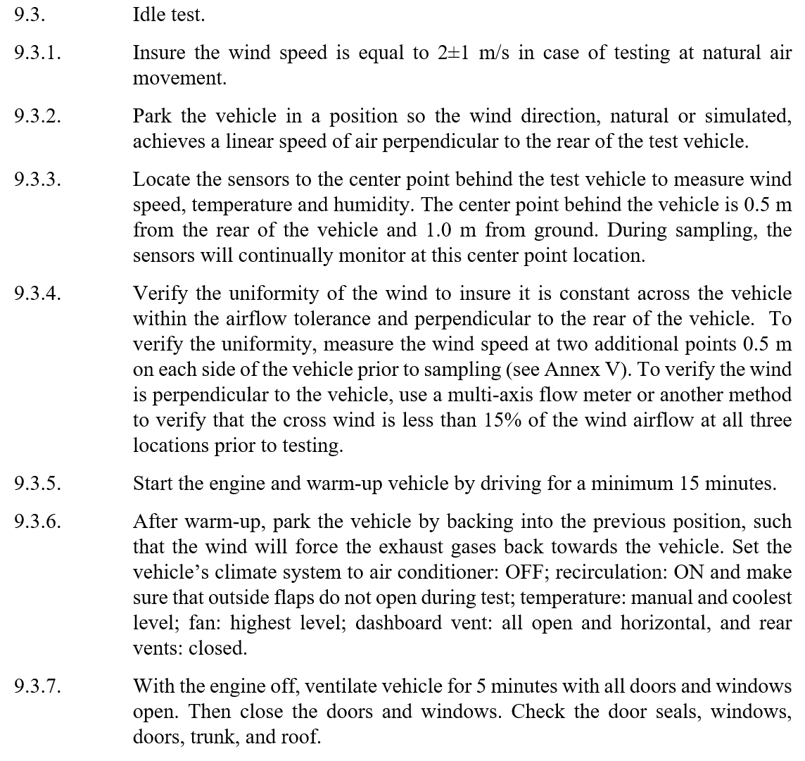
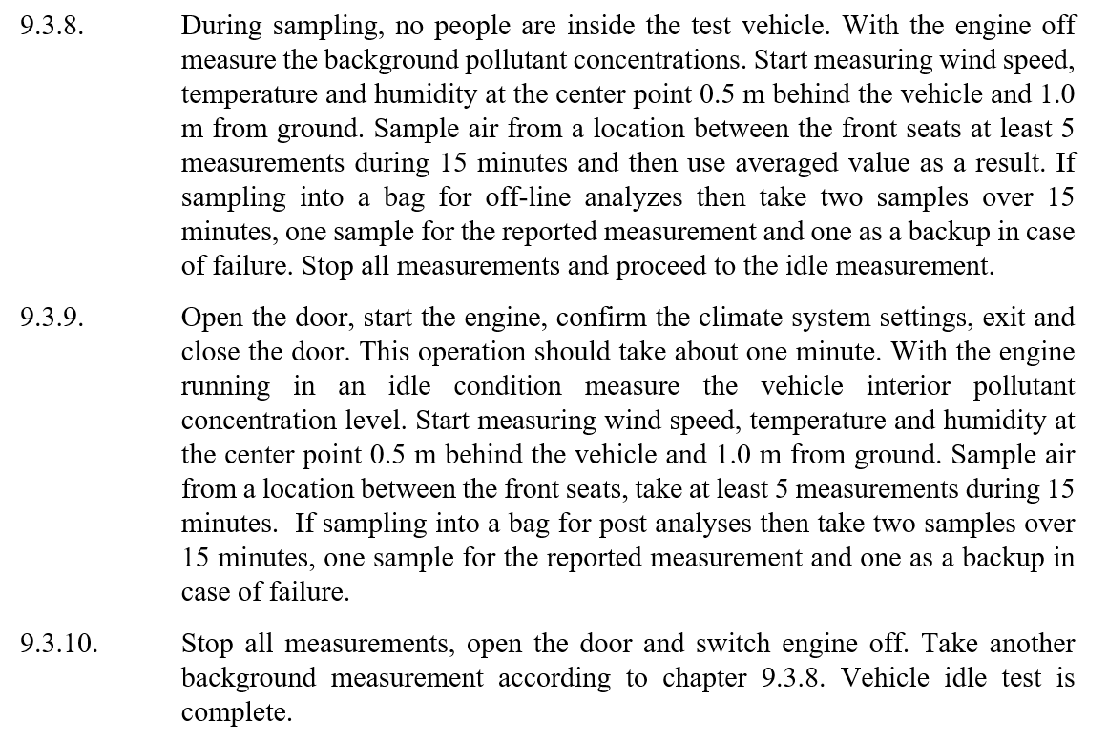
Part III of M.R.3 (Revision 1) on VIAQ
Notes:
12

Slide 13
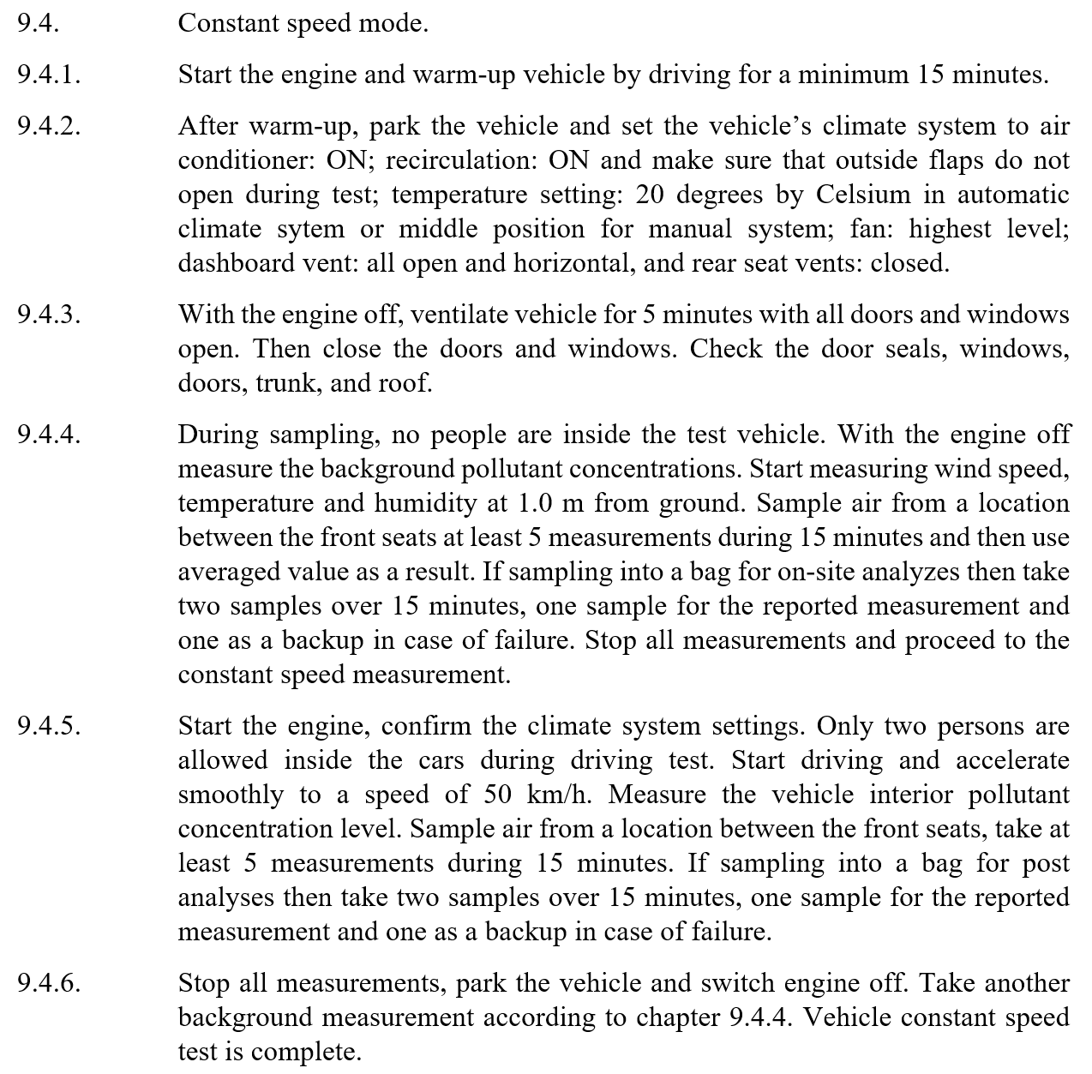
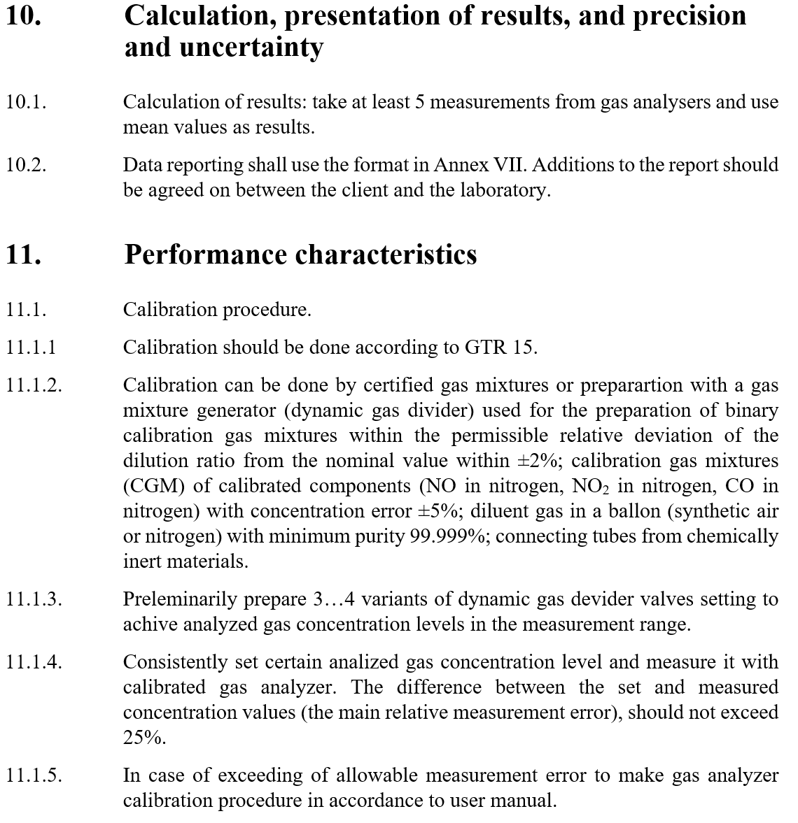
Part III of M.R.3 (Revision 1) on VIAQ
Notes:
13

Slide 14
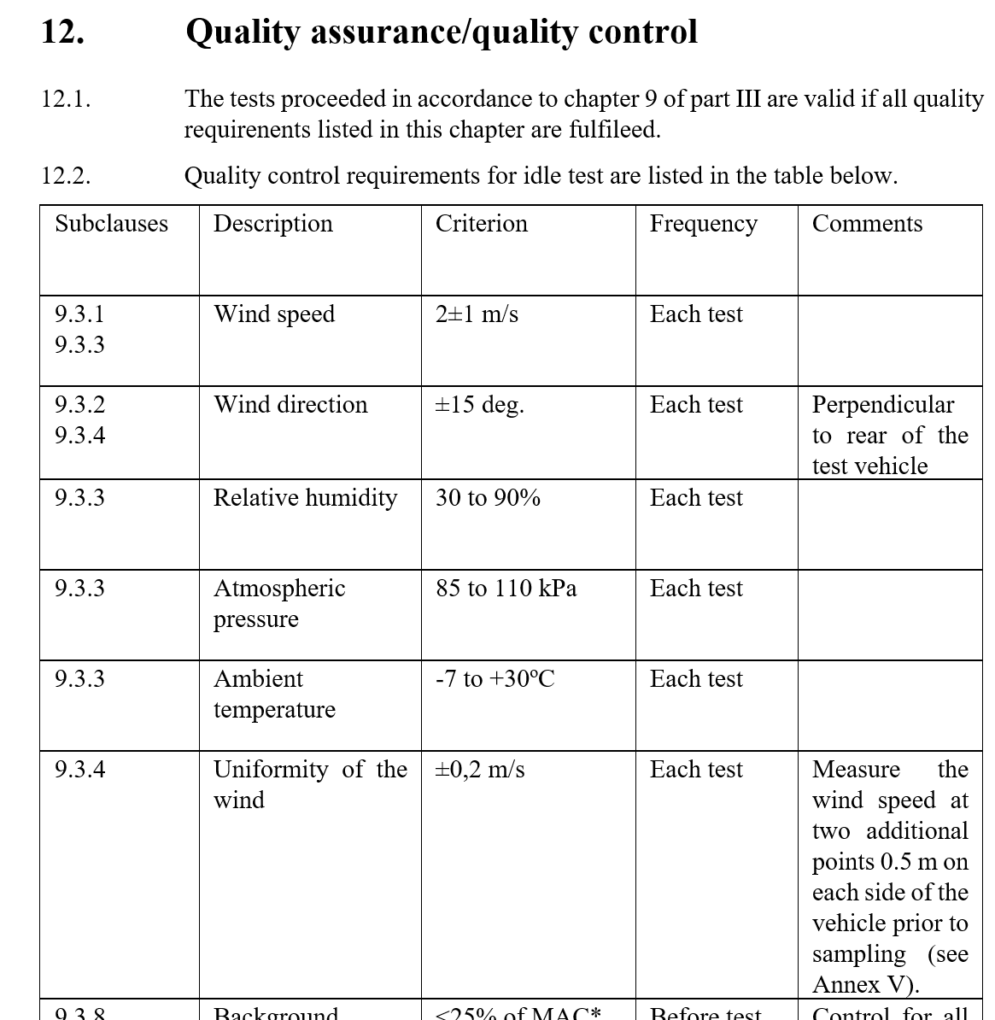
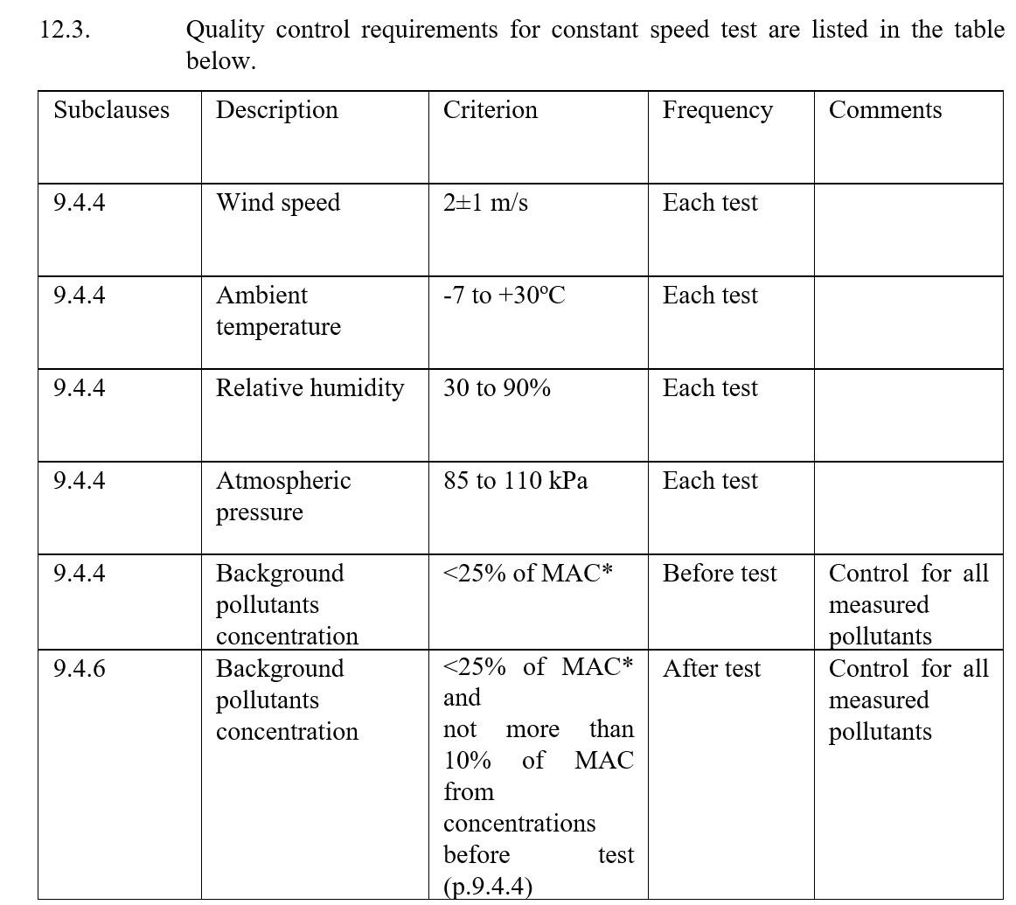
Part III of M.R.3 (Revision 1) on VIAQ
Notes:
14

Slide 15
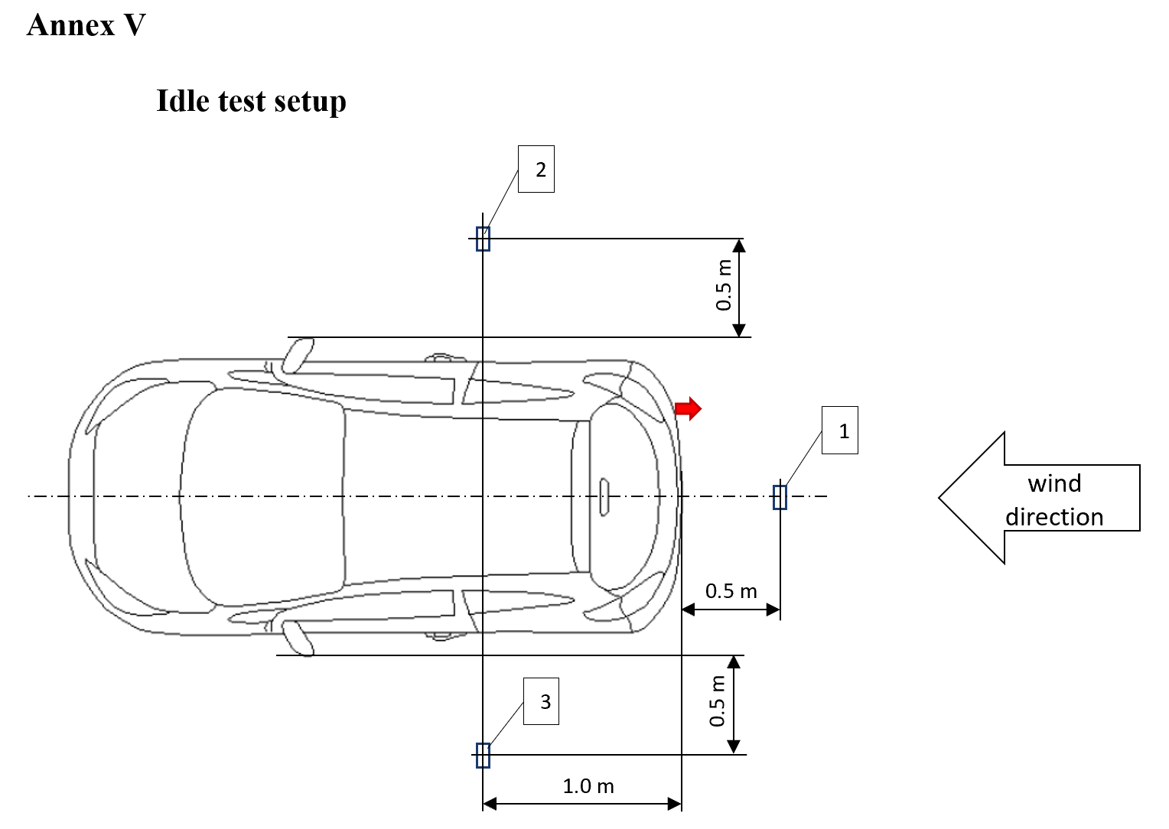
Part III of M.R.3 (Revision 1) on VIAQ
Notes:
15

Slide 16
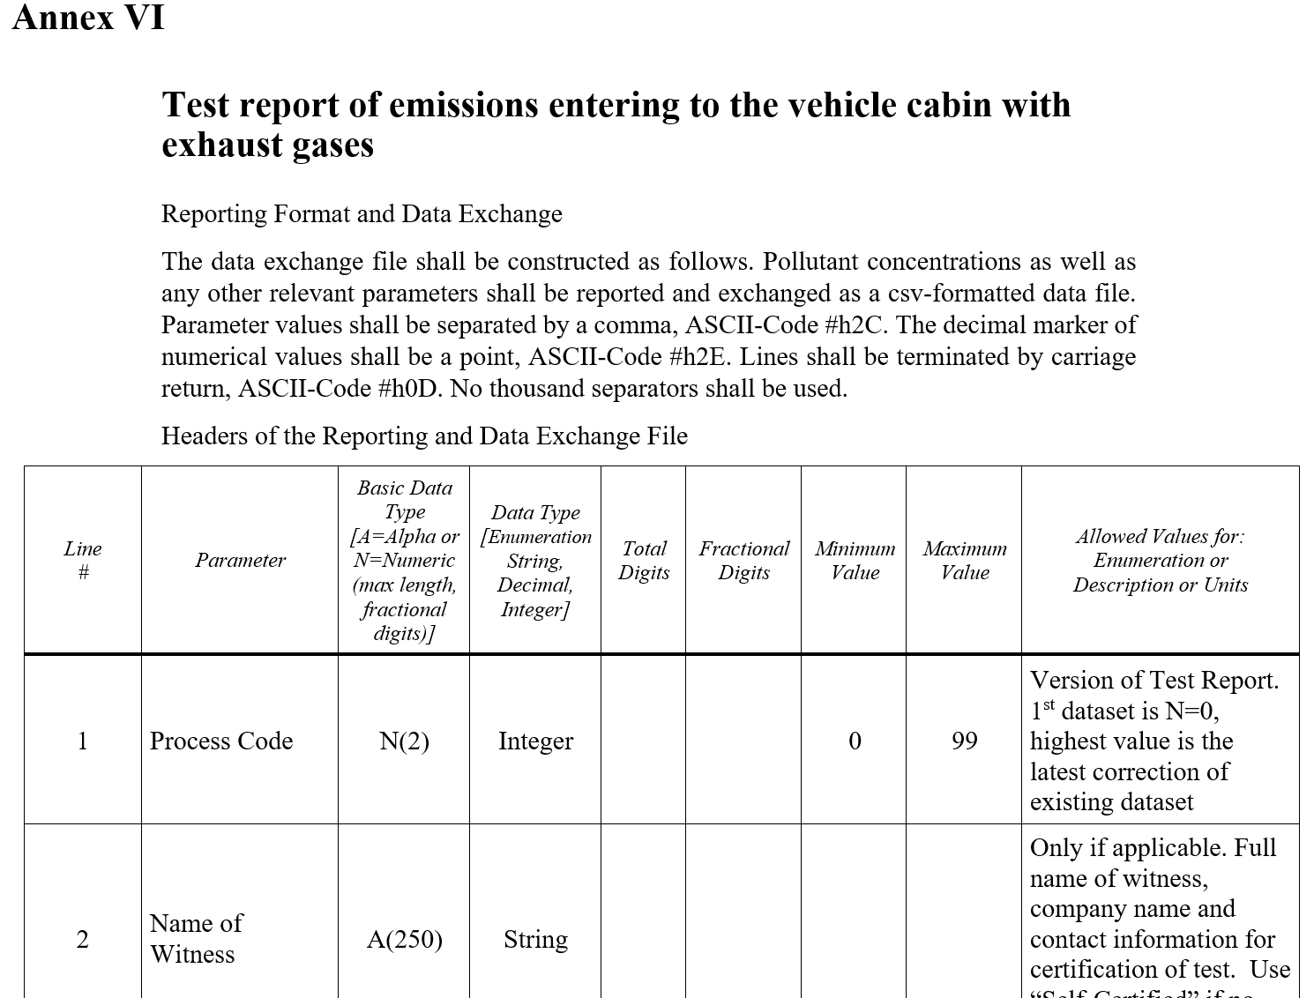
Part III of M.R.3 (Revision 1) on VIAQ
Notes:
16

Slide 17
Final Revision 1 of M.R.3
The final version of Revision 1 of Mutual Resolution (M.R.3) on Vehicle Interior Air Quality has to be submitted to 81th GRPE session not later than 17 of March 2020
Notes:
17

Slide 18
Next VIAQ IWG Meetings
19th VIAQ IWG Meeting (TBD)
  Paris, France, 9-10th March 2020
  Two days
20th VIAQ IWG Meeting (TBD)
  • Moscow, Russia, October 2020 (two days)
  or
  Brussels, Belgium, October 2020 (two days)
Notes:
18

