Slide 1
Informal document GRBP-71-26
Agenda item 5.d
Submitted by GRBP GOIE on 3PMSF
Justification for ECE/TRANS/WP.29/GRBP/2019/14
Technical rationale for the proposed requirements for the new category of tyres ‘Special use tyre that is classified as tyre for use in severe snow conditions’
GRBP January 29th 2020
European Tyre and Rim Technical Organisation

Slide 2
Background
Some countries require vehicles to be fitted with 3PMSF-approved tyres in winter season or in wintery conditions
In UN R 117 those tyres are qualified as “tyres for use in severe snow conditions”
Some specific vehicles are equipped with special use tyres, that currently cannot be approved as 3PMSF and therefore cannot be qualified for use in severe snow conditions
European Tyre and Rim Technical Organisation 2

Slide 3
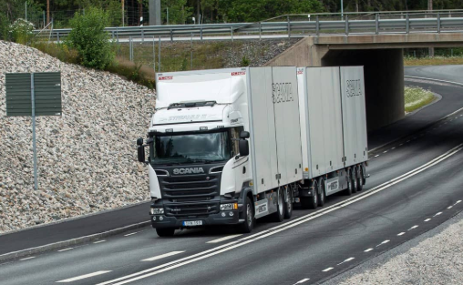
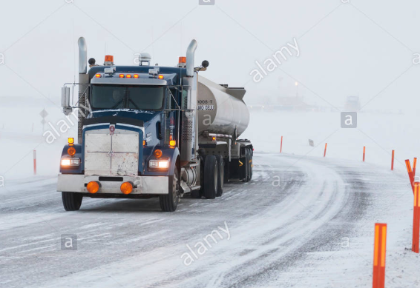
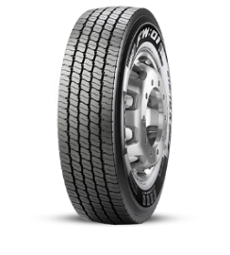
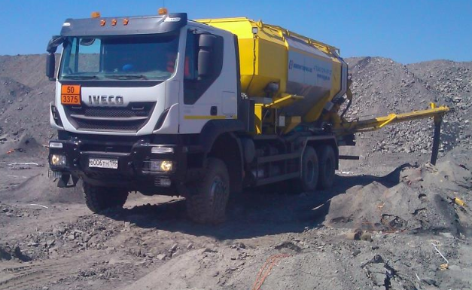
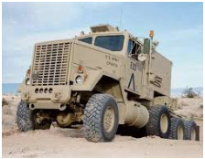
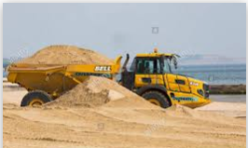
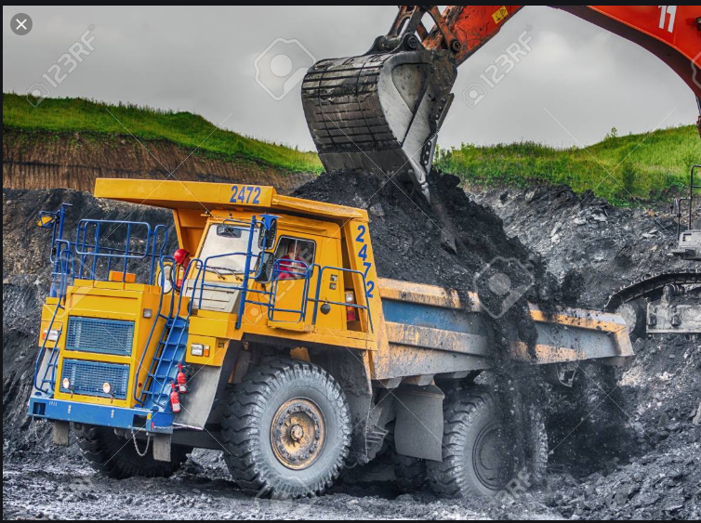
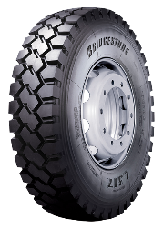
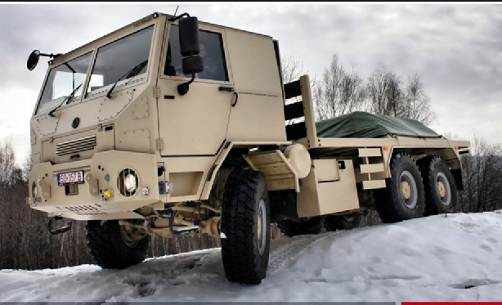
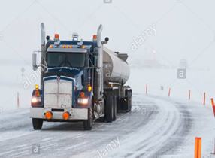
Different Uses
Normal
3PMSF
Special
Special
+ 3PMSF
?
European Tyre and Rim Technical Organisation 3

Slide 4
Objectives of ECE/TRANS/WP.29/GRBP/2019/14
Allow Special Use tyres to pass the qualification test in Annex 7 to UN R 117 and be approved to bear 3PMSF marking
Introduce specific allowances for special use + 3PMSF tyres taking into account existing allowances for existing 3PMSF approved tyres
European Tyre and Rim Technical Organisation 4

Slide 5
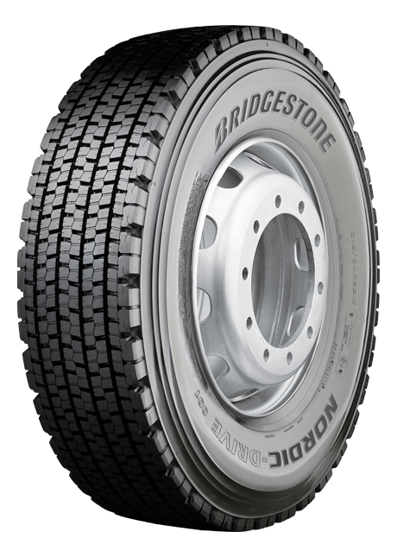
Correction of definition
Snow tyre for use in severe snow conditions
(3PMSF marked)
Special use tyre
Fusion
"2.13.1. "Snow tyre Tyre for use in severe snow conditions" means a snow tyre or a special use tyre whose tread pattern, tread compound or structure is specifically designed to be used in severe snow conditions and that fulfils the requirements of paragraph 6.4. of this Regulation."
European Tyre and Rim Technical Organisation 5

Slide 6
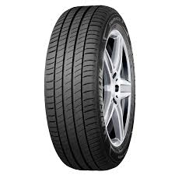
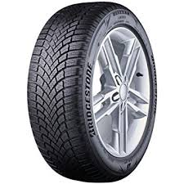
C2 & C3
Normal tyre
Snow tyre that is classified as tyre for use in severe snow conditions
Existing design differences to comply with 3PMSF
Tread pattern (more sipes and knife blades)
Tread compound
NEW: Special use tyre that is classified as tyre for use in severe snow condition
Special use tyre
?
Potential design differences needed to comply with 3PMSF
Tread pattern (sipes and knife blades)
Tread compound
Chip resistance + flexibility for snow conditions.
European Tyre and Rim Technical Organisation 6

Slide 7
GOIE Assumption
Specific allowances for special use + 3PMSF tyres should be the same as the existing allowances for existing 3PMSF approved tyres and special use tyres as the tread design of special use + 3PMSF tyres shall be adapted in order to comply with the already existing R117 Snow Performance threshold
European Tyre and Rim Technical Organisation 7

Slide 8
C2 R117 Regulatory Noise requirements
Normal tyre
Snow tyre that is classified as tyre for use in severe snow conditions
Stage 2
Category of use |  | Limit dB(A)
 |  | Other | Traction tyres
Normal tyre |  | 72 | 73
Stage 2
Category of use |  | Limit dB(A)
 |  | Other | Traction tyres
Snow tyre |  | 72 | 73
 | Snow tyre for use in severe snow conditions | 73 | 75
+1 dB(A) & +2 dB(A) Noise allowances that considered the specific 3PMSF tread pattern design
NEW: Special use tyre that is classified as tyre for use in severe snow condition
Special use tyre
Stage 2
Category of use |  | Limit dB(A)
 |  | Other | Traction tyres
Special use tyre |  | 74 | 75
 | Special use tyre that is classified as tyre for use in severe snow conditions | 75 | 77
The same +1 dB(A) & +2 dB(A) Noise allowances proposal to consider specific new tread pattern design
Stage 2
Category of use |  | Limit dB(A)
 |  | Other | Traction tyres
Special use tyre |  | 74 | 75
European Tyre and Rim Technical Organisation 8

Slide 9
C3 R117 Regulatory Noise requirements
Normal tyre
Snow tyre that is classified as tyre for use in severe snow conditions
Stage 2
Category of use |  | Limit dB(A)
 |  | Other | Traction tyres
Normal tyre |  | 73 | 75
Stage 2
Category of use |  | Limit dB(A)
 |  | Other | Traction tyres
Snow tyre |  | 73 | 75
 | Snow tyre for use in severe snow conditions | 74 | 76
+1 dB(A) Noise allowances that considered the specific 3PMSF tread pattern design
NEW: Special use tyre that is classified as tyre for use in severe snow condition
Special use tyre
Stage 2
Category of use |  | Limit dB(A)
 |  | Other | Traction tyres
Special use tyre |  | 75 | 77
Stage 2
Category of use |  | Limit dB(A)
 |  | Other | Traction tyres
Special use tyre |  | 75 | 77
 | Special use tyre that is classified as tyre for use in severe snow conditions | 76 | 78
The same +1 dB(A) Noise allowances proposal to consider specific new tread pattern design
European Tyre and Rim Technical Organisation 9

Slide 10
C1 R117 Regulatory Wet Grip requirements
Category of use |  | Wet grip index (G)
Normal tyre |  | ≥ 1.1
Snow tyre |  | ≥ 1.1
 | "Snow tyre that is classified as tyre for use in severe snow conditions" and with a speed symbol ("R" and above, including "H") indicating a maximum permissible speed greater than 160 km/h | ≥ 1.0
 | "Snow tyre that is classified as tyre for use in severe snow conditions" and with a speed symbol ("Q" or below, excluding "H") indicating a maximum permissible speed not greater than 160 km/h | ≥ 0.9
Special use tyre |  | Not defined
 | Special use tyre that is classified as tyre for use in severe snow conditions | Not defined
The same requirements
European Tyre and Rim Technical Organisation 10

Slide 11
C2 R117 Regulatory Wet Grip requirements
Category of use |  | Wet grip index (G)
 |  | Other | Traction tyres
Normal tyre |  | ≥ 0.95 | ≥ 0.85
Snow tyre |  | ≥ 0.95 | ≥ 0.85
 | Snow tyre that is classified as tyre for use in severe snow conditions | ≥ 0.85 | ≥ 0.85
Special use tyre |  | ≥ 0.85 | ≥ 0.85
 | Special use tyre that is classified as tyre for use in severe snow conditions | ≥ 0.85 | ≥ 0.85
The same requirements
European Tyre and Rim Technical Organisation 11

Slide 12
C3 R117 Regulatory Wet Grip requirements
Category of use |  | Wet grip index (G)
 |  | Other | Traction tyres
Normal tyre |  | ≥ 0.80 | ≥ 0.65
Snow tyre |  | ≥ 0.65 | ≥ 0.65
 | Snow tyre that is classified as tyre for use in severe snow conditions | ≥ 0.65 | ≥ 0.65
Special use tyre |  | ≥ 0.65 | ≥ 0.65
 | Special use tyre that is classified as tyre for use in severe snow conditions | ≥ 0.65 | ≥ 0.65
The same requirements
European Tyre and Rim Technical Organisation 12

Slide 13
R117 Regulatory Rolling Resistance requirements
Paragraph 6.3.1., last sentence, amend to read:
"For " tyres for use in severe snow conditions", the limits shall be increased by 1 N/kN."
Paragraph 6.3.2., last sentence, amend to read:
"For " tyres for use in severe snow conditions", the limits shall be increased by 1 N/kN."
The same requirements
European Tyre and Rim Technical Organisation 13

Slide 14
Thank you

