Slide 1
Report on Automated Vehicle activities
Informal document GRSG-116-46
(116th GRSG, 1-5 April 2019
Agenda item 18.)
GRSG-116
April 2019

Slide 2
Timeline
Sept 18
Jan 19
March 19
June 19
Sept 19
Jan 20
WP29-176
WP29-177
WP29-178
WP29-179
GRVA-01
GRVA-02
GRVA-03
GRVA-04
GRSG-115
GRSG-116
GRSG-117
Debates on
GRVA structure
GRVA priorities
Proposals to
Create new GRVA inf grs
One of them dedicated to the DSSAD
Allocate EDR to GRSG
Good communication between the GRs
WP29 to be the hub

Slide 3
State of play at GRVA
ALKS
Entry in and exit from the transition phase
Which support can the driver still have from the system when he overrides the ADS?
Which control to activate LKAS, which information on status?
DSSAD
VMAD
3-pillar approach
Audit? CEL?

Slide 4
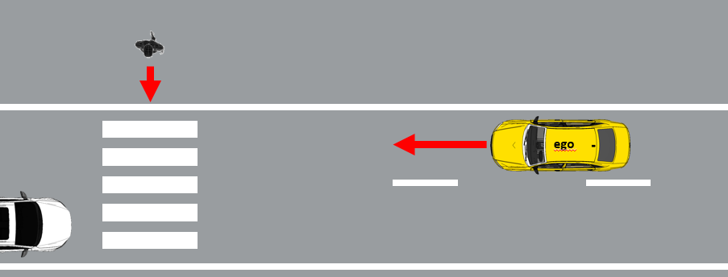
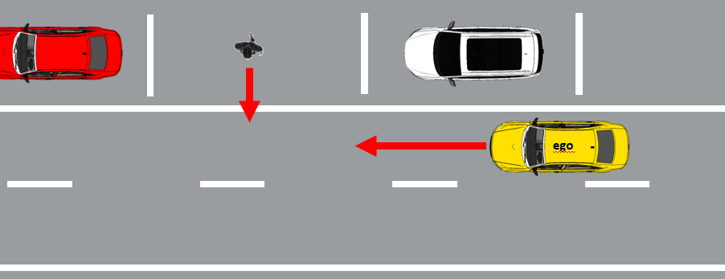
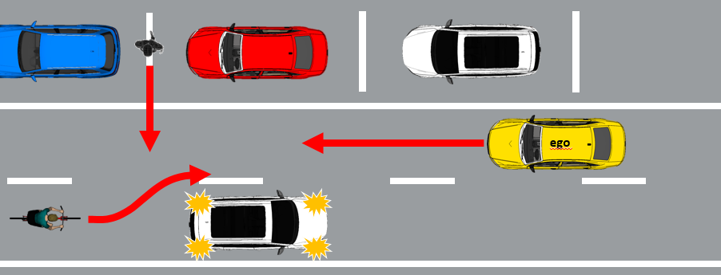
Examples for the different pillars’ functions
Typical traffic scenarios
Real World Test Drive
Pedestrian crossing a crosswalk
Critical traffic scenarios
Physical certification Tests
Scenario probability of occurrence in real world traffic
Obstructed pedestrian crossing
Edge case scenarios
Audit and Assessment (e.g. simulation)
low probability, but high efforts to identify and confirm performance!
Complexity/risk of scenario
Obstructed pedestrian crossing + cyclist overtaking

Slide 5
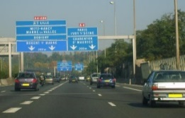
Concept for certification – the three pillars and their individual purpose
PILLAR 1
PILLAR 2
PILLAR 3
Audit/Assessment
Understand the system to be certified
Assess that the applied processes and design/test methods for the overall system development (HW and SW) are effective, complete and consistent
Assess system’s strategies/rest performance to address (multiple) fault-conditions and disturbances due to deteriorating external influences; vehicle behavior in variations of critical scenarios
Simulation: Test parameter variations (e.g. distances, speeds) of scenarios and edge-cases that are difficult to test entirely on a test track
Physical Certification Tests
Assess critical scenarios that are technically difficult for the system, have a high injury severity and are representative for real traffic
Compare with critical test cases derived from simulation and validate simulation tools
Real World Test Drive
Assess the overall system capabilities and behavior in non-simulated traffic on public roads and show that the system has not been optimized on specific test scenarios
Assess system safety requirements like e.g. HMI and ODD
Assess that the system achieves a performance comparable to an experienced driver
Simulation

Slide 6
State of play at WP1
Important for GRSG in particular for HMI
Adoption of a Resolution addressing the conditionally and the highly automated vehicles
Ongoing discussions:
What “other activities than driving” may the driver undertake when the AD is engaged
Remote driving
Amendments to the Vienna Convention and the Geneva Convention.

Slide 7
Challenge facing the Automated Driving (AD)
Conventional vehicles
Technical Regulation frame
Road Traffic Regulation frame
Technique
HMI
Driver
Braking system
Steering system
…
Controls
Indicators
…
Tactical decisions
Strategic decisions

Slide 8
Challenge facing the Automated Driving (AD)
Automated vehicles
Road Traffic Regulation frame
Technical Regulation frame
Technique
AD System
HMI
Driver
Tactical decisions
Braking system
Steering system
…
Strategic decisions

Slide 9
Challenge facing the Automated Driving (AD)
Automated vehicles
Road Traffic Regulation frame
Technical Regulation frame
Technique
AD System
HMI
Driver
Tactical decisions
Braking system
Steering system
…
Strategic decisions
Requirements specific to automation

Slide 10
Thank you

