Slide 1
NUMBER OF VEHICLES IMPACTED
Transmitted by the experts from CLEPA
Informal document GRSG-116-34
(116th GRSG, 1-5 April 2019
Agenda item 3)
Comments on ECE/TRANS/WP.29/GRSG/2019/11
UN Regulation No. 26 (External projection for passenger cars)
1

Slide 2
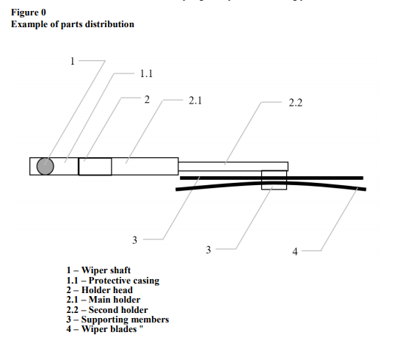
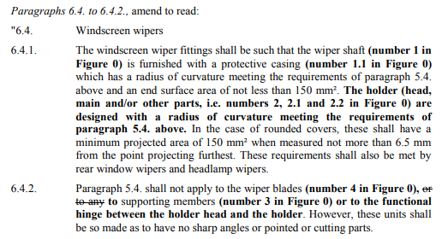
Proposals GRSG/2019/11

Slide 3
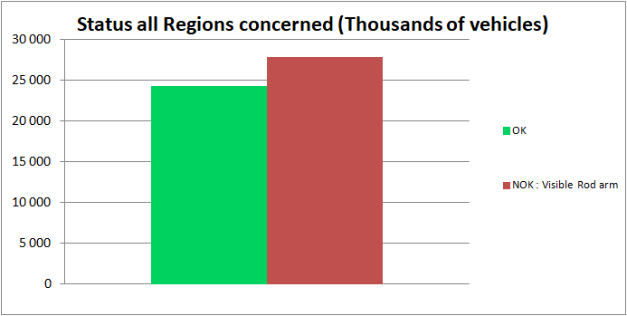
All Regions
W. Europe + E. Europe + Russia + Turkey + Japan + China
53% of vehicles are impacted by 2.5mm radius regulation change proposal
3

Slide 4
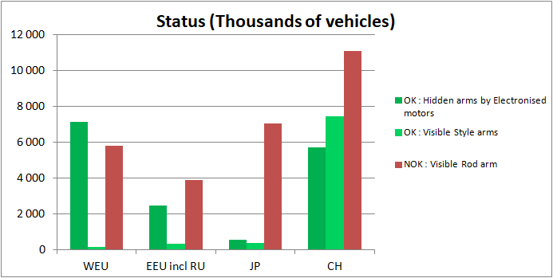
Results per Region
4

Slide 5
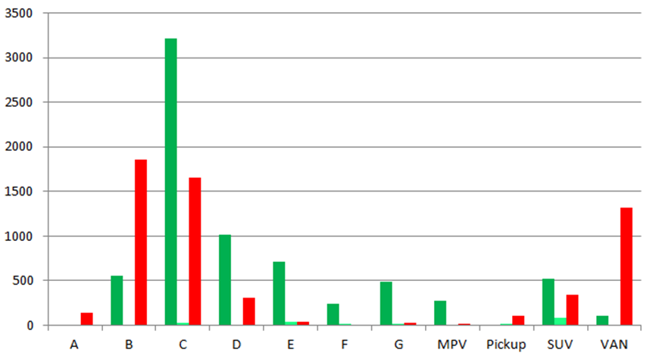
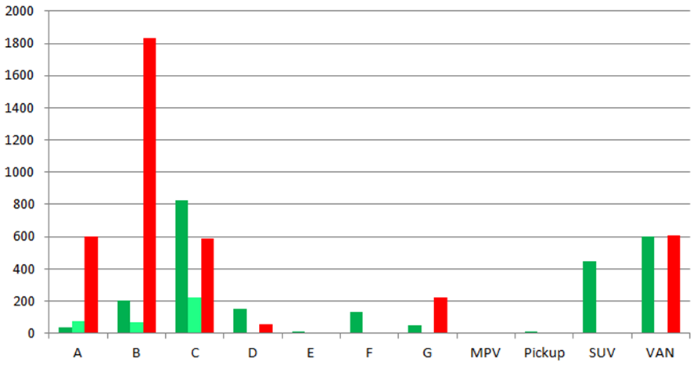
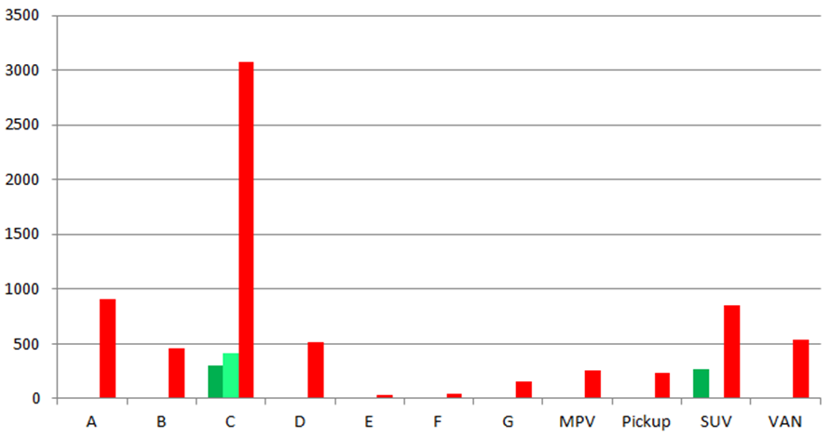
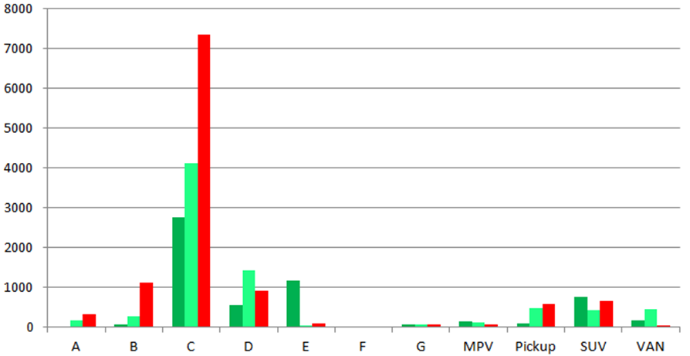
Results per Segments
1000 veh
1000 veh
W. Europe
E. Europe inc. Ru
1000 veh
1000 veh
Japan
China
5

Slide 6
Technical / economical impact
6

Slide 7
Summary of solutions
Solution | Weight Impact per vehicle | Price impact at Carmaker level Base 100 = wiper arm cost per vehicule | Reason for price impact
Put a complete cover on the rod arm | + 100g | 120 | Amortization of specific tooling per vehicle + overprice of part
Increase thickness of arm components | + 300g | 125 | Amortization of new processes and toolings and additional material for parts
Move from rod arm to style arm | + 200g | 130 | Amortization of specific tooling per vehicle + overprice of part
Move from Continuous motor to Reversible motor | - 250 g | 170 | Additional electronic Hardware and Software
7

