Slide 1
Electric Vehicles and the Environment (EVE IWG)
Submitted by the EVE informal working group
Informal document GRPE-78-30-Rev.1
78th GRPE, 10-11 January 2018
Agenda item 9
Report to GRPE 78th Session

Slide 2
Original Mandate & Current Status
Original mandate targeted establishment of a power determination GTR by AC.3 in the Global Registry in November 2019 with flexibility to extend by up to 1 year based on results of validation testing
Hybrid power determination
Developing GTR to determine system power of HEV and multi-motor PEVs, primarily for use with WLTP (downscaling, classification)
In-vehicle battery durability
Continuing research on EV battery performance and durability
Return to AC.3 with recommendation for next steps (if any), or conclusion of topic
Method of stating energy consumption
The Group of Experts on Energy Efficiency (GEEE) and the Cleaner Electricity Production (CEP) group were contacted to request that they assume leadership of the work with the support of the EVE IWG as needed
The CEP group has shown interest but the EVE IWG is waiting for further response

Slide 3
Revised Mandate
In November 2019, AC.3 authorized the drafting group working on developing the procedure to determine the electrified vehicle power to develop a standalone UN GTR.
Previous assumption had been an annex to GTR No. 15
The Chair of GRPE announced that the secretariat would prepare a working document to request authorization to develop a new UN GTR for consideration by AC.3 at its March 2019 session.
AC.3 also requested to confirm that working document firstly by GRPE at its January 2019 session.

Slide 4
Summary of January 2019 Deliverables in Mandate
Draft of Hybrid Power Determination GTR
Validation testing has been completed according to schedule
Due to the test results there are concerns arising whether the EVE IWG will be able to meet the original November 2019 deadline (See slide 8)
A first draft on the status of the Battery Durability research work and proposals for subsequent work if appropriate (including GTR development recommendation)
Modelling & testing work not complete, but progressing well
Not close to consensus on whether a durability GTR is appropriate
Report on status of work on method of stating energy consumption
Draft status report is available

Slide 5
Timelines for in-vehicle battery durability
Quote below from original mandate
(ii) November 2016 - June 2018:
a. EVE continues research on battery performance
EVE develops a detailed workplan and drafts request for relevant activities (including gtr development);
b. EVE continues consultation with the WLTP, including the WLTP-E-Lab sub-group and WLTP co-sponsors (Japan and the European Commission) as well as the EPPR IWG.
(iii) June 2018: →previously adjusted to January 2019
a. EVE IWG presents a first draft on the status of research work and proposal(s) for subsequent work (if appropriate) to GRPE;
b. EVE IWG presents informal documents on the status of research work and proposal(s) for subsequent work (if appropriate) for review by AC.3.
iv) November 2018: Approval of the authorization to develop a gtr by AC.3, if appropriate;

Slide 6
Timelines for Method of Stating Energy Consumption
Quote below from original mandate
(i) November 2016:
Approval to approach the Group of Experts on Energy Efficiency (GEEE), and possibly UNECE Executive Secretary about continuing work on the method of stating energy consumption;
(ii) November 2016 - June 2018:
EVE supports work of GEEE or another group on method of stating energy consumption as needed;
(iii) June 2018: → Previously adjusted to January 2019
a. Report status of work on method of stating energy consumption to GRPE;
b. Report status of work on method of stating energy consumption to AC.3.

Slide 7
Timelines on Hybrid Power Determination
Quote below from original mandate
(a) Determining the powertrain performance
November 2016: Approval of the authorization to develop an amendment to GTR No. 15 by AC.3
June 2018: Draft GTR available, guidance on any open issues by GRPE;
June 2018-January 2019: Final drafting work on gtr text;
January 2019:
a. Endorsement of the draft gtr based on an informal document by GRPE;
b. Transmission of the draft gtr as an official document twelve weeks before the June 2019 session of GRPE
June 2019 Recommendation of the draft gtr by GRPE;
November 2019: establishment of the gtr by AC.3 in the Global Registry

Slide 8
Hybrid Power Determination Concerns
The ongoing “Validation Program” will influence on the schedule planned in the current ToR.
The following concerns affect the timeline:
The decision to draft a separate GTR instead of an annexed GTR as decided at the November 2018 AC. 3 meeting
This process may lengthen the drafting time
Discrepancy in validation testing results at this time are requiring further discussion as to their cause
Test procedure would have to be redefined for more robust results
Longer drafting time is needed to ensure that the GTR draft is not causing discrepancies in the testing results

Slide 9
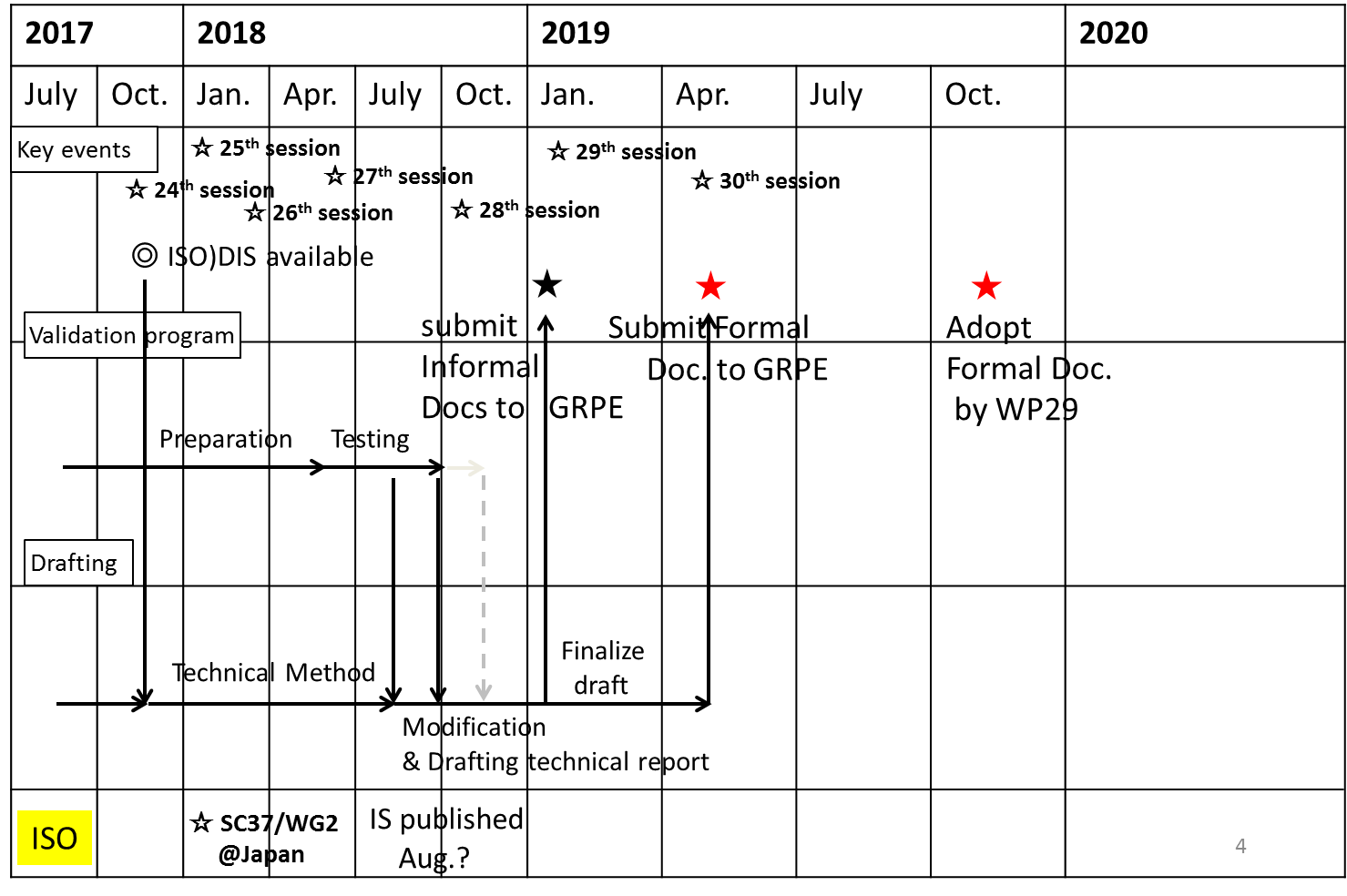
Original Planned Schedule for Hybrid Power Determination

Slide 10
Deliverables for Hybrid Power Determination
At this time, not all contracting parties are available to agree to the suggested change in schedule
Current circumstances of the validation test results indicate that an extension of at least one year could be required to create a more robust procedure
At the next GRPE the EVE IWG will propose a detailed schedule

Slide 11
Update on Status Report
At the previous GRPE meeting, it was agreed to combine the deliverables for the status reports on in-vehicle battery durability and Method of Stating Energy Consumption along with the deliverables for Hybrid Power Determination
A draft status report has been made available at this time (EVE-29-03-Rev1.pdf) https://wiki.unece.org/display/trans/EVE+29th+session
Due to the unavailability of the U.S. contracting party at this time, a final status report version will be sent and posted upon meeting with the U.S. via teleconference at the earliest available time before the next GRPE meeting in May

Slide 12
Next Steps for Hybrid Power Determination
Initial plan for GTR development included:
Reference Method, validated by vehicle testing
Candidate Method, which would allow certification based on component data
Candidate Method would only be developed if testing and analysis showed good correlation to the Reference Method
Current work is focused on development of the Reference Method
Candidate Method has not shown good prospect for being developed at this stage and is not being pursued
EVE has continued close collaboration with WLTP, to ensure procedure and timelines meet WLTP needs

Slide 13
Next Steps for Hybrid Power Determination
Initial draft posted on shared site of Drafting Group on 23 May 2018
Many open issues identified, including validation needs
Validation testing program results discussions
JRC-OICA, Canada, U.S.A and Korea have presented results at the 28th EVE meeting in Ottawa in October, 2018
The EVE IWG continues discussion of the results and GTR drafting to address relevant concerns

Slide 14
Next Steps For Electrified Vehicle Durability
Recent work included development of a parametrized simulation model (JRC lead) validated by on-road testing (Canada lead)
Parameters include cell chemistry, battery architecture, battery reserve capacity, driving activity, vehicle architecture, charging power, charging frequency
EVE IWG continues to cooperate with WLTP SG-EV to consider vehicle level durability requirements
Final recommendation to AC.3 (likely in 2019) may include a recommendation to seek authorization for relevant additional activities such as GTR development, continue research, concluding the topic or another alternative

Slide 15
Next Steps For In-Vehicle Battery Durability
Contracting parties to provide views on the urgency of creating a durability procedure for electrified vehicles if a durability procedure is required
EVE IWG members have discussed different views on air pollutant, CO2/Electric Consumption and range for a durability requirements
EVE has identified potential solutions, however, considerable work still needs to be done

Slide 16
Next Steps for Method of Stating Energy Consumption
At conclusion of previous mandate, EVE noted that further improvement of EVE’s models to assess energy consumption of electrified vehicles would require the work of experts in electricity generation and distribution
On 01-Nov-2017, EVE Secretariat presented via WebEx to the Group of Experts on Energy Efficiency (GEEE) to request that they assume leadership of the topic, with the support of the EVE IWG as needed
GEEE was receptive to the idea, but ultimately did not pursue work further

Slide 17
Next Steps for Method of Stating Energy Consumption
On the 27th of September, 2018, EVE Secretariat presented to the Cleaner Electricity Production Group (CEP) to request that they assume leadership of the topic, with the support of the EVE IWG as needed
Presentation is posted at EVE-28-15e https://wiki.unece.org/display/trans/EVE+28th+Session
Group of Experts on Cleaner Electricity Production (CEP) are still considering leadership of this work
No formal cooperation mechanism has yet been established
The EVE will continue to follow updates from the CEP on this topic at this time with support of GRPE Secretariat

Slide 18
Overall EVE Next Steps
Continue drafting of GTR for power determination
Continue discussion of GTR draft issues based on results of validation program on hybrid power determination
Prepare a new timeline for the next GRPE meeting
Improve and expand vehicle durability simulation and testing to validate the modeling
Prepare recommendation on next steps for in-vehicle battery durability (for eventual consideration by WP.29)
Establish a cooperation mechanism with CEP experts to support work on a method of stating energy consumption

Slide 19
EVE Meetings
Regular meetings concurrent with GRPE each January and June
10-11 April 2017 – Ann Arbor, USA
24-25 October 2017 – Vienna, Austria
27-28 March 2018 – Tokyo, Japan
16-18 October 2018 – Ottawa, Canada
8-9 April 2019 (Tentative) – Stockholm, Sweden
Fall 2019 – TBD

