Slide 1


ACEA - Tyre Performance Study
Noise VS other performances
Submitted by the experts of OICA
Informal Document GRBP-70-25
70thGRBP, September 11-13, 2019
Agenda item 13
12/09/2019 – GRBP, 70th

Slide 2

Content
Literature Study
Test Program
Statistical Analysis
Appendixes

Slide 3

1 - Literature Study

Slide 4
Reason for why the literature study was conducted
Is it possible to optimize Rolling Sound performance without compromising other parameters essential for vehicle safety and CO2 emission reduction ?
Do performance parameters, i.e. like
  Rolling Sound (coast-by) ➔ Health Protection
  Rolling Resistance ➔ Environmental Protection (CO₂ emission reduction)
  Wet Grip ➔ Safety (braking distance, handling)
…affect other performance parameters like
  Longitudinal and Lateral Aquaplaning
  Rolling Sound during Acceleration
  Dry Grip
  Dry Handling
  Wet Performance
  Wear Life

Slide 5
Significant studies which have been analysed
Journalistic Studies
  EVO103_LD (2015)
  Auto Express Studies (2018)
  Whichcar Wheels (2017)
European Research Organization Studies
  GRB-61-03 Study based on TNO 2014 R10735 report (12 June 2014)
  FEHRL – Study SI2,408210 Tyre/Road Noise (2007)
Internal Manufacturer Studies
  Noise Technology (Continental - 2011)
  Noise Trade-offs (Michelin - 2007)
  Tire-Road Noise (Goodyear - 2018)
  Noise (Michelin – 2015)
Technical University Studies
  Inter.noise_HAMBURG 2016
  Tyre modelling for rolling resistance (MASTER’S THESIS IN AUTOMOTIVE ENGINEERING) 2014

Slide 6
Analysis template
Framework
  Framework and goal of the studies
Content
  Description of the content and the parameters of the studies
Vehicle type
  Information about vehicles used for each tests
Tyre types, sizes and dimensions
  Description of the sample used for each tests
Tracks
  Description of the tracks used for each tests
Test methods
  Description of the tests methods used
  Description of the tests conditions
  Description of the tests equipment

Slide 7
Summary of all important information regarding measured parameters and test method used
Study | Wet-Grip | Longitudinal aquaplaning | Aquaplaning in curve | Dry-Grip | Handling | Snow Performance | Rolling Resistance | Rolling Sound | RS during acceleration | Wear
TNO R10735 report (2014) | EU Regulation EC1222/2009 | No Information | No Information | No Information | No Information | No Information | EU Regulation EC1222/2009 | - EU Regulation EC1222/2009 - VENOLIVA | - EU Regulation EC1222/2009 - VENOLIVA | No Information
FEHRL – Study (2007) | - ECE R117 - 80 to 10km/h ; water depth 1,5mm | - ECE R117 - Water depth 8 mm ; slip of 15% was reach | No Information | No Information | No Information | No Information | - ISO 8767:1992 or 9948:1992 - ISO 18 164 : 2005 | ECE R117 | No Information | No Information
Continental (2011) | No Information | No Information | No Information | No Information | No Information | No Information | No Information | ECE R117 | No Information | No Information
Michelin (2007 & 2015) | - 80 to 10 km/h - on macro rough surface | - Water depth 8mm - 82 to 66km/h | - Water depth 7mm - acceleration 55 to 85km/h | No Information | No Information | No Information | No Information | ISO 10 844 | No Information | No Information
GoodYear (2018) | No Information | No Information | No Information | No Information | No Information | No Information | No Information | - ISO 10 844 At 50km/h - ISO 3745 | No Information | No Information
Inter-noise HAMBURG (2016) | No Information | No Information | No Information | No Information | No Information | No Information | Trailer method | CPX method nowadays specified ISO/FDIS 11 819-2 | No Information | No Information
Tyre modelling for RR (2014) | No Information | No Information | No Information | No Information | No Information | No Information | No Information | No Information | No Information | No Information
EVO103_LD (2015) | No Information | No Information | No Information | No Information | No Information | No Information | No Information | No Information | No Information | No Information
Auto Express Studies (2018) | No Information | No Information | No Information | No Information | No Information | No Information | No Information | No Information | No Information | No Information
Whichcar Wheels (2017) | No Information | No Information | No Information | No Information | No Information | No Information | No Information | No Information | No Information | No Information
➔ No study has information in each cell

Slide 8
Conclusions
3 Tyre Manufacturers studies show antagonistic relationship between Noise and Safety (Aquaplaning, Wet Grip and Handling)
2 Tyre Manufacturers studies show relationship between Noise and Rolling Resistance
Test procedures or testing methods are disparate from one study to another
General agreement on the major role of road surface on the noise emission
Due to the purpose of the journalistic studies and the lack of technical information it is difficult to make a statement about the results
  The main goal of the journalistic studies is to rank a sample of tyres
  Test methods are not described precisely and are different from one study to another
  In some studies, repeatability conditions are questionable
  Test data are not provided
ACEA Tyre Performance Study aims at determining the inter-dependency between rolling sound, rolling resistance and the main safety performances by carrying out tests according to regulatory or standard procedures

Slide 9
Literature study
For detailed information, see Appendix 1

Slide 10
2 - Test Program

Slide 11

Test Program
Test sample
  16 different tyre references
    OEM x4
    After Market x12
  2 snow tyres (3PMSF) among the 16
  205 55 R16 91H, T, V or W
    Most common size on European after market
Tests Content
  Rolling Resistance
    Bench test
    RR Index
  Rolling Sound
    Vehicle test / VW GOLF 5 & NISSAN LEAF
    Noise level in different conditions
  Wet Grip
    Trailer method test on wet surface
    Wet Grip index
  Dry Grip
    Vehicle test / PEUGEOT 308
    Braking performance on dry surface
  Dry handling (Flat) Track
    Bench test
    Cornering stiffness
  Aquaplaning
    Vehicle test / PEUGEOT 308
    Aquaplaning speed and acceleration under aquaplaning condition

Slide 12
Test Programs
Test Methods
  Rolling Resistance : UN Regulation No.117 procedure
  Rolling Sound : UN Regulation No.117 procedure & UN Regulation No.R51.03
  Wet Grip : UN Regulation No.117 procedure
  Dry Grip : UN Regulation No.R13H procedure Type 0
  Dry handling (Flat Track): Procedure proposed by ETRTO
  Aquaplaning : VDA E08 Longitudinal Aquaplaning & VDA E05 Lateral Aquaplaning

Slide 13
Tests Program
Test Conditions
  Rolling Resistance
    UN Regulation No.117 procedure
    Test Speed (km/h): 80
    Load (kg): 482
    Tyre initial reference pressure (kPa) : 210
    Room temperature (°C) : 24<T°C<25
  Rolling Sound
    8 passes @ 50 & 80 kph according to UN Regulation No.117 procedure
    4 accelerations @ 50 kph & cruising according to UN Regulation No.R51.03 (Acceleration values close to @ 2,0 m/s²)
  Wet Grip
    UN Regulation No.117 procedure
    Test Speed (km/h): 65
    Water depth (mm) : 0,9
    Track texture depth (mm) : 1
    Load (kg) : 461
  Dry Grip
    UN Regulation No.R13H procedure Type 0
    Test speed (km/h) : 100
    Tyre pressure (kPa) :
      Unladen : 250 Front and 240 Rear
      Laden : 260 Front and 340 Rear
  Dry handling (Flat Track)
    Procedure proposed by ETRTO
    Test speed (km/h) : 80
    Test duration (min) : 20
  Aquaplaning
    VDA E08 Longitudinal Aquaplaning
    VDA E05 Lateral Aquaplaning

Slide 14
Tests Schedule
2 sets of tyres to avoid influence on each tests

Slide 15
3 - Statistical Analysis

Slide 16
Interdependence analysis
Results, Explanations & Interpretation

Slide 17
Results Table
*Tyre P is the reference tyre for dry Grip & Longitudinal Aquaplaning.

Slide 18
Spider Diagrams
The 4 best tyres for Safety
The 3 best tyres for Noise
10 : Defined by the best tyre of the sample
0 : Defined by the worst tyre of the sample
Good in Safety ➔ Less in Noise
Good in Rolling Sound ➔ Less in Aquaplaning

Slide 19
Spider Diagrams
The 3 best tyres for CO2
Good in Rolling Resistance
➔ Less in Handling and Aquaplaning

Slide 20
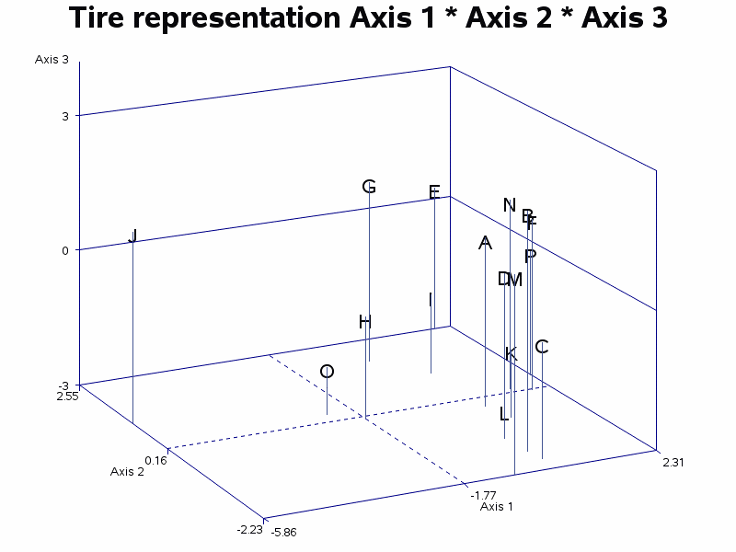
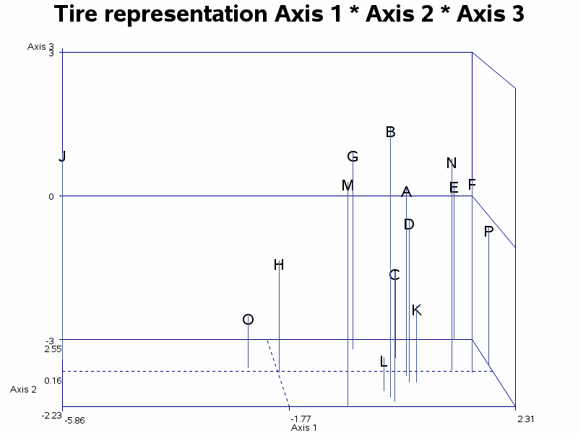
Toolbox
Principal Component Analysis (PCA)
  “Principal component analysis (PCA) is a statistical procedure that uses an orthogonal transformation to convert a set of observations of possibly correlated variables (entities each of which takes on various numerical values) into a set of values of linearly uncorrelated variables called principal components”. Wikipedia
  In our case it is used to reduce the number of input characteristics (rolling resistance, dry grip, wet grip and aquaplaning) from 8 to 3 to allow a 2D or 3D visualization
3D representation
Letters A to P correspond to the 16 tyres tested

Slide 21
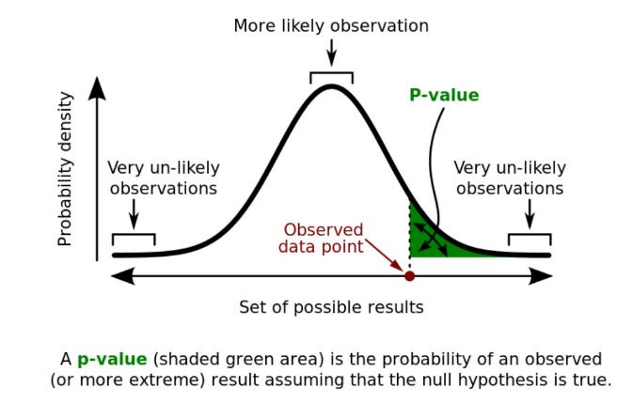
Toolbox
The P-value or probability value is, for a given statistical model, the probability that, when the null hypothesis is true, the statistical summary would be greater than or equal to the actual observed results. In our case the hypothesis is “there is no correlation between characteristics”. In other words, if p-value is low then our hypothesis is false and we can conclude that there is a correlation. The admitted threshold value is 5%.

Slide 22
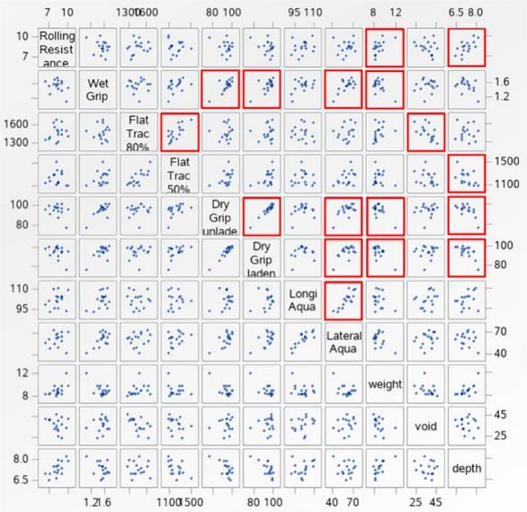
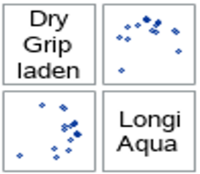
Toolbox
In the chart of scatterplots, Red boxes show strong probability of correlation (P-value <5%)
As the chart is symmetric, we just focus on the right part of it.
Test | Units
Rolling Resistance | RR Index
Wet Grip | WG Index
Flat Track | N/°
Dry Grip | %
Longitudinal Aquaplaning | %
Lateral Aquaplaning | m/s (integer)
Weight | Kg
Void Ratio | %
Tread Depth | mm
➔ This tool allows us to show direct relationship between the parameters
Without Rolling Sound

Slide 23
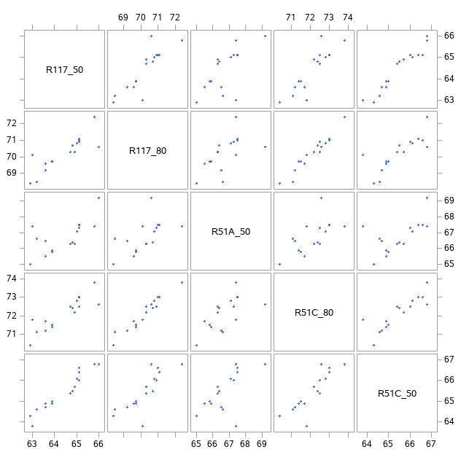
2D charts and Scatterplots for rolling sounds
Comparison between each Rolling Sound tests with P-value <1%
As the P-value is less than 1% we have a top level of probability of correlation
➔ We have the opportunity to state on the Rolling Sound performance only through one noise characteristics e. g. R117
dB

Slide 24
Rolling Sound tests correlation
The tyres are behaving differently depending on the sensitivity of each tyre to the test procedures used (R117, R51C and R51 A).
In general the shape of each “circle” shows a quite good correlation, better for R117 80 vs R51C 80 and R51A 50 vs R51C 50 than for R117 50 vs R51C 50.
Difference due to 2 different tests procedure : R51A 50 and R51C 50
Difference due to 2 different tests procedure : R117 50 and R51C 50
Difference due to 2 different tests procedure : R117 80 and R51C 80
This confirms that we can keep just one representative characteristic among the 5 : R117 80

Slide 25
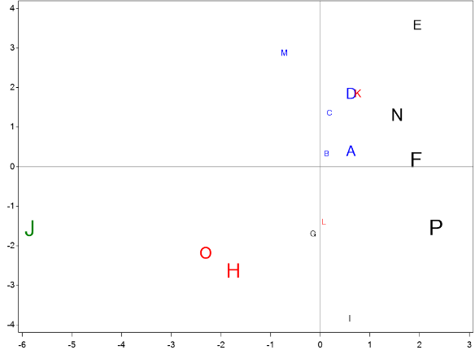
Representing Rolling Sound
5 characteristics for Rolling Sound (R117_50, R117_80, R51A_50, R51C_80 & R51C_50)
In results previously shown, measurements for R117_80 were used to represent Rolling Sound among the 5 characteristics. To be noted that an PCA on the 5 characteristics leads to a first axe explaining 84% of sound variability see next slides for details.
The chosen option is to keep just one representative characteristic among the 5 : R117 80

Slide 26
Statistical Analysis
For detailed information, see Appendix 2

Slide 27
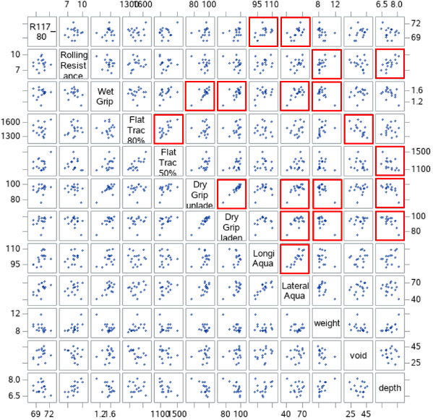
2D charts and Scatterplots
dB
See next slide for visualization : R117_80 vs Aquaplaning
RR Index
Same as before but with R117 80
Red boxes show very strong probability of correlation (P-value <5%)
integer

Slide 28
Tests results - Visualization
Strong correlation between R117 80 and Aquaplaning visually noticeable (sorted on R117 80)

Slide 29

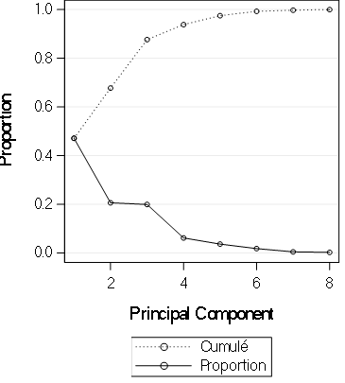
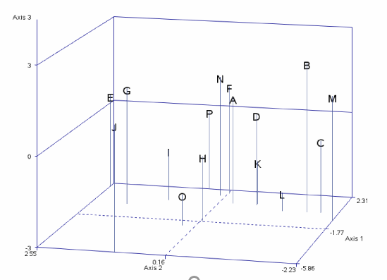
Multidimensional Analysis - Axis
Principal Component Analysis (PCA)
  Reduce the 8 studied characteristics (Rolling Resistance, Wet Grip, Flat Track 80%, Flat Track 50%, Dry Grip unladen, Dry Grip laden, Longitudinal & Lateral Aquaplaning) to 3 variables
0.88 -
The first 3 axis represent 88 % cumulative inertia
The first 2 68 %
3
1
2
|
3

Slide 30
2D representation
In the 2D representation :
  The bigger the letters, the more the axis is driven by the tyre in comparison to the others for this 16 tyres sample
  The smaller the letters, the less the axis is driven by this tyre in comparison to the others for this 16 tyres sample

Slide 31
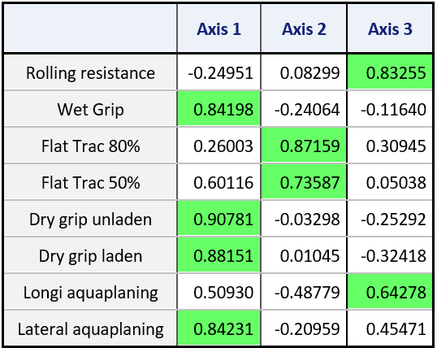
Principal Component Analysis (PCA)
Axis 1 mainly represents Wet Grip, Dry Grip, Lateral aquaplaning
To be noted that in axis 1 direction all tests performance improve
  It is representative for Safety
Axis 2 mainly represents Flat Track
  It is representative for Handling
Axis 3 mainly represents Rolling Resistance and Longitudinal Aquaplaning
  It is representative for CO2 Emissions because Rolling Resistance factor is the most important
Part of inertia 47% 21% 20%

Slide 32
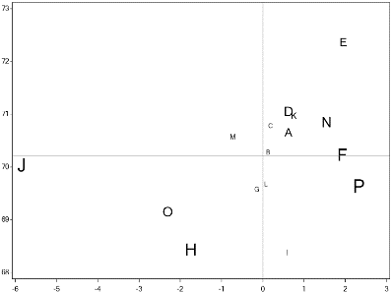
PCA Results (1st axis)
R117_80 vs Axis 1 Safety
noisier
R117 80
quieter
Less safe
Axis 1 Safety
Safer
Axis 1 mainly controlled by Wet Grip, Dry Grip, Lateral aquaplaning

Slide 33


Interpretations (1st axis)
Axis 1 mainly represents Safety through Wet Grip, Dry Grip, Lateral Aquaplaning
The statistic concerning our sample of 16 tyres shows a conflict between Rolling Sound and Safety performances.
noisier
noisier
Focus on Tyre P
R117 80
quieter
quieter
Less safe
Axis 1 Safety
Safer

Slide 34
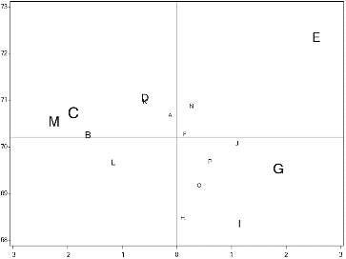
PCA Results (2nd axis)
R117_80 vs Axis 2 Handling
noisier
R117 80
quieter
worse
Axis 2 Handling
better
Axis 2 mainly controlled by Flat Track 50 % and Flat Track 80 %

Slide 35
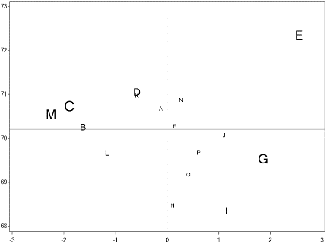
Interpretations (2nd axis)
Axis 2 mainly represents handling through Flat Track
Noise and Handling performances improve together along Axis 2 (E does not follow the trend)
noisier
noisier
noisier
noisier
Focus on Tyre E
R117 80
R117 80
quieter
quieter
quieter
quieter
worse
worse
Axis 2 Handling
better

Slide 36
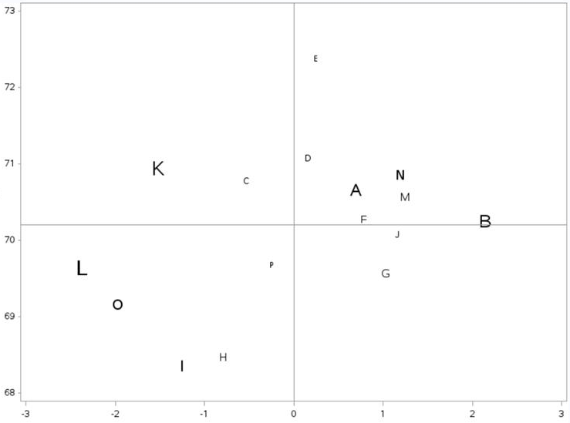
PCA Results (3rd axis)
R117_80 vs Axis 3 CO2
noisier
R117 80
quieter
worse
Axis 3 CO2
better
Longitudinal Aquaplaning
better
worse
Rolling Resistance
Axis 3 mainly controlled by
Rolling Resistance & Longitudinal Aquaplaning

Slide 37
Interpretations (3rd axis)
Axis 3 mainly represents CO2 Emissions (through Rolling Resistance) and Longitudinal Aquaplaning.
(!) In this axis, performance in Rolling Resistance decreases while increasing in Longitudinal Aquaplaning
Focus on Tyre B
Focus on Tyre K
noisier
R117 80
quieter
Simple conclusion can not be drawn on Axis 3
Longitudinal Aquaplaning
worse
Axis 3 CO2
better
Rolling Resistance
better
worse

Slide 38
Conclusions – Literature Study
3 Tyre Manufacturers studies show antagonistic relationship between Noise and Safety (Aquaplaning, Wet Grip and Handling)
2 Tyre Manufacturers studies show relationship between Noise and Rolling Resistance
Test procedures or testing methods are disparate from one study to another
General agreement on the major role of road surface on the noise emission
Due to the purpose of the journalistic studies and the lack of technical information it is difficult to make a statement about the results
  The main goal of the journalistic studies is to rank a sample of tyres
  Test methods are not described precisely and are different from one study to another
  In some studies, repeatability conditions are questionable
  Test data are not provided
ACEA Tyre Performance Study aims at determining the inter-dependency between rolling sound, rolling resistance and the main safety performances by carrying out tests according to regulatory or standard procedures

Slide 39
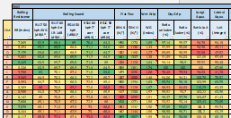
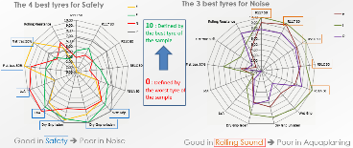
Conclusions
Measurement Program
This new study offers a comprehensive toolbox to evaluate the relationship between rolling sound and the main other tyre performances according to standard measurement protocols.
A correlation analysis shows that the 5 acoustic characteristics concerning R51.03 (Vehicle measurement) and R117 (Tyre measurement) at different velocities are correlated and can be represented by only one.

Slide 40
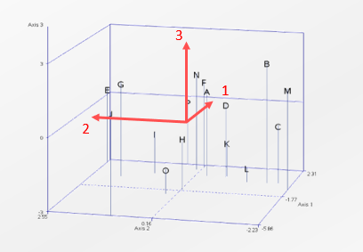
Conclusions
Statistical analysis
We have described the relationship between the characteristics through 3 variables with a good level of representativeness (inertia of 88%)
The main table, the spider diagrams and the Principal Components Analysis show a conflict between rolling sound (R117) and Safety performances (Wet Grip, Dry Grip, Lateral Aquaplaning)
Simple conclusions regarding rolling sound, rolling resistance and Safety performance (Longitudinal Aquaplaning) cannot be drawn

Slide 41
Conclusions
Main conclusion
Obtaining a low level of Rolling Sound performance without a compromise regarding other parameters essential for vehicle safety and CO2 emission reduction could not be proven as feasible by this Study

Slide 42
Conclusions
General conclusions
ACEA Tyre Performance Study is the first study to analyze the inter-dependency of the parameters of the tyre with accurate reliable repeatable measurement methods
ACEA Tyre Performance Study conclusions are consistent with the outcomes of the Literature Study regarding Rolling Sound and Vehicle Safety
The ACEA Tyre Performance Study has not observed or deduced any correlation between Rolling Sound and Rolling Resistance as claimed by the FEHRL Study
  Remark: WLTP has caused a shift in tyre technology in recent years, in order to provide improved Rolling Resistance. The tyres in the study may have been designed before this shift.

Slide 43
Conclusions
Recommendation for complementing the study:
Wear Life testing was part of the initial test program but due to budget constraints the testing could not be performed, although the tyres are available and the test procedure has been defined.
The tyres that could be used also for Wear Life testing can be provided by ACEA and we encourage the stakeholders to raise funding and do the wear test, thus complementing the study in order to deliver a more complete picture of tyre parameters interdependence.

Slide 44
Conclusions
Suggestions
To prove that the conclusions of this study are also valid for other tyre types, the test program needs to be expanded to
  Class C1 tyres with bigger outer diameter, tyre width, and lower rolling resistance
  Class C1 tyres (winter and reinforced tyres)
  Class C2 tyres and Class C3 tyres with bigger outer diameter and tyre width

Slide 45
THANK YOU FOR YOUR ATTENTION

Slide 46
Appendixes
  Literature study
  Statistical Analysis

Slide 47
APPENDIX 1 – LITERATURE STUDY

Slide 48
Literature study analysis Appendixes
Studies covered
  EVO103_LD (2015)
  Auto Express Studies (2018)
  Whichcar Wheels (2017)
  GRB-61-03 Study based on TNO 2014 R10735 report (12 June 2014)
  FEHRL – Study SI2,408210 Tyre/Road Noise (2007)
  Noise Technology(Continental - 2011)
  Noise Tradeoffs (Michelin - 2007)
  Tire-Road Noise (Goodyear - 2018)
  Noise (Michelin – 2015)
  Inter.noise_HAMBURG 2016
  Tyre modelling for rolling resistance (MASTER’S THESIS IN AUTOMOTIVE ENGINEERING) 2014

Slide 49
EVO103_LD Study (2015)
Framework
  Test campaign carried out in 2015, to demonstrate the importance of tyres in time performance
Settings
  The subjective parameter is the most important (40% of the overall score)
  Parameters influencing performance (braking, timing) dominate price and noise criteria
Vehicle type
  For all tests it is a VW Golf GTI 230 Performance with a limited-slip electronic differential and a DSG box (this dual-clutch gearbox guarantees constant gear passages)
Tyre types, sizes and dimensions
  10 different manufacturers' gums but equal tyresizes 225/40R18 Y92 except for bridgestone whose speed and load indices are W92
  Each set of tyres comes from independent sources
  They were all slightly sanded before the tests
  Only one set is used for all measurements, the comparison starting with the least destructive tests, i. e. on wet track
Tracks
  For wet tests and dry braking : Pirelli de Vizzola test track
  For dry tests : Tazio Nuvolari piste
  For subjectively judges the noise and comfort : Open road around Vizzola test track
Test methods are not describe precisely. No information about
  Tyre inflation pressure from the manufacturer or the vehicle ? Tyre load ?
  Track and ambient temperature. Period of tests during 2015 ?
  Technical tools used : sound level meter distance to the vehicle, dB ponderation, personal qualification …
  Technical guidelines or standard used

Slide 50
Auto Express Study (2018)
Framework
  The goal was to make a classification between tyres whose size is : 225/45 R17
Settings
  The test covers nine criteria, including a more driver-relevant cabin noise rating, dry grip and a range of wet road tests
  Auto Express drivers carried out all tests apart from aquaplaning, which requires special training
  Pass-by noise is measured in decibels (no ponderation)
Vehicle type
  No information : Pictures look at a VW Golf GTI, a VW Passat ? and an Audi A6
Tyre types, sizes and dimensions
  10 different manufacturers' gums but equal tyre sizes 225/45R17 and had weight ratings of 94, as well as speed ratings of Y (up to 186mph)
  No specify running-in period describes
Tracks
  Continental’s proving ground at Uvalde, Texas. The 1.8km Uvalde wet handling track is a recreation of the one at Continental’s Contidrom facility near Hanover, Germany
  The tarmac was shipped from Europe to ensure comparable results
Test methods are not describe precisely. No information about
  Period of testing
  Tyre inflation pressure from the manufacturer or the vehicle ? Tyre load ?
  Track and ambient temperature
  Technical tools used : sound level meter distance to the vehicle, personal qualification …
  For Rolling Resistance test : all tests carried out to industry standard. Which ones ?

Slide 51
Whichcar Wheels Study (2017)
Framework
  The test campaign carried out in 2017, to compare eight brands
Settings
  A control tyre was deployed at regular intervals as a means of measuring track and car evolution, which could be addressed in the analysis
  Taking the sound pressure level (SPL) results in decibels (dB)
Vehicle type
  For all tests it is a Mazda 6 Touring with aluminum rims
  Its electronic stability control system was switched fully off
Tyre types, sizes and dimensions
  8 different manufacturers' gums but equal tyre sizes 225/55R17s because that is the standard fitment on the Mazda 6 test mule
  A series of hot laps of compact handling circuit, which served to scrub the surface of the tyres
  Inflating each to 33psi as per the Mazda’s placard
Tracks
  The tarmac surrounding the Sydney Dragway scrutineering shed
Test methods are not describe precisely. No information about
  Period of testing
  Track and ambient temperature
  Technical tools used : sound level meter distance to the vehicle, personal qualification …
  For tyre noise : use an SPL meter to store a peak dB figure over a straight section of coarse chip road – test at 60km/h

Slide 52
TNO 2014 R10735 report (June 2014) 1/2
Framework
  The ministry of Infrastructure and Environment in the Netherlands has asked TNO to perform a ‘quick-scan’ study to evaluate the potential of high-quality tyres in terms of energy, safety and noise
The study compares two scenarios of tyre distribution in the Netherlands
  The baseline scenario : represents the tyre distribution as it currently exists in the Dutch vehicle fleet. The distribution of tyre labels is based on the tyre labels available in the retail database of VACO (VACO is the Dutch industry association for tyres and wheels)
  The second scenario assumes that all currently-used tyres in the Netherlands are replaced by A-rated tyres
Vehicle type
  As the study is carried out on the distribution of tyres as it exists, it does not take into account the model of the vehicle that the tyre equips
Tyre types, sizes and dimensions
  On average vehicles in the Netherlands drive with a D-label for rolling resistance, a C-label for wet grip and a 2 waves label for noise
  Tyres are classified according to the EU Regulation EC1222/2009
  The set is based on the 7 brands and the 7 sizes with the highest market share
The energy savings potential of a shift to A-rated tyres for energy is evaluated for different vehicle types and tyre classes based on:
  The relative reduction in rolling resistance between the tyre X and tyre Y (based on the average of the range of RRCs)
  The driving pattern, e.g. predominantly urban or highway (are estimated) because the rolling resistance is proportional to the vehicle weight and the share of air resistance in the vehicle’s total driving resistance increases with speed
  The fuel consumption, mileage and fuel costs (petrol and diesel)

Slide 53
TNO 2014 R10735 report (June 2014) 2/2
The potential annual safety improvement is calculated as reduced (severe) injuries, fatalities and their societal monetary benefits :
  The dry grip performance is therefore not related to the safety label for tyres and thus not assessed in this study
  The wet grip performance is assessed by measuring the friction potential, which is highly correlated to the acceleration levels that can be achieved with the vehicle
  From the acceleration levels the safety related quantities such as braking distance and safe cornering speed are calculated
  In the analyses the calculation is done for a wet grip level of the reference tyre of 0.6
  Several assumptions are made in the translation from impact speed reduction to societal cost. Seven assumptions are listed
The potential benefits in terms of environmental impact and health of a transition from the currently available tyre mix to tyres with the best performance :
  External rolling noise emission are computed according to the methods and assumptions that were developed in the VENOLIVA study
  The EC database of type approval test results was used to assess the expected noise emission reduction during the acceleration and the constant speed tests caused by noise reducing measures, either to the power train or to the tyres or to both
  From this emission reduction during the test the emission reduction in normal traffic was estimated, making a distinction between accelerating and free flowing traffic
  The five different vehicle types used in the VENOLIVA computation method, were regrouped into three different vehicle categories (Light, Medium and Heavy)
  A distinction was made between the tyre classes C1, C2 and C3. Within these classes the following subdivisions are made, following the specification of the noise emission limit values
  4 computation step was performed :
    the average reductions of the tyre rolling noise for each of the tyre classes
    the effective reductions of in-traffic vehicle noise emissions (according to vehicle category, driving speed, operating condition, type of road surface)
    the reduction of the characteristic noise impact of a traffic flow for 8 different road / traffic combinations
    the numbers of (highly) annoyed and (highly) sleep disturbed people from the changes of the traffic flow noise impact

Slide 54
FEHRL – Study SI2,408210 Tyre/Road Noise (2007) 1/2
Framework
  To assess the potential for reducing tyre noise through the implementation of more stringent type approval limit values, and to assess the impacts that such reductions might have on overall traffic noise, road safety and economy
Settings
  The collation of a comprehensive database collected from previous studies examining tyre noise, safety performance and rolling resistance
  Some measurements are not taken precisely in accordance with the procedure provided in the tyre noise Directive but they are included in the database as additional useful information
  To determining the tyre noise level of the database, it is necessary to adjust the raw measured values according to the procedures for rounding stipulated in the Directive
Some tests was performed by the UBA/¨TÜV Automotive
  Wet grip
    on an artificially wetted asphalt surface. The water depth wad permanently kept below 1,5mm in order to exclude the effects of aquaplaning
    ABS braking system on the 4 wheels was used
    the vehicle was decelerated from approximately 85km/h to standstill. Speed and distance were measured from 80 to 10 km/h with a satellite-based measuring device
    for each tyre set, at least 6 valid measurements were performed
  Rolling resistance
    measured using methods described in ISO 8767:1992 or 9948:1992 (provided by the ISO 18 164 : first edition from the 1st June 2005)
    the coefficient Cr [%] is calculated from the average values of the rolling resistance force in Newton [N] divided by the test load in [kg] multiplied by 100 [%]
    the mean weight of all four tyres of one set is determined prior the rolling resistance measurements
  Longitudinal Aquaplaning
    the test vehicles were equipped with rotational speed sensors on both wheels of the front axle
    for the measurement of the floating speed the test vehicle was run on the test track with the right front wheel aligned with a water basin with 8mm water depth
    when the vehicle reached the basin it was accelerated maximally
    the floating speed VAqu is defined as that speed, at which a slip of 15% was reached
    for each tyre set, at least 6 valid measurements were performed

Slide 55
FEHRL – Study SI2,408210 Tyre/Road Noise (2007) 2/2
Results of tests performed by the UBA/¨TÜV Automotive
  Tyre noise and wet braking performance
    the tyre/road noise levels are compared with the wet brake deceleration values
    no clear trend/correlation can be found between increasing noise levels and with increasing deceleration levels
  Tyre noise and Rolling resistance
    the tyre/road noise levels are compared with the rolling road resistance coefficients values
    no clear trend/correlation can be found between tyre/road noise levels and rolling resistance coefficients
    C1c winter tyres and C1c summer show opposite trend and no significant trends in either direction cans be seen for the other C1 classes
  Tyres noise levels and Longitudinal Aquaplaning
    the tyre/road noise level are compared with the aquaplaning speed values
    no clear trend/correlation can be found between tyre/road noise levels and aquaplaning speed values
Addition tests/data (same data inter-noise HAMBURG 2016 ?)
  All data confirm the results present in the previous conclusion
Future trends in tyre design
  Regarding conventional tyres the literature review examines the potential benefits from adapting winter tyres for all year round use and describes modifications to the tread design to include :
    changing the air/rubber ratio
    changing the size of the tread elements and using different rubber compounds
  The increasing use of run-flat tyre designs is also examined together with the potential noise advantages of ensuring that tyres are correctly inflated in use
  Unconventional tyre designs include an overview of non-pneumatic composite tyres. The noise-reducing potential for a composite wheel has been demonstrated to be around 10dB(A)
Part of the mismatch between testing and real situations lies in the test surface used for type approval

Slide 56
Noise Technology - Continental (April 2011)
Framework
  Tyre development is managing of target conflicts : Rolling Resistance – Braking – Noise
  A tyre which have a Rolling Resistance optimized compound, is impacted by the performance on : Dry Grip, Wet Grip, Mileage and Noise
Settings
  Use an (internal ?) methodology to simulate the tyre noise
    Focus on a tyre perimeter (contact with the road surface)
    Divide the tyre by tracks (groove separation) (in general n)
    Suppose a shift step
    Compute the total number of positions for each track (in general m)
  These assumptions allow to compute the total number of track constellations for a pattern : m(n-1)
Only one test for rolling noise is presented (serves as a preface)
  4 car tyres of size 235/45R17 but with different tread compounds. A motorcycle slick tyre is used as a reference
  No information on the tracks and vehicle used. Measurements according to the ECE R117
  Conclusion :
    Small slick tires are not always less noisy than wide slick tyres. The average sound level of a modern slick tyre is 68dB (A).
    The sound level depends on the tread compound
Tyre design trade-offs
  Tread pattern design
    A tyre with a 34% void ratio is better than a slick tyre for the wet braking and the aquaplaning in curve but is 3dB(A) noisier
  Tread material
    A tyre with a summer tread compound is better than a tyre with a very low stiffness tread compound for the cornering stiffness and the wear but is 3dB(A) noisier
  Tread thickness
    A tyre with a very low stiffness tread compound is 3dB(A) quieter than a tyre with normal tread but has a 15% increase in rolling resistance
  Void volume effect on tyre noise
    Longitudinal void is less important
    Lateral void influences the noise level more

Slide 57
Noise Trade-Offs - Michelin (October 2007)
Framework
  Reduction of tyre/road noise through tyre design :
    Tread pattern design
    Tread rubber compound
    Tyre internal structure
No specific test describe. Seems to be a cluster of studies (experience feedback)
  For each items : behaviour description between two tyres
  Effect on longitudinal aquaplaning
    Speed at onset of aquaplaning : 82km/h to 66km/h. Water depth 8mm
    Sculptured tyre with a void ratio of 28% is 3,5dB(A) noisier than a slick tyre but is more safety on a longitudinal aquaplaning
  Effect on aquaplaning in curve
    Mean lateral acceleration between 55km/h to 85 km/h. Water depth 7mm
    Sculptured tyre with a void ratio of 28% is 3,5dB(A) noisier than a slick tyre but is more safety on an aquaplaning in curve
  Effect on wet braking
    From 80 to 10 km/h on macro rough surface
    Sculptured tyre with a void ratio of 28% is 3,5dB(A) noisier than a slick tyre but is more safety on a wet braking
  Effects on wear and handling
    A tyre with a very soft tread compound is quieter of -1dB(A) than a Standard tread compound but it is -15% in handling, thus less safety in avoidance manoeuvres. Furthermore, the wear decrease of -25%
    A tyre with a thicker under-tread more important is quieter of -2dB than a tyre with a normal tread but it is -15% in handling
  Effect on cost
    A tyre with a thicker under-tread more important is +12% more expensive than a tyre with a normal tread

Slide 58
Tire-Road Noise - GoodYear (November 2018)
Framework
  Goodyear Dunlop’s development goal is a balanced tyre with a strong focus on safety-related criteria
  Tyre development considers +50 tyre performances. Optimized performances in function of vehicle, road and weather conditions
Significantly different noise testing in tyre and vehicle legislation
  Tyre Noise : Reg. (EC) No 661/2009
  Vehicle Noise : Reg. (EC) No 540/2014
Balancing of the different noise sources required to reach an overall vehicle noise target under the vehicle noise regulation
Tyre/Road Noise Generation Mechanisms
  Tread element impact Running deflections Road texture impact
  Stick-slip adhesion Air turbulence Air displacement Stick-snap adhesion
  Helmholtz resonator Pipe resonators Horn amplification
  Key role of road surface in all aspects of tire/road generation
Tyre and Road Influence on Noise
  Laboratory noise test at 50 km/h on a drum with 2 different road surfaces : Smooth road replica and coarse road replica
  6 tyres of the same size with different construction and tread pattern. 1 slick tyre (no tread pattern) with low noise construction
  Result : 10dB difference between the two road surfaces. For majority frequency, slick tyre is quieter
Performed tyre sound power measurements in Low/High spatial resolution with a specific method describes
Examples of tyre/road noise trade-offs
  Slick tyres. normal tyres : Size and dimensions : 235/40 R19. Noise at 50km/h : 67dB(A). Slick tyre is -1,5dB(A) quieter ; RR : Slick tyre is 10% worse ; Straight Aquaplaning : Slick tyre have an unacceptable level
  Tread compound vs. High hysteresis tread compound : Noise at 50km/h : High hysteresis tread compound is -0,5dB(A) quieter ; RR :High hysteresis tread compound 25% worse
  Standard belt vs. Heavy belt : Noise at 50km/h : Heavy belt is -0,3dB(A) quieter ; tyre weight : Heavy belt is 10% heavier
  Tread pattern vs. Tread 25% lower groove volume: Noise at 50km/h : tread 25% lower groove volume is -0,5dB(A) quieter ; RR : Same result ; Straight Aquaplaning : tread 25% lower groove volume is 15% worse

Slide 59
Noise - Michelin (March 2015)
Framework
  A few words about mechanisms, an overview of the noise test procedure and impacting factors
2 main phenomena dominate the generation of exterior noise
  The structural vibration of the tyre caused by the roughness of the road surface and the tyre’s tread pattern
  Air pumping caused by the compression and decompression of the air trapped within the tread block and the road surface
3 main phenomena dominate the mechanisms that affect the exterior noise
  Resonance of air in the void network: Organ pipe
  The horn effect in front and behind the contact patch
  The absorption of the ground
Temperature impacts the noise level because tyre behavior and road surface behavior are temperature dependent
The increase of the load leads to the expansion of the contact patch area but have a small effect on contact pressure
The increase of inflation pressure leads to the shrinkage of the contact patch area and higher contact pressure
Car manufacturer choses tyre size and category (sporty, all season, luxury, winter, …) to fit the vehicle
  For a given tyre size and category, difference in noise may be up to 3 dB(A)
Noise test procedure
  Coast-down (engine-off) at several speeds between 70 kph & 90 kph. At least 10 dB(A) difference with ambient noise
  Load: Average between 70% & 80% of reference load
  ISO surface (ISO 10844). 50m zone cleared of any obstacle
  Preparatory phase : 100 km run-in for each set of tires and warming-up
  Max pressure of each microphone is retained. Value is temperature corrected and rounded
  A necessary linear regression is applied for measurement random deviation and speed peed sensitive tyre vibration effects
  Interpolated value at 80 kph (C1 tires) is calculated
No specific test describe. Seems to be a cluster of studies (experience feedback) ➔ Noise Trade-Offs - Michelin (October 2007)

Slide 60
Inter-noise HAMBURG (2016)
Framework
  This paper presents a study where noise and rolling resistance properties of tyres for winter conditions are compared to summer and all-season tyres
  3 Studies : first in 1995 to 2000, a second in 2011 to 2012 and the last in 2015 to 2016
Settings
  All measurements results have been normalized to a reference air temperature of 10°C in order to minimize that varying temperatures during the measurements affect the results
  A measurements correction was applied for noise according to ISO/DTS 13 471-1
Vehicle type
  No vehicle. Use a trailer
Tyre types, sizes and dimensions
  Approximatively 50 car tyres have been measured with a trailer method
  The winter tyres include types optimized for central European climate, tyres optimized for Nordic climate and tyres with studs
  There is a special winter tyre design which is essentially optimized for northern climates but having silicium carbide granules evenly mixed into the rubber compound of the tyres tread
  Use a SRTT : Standard Reference Test Tyre according to ASTM 2493:14
  Use tyres in new condition and in used condition
  Tyres were loaded essentially in accordance with ECE regulation R117 (406kg for noise, 408kg for rolling resistance)
  Inflation pressure was adjusted in accordance with the specifications in ECE R117 : fixed 180kPa in cold condition for noise, regulated 200kPa for rolling resistance
Tracks
  All measurements made on two road surfaces : SMA 8 (the surface texture was characterized according to ISO 13 473-1) and DAC 16 (its texture appeared to be similar to the SMA 16)
Test methods are describe precisely
  For noise : using a dedicated CPX trailer, according to the procedure given in ISO/FDIS 11 819-2. With 3 speeds : 30, 50 and 80km/h an minimum 2 runs
  For Rolling resistance : measurements were performed with the trailer owned and operate by the Technical University of Gdansk (TUG). With 2 speeds 50 and 80km/h

Slide 61
Thesis Report Tyre Modelling For RR (2014)
Framework
  This study investigates mathematical models based on physical understanding and literature reviews of tyre rolling resistance phenomena
  The work aims to develop a tyre model that explains the influence of tyre inflation pressure, tyre size, velocity and normal load on the rolling resistance coefficient
Settings
  Some design parameters such as tyre material, tread pattern, road types and temperature are not considered
  The tyre model applies to free rolling cases and does not include any torque application to wheels or longitudinal slip
  There are many assumptions such as :
    Contact patch shape is assumed to be perfect rectangle
    Inflation pressure doesn’t change with deflection
    Tyre material and tread pattern are kept constant
    Road type is fixed to hard, dry and flat surface
  Most of the tyre information has been taken from various research papers and correspondingly, most constants used have been obtained thereof
Vehicle type
  No vehicle used in this study
Tyre types, sizes and dimensions
  No specifics tyres types, sizes and dimensions used in this study
Tracks
  No tracks used in this study
The results are describe for 4 parameters which influence on the rolling resistance

Slide 62
APPENDIX 2 – Statistical Analysis

Slide 63
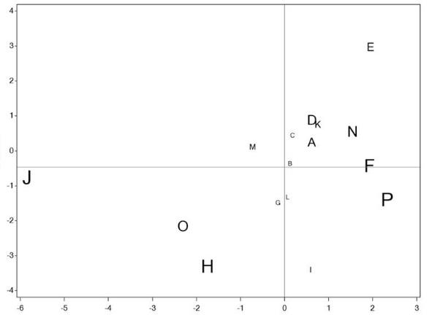
Representing Rolling Sound (1/6)
Representation of Noise and R117_80 vs Axis 1 Safety
Rolling Sound
R117_80
Axis 1 Safety
Axis 1 Safety

Slide 64
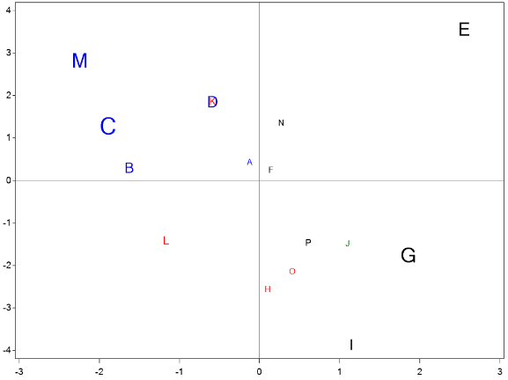
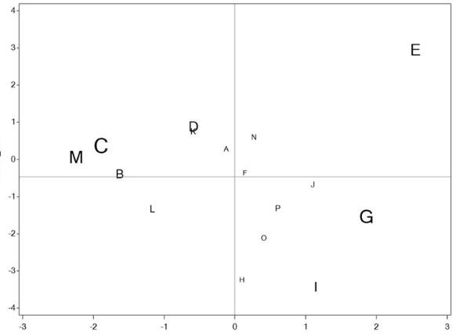
Representing Rolling Sound (2/6)
Representation of R117_80 vs Axis 2 Handling
Rolling Sound
R117_80
Axis 2 Handling
Axis 2 Handling

Slide 65
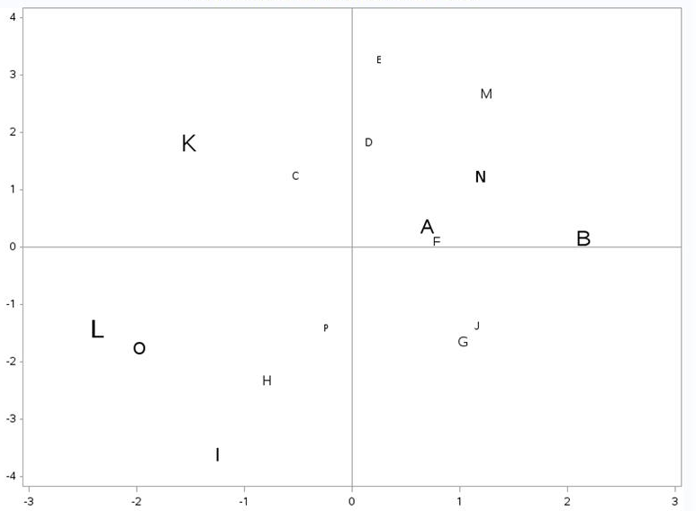
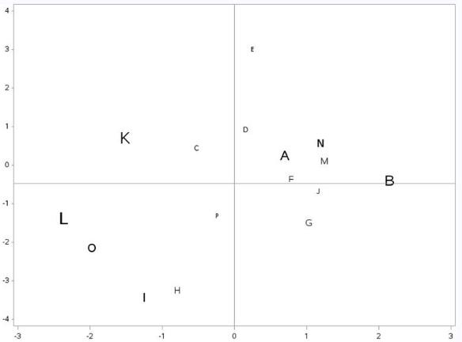
Representing Rolling Sound (3/6)
Representation of R117_80 vs Axis 3 CO2 Emissions
Rolling Sound
R117_80
Axis 3 CO2
Axis 3 CO2

Slide 66
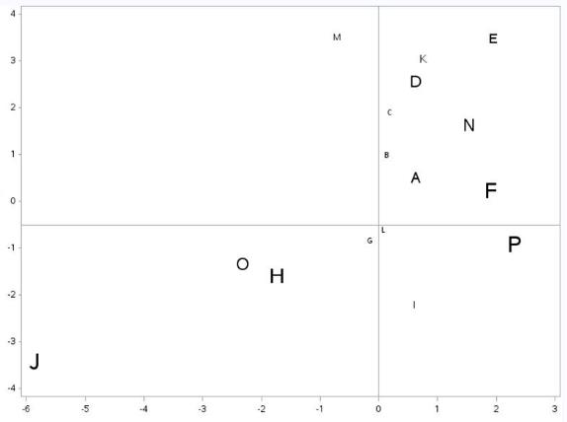
Representing Rolling Sound (4/6)
Representation of Noise and R51C_50 vs Axis 1 Safety
Rolling Sound
R51C_50
Axis 1 Safety
Axis 1 Safety

Slide 67
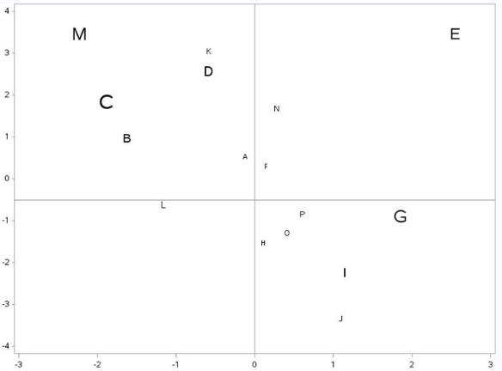
Representing Rolling Sound (5/6)
Representation of R51C_50 vs Axis 2 Handling
Rolling Sound
R51C_50
Axis 2 Handling
Axis 2 Handling

Slide 68
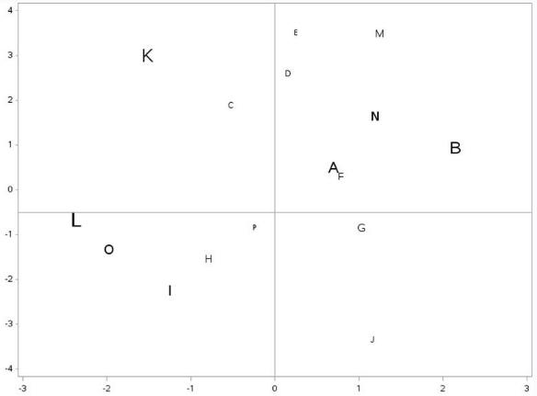
Representing Rolling Sound (6/6)
Representation of R51C_50 vs Axis 3 CO2 Emissions
Rolling Sound
R51C_50
Axis 3 CO2
Axis 3 CO2

