Slide 1
German Rail Freight Masterplan
UNECE – ITC – Working Party on Rail Transport
73rd Session, Geneva, 25 November 2019
Workshop: “Making rail freight more competitive and the coordinated development of the rail network with a focus on how to work together at the government and sectoral levels on EATL”
www.bmvi.de

Slide 2
Initial situation
Policy context of the initiative

Slide 3
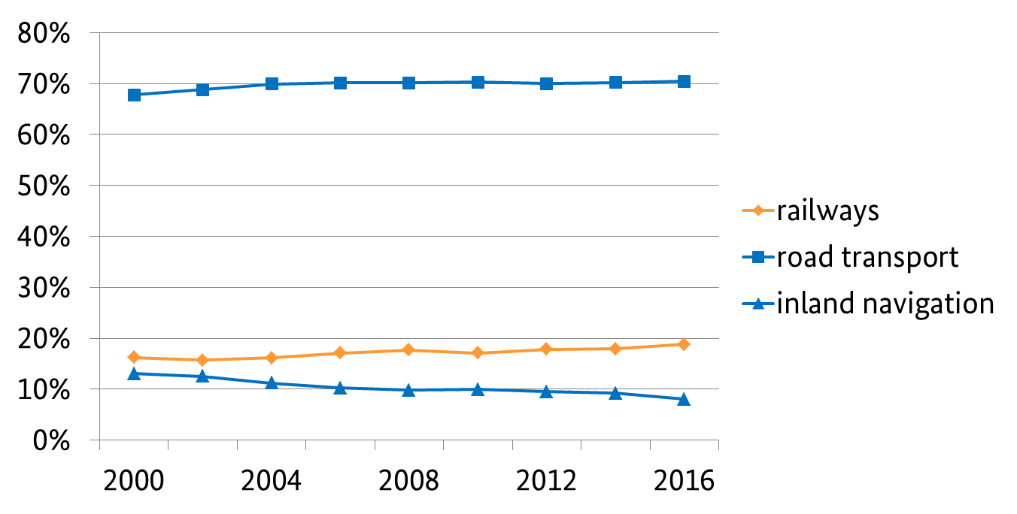
The Situation in Germany
Stagnating market share of Rail freight
The modal split of railways in freight transport has been stagnating at <20%
Source: Verkehr in Zahlen 2018/2019, volume 47, Federal Ministry of Transport and Digital Infrastructure, in-house table

Slide 4
Responsive actions taken by the Federal Ministry of Transport and Digital Infrastructure
Development of the Rail Freight Masterplan

Slide 5
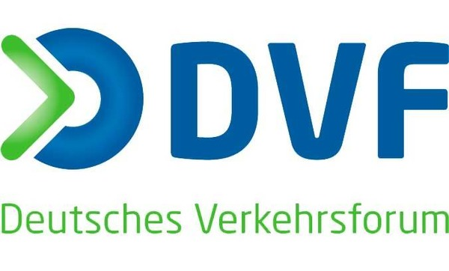


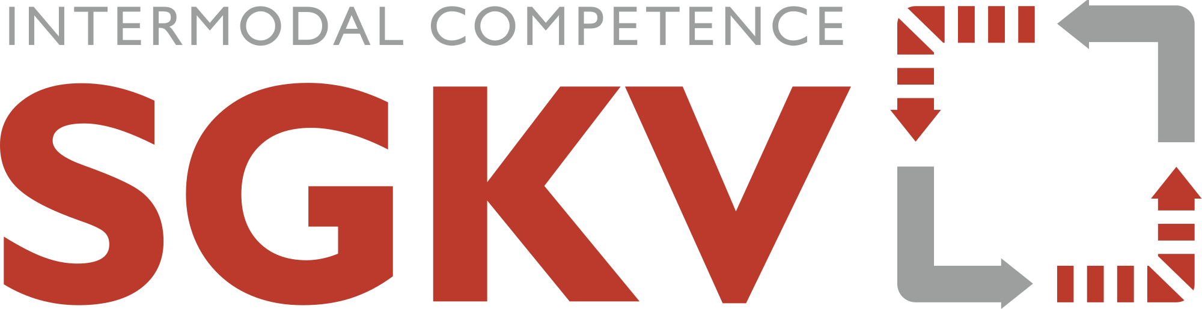








The Round Table on Rail Freight
Involving all important stakeholders
Objective: Development of the Rail Freight Masterplan

Slide 6
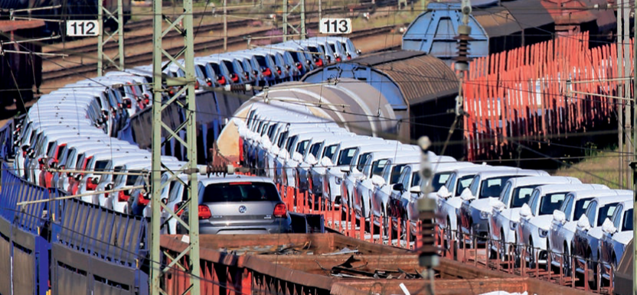
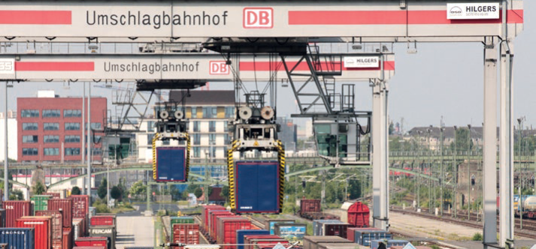
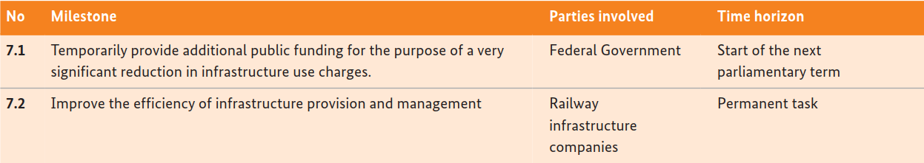
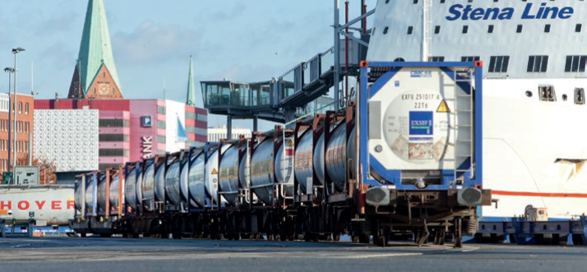
The Rail Freight Masterplan
10 packages of actions including 66 individual measures
Provide high-capacity infrastructure
Progress digitalization
Increase the level of automation in railway operations
Expedite technological innovations
Boost multimodality
Expand electric haulage
Reduce track access charges and charges for access to service facilities
Limit the burden imposed by levies and taxes
Ensure comparable standards in labour and social legislation
Step up initial training and continuing professional development
Source: Figure 1 – Uwe Miethe, DB AG | Figure 2 – Wolfgang Klee, DB AG | Figure 3 – Kombiverkehr KG

Slide 7
The short term measures
Five immediate actions
  Additional public funds to reduce track access charges
  740 metre network
  Entrepreneurial contributions by the sector to the modernization of rail freight
  Establishment of the first test bed for the digitalization and automation of the marshalling of freight trains
  Preparation of a blueprint for the Federal Government programme entitled "The Future of Rail Freight"

Slide 8
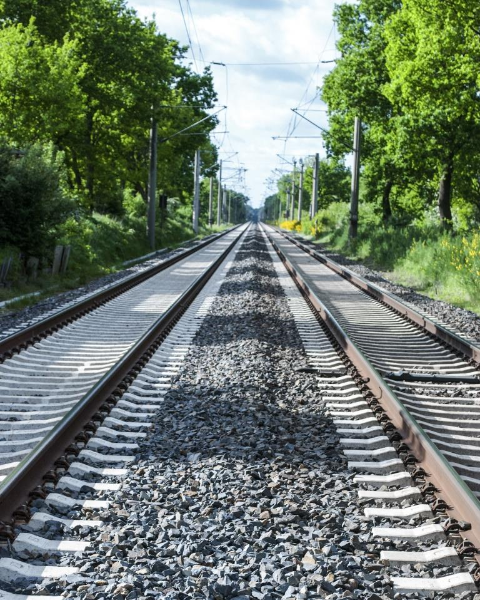
Reducing track access charges
Strengthening rail freight
Implementation on the basis of funding guidelines
Approved by the European Commission
DB Netz AG track access charges authorized by the Federal Network Agency are funded
350 million euros per year over a period of 5 years
© bidaya/stock.adobe.com

Slide 9
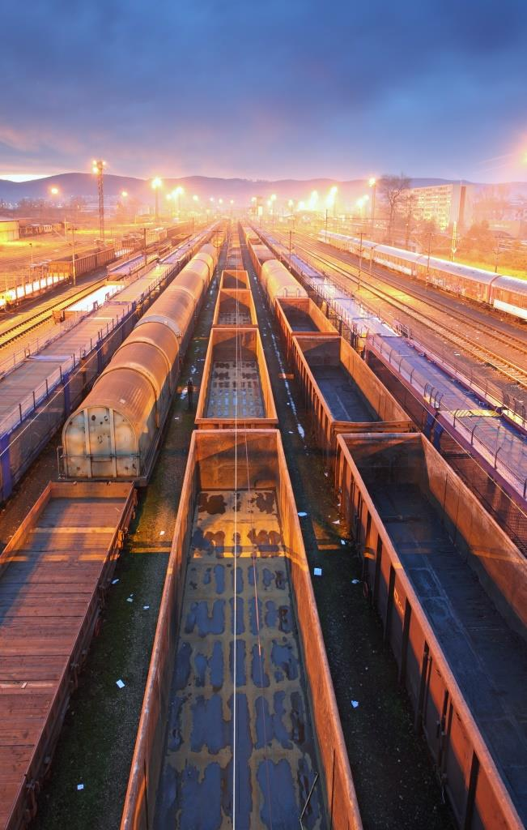
Federal Government Programme on the Future of Rail Freight
Overcome the backlog of investment in rail freight
The strategy has been adopted by the Round Table on Rail Freight
Funding guidelines were developed together with industry, currently pending notification by the Commission
Trialling and market launch of innovations in rail freight transport
Digitalization – automation – innovative rolling stock technology
Funding requirements: 1 billion euros over the period of 5 years – funding share of 50-50
Draft budget for 2020 150 million euros over the period of 5 years
© Ttstudio/stock.adobe.com

Slide 10
Digital automatic coupling (DAC)

Slide 11
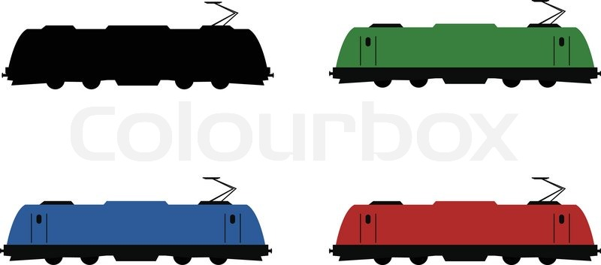
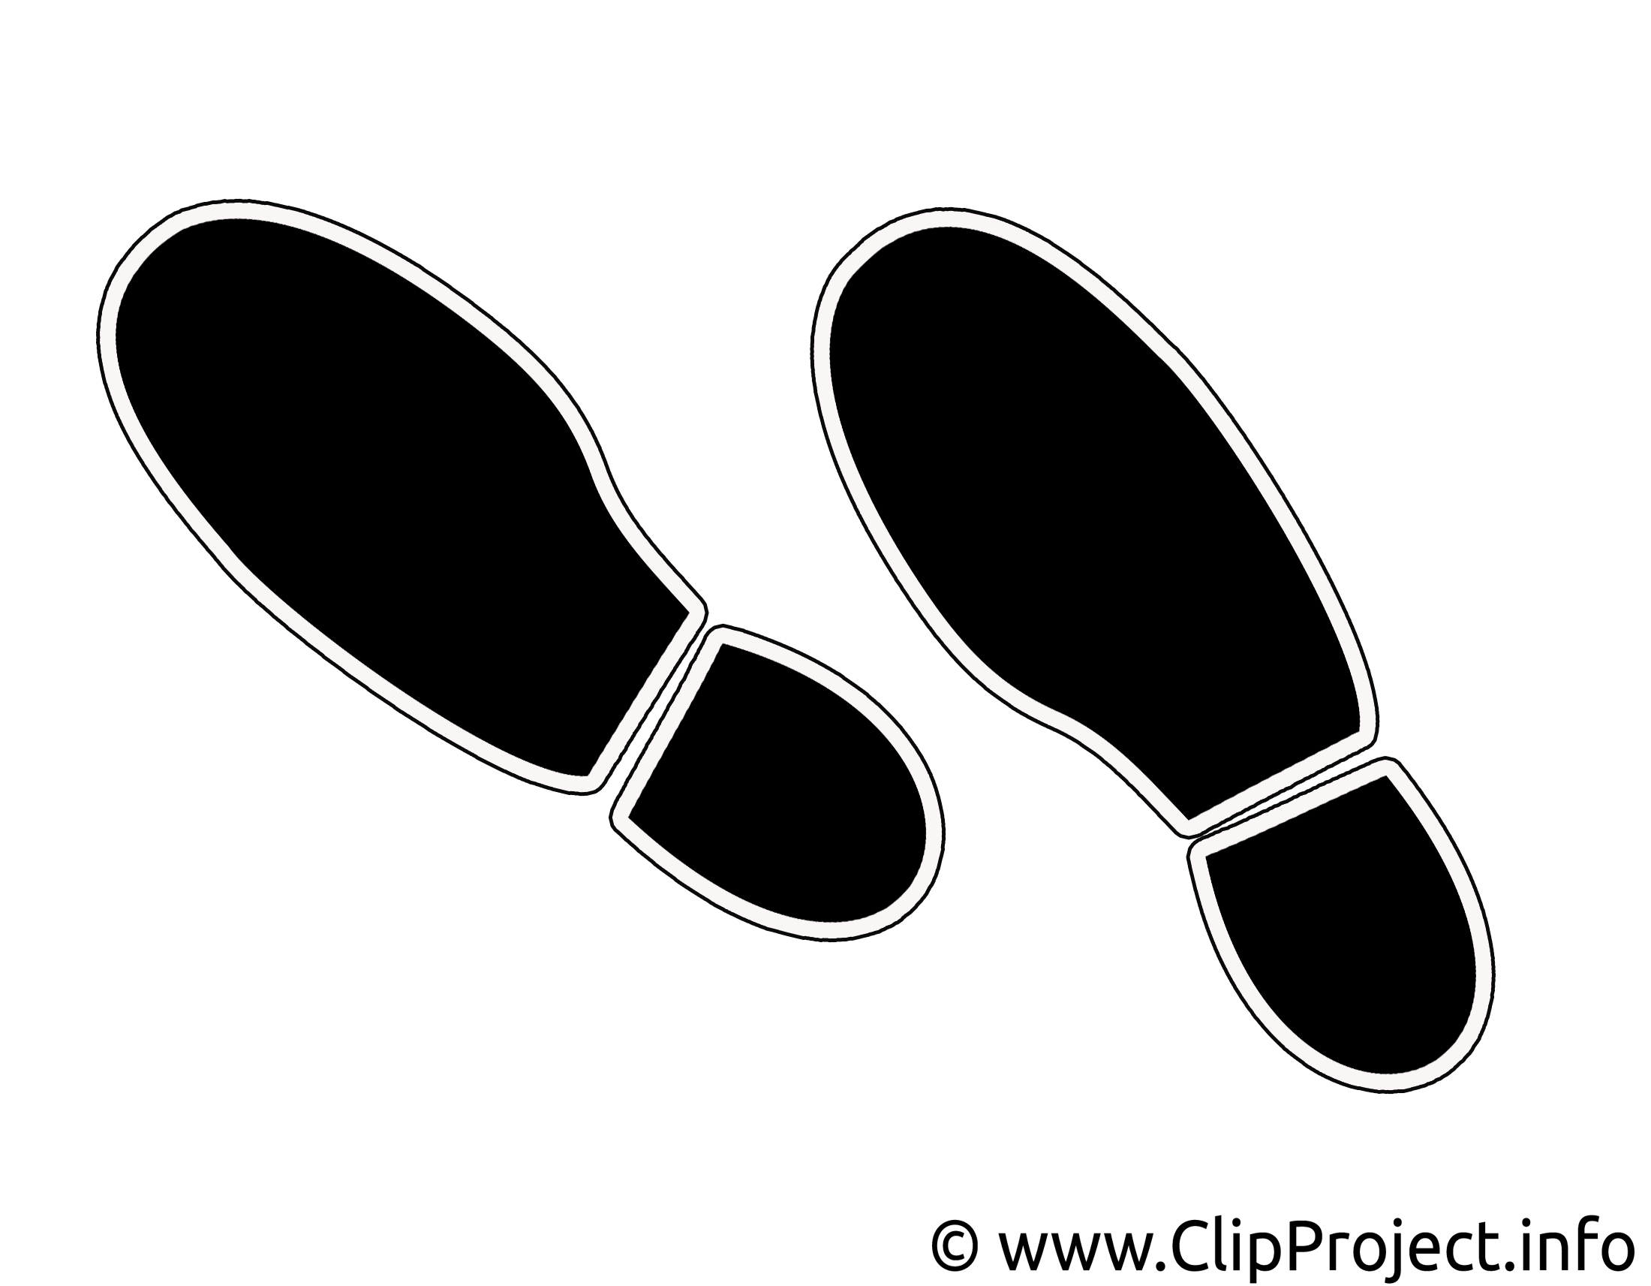


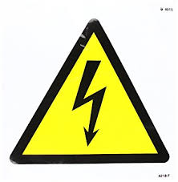
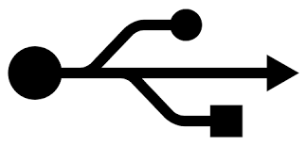
Automation and digitalisation of operations Shaping the future of rail freight
Diagram of an example of the manual efforts required before train departure*
Coupling/decoupling of wagons
Producing of wagon list/brake docket
Coupling/decoupling of the locomotive
Technical wagon inspection
Simple/full brake testing
Recording/processing of train data
* In wagon load services, in train formation yards in particular, there are substantially more manual efforts involved than shown in the diagram above.
Sources: TIS / Figures: 1 – Pixabay - _Alicja_ | 2 – Pixabay - moritz320 | 3 – Pixabay – Kaufdex
www.bmvi.de | 25 September 2019

Slide 12
Digital automatic coupling
The basis for digitalisation and automation
The introduction of digital automatic coupling (DAC) is the basis for making rail freight fit for the future. DAC includes the automatic coupling of air, power and data lines.
DAC enables the application of telematics and other innovative components, data supply from freight wagon to freight wagon and between freight wagons and traction unit(s) and allows for cost savings in rail and shunting operations.
The Federal Ministry of Transport and Digital Infrastructure has put out to tender a study for the establishment of a migration strategy for the introduction of DAC in Europe.

Slide 13

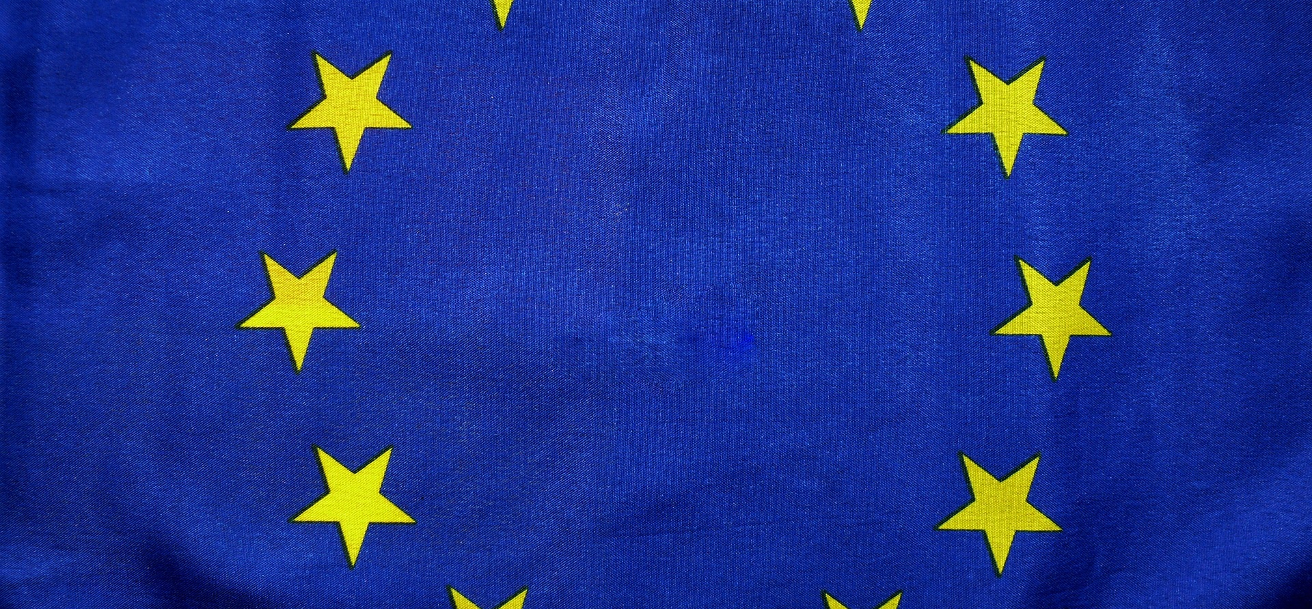

Improving cooperation in Europe and with other international partners
Rail freight is international traffic
More successful if railways are able to cross Europe without hindrance
Stronger cooperation between the European states and with other international partners is necessary
Germany is ready for this

Slide 14
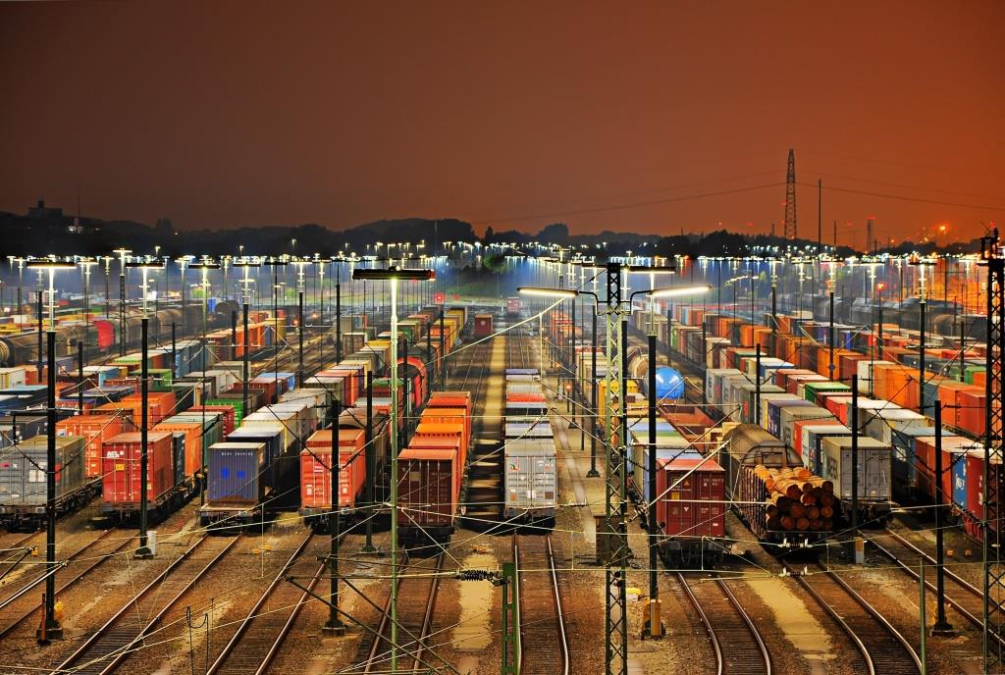
Thank you very much!
Contact
Federal Ministry of Transport
and Digital Infrastructure (BMVI)
Division: E 11 Rail Freight Masterplan, Funding of Private Sidings
Invalidenstraße 44
10115 Berlin
Contact person
Mathias Schulz
Mathias.Schulz@bmvi.bund.de
www.bmvi.de
Tel. +49 (0) 30 18300 - 4114
© Marco2811 /stock.adobe.com

