Slide 1
Modifications to UN R131
AEBS for Heavy Vehicles
Submitted by the expert from Germany
Informal document GRVA-01-30
1st GRVA, 25-28 September 2018
Agenda item 7
Explanation of ECE/TRANS/WP.29/GRVA/2018/4
at the 1st GRVA
Notes:
The aim of this presentation is to explain the proposed modifications of R131, in addition to the justifications provided with ECE/TRANS/WP.29/GRVA/2018/4. The sequence of topics is different to the working document and there is additional content.

Slide 2
Structure of Presentation
Structure of R131
Target
Overriding
Warning Requirements
Deactivation
Performance Requirements & Test Conduction

Slide 3
Proposed Structural Changes
Current structure defines performance requirements ONLY for one speed
Performance requirements for other speeds unclear
Proposed structure introduces requirements for whole speed range
All performance requirements are included in section 5 (Specifications)
Proposed structure increases clarity of requirements

Slide 4
Structure - Overview
Current Structure:
Proposed Structure:
5 – Specifications
General requirements
6 – Testing
Warning timing
Restriction of speed
Reduction in warning phase
Definition of test speed (ego Vehicle)
Tolerances
Annex 3
Definition of target speed
Definition of warning timing
(for test speed 80 km/h)
Definition of speed reduction
(for test speed 80 km/h)
5 – Specifications
General requirements
Warning timing for whole speed range
Speed reduction
6 – Testing
Tolerances
Parametric test description
Test speeds
Pass/fail per reference to chapter 5

Slide 5
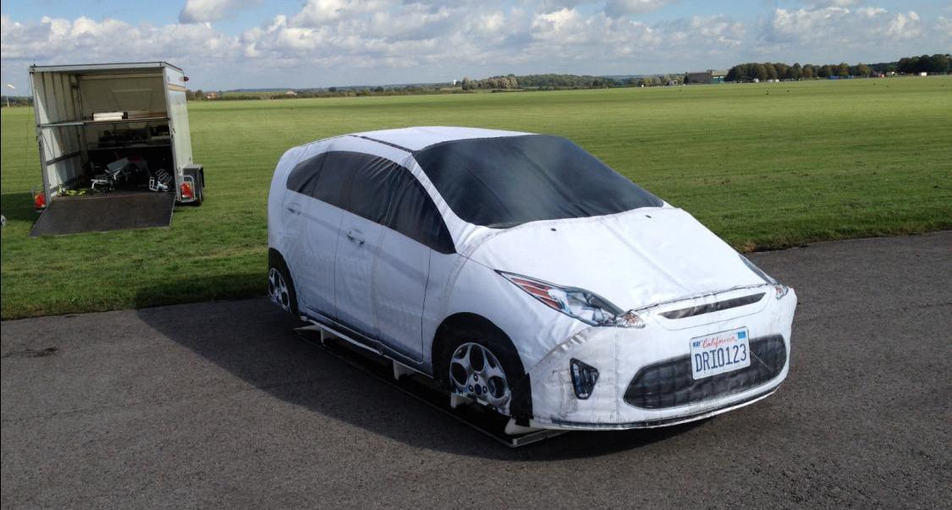
Target
Current R131 allows any M1 AA saloon car
Proposal: Use compact car, such as the target defined in ISO 19206-3.

Slide 6
Overriding
R131 mentions direction indicator as example for overriding.
Example for direction indicator as positive action could suggest that a direction indicator signal might be sufficient for abortion of AEBS intervention.
Conclusion: Delete example reference
Natural driver movements caused by braking could lead to system override.
“5.3.4. The vehicle manufacturer shall demonstrate to the satisfaction of the technical service that natural driver movements generated purely by brake activations shall not lead to an interruption of the emergency braking phase.”
This is assumed to be state of the art; included for clarification.

Slide 7
Warning
Current warning requirements: too frequent warnings in certain situations
  Low speeds: Manual brake application in regular situations late
  Warning required 1.4 seconds before emergency brake phase → long before manual brake application!
Current warning requirements prevent effective braking e.g. for decelerating lead vehicles
  Minimum warning time of 1.4 seconds (0.8 s for lighter vehicles) before full braking can be applied
  Speed reduction in warning phase is limited
Conclusion: Speed reduction/deceleration constraints for warning phase need to be removed for efficient braking!

Slide 8
Deactivation
Documents ECE/TRANS/WP.29/GRRF/2017/24 and GRRF-86-32 included in the text
Changes to warning timing (effectively removing mandatory warnings for city speeds)
→ less unjustified warnings in cities! See GRRF-85-21, third bullet point
While GRRF-86-32 introduced provisions for detecting sensor blocking, it is anticipated that it will be more beneficial to address this problem by exempting the relevant vehicles by national legislation from the requirement to use UN Regulation No. 131.
Certain N₃ vehicles are available without switch!

Slide 9
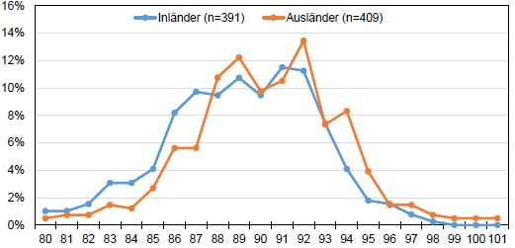
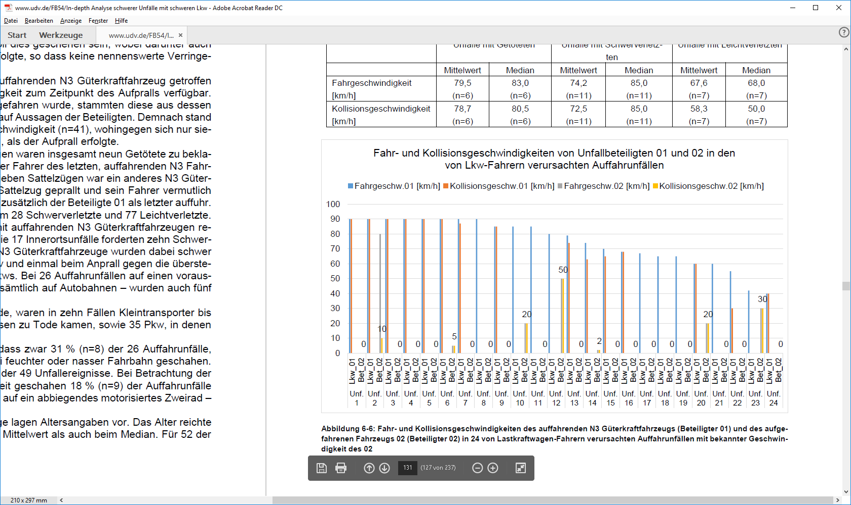
Accidentology
Collision speed of heavy vehicles with stationary targets often high
Typical speeds on German highways: >> 80 km/h
Requirements for speed reduction on moving and stationary vehicles should be harmonized
Speed reduction should be required/tested for full speed range
Initial Speed Heavy Vehicle
Collision Speed Heavy Vehicle
Initial Speed Target Vehicle
Collision Speed Target Vehicle
Source: UDV (Observations)
Speed [km/h]
Speed Classes [km/h]
Accident No.
Source: UDV (German Insurance Data)
Notes:
Accident data from the German insurance accident research institute shows that a significant portion of accidents occurs between trucks travelling at high speeds and stationary vehicles. The left diagram shows initial and collision speeds of heavy vehicle (causing the accident) and target vehicle, for all available accidents (n=24). In at least 7 of the accidents, a heavy vehicle hits a stationary vehicle without any decelaration. The relative speed is always above 80 km/h, in 5 out of 7 cases, it is 90 km/h.
The diagram on the right-hand side of this slide shows the distribution of driving speeds in an observation of traffic using a measurement system. The majority of observed vehicles was travelling at approximately 90 km/h.
The accident data therefore supports higher speed reductions on stationary vehicles, and it supports higher operation speeds as well.

Slide 10
Performance Requirements (Speeds in km/h)
70 km/h relative speed reduction already required for moving vehicles
Now: require this also for stationary vehicles
 | Stationary Vehicles | Constant Moving Vehicles | Proposal
N2*, M2* (current R131) | v_{red} = 10 | v_{red} = 12 | v_{rel,avoid} = 70 v_{rel,red,mitig.} = f(v_{rel})
N3**, M3** (current R131) | v_{red} = 20 | v_{red} = 68 | v_{rel,avoid} = 70 v_{rel,red,mitig.} = f(v_{rel})
Test Speeds | 80 | v_{Ego} 80, v_{Target} 12 (N3), v_{Target} 68 (N2*) | To be selected from whole operating speed range
* N₂ < 8t, M₂, N₃ with hydraulic brakes
** N₂ > 8t, M₃, N₃ with pneumatic brakes
Notes:
The higher speed reductions for stationary targets are reflected in proposed performance requirements.
Currently, a speed reduction of 68 km/h is required for moving targets. This means that, from a driving dynamics point of view, a speed reduction of 70 km/h for stationary targets should be achievable. The reason for limiting the speed reduction on stationary targets in Regulation 131 was the challenging detection of those targets with sensors. Technology has progressed in the meantime, therefore it should be feasible to transfer the performance requirements from moving targets towards stationary targets.

Slide 11
Performance Requirements – Consequences
Brake strategy (TTC, Last Point to Steer etc) same as for moving vehicles (N₃)
In that sense, the proposal does not ask for new system designs!
Classification of stationary targets as “in vehicle path - relevant for braking“ might require more advanced sensor technology
  Fusion with lane detection could be required
  High resolution RADAR could be required
Systems on the market show: this technology has become readily available in recent times

Slide 12

State of the Art
Other Data:
ADAC (2017)
3 trucks from independent companies
Trucks fully loaded
Speed reduction:
≥ 70 km/h on stationary target
3 of 5 truck corporations with > 50% market share in Western Europe
System: Single RADAR
Avoidance up to 80 km/h
Notes:
Marktanteile:
Mercedes-Benz: 23 Prozent
VW MAN: 17 Prozent
Paccar DAF: 15 Prozent
Volvo: 11 Prozent
Iveco: 11 Prozent
Sonstige: 23 Prozent
Werte gerundet und inklusive erwarteter Marktanteile für 2014
Quelle: IHS Automotive
https://www.wiwo.de/unternehmen/auto/lkw-markt-eine-profitable-nische/10724270-2.html

Slide 13
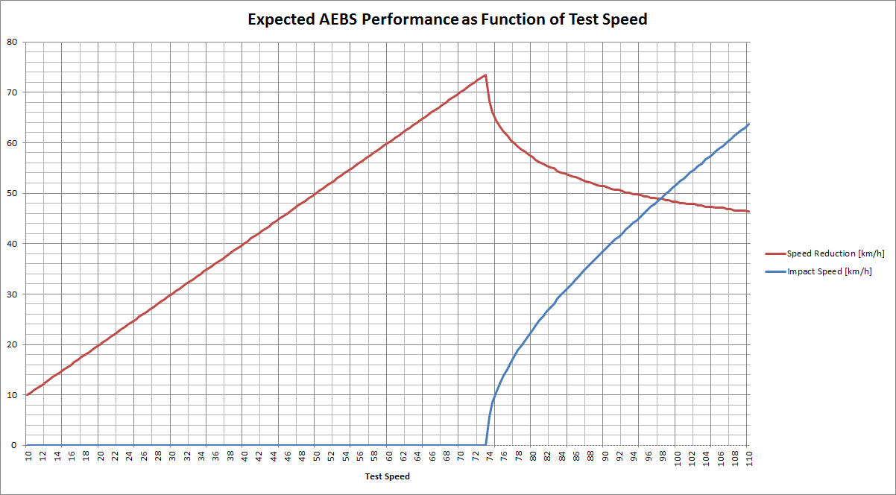
Proposed Speed Reduction Requirements
Valid for parameters:
Speed reduction [km/h]
Impact speed [km/h]
Example: Required Performance
Test Speed [km/h]
(Derivation of curves: see annex
to this presentation)

Slide 14
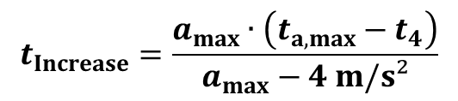
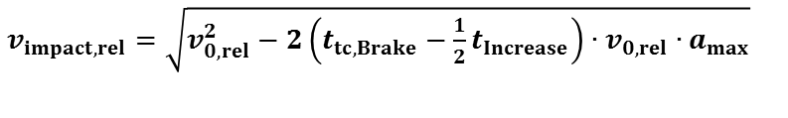

Identification of Parameters for Mitigation Req‘s possible from measurements
$v_{impact,rel}=\sqrt{v_{0,rel}^{2}−2\left(t_{tc,Brake}−\frac{1}{2}t_{Increase}\right)∙v_{0,rel}∙a_{max}}$
Hypothetical brake measurements
e.g. 70 km/h
Speed [km/h]
Deceleration [m/s²]
e.g. 7 m/s²
a_{max}
4 m/s²
e.g. 3 m/s²
$$t_{tC,Brake}=t_{tC,4}∙v_{0,rel}/v_{4,rel}$$
$$t_{Increase}=\frac{a_{max}∙\left(t_{a,max}−t_{4}\right)}{a_{max}−4 m/s²}$$

Slide 15
Implementation: Performance Requirements
Paragraph 5.2.2.2. asks for an avoidance up to [70] km/h on dry, [40] km/h on wet roads.
This avoidance speed is the maximum achievable speed reduction. For mitigation, the speed reduction is lower:
Paragraph 5.2.2.3. defines a speed reduction according to the equation for mitigation (test speed > avoidance speed).
The input parameters for the equation in paragraph 5.2.2.3. can be taken from actual measurement in paragraph 5.2.2.2.
Effectively this means the brake strategy should not be changed above the avoidance speed!
Paragraph 5.2.2.4. requires that the maximum deceleration is used for decelerating lead vehicle situations (no other requirements set!)

Slide 16
Proposed Changes for Test Conduction
 | Current (Stationary) | Current (Moving) | Proposal (Stationary) | Proposal (Moving)
Functional part of test shall start… | 50 m distance | 120 m distance | 6 s TTC (133m@80km/h) | 6 s TTC (113m@80-20)
Test Speed | 80 ± 2 km/h |  | X* ± 2 km/h | X* ± 2 km/h
Test Speed Target | - | 67 km/h**, 12 km/h*** | - | 12 km/h or any other speed within requirements
Tolerance for Speed Reduction | - | - | 5 km/h (up to [70] km/h vrel) 10 km/h (above [70] km/h vrel)
*Test Speed: (20 for stationary), 40, 60, 80, 100, v_{Avoidance}, v_{max},
where: v_{Avoidance} = v_{relative,avoidance} + v_{Target}
** N₂ < 8t, M₂, N₃ with hydraulic brakes
*** N₂ > 8t, M₃, N₃ with pneumatic brakes

Slide 17
Summary
New structure
Scope NOT changed – still highway systems!
Clarification of requirements for speeds other than 80 km/h
Target size limited to compact class vehicle
Overriding clarified
Warning – increased flexibility of warning (e.g. allow full braking in warning phase)
Deactivation – no changes to last proposals.
  Deactivation less required in complex situations
Performance:
  Accidentology shows stationary targets are highly relevant.
  Proposal aims to align requirements for moving and stationary vehicles (NO new requirements introduced!)
  State of the art systems (for N₃, M₃) are able to meet the proposed performance requirements
  Assumption: Different performance req’s for lighter vehicles not needed anymoe.

Slide 18
Thank you for your attention!
Federal Ministry of Transport
and Digital Infrastructure
Robert-Schuman-Platz 1
D-53175 Bonn

Slide 19
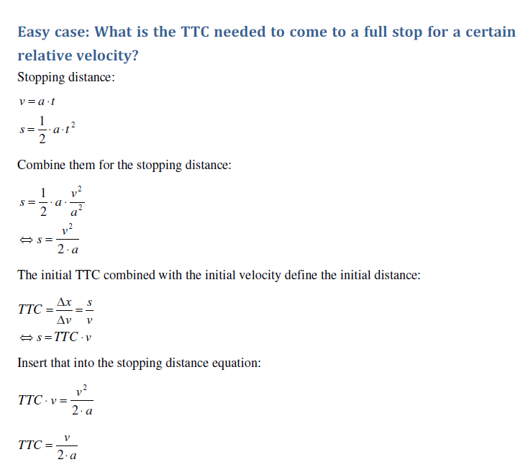
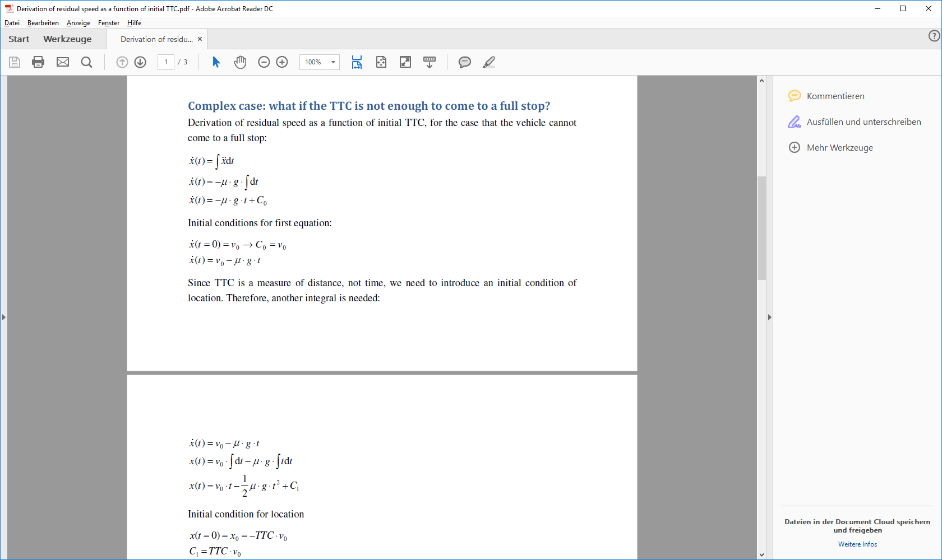
Annex (1) – Derivation of Mitigation Speed Reduction (paragraph 5.2.2.3.)

Slide 20
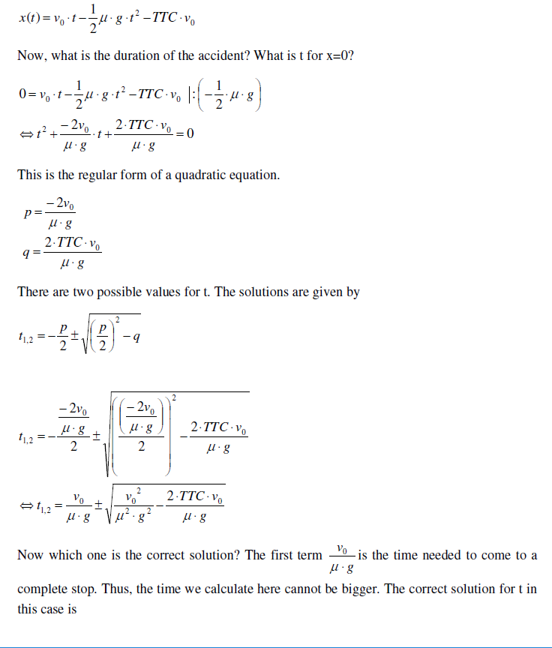
Annex (2)

Slide 21
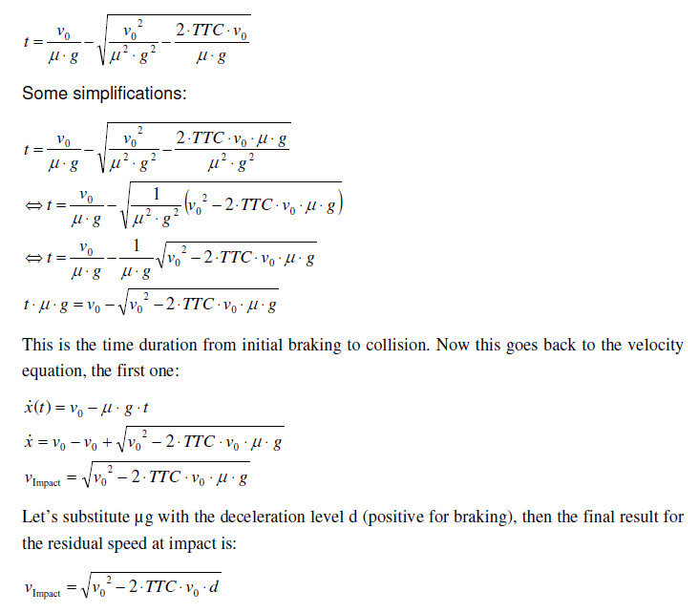
Annex (3)

