Slide 1
Additional Test Methods to ensure robust deployment of Airbag as alternative to airbag switch off / deactivation
Submitted by the expert From OICA | Informal document GRSP-65-09 (65th GRSP, 13-17 May 2019, agenda item 8)
GRSP, May 2019

Slide 2
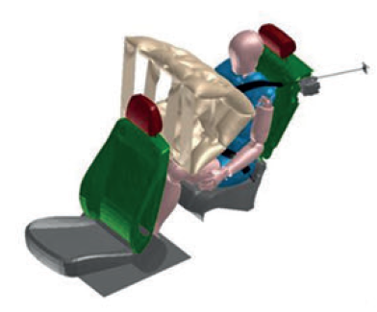
Alternatives to airbag switch off
Motivation - General:
Optimal protection of adult occupants in case of a frontal crash if a restraint system includes safety belt and airbag
The improvement of occupant protection can be seen in the accident statistics of the last years
The system (safety belt and airbag) for driver and passenger in the first row has been continuously optimised
This has also been considered by legislation
Under certain conditions, it could also be beneficial to use those systems for rear adult occupants
Motivation - Current Challenges in Design and Type Approval:
The implementation of an airbag in the rear is very complex due to the integration of the component, the geometrical situation and the many variances of possible seating positions
Therefore it is recommendable to develop for this situation a harmless airbag technology, fulfilling appropriate performance requirements (e.g. see USA “Low Risk Deployment”) , which should be defined as optional alternative
In this case manual / automatic deactivation is not needed anymore

Slide 3
Proposal
Draft proposal to amend UN-R16.
To allow for an additional, optional test method for frontal airbags in the rear of a vehicle in combination with rearward child restraint systems.
Tests and criteria are taken from UN-R129.
If the defined criteria are fulfilled, deactivation and warning of airbag would not be needed anymore.
Existing § 8.1.9. + 8.1.10. were modified.
A new § 8.5. and a new annex 19 were added.
UN-R94+137 would have to be modified accordingly. In UN-R14+145 also slight modifications are needed.

