Slide 1
KEY DIRECTIONS OF THE REGIONAL LOGISTICS SYSTEM DEVELOPMENT,
APPLICATED BY FREIGHT VILLAGE RU
Alexander Oleynikov
Ph.D in economics,
Director for government and international organizations relations
November 20, 2018
Geneva

Slide 2

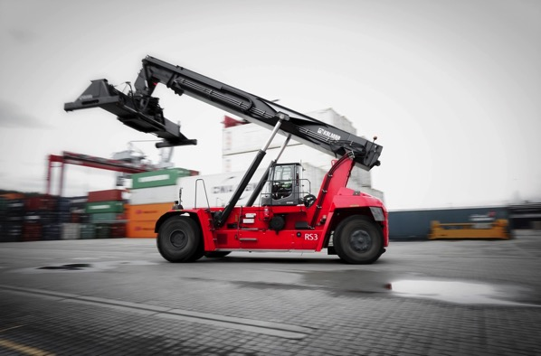
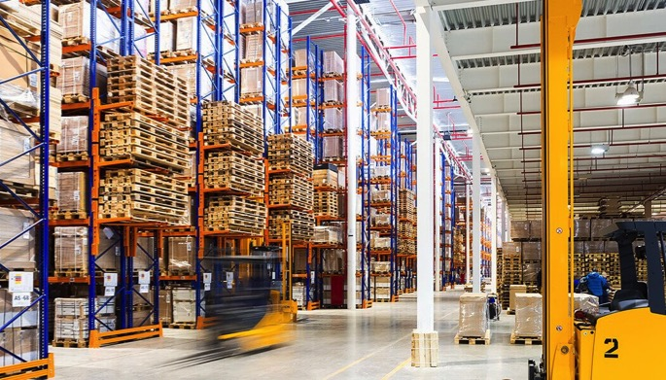
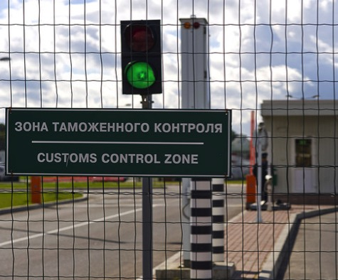
COMPANY’S PROFILE
In 2012 FREIGHT VILLAGE RU started development of the largest multimodal industrial-logistics centre in Russia in unique concept of ‘freight village’ – Freight Village Vorsino and Freight Village Rosva.
FREIGHT VILLAGE VORSINO (international format of freight village, 570 ha) located on the border of Moscow and Kaluga region as a part of Industrial Park Vorsino.
FREIGTH VILLAGE ROSVA (regional format of freight village, 64 ha) located on the border of Kaluga as a part of Industrial Park Rosva.
The Group offers warehouse and industrial facilities for rent and owner-occupation, industrial land for sale and delivers rail container terminal and customs services to the market, as well as developing large-scale industrial and residential projects.
Industrial land
Container terminal
Cross-docking warehouses
Customs terminal

Slide 3
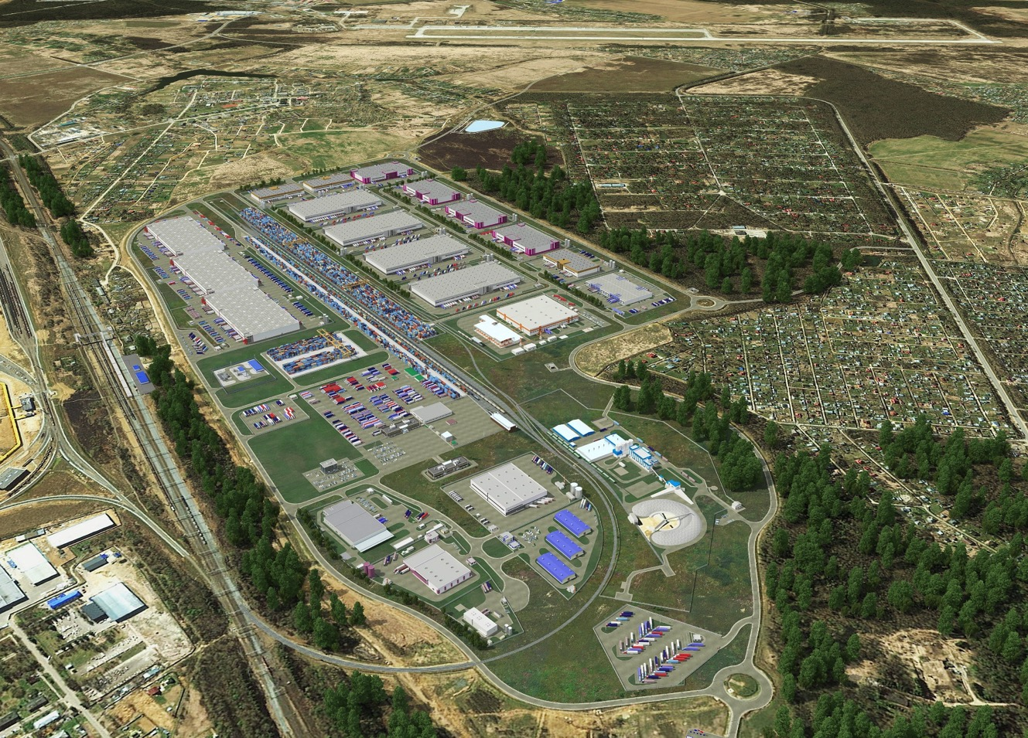
FREIGHT VILLAGE VORSINO CONCEPT
Rail terminal
Customs terminal
Airport
INDUSTRIAL–LOGISTIC INFRASTRUCTURE
Cross-docking warehouse
INFRASTRUCTURE OF ADDED VALUE
Rail container terminal, customs terminal and bonded warehouses, repair and maintenance container services, truck stops, transport companies
SERVICE INFRASTRUCTURE
Offices of property management and facility management companies, retail zone, hostels
INDUSTRIAL–LOGISTIC INFRASTRUCTURE
Industrial zone
TRANSPORT INFRASTRUCTURE
Multimodal logistic terminal:
auto, air and rail transportation

Slide 4
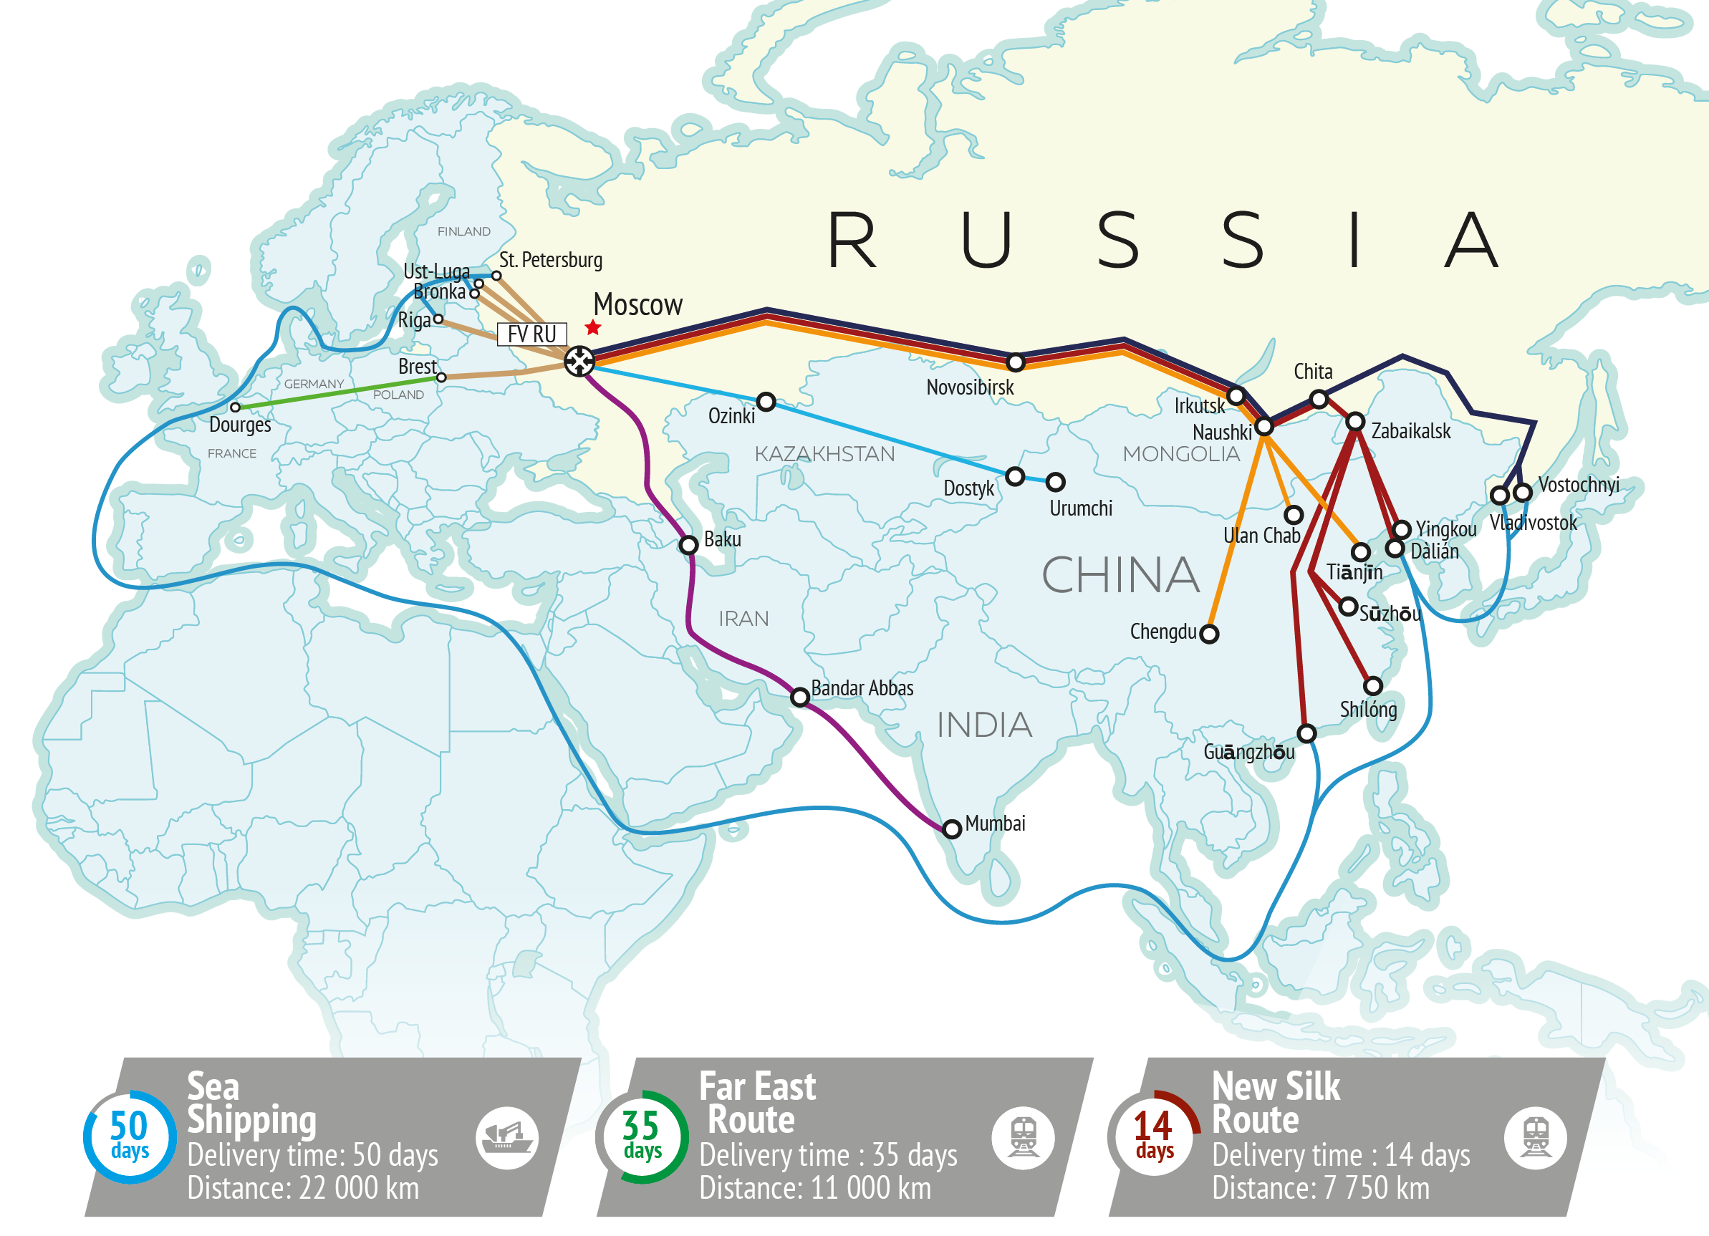
НОВЫЙ ШЕЛКОВЫЙ ПУТЬ ДЛЯ ЕВРАЗИИ
CONTAINER ROUTES VIA VORSINO

Slide 5
CONTAINER CARGO MARKET TENDENCIES
The Russian container market will grow 5,8% per year in average from 2018 to 2023
The Moscow transport knot in separate is expected to grow 5,2% per year
Volume of rail container transportation in Russia,
mln TEUs
Container handling volume at MTU,
thsd TEUs
CAGR +5,8%
CAGR +5,2%
Volume of container-offloading at MTU
Volume of container-offloading at FV Vorsino

Slide 6
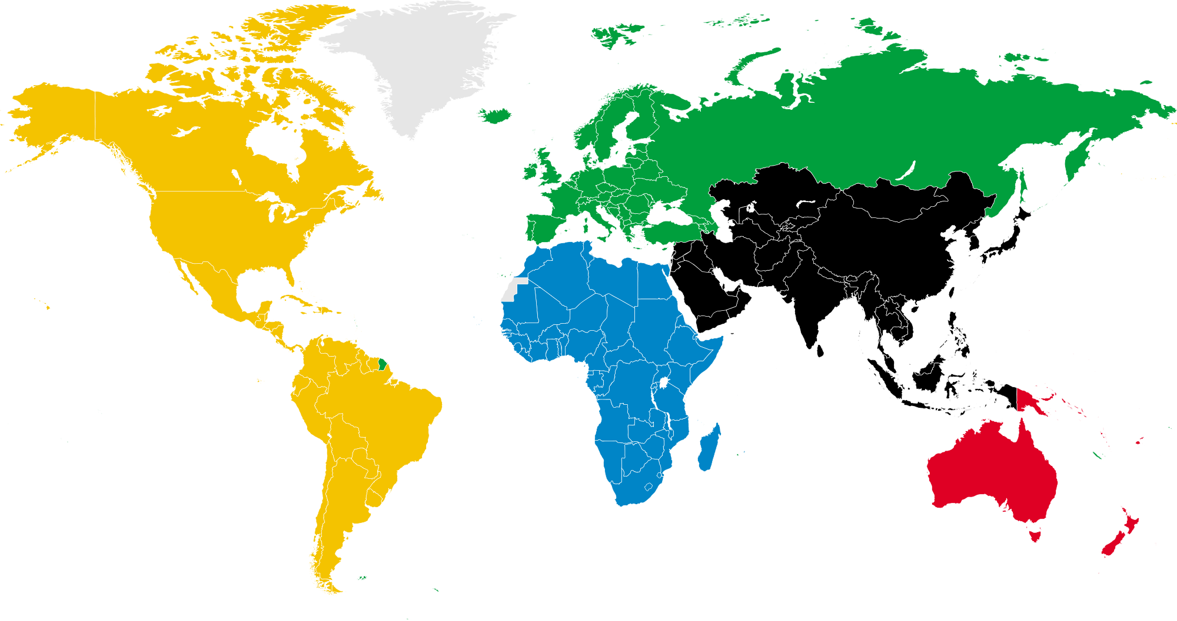
The population growth is corelated with the largest cities GDP growth
THE CITIES POPULATION GROWTH CHALLENGE
The world population is approximately 7,6 billion people
There is 10% of the world’s population living in the 50 largest cities
More than half of world’s GDP is produced by the largest cities
The average population density in the megapolises is 6 thousand people per squire km.
The Moscow population is 11% of the whole Russian population
Moscow share in Russian GDP is 26%
The Moscow population density is 4 thousand people per sq km
The new tendencies of the agglomerations development are being formed

Slide 7

Megapolis development requires implementation of new technologies into logistics system
KEY TENDENCIES
Key tendencies
Movement of the industries, centers of consumption and entertainment to the suburbs of the cities
Development of the industrial and logistics parks (new types of the joint infrastructures)
Turn to the comfortable public transport development
Formation of the comfortable and environmental city infrastructure
Application of the new ‘smart’ technologies of the cities management

Slide 8
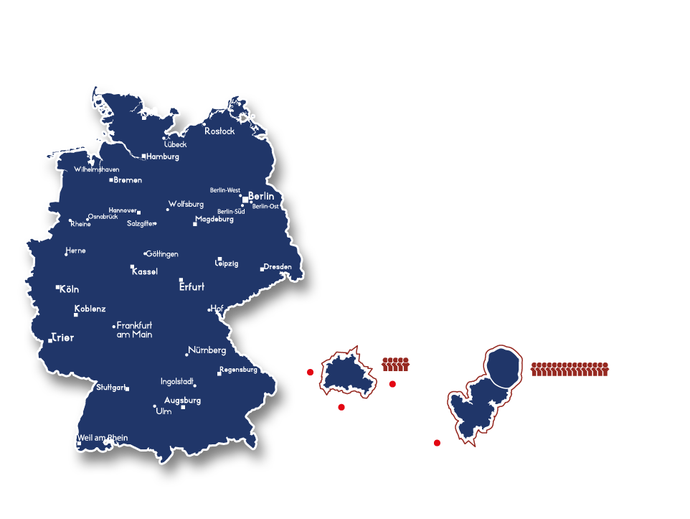
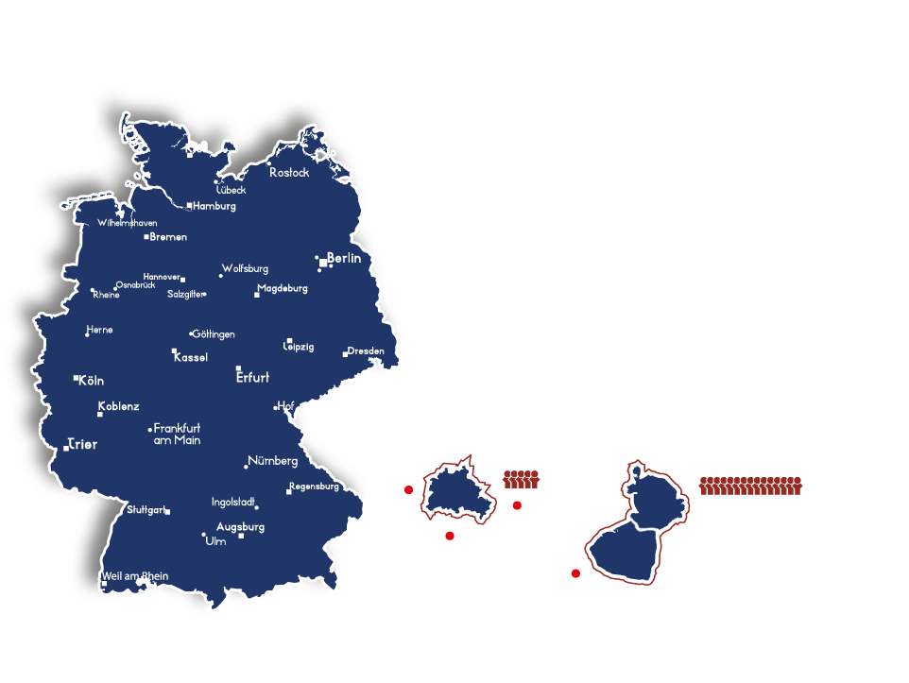
FREIGHT VILLAGE CONCEPT, EUROPEAN APPROACH
ITALY
More than 25 freight villages
More than 1,000 transport companies – residents
38,000 people employed
GERMANY
More than 30 freight villages
Integration into the joint network
Outside the cities
Situated on the cross-points of the main transport routes
Milano
MILAN
BERLIN
MOSCOW
Verona
Berlin-West
Population:
5 mln.
Torino
Population:
4.6 mln.
Population:
15 mln.
Pavia
Berlin-Ost
Genova
Berlin-Süd
FV Vorsino

Slide 9
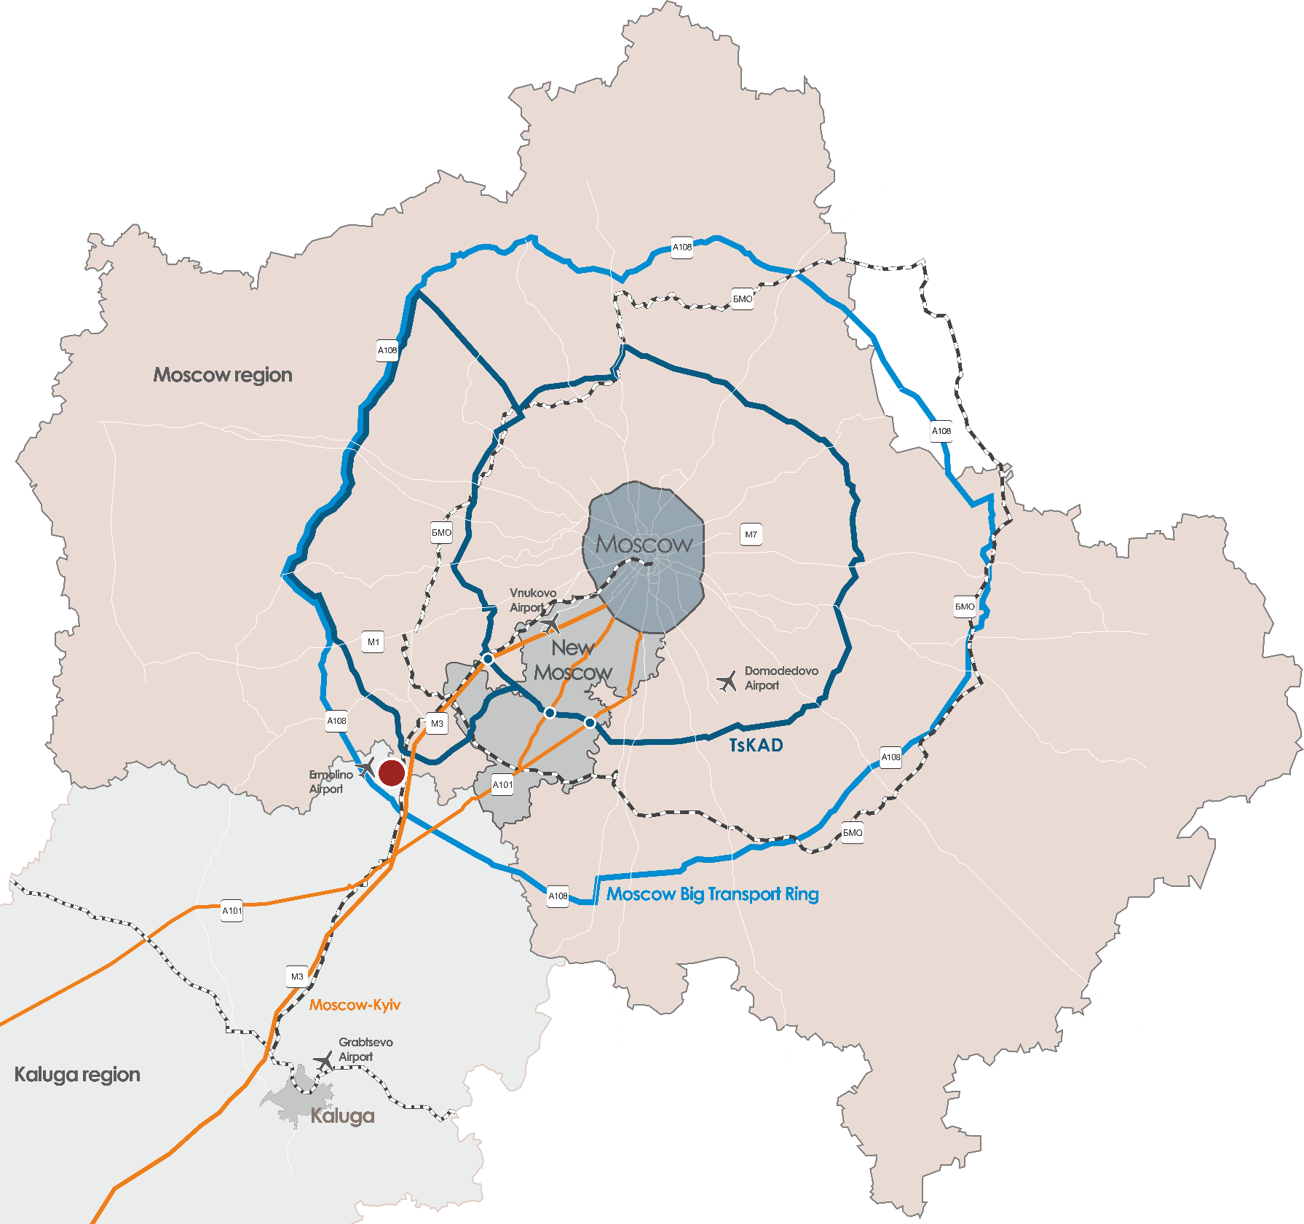






FREIGHT VILLAGE LOCATION IN RUSSIA
Freight Village Vorsino – large-scale multi-modal industrial-logistics cluster of nation wide significance
Optimal distance to the New Moscow
Transit to other regions of the Central Federal District
Severyanin
67 km
40 km
3 km
40 km
| 40 min to MKAD
| 25 min to A-107
| 5 min to A-108
| 30 min to М-1 Moscow-Minsk
Khovrino
Orekhovo-
Zuevo
Kuntsevo-2
Lyublino
Ecodor Podolsk
3 km to new TsKAD section
FV Vorsino
45 km to Vnukovo airport
Vorsino railway station – onsite
Bekasovo marshal yard – 25 km
Moscow cargo hubs
Moscow cargo hubs – planned closure
(Paveletskaya, Oktyabrskaya, Butyrskaya, Rizhskaya, Ryazanskaya, Kurskaya, Kievskaya, Smolenskaya)
Federal cargo hubs

Slide 10
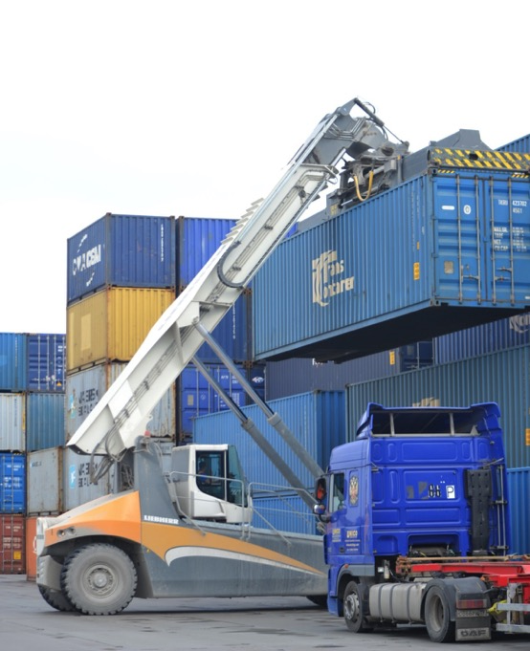
SMART LOGISTICS PROJECT
Historical overview
On March 9, 2016 the Russian Railways took the decision to close the freight yards inside Moscow moving the cargo work outside the city borders
On October 2, 2018 Freight Village RU and the Russian Railways signed an agreement of cooperationship in the field of the projects “Digital container terminal” and “Smart logistics”
On October, 18 2018 - the test freight delivery by short container train from Vorsino to the station Kuntsevo-II inside Moscow
The Aims of the Smart Logistics Project
to form the concept of forwarding the container cargo to the special city terminals by rail finally addressed to the customers inside the city
to optimize the digital document circulation between freight forwarder, terminal and the Russian Railways during the process of transportation organization
to optimize the process of exporting the containers from the Moscow terminal

Slide 11



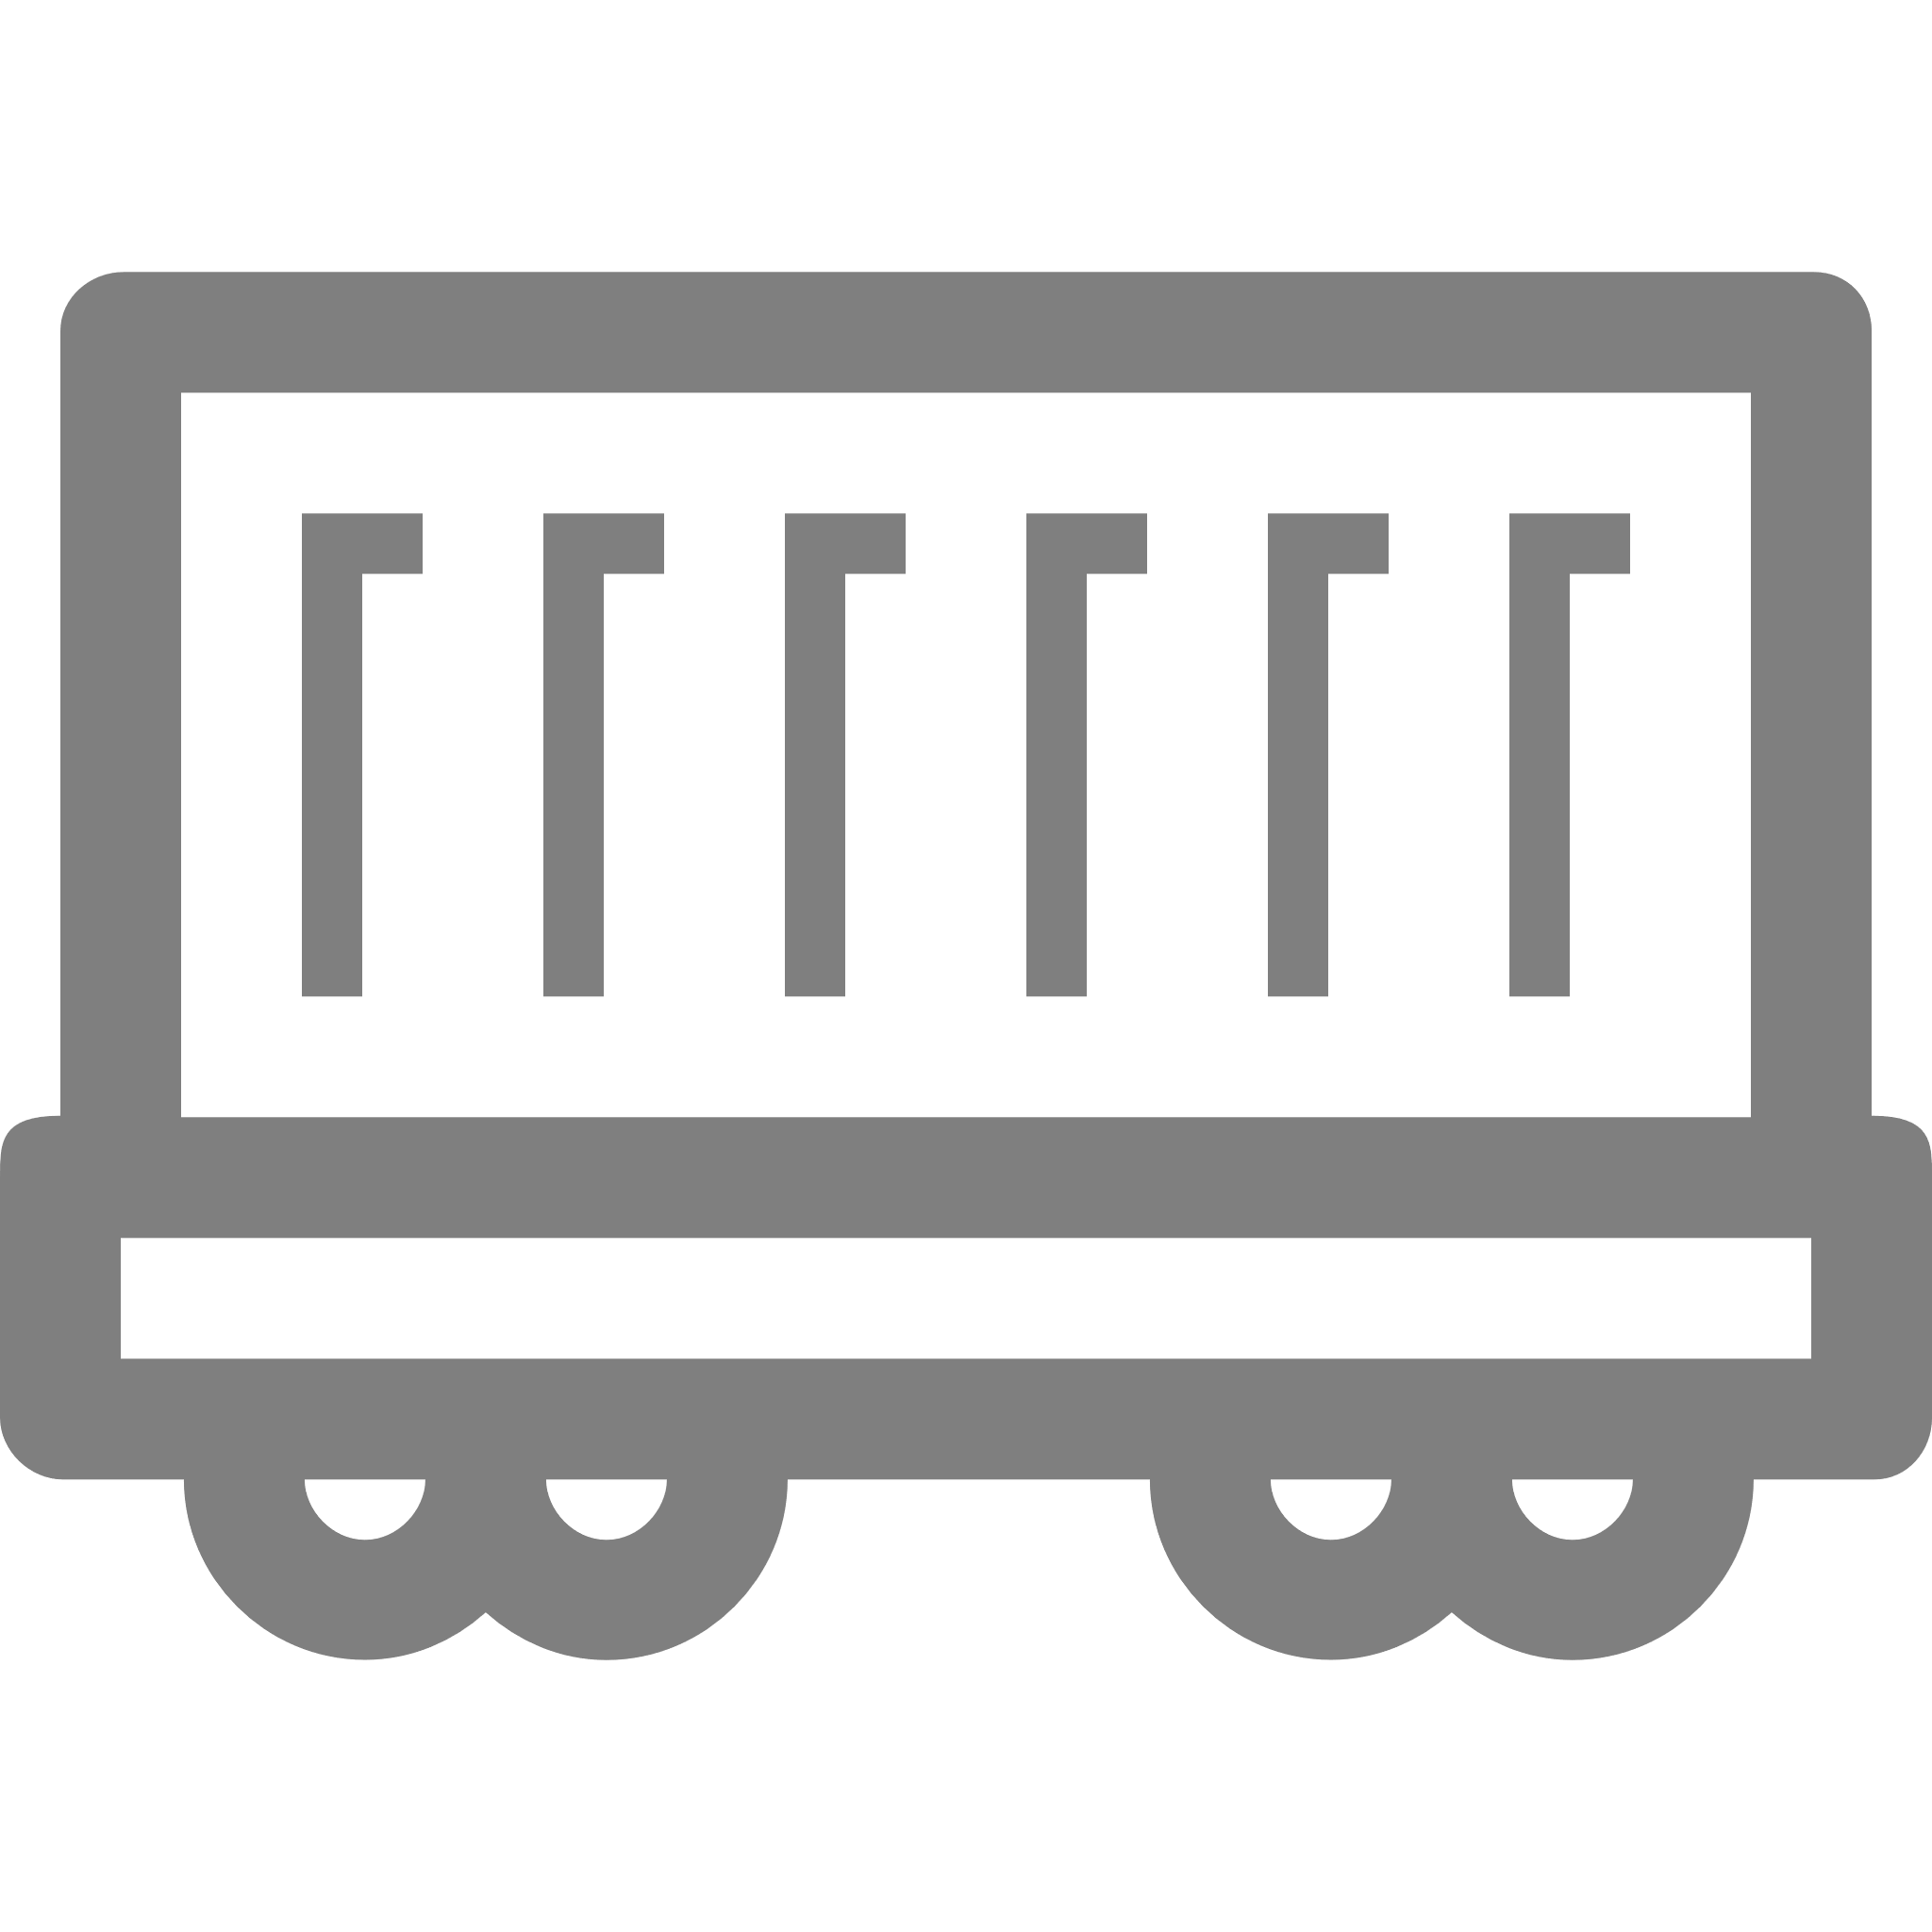


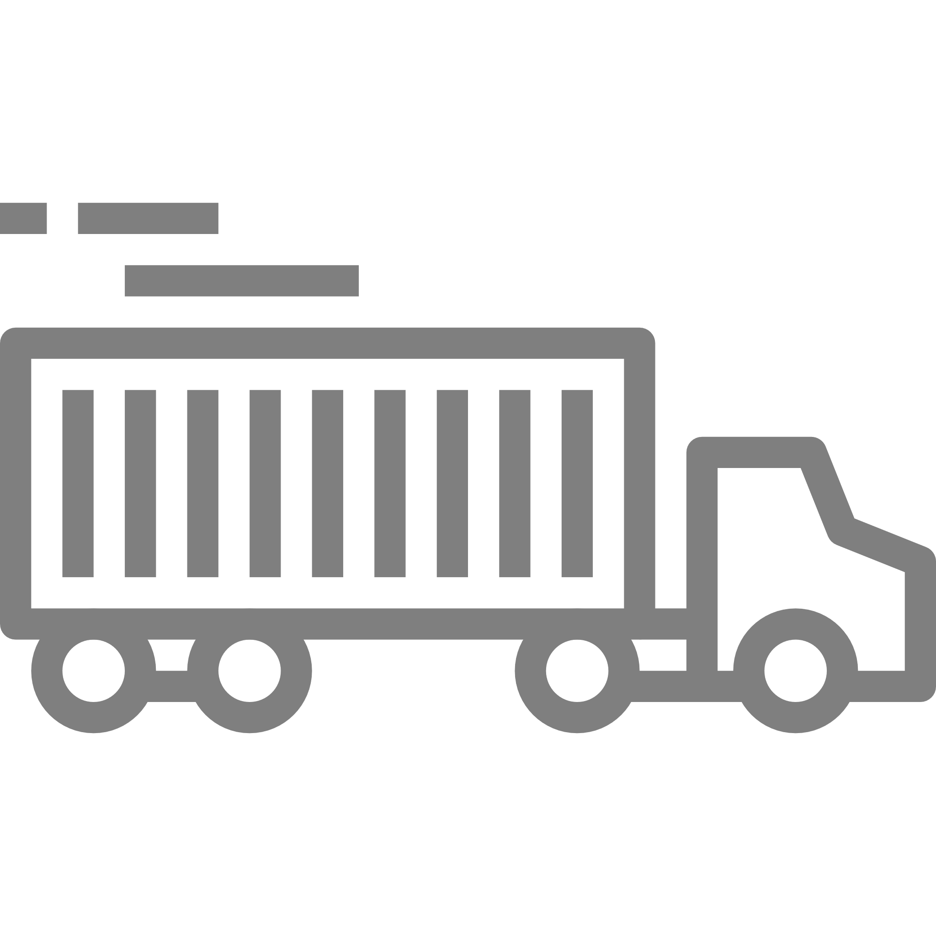
THE SATELLITE HUB
  SMART TERMINAL
  Cross-docking for light-duty trucks
  Warehousing
  SHATTLS («regular container trains»)
  Regular daily schedule irrespective the fallibility of the train
  The train length is suitable for the stations inside the city
  Back delivery of the empty containers to the hub
Joint
Digital
Platform
  FREIGHT VILLAGE // DRY PORT
  Customs operations, bonded warehouse
  Sort of containers by destination
  Container load/unload
  Train formation

Slide 12
DIGITAL LOGISTICS PLATFORM
DIGITAL LOGISTICS PLATFORM
IS ABLE TO:
Automate the logistics business processes, analyze the consumer behavior and offer the optimal decisions for the flows organization
Take into account the specific of auto, rail, water and avia types of transport, the peculiarities of cargo handling at the ports and terminals, warehousing, government relation
Provide the cooperation during the freight transfer orders fulfillment, including the exchange of the legislation significant digital docs
Accumulate, structure and analyze the large volume of data, forecast the future occasions and minimize the risks for the participants of the logistics processes
Optimize the operation of transport, terminal and warehouse assets, increasing its profitability and reducing the delivery cost

Slide 13


DIGITAL LOGISTICS PLATFORM
The digital logistics platform will provide the optimal logistics and manage the distributive warehouses with the minimum amount of staff – the digital warehouse
Managing of the transportations
Joint digital logistics platform
Digital
warehouse
Search of the optimal routes using the technologies of machine learning (the route, considering the terminal points, stuffing, type of property, container runoff, geographical effectiveness and so on)
Interfaces for the forwarders and the clients
Integration with the governmental informational and supply chain management systems of the clients
Digital document circulation
Cooperation with the customs
Management of the cargo deliveries dry port – warehouse, warehouse – destination point
Infrastructure and staff expenditures minimization on the terminals by creating smart loaders using the Computer Vision technologies
Management of the inner warehouse logistics and fulfillment
Digital warehouse – digital copy of the warehouse with more than 40 parameters of the technical condition

Slide 14




Customer journey should be based on the Joint Digital Platform
DIGITAL LOGISTICS PLATFORM
Coordination by phone:
If the customer
intends to deliver
3 pallets to the shop
Current situation
Unpredictability and delays
Absence of transparency
Ineffectiveness
Container delivery to the Moscow area terminal by rail
Container delivery to the transport logistics center in the Moscow area by auto
Warehousing and fulfillment
Delivery to Moscow by auto
Freightforwarders
Joint digital platform:
Digital logistics platform service
Minimization of manual labor
Transparency and predictability of logistics
Optimization
Delivery to the dry port (Freight Village)
Warehousing and digital fulfillment
Transportation to the smart terminal in Moscow by rail
Uberization of delivery inside Moscow

Slide 15
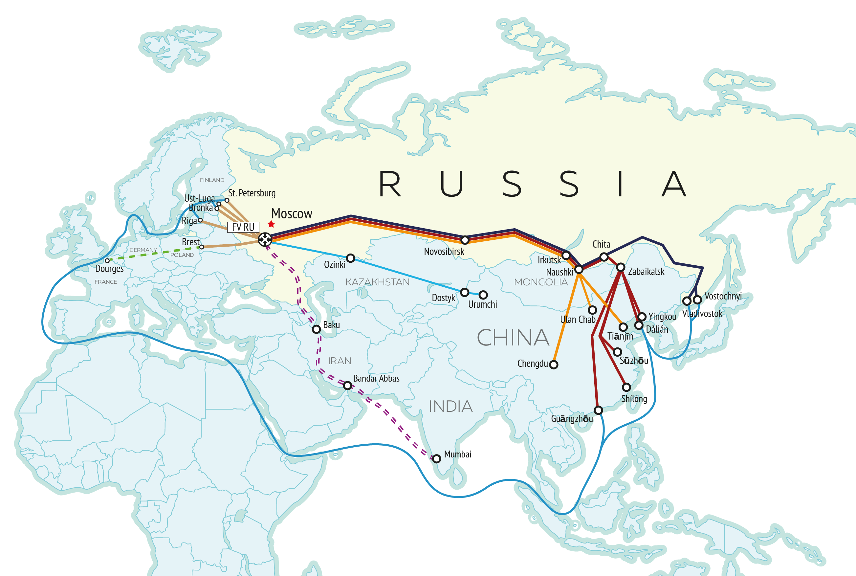
НОВЫЙ ШЕЛКОВЫЙ ПУТЬ ДЛЯ ЕВРАЗИИ
FREIGHT VILLAGE RU DEVELOPMENT PLAN

Slide 16
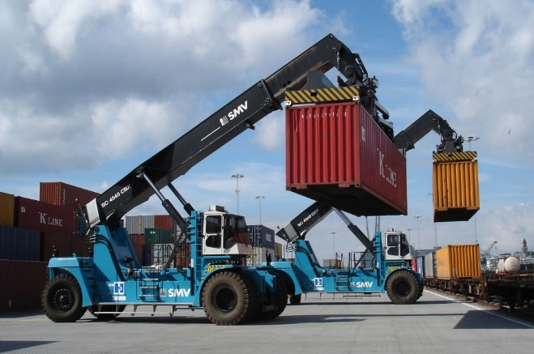
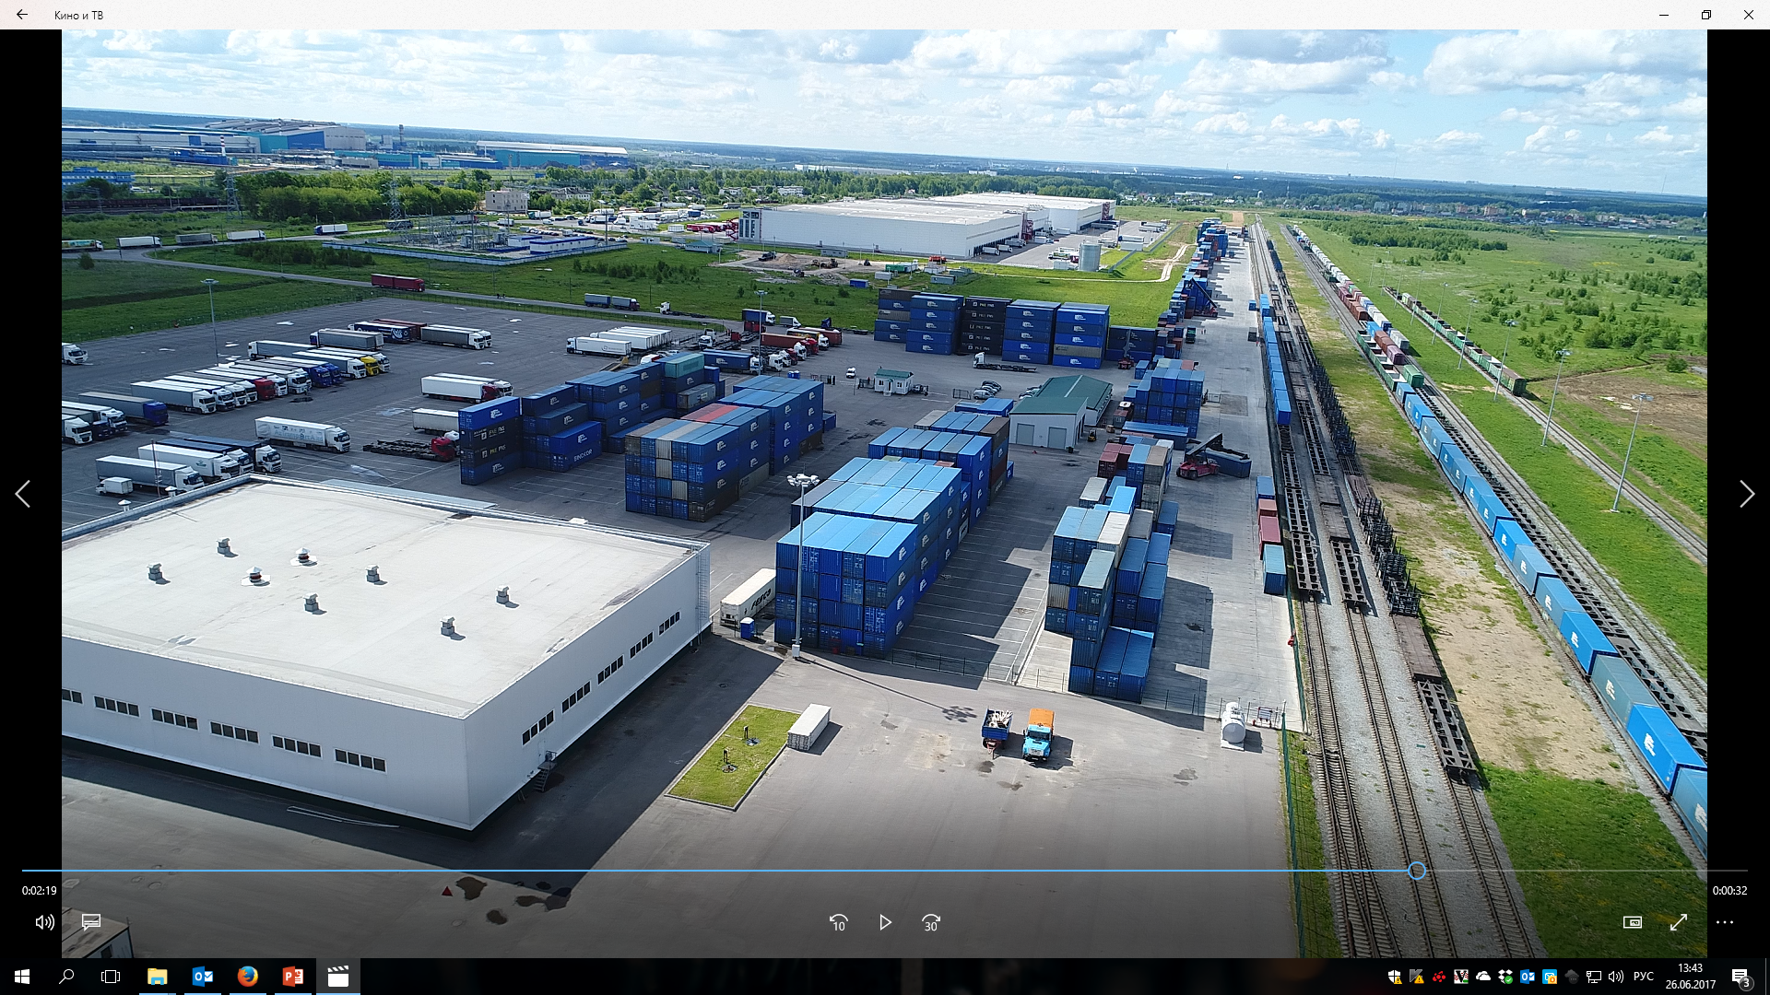




CONTACTS
Thanks for your attention!
Moscow – The city of capitals tower, 4 floor
Vorsino – North Industrial Zone, bld. 6
+7 (495) 741 87 74
sales@freightvillage.ru
www.freightvillage.ru

