Slide 1
International Transport Infrastructure Observatory

Slide 2
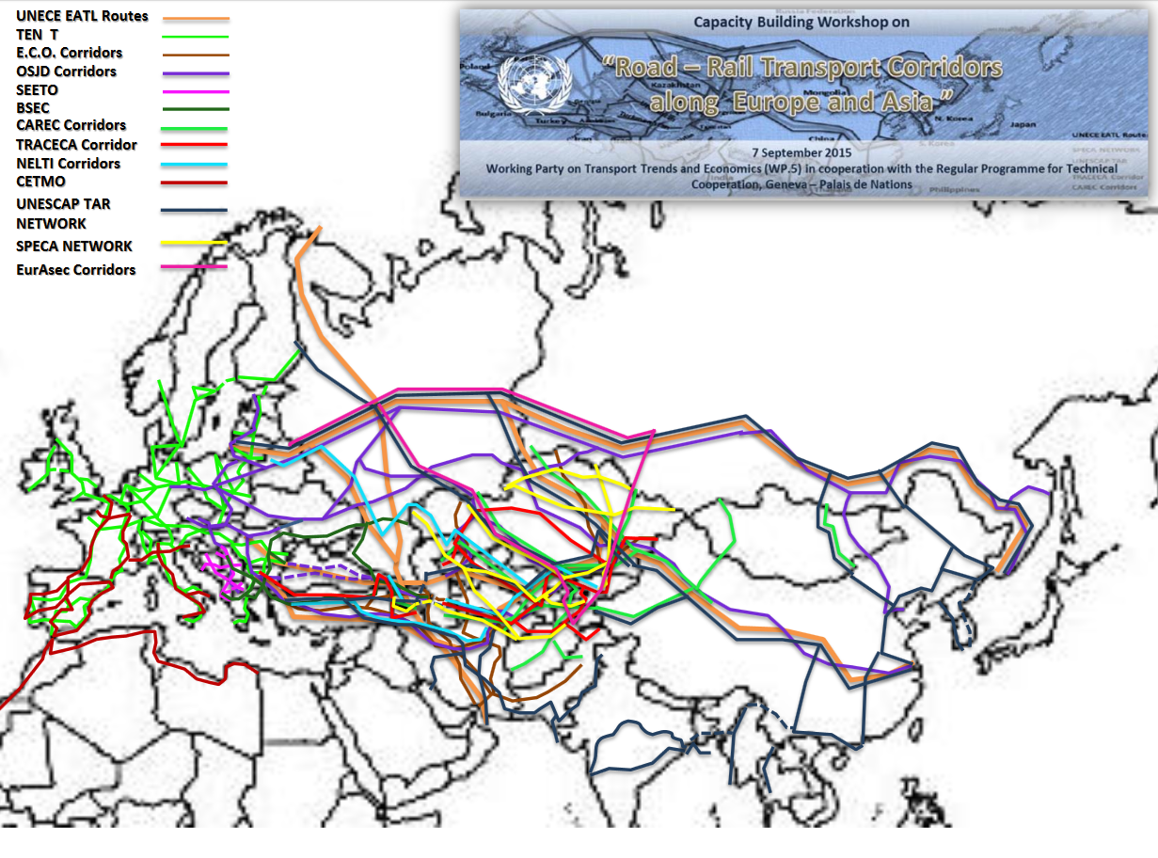
Workshop on Road Rail Transport Corridors along Europe and Asia (2015, follow up 2017)

Slide 3
International Transport Infrastructure Observatory
As a follow up to the Workshop the development of an International Transport Infrastructure Observatory was agreed and mandated to the secretariat.
This Observatory will be an electronic space, an internet based platform which
would permit to all users:
(a) Communicate and exchange of basic information (next meetings of their groups, agendas, reports, workshops programs , etc.);
(b) Disseminate ad hoc knowledge and best / good practices including information about vendors, consultants ,etc.;
(c) Exchange information about projects and other initiatives / proposals;
(d) Seek for cooperation on specific transport infrastructure projects / tasks / studies and researches decided during their Secretariat sessions;
(e) at a later stage and depending on extra budgetary resources all international transport corridors will be hosted in this observatory in a GIS environment in order to create a more interactive and user friendly environment that would further promote and enhance cooperation on development of transport infrastructure.

Slide 4
Enhancing regional connectivity through geographical information system (GIS)
Islamic Development Bank as follow up to the decision on the development of the International Transport Infrastructure Observatory offered the funds needed in order the secretariat to procure, customize and implement the GIS application that will host the Observatory.
The project is called “Enhancing regional connectivity through geographical information system (GIS)” and it includes 4 components:
Establishment of a GIS database;
Preparation of the list of potential investment projects and their prioritization;
Benchmarking of transport infrastructure construction and maintenance costs;
Study on good practices/success stories for financing RCI and regional transport connectivity
The project has already started and it will be ready towards the end of 2018. Initially will include the 56 UN ECE member States. However discussions have already started in order to include in the near future the Middle East and Africa countries.

Slide 5
International Transport Infrastructure Observatory Components I
The Observatory will include information for roads, railways, inland waterways,
intermodal terminals, ports, border crossings. For instance:
ROAD NETWORKS
Motorways
Express roads
Ordinary roads
Design speed (km/h)
Number of traffic lanes
Width of traffic lanes
Width of shoulders
Minimum width of the central reserve
Number of interchange points
Railway intersections
Vertical signs and road markings
Safety fences and barriers
Traffic control and user information
Traffic light signals
Emergency communication systems
Road lighting
Safety of pedestrians and cyclists
Protection of disabled persons
Protection from and of animals
Rest areas
Service areas
Toll areas
Traffic management systems
Emergency exits and access for emergency services
Tunnel equipment
Cost of maintenance
Flows (e-census)
RAIL TRANSPORT :
Number of tracks
Vehicle loading gauge
Minimum distance between track centres for passenger traffic only
Minimum distance between track centres for passenger and goods traffic
Nominal minimum speed for passenger traffic only
Nominal minimum speed for passenger and goods traffic
Authorized mass per axle: Locomotives (≤200 km/h) for passenger traffic only
Authorized mass per axle: Locomotives (≤200 km/h) for passenger and goods traffic
Authorized mass per axle: Rail cars and rail motor sets (≤300 km/h) for passenger traffic only
Authorized mass per axle: Rail cars and rail motor sets (≤300 km/h) for passenger and goods traffic
Authorized mass per linear metre for passenger traffic only
Authorized mass per linear metre for passenger and goods traffic
Test train (bridge design) for passenger traffic only
Test train (bridge design) for passenger and goods traffic
Maximum gradient for passenger traffic only
Maximum gradient for passenger and goods traffic
Minimum platform length in principal stations
Minimum useful siding length
Number of Level crossings
Comments
Cost of Maintenance
Flows (e-census)
Electrified
Intermodal Terminals
with Railways
with Highways
with Airport
with IWT
Customs Warehouses
Simple Warehouse
Logistics Warehouses
Open Warehouses
Trucks parking spaces
Rail stopping spaces
IWT PORT
Number of Rail Container Cranes
Number of Rail Bulk cargo Cranes
Number of Boat Container Cranes
Number of Boat Bulk cargo Cranes
Opening Hours
Logistics Services
Total Capacity in Containers storage
Total Capacity in Bulk Cargo Storage
General Description
Comments

Slide 6
International Transport Infrastructure Observatory Components II
Open to everybody
ROADS
Climate Change Adaptation
Benchmarking Construction Costs
Prioritized
RAIL
Pre-Feasibility Studies
International Financial Institutions, DONORS, Funds etc
USERS
USERS
Governments,
Shippers,
Freight Forwarders
Universities
Railway Undertakings
Existing Networks
International Transport Infrastructure Observatory
New Transport Infrastructure Projects
Border Crossings
Mapping Traffic Analysis
I.W.T
Rehabilitation
Maintenance
INTERMODAL
TERMINAL
Strategic Decisions
Cargo Flows
Innovative Financing
DATA Collection:
Governments’ Focal points, UN ECE projects / Group of Experts

Slide 7
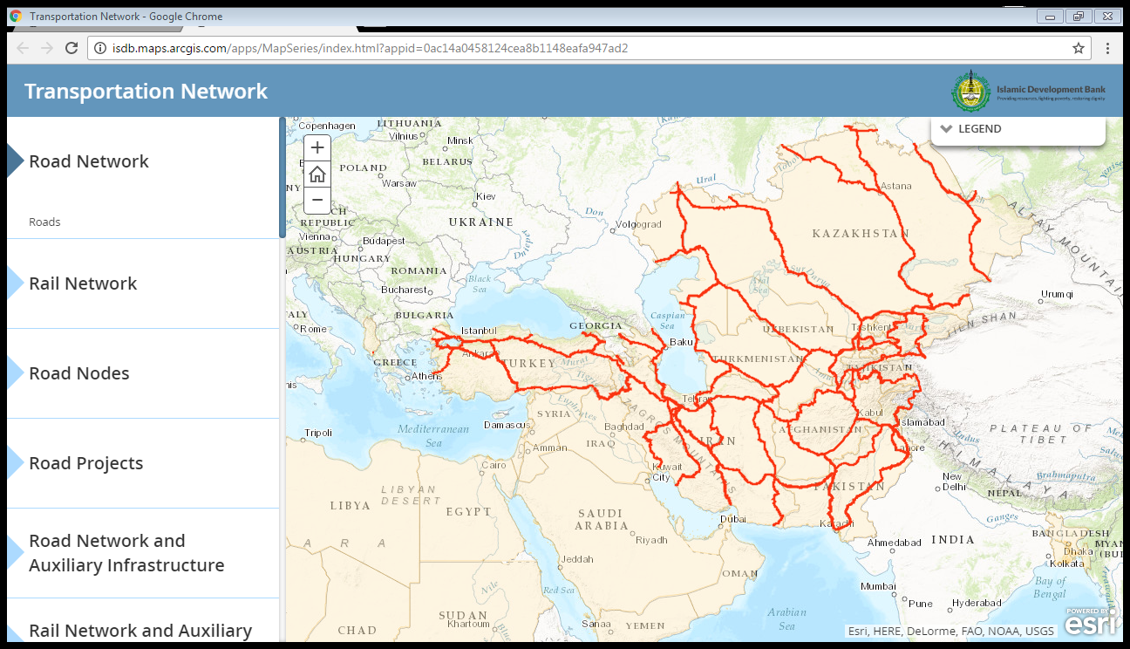
Creation of a GIS Platform: An instrument for Designing/Monitoring Transport Networks
Road Transport Network of the Selected Countries in the 1st Phase. The 2nd phase will be expanded to the Africa and MRNA regions.

Slide 8
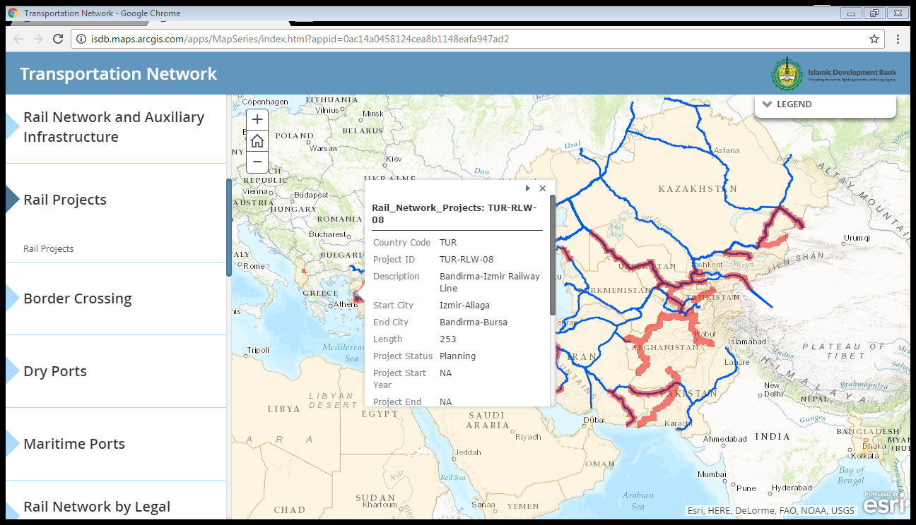
Creation of a GIS Platform: An instrument for Designing/Monitoring Transport Networks

Slide 9
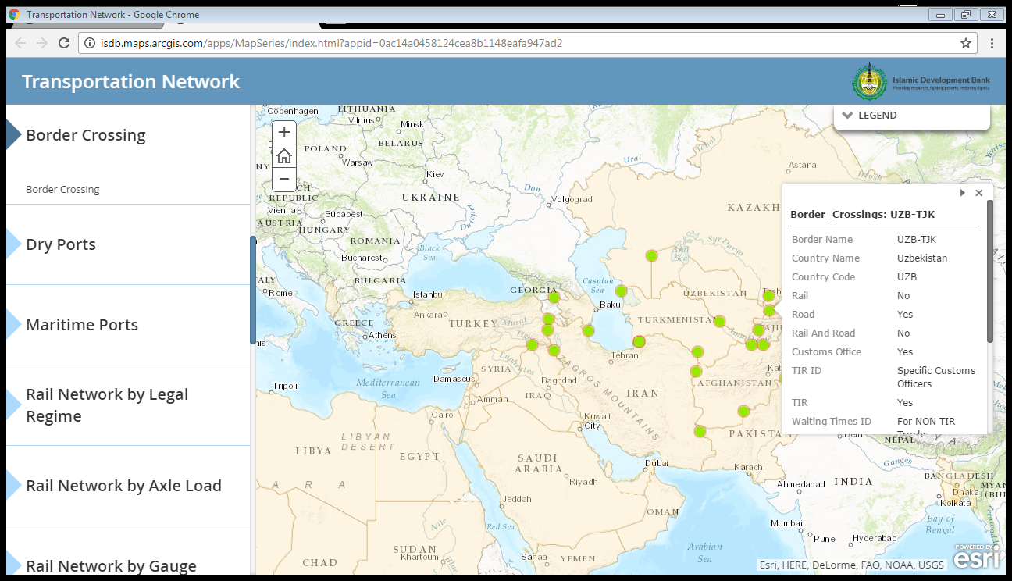
Creation of a GIS Platform: An instrument for Designing/Monitoring Transport Networks
Border Crossing points

Slide 10
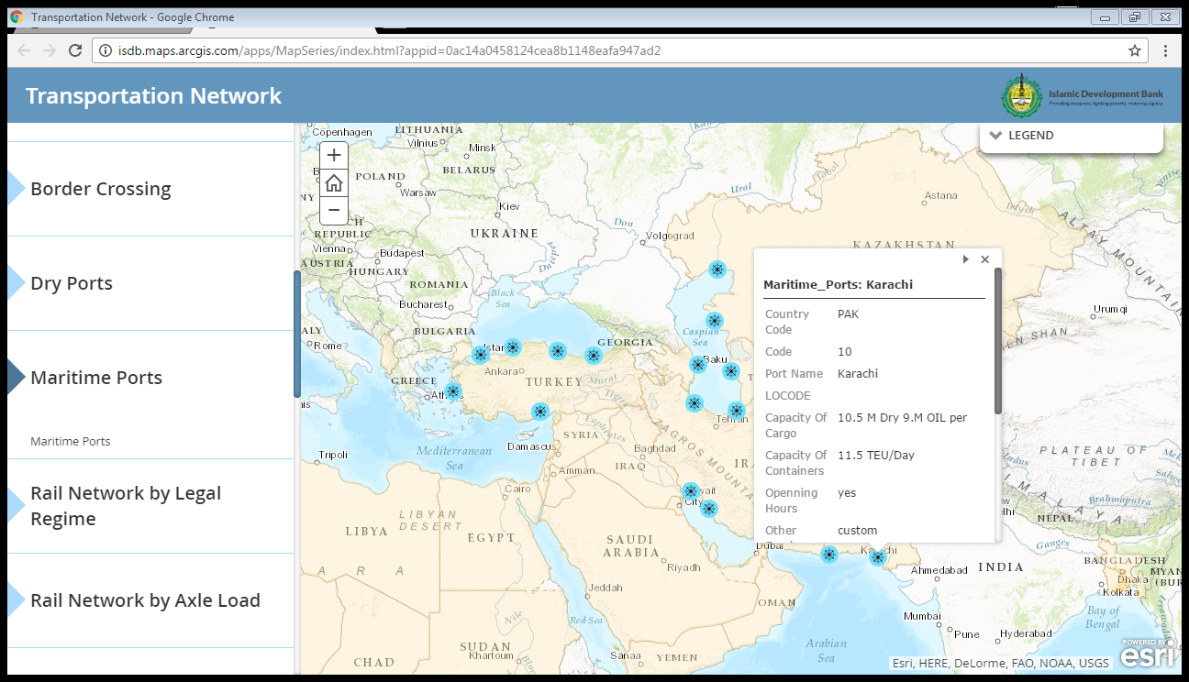
Creation of a GIS Platform: An instrument for Designing/Monitoring Transport Networks
Maritime Ports

Slide 11
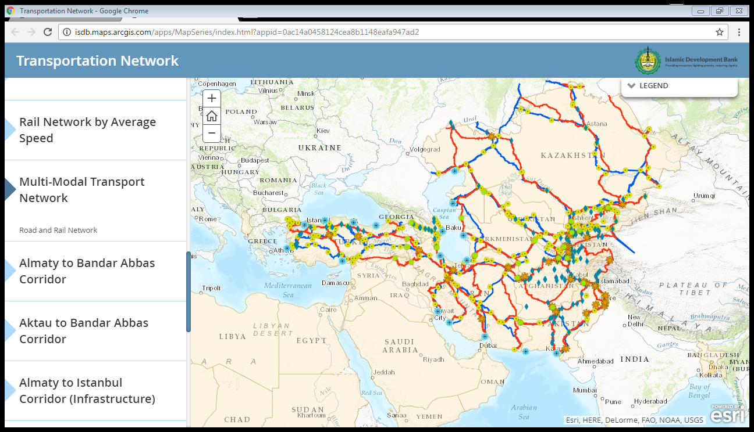
Creation of a GIS Platform: An instrument for Designing/Monitoring Transport Networks
Multimodal Transport Network ( A complete picture of inland transport network)

Slide 12
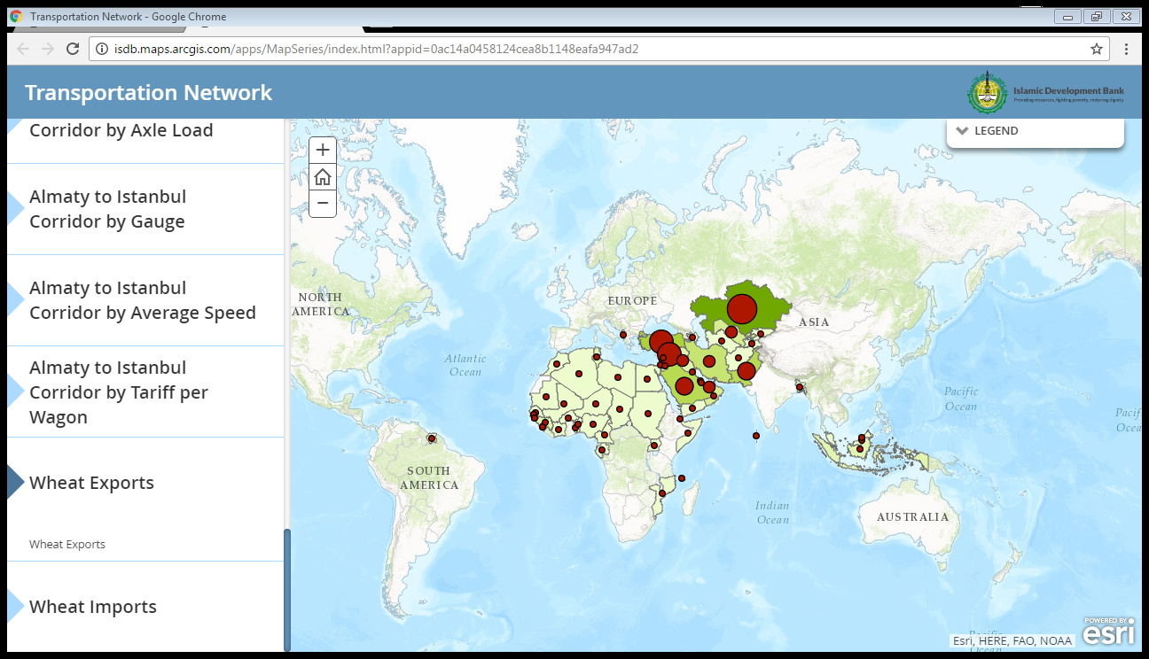
Creation of a GIS Platform: An instrument for Designing/Monitoring Transport Networks
Trade Flow Data: Wheat Exports

Slide 13
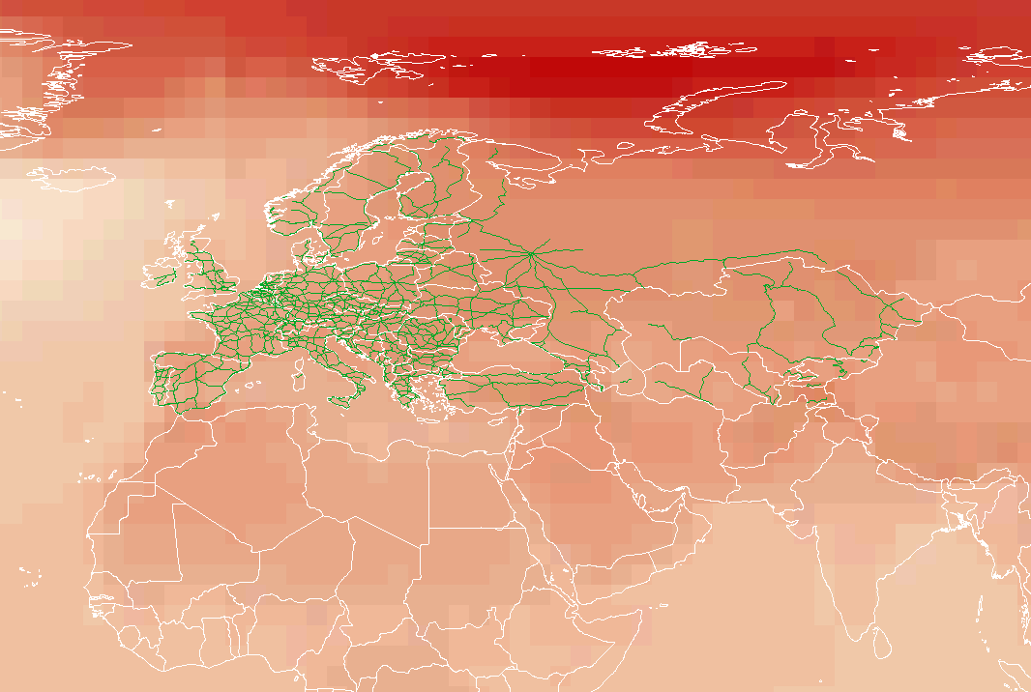
Creation of a GIS Platform: An instrument for Designing/Monitoring Transport Networks
Climate Change Impacts and Adaptation for Transport Networks and Nodes

Slide 14
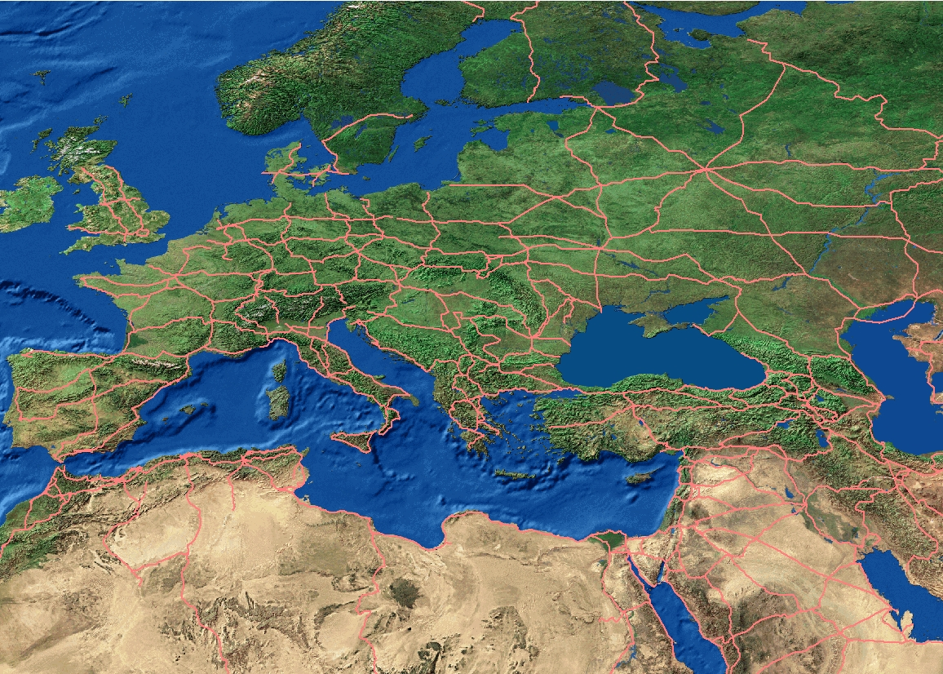
Creation of a GIS Platform: An instrument for Designing/Monitoring Transport Networks
Online –Real time monitoring of block train services
11:40 passed the borders …
Now, it is in Russian territory…
A
B

