Slide 1
From national networks to a unified international network
F. Davenne
UIC – May 2018

Slide 2
Notes:
Rail is probably the only major mode of transport not developed fully internationally from its inception.
Road: truck + driver with licence can drive internationally+TIR carnet
Air: seamless crossing of air borders; only formalities at departure and arrival
Sea shipping: port to port through international waters

Slide 3
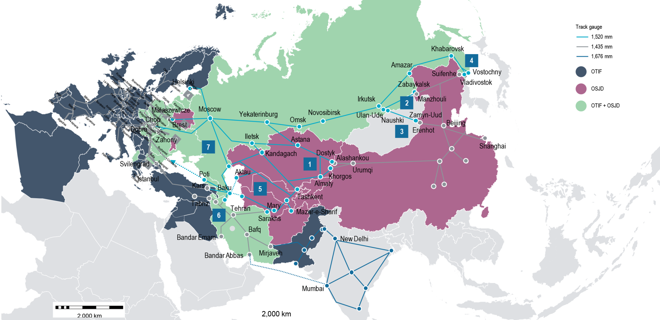
Software vs Hardware

Slide 4
Safe operation of trains

Slide 5
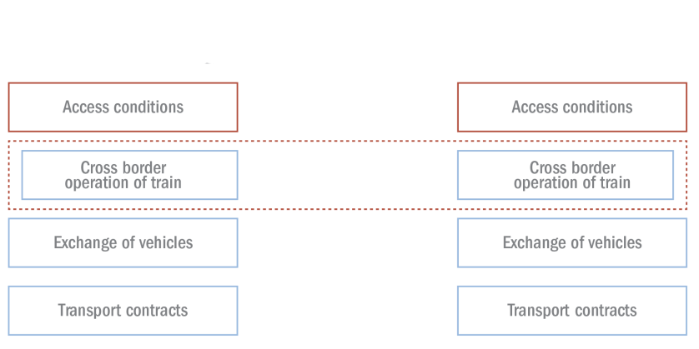
Organising international rail transport

Slide 6
New EST rules in COTIF concerning the safe operation of trains in international traffic
Basic principles
EST rules
National provisions not conflicting
RU + IM establish SMS
Safety certification of RUs
RU + IM share safety responsibility
Supervision of RUs
States to ensure:
Trains are operated in international traffic in accordance with the new Appendix
National binding operational and safety rules are published (and must not conflict with COTIF rules, otherwise it would conflict with principle 1.)
RU and IM are responsible for safety and each must establish their SMS (even when part of one integrated railway organisation)
A Certification Authority is established
A Supervision Authority is established
These authorities must be independent from any RU or IM and can be national or international
Notes:
Draft new Appendix H concerning the safe operation of trains in international traffic.
(Règles uniformes concernant l’exploitation en sécurité des trains en trafic international - EST UR)
Principles accepted in RC26 and final adoption in GA13)
After adoption start developing the subsidiary provisions, e.g. concerning the SMS and safety certification
New Appendix H:
Common framework for safety certification of RUs
Safety management systems for RUs and IMs
Certification and supervision of authorities
Develop infrastructure requirements based on experience of Member States and non-Member States and analyse the need for an international infrastructure register.
Initiate discussions concerning network access conditions

Slide 7
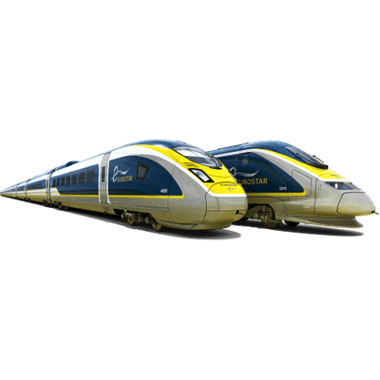
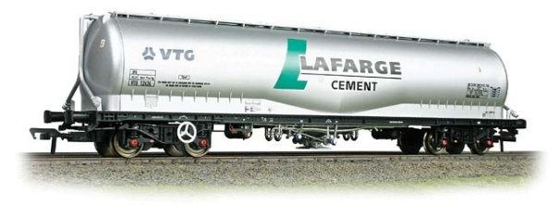
Open questions currently being discussed within OTIF
Assessing infrastructure compatibility:
process (starting from Infra TSI?)
developing OTIF’s regulations?
Role of ERA ?
How to create a regulatory package with UIC ?
APTU
ATMF
UTPs
TSIs
Detailed engineering
System
specific standards
(Common) procurement
specifications

Slide 8
Building mobility services in the digital age

Slide 9
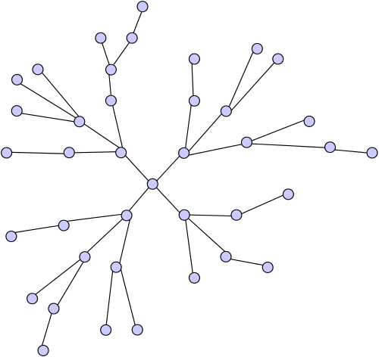
Packet swiching/train switching: an analogy
1. Each terminal must be able to exchange data with any other terminal
2. The data units (the packets) are exchanged between the node and across the physical lines
3. The physical signals are transmitted along the line and physical interfaces
An analogy can be made with freight/passenger transport by rail
Data transmission model can be used to model an interoperability and transport concept.

Slide 10
Passenger traffic: a layered approach
International ticketing system
interfacing with regional lines
and public transport
International ticketing system
interfacing with regional lines
and public transport
CIV / electronic tickets
Interoperability:
Compatibility with the network
Interoperability:
Compatibility with the network
EST rules
TSI/UTP
Physical layer: Physical requirements
Physical layer: Physical requirements
CEN standards/UIC leaflets
Well defined interfaces: relations and hierarchy between regulations are clear
Smooth integration of contract law and commercial processes
Identifying the potential security breach
=> Readiness for building mobility services in the digital age

Slide 11
Rail as a backbone for seamless mobility
External interfaces
Taking into account the physical interfaces
Interfacing with other regulations: custom, public tansport, security, etc.
Creating and securing common data models and exchange protocols
Internal regulation
1. Minimising the internal complexity of the rail system
2. Creating interoperable train path
3. Connect different regional railway systems
Rail as a backbone

Slide 12
Gryphenhübeliweg 30
CH - 3006 Berne
+ 41 (0)31 359 10 10
media@otif.org
www.otif.org

