Slide 1
ECE R110: Harmonization of CNG Fuel Tank Requirements with ISO 11439 April 26, 2017
Informal document GRSG-112-38
(112th GRSG, 24-28 April 2017,
agenda item 9.)
Craig Webster, P.Eng.
Senior Manager
Transportation Fuels

Slide 2
BACKGROUND
CRAIG WEBSTER
Convener of ISO TC 58/SC 3 Working Group for the ISO 11439 Standard
Convener of ISO 11439 since 1995!
ISO 11439
Covers performance requirements for CNG fuel cylinders on-board vehicles
Standard first published in 2000
ECE R110
Annex 3A of the Regulation adopted the 1998 draft of ISO/DIS 11439
There were significant differences between the 1998 draft and the published version of ISO 11439
HARMONIZATION
Attempting to align the test requirements in ECE R110 Annex 3A, with those in the latest version of ISO 11439: 2013 for CNG vehicle fuel cylinders

Slide 3
WHY HARMONIZATION?
SAFETY
The 2013 version of ISO 11439 contains a number of changes made to improve safety due to in-service cylinder failures
COST TO CYLINDER MANUFACTURERS
Manufacturers often must test to the Regulation, and perform additional tests to meet ISO 11439
ERRORS IN ECE R110 ANNEX 3A
In adopting the 1998 ISO/DIS 11439, Annex 3A inadvertently included some erroneous references
In one case a test cannot even be performed because the completely wrong standard is referenced
Some tests are difficult to conduct as described

Slide 4
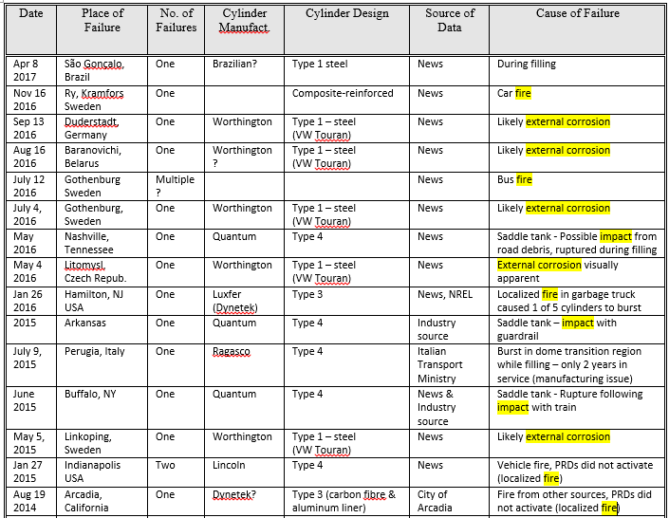
SAFETY OF CNG FUEL CYLINDERS – Recent In-Service Failures

Slide 5
CURRENT APPROACH TO HARMONIZATION
The convener of ISO 11439 had proposed a series of changes that would make the wording in ECE R110 (particularly the test requirements in Annex 3A) match the wording in ISO 11439: 2013
Detailed wording changes were proposed to avoid the need to simply reference the ISO 11439 standard
The proposed changes were reviewed in some detail by the French, German, Japanese, and Dutch delegations
The work of these delegations is very much appreciated, and they helped identify several areas for improvement in the ISO 11439: 2013 standard
The delegations also identified certain areas in ECE R110 where full harmonization with ISO 11439 would be difficult
It is now understood a cylinder standard could have difficulty in some areas completely harmonizing with a vehicle regulation

Slide 6
FUTURE APPROACH TO HARMONIZATION
100% harmonization of the CNG cylinder requirements between ECE R110 and ISO 11439: 2013 may not be achievable
One can never achieve complete harmonization, because as soon as the regulation is harmonized with the standard, the standard changes (or the regulation changes)
In this case, the ISO 11439: 2013 standard is due for its 5 year periodic review in 2018, which will likely result in further changes due to recent safety issues.
ISO therefore intends to propose to the GRSG for consideration at the next meeting, a revised harmonization proposal that will be limited to addressing only issues that:
Affect the safety of fuel cylinder designs
Interfere with the ability to perform certain cylinder tests in ECE R110
Impose a cost burden on cylinder manufacturers by requiring multiple tests to comply with both documents

