Slide 1
The importance of the type definition in the UN Regulation No. 67 type-approval process
Informal document GRSG-112-37
(112th GRSG, 24-28 April 2017,
agenda item 7.)
This presentation concerns the proposal for Supplement 15
to the 01 series of amendments to Regulation No. 67 (LPG vehicles),
submitted by the expert from Poland
ECE/TRANS/WP.29/GRSG/2017/10

Slide 2
UN Regulation 67 type approval concerns:
Container,
80 per cent stop valve,
Pressure regulator,
Pressure relief valve (discharge valve),
Remotely controlled service valve with excess flow valve
and so on, up to the position 23….
The result of the "competition":
Definition OK! No definition !
1 : 22

Slide 3
Type – approval of:
Accessories:
Multivalve
PRV and fusible plug
80% STOP VALVE
Container
Container with accessories:
  PRD verification and the bonfire test
  80% stop valve verification
  and so on…

Slide 4
APPROVED
ACCESSORIES
VERSION A
APPROVED
CONTAINER
+
VERSION B
VERSION C
VERSION D

Slide 5
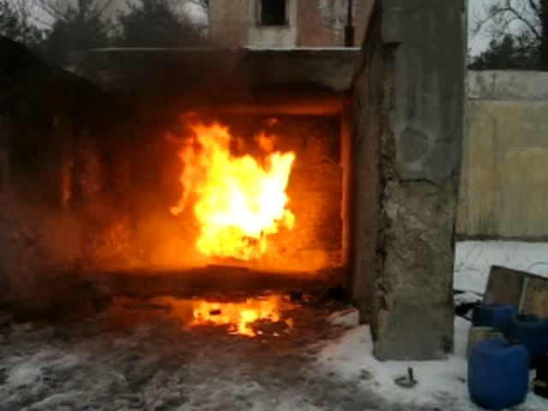

Slide 6
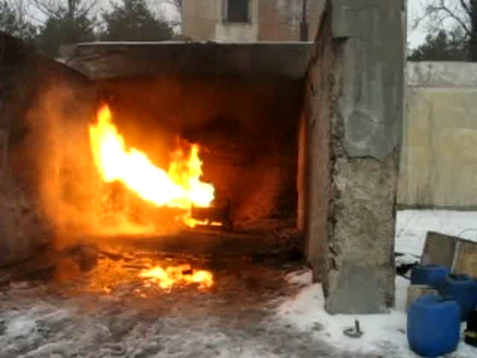

Slide 7
Proposals is aimed to specify
the limits of container accesssories construction changes carried out in the framework of one type of approved devices, especially for the modifications,
which are essential for the approval of a LPG container.

Slide 8
Thank you for your attention
ECE/TRANS/WP.29/GRSG/2017/10

