Slide 1
Electric Vehicles and the Environment
(EVE IWG)
Submitted by the EVE informal working group
Informal document GRPE-75-28
75th GRPE, 8-9 June 2017
Agenda item 9
Report to GRPE 75th Session

Slide 2
Areas of Work for EVE IWG
Current mandate authorizes work in three primary subject areas
  Determination of electrified vehicle power
    Goal is to develop GTR for determining power of electrified vehicles
  Electrified vehicle durability
    Goal is to continue research on the topic of electrified vehicle durability and make formal recommendation related to GTR development at the end of the current mandate
  Method of stating energy consumption
    Goal is to find an additional partner with expertise in electricity generation and distribution to lead the development of a model to assess upstream emissions of EVs, with support of EVE IWG

Slide 3
Meeting Frequency and Locations
Completed and planned meetings
  January 2017 – Geneva – ½ day
  April 2017 – Ann Arbor, USA – 2 days
  June 2017 – Geneva – ½ day
  September 2017 – Teleconference – ½ day
  October 2017 – Vienna, Austria – 2 days (confirmed)
  January 2018 – Geneva – ½ day
  March/April 2018 – Japan – 2 days (tentative)
  June 2018 – Geneva – ½ day
  September/October 2018 – Ottawa, Canada – 2 day (tentative)
  January 2019 – Geneva – ½ day
EVE IWG and WLTP SG-EV will try to organize joint meeting, possibly September 2017 teleconference

Slide 4
Determination of Electrified Vehicle Power
Test procedure to be based on the ISO method
  Final balloting for ISO procedure has begun
  Expect approved ISO document to be available at the end of November 2017
Draft technical report supporting GTR has already been started (online as EVE-23-06e)
Chair of drafting group appointed (Mike Safoutin – USA)
Multiple labs identified for validation testing (Canada, JRC, Korea & EPA, possibly others)
  Target finalized test matrix by October 2017
Priority will be given to developing/validating the reference method, and a decision on whether to also develop the candidate method will depend on work progress

Slide 5
Planned Schedule for
Power Determination GTR Development
2017 |  | 2018 |  |  |  | 2019
July | Oct. | Jan. | Apr. | July | Oct. | Jan. | Apr. | July | Oct.
Key events
☆ 25th session
☆ 26th session
☆ 27th session
☆ 28th session
★ Submit Formal Doc to GRPE
★ Adopt
Formal Doc
by WP.29
☆ 24th session
★ Submit
Informal
Docs to GRPE
◎ ISO procedure available
Validation
program
Preparation
Testing
Drafting
Conditions
Technical Method
Finalize draft
Modification
& Drafting technical report

Slide 6
Electrified Vehicle Durability
EVE IWG continues to interact with WLTP EV subgroup for durability requirements which should be assessed by EVE IWG
EVE IWG members continue to discuss a variety of durability related research topics
Draft battery durability technical report has already been started (EVE-23-05e)

Slide 7
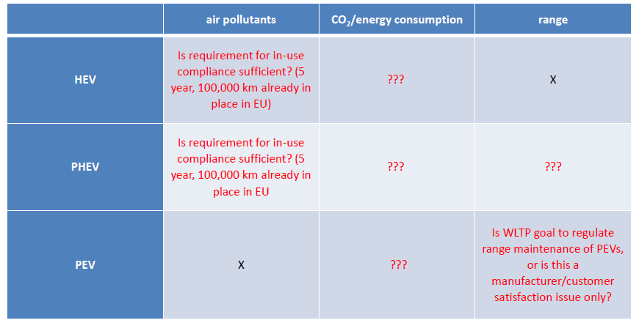
Electrified Vehicle Durability
EVE awaits durability requirements from WLTP as shown in table below
  WLTP has committed to providing answers by end of summer

Slide 8
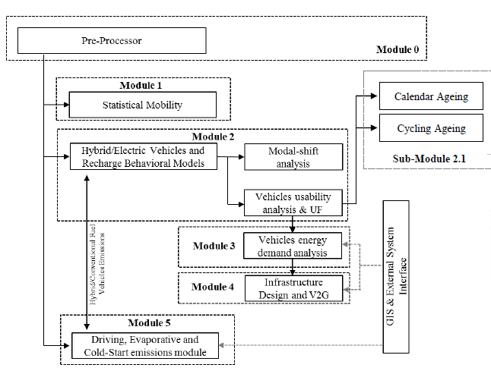
Electrified Vehicle Durability
JRC has developed an ageing model with activity data from >600,000 vehicles and >2.5 billion trip events
JRC model
estimates effect
of both cycle
ageing &
calendar ageing

Slide 9
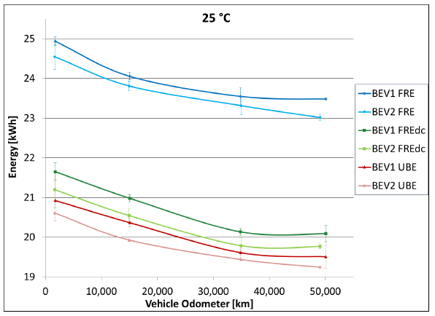
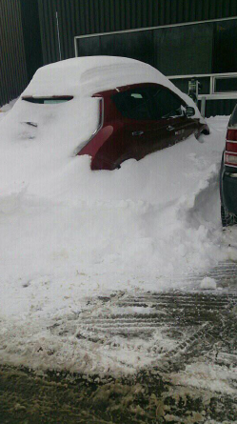
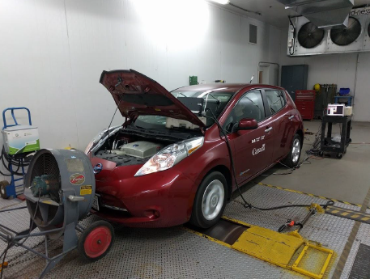
Electrified Vehicle Durability
Canada continues research project assessing the durability impact of L2 vs L3 charging, and cold weather operation

Slide 10
Method of Stating Energy Consumption
As authorized by mandate from WP.29, on
02-May-2017 EVE IWG sent message to Chair and Secretary of the Group of Experts on Energy Efficiency (GEEE) to ask if they are willing to assume leadership of the project to assess upstream emissions from EVs, with support of EVE IWG (EVE-23-07e)
Outreach to GEEE included status report on the work (EVE-23-09e)
No response yet
  Plan additional follow up following GRPE
Some members would like to know if this project is a priority for any contracting parties other than China

Slide 11
Next Steps for EVE IWG
Power determination
  Await ISO method in November, 2018
  Begin drafting introductory sections of GTR
  Continue developing power determination technical report which will support GTR
  Develop test matrix (select vehicles, labs, etc.) – based on what we know now
  Target informal document January 2019, formal document voting at GRPE in June 2019
Electrified vehicle and battery durability
  Continue durability research and modelling
  Continue developing technical report for EV and battery durability

Slide 12
Next Steps for EVE IWG
Energy Consumption
  Follow up again with GEEE about method of stating energy consumption
Next meetings
  September 12, 2017 telecon (possibly with WLTP SG-EV)
  October 24-25, 2017 in Austria
  January, 2018 Geneva
  Explore possibility of March/April, 2018 meeting in Japan

Slide 13

Questions

