Slide 1
75th UNECE GRPE session
Informal document GRPE-75-17
75th GRPE, 6-9 June 2017,
Agenda item 7
PMP IWG Progress Report
UNITED NATIONS

Slide 2
PMP meetings in 2017
2017-01-11: PMP 42nd (GRPE Geneva summary)
2017-03-15/16: PMP 43rd
2017-05-22: PMP 44th (telco)
NEXT MEETING: 7th – 8th November 2017 (Location: JRC Ispra)

Slide 3
EXHAUST PARTICLE EMISSIONS

Slide 4
Main open points
Round Robin Sub-23nm
Raw exhaust sampling
Round Robin PNC (Particle Number Counter)
Horizon 2020 projects
WLTP low temperature PN testing

Slide 5
Scope of the sub-23 Round Robin
Development of a sub23nm (cut-off size:∼ 10 nm) particle number measurement procedure based on the existing PMP methodology conveniently adapted.
Main purpose: Monitoring particle emissions of new engine/after-treatment technologies.
Assessment of the repeatability/reproducibility of the proposed particle counting methodology by means of a “round robin”.

Slide 6
Investigation of sub23nm protocol
Two systems with CS and 10nm CPC to circulate
Each lab PMP system plus a 10nm CPC (to circulate)
One golden vehicle (to be decided)
Different labs will test different engine technologies

Slide 7
Suggested setup

Slide 8
Investigation of sub23nm protocol
Instruments to be delivered to JRC in July
At least 6 labs confirmed participation
Most labs would prefer GDI+GPF as Golden vehicle
However Golden car with GPF might have bad reproducibility
Detailed program to be decided (desired timing and logistics do not match)
JRC can start as soon as golden instrument and vehicle are available

Slide 9
PN Counting from Raw Exhaust via Fixed Dilution
        Interest in this approach confirmed by some engine manufacturers and some instrument manufacturers
        01 Series of amendments to Reg. 132 already includes such possibility but the procedure is not defined
        First analysis of potential benefits/issues presented during the last meetings
        Correlation with other methods (CVS and partial flow system) and advantages/disadvantages to be checked – Additional data required

Slide 10
Raw exhaust (tailpipe) sampling
Preliminary results generated by the JRC show 20% differences
Input from others is necessary
Theoretical investigation of uncertainty

Slide 11
Raw exhaust (tailpipe) sampling
Data presented by the industry during the 43rd meeting confirming good correlation
Questionnaire on experimental program circulated
Replies still to be received
Experimental program details under discussion

Slide 12
PNC Calibration Round Robin
Confirm that the k factor can be included in the final counting efficiencies
Investigate the possibility to change the calibration material
Investigate the possibility to calibrate at 10 nm
Preliminary results were presented. CAST aerosol showed good reproducibility – Report in preparation
Sub-group led by PTB (German NMI) was formed to look into more detail the results – New limited RR taking into account lessons learned?

Slide 13
HORIZON 2020
Participants presentations
  DownToTen
  PEMS4nano
  SUREAL-23

Slide 14
Gas engine testing
Industry to provide facilities
Experimental program under discussion

Slide 15
Low Temperature testing
Testing is done since >10 years
Input is necessary on experimental setup / difficulties encountered or topics to be investigated
          Are there difficulties with current setups?
          Are there any other questions. E.g. Quantification of temperature effect: Urban part or whole cycle?

Slide 16
NON-EXHAUST PARTICLE EMISSIONS
Steps for Building a Common Method for Measuring Brake Wear Particles

Slide 17
PROPOSED APPROACH
Three steps were identified as fundamental for the development of the methodology for brake wear particles measurement:
Development of a new braking test cycle representative of real-world conditions
Selection of the most suitable methodology for sampling brake wear particles
Selection of the most suitable methodology for brake wear particles measurement and characterization

Slide 18
STEP 1 – BRAKING CYCLE
Four sub-steps were identified as necessary for the development of the desired braking schedule:
Analysis of the WLTP Database for understanding real world driving and braking behavior (Concluded)
Comparison of WLTP data with existing braking cycles (Concluded)
Development of a first version of the braking schedule (Deadline: June 2017)
Testing and Validation of the schedule – possible round robin (Deadline: January 2018)

Slide 19
STEP 1 – BRAKING CYCLE
The situation as we speak can be summarized as follows:
A WLTP database based profile is being developed by FORD and will become available to the TF and the PMP Group
A short version LACT profile is being developed for the purposes of the LOWBRASYS Project and will become available to the TF and the PMP Group
TF members are willing to test and validate both schedules at least in terms of temperature profile and wear
6 laboratories will participate in this round robin which is expected to start in September and finish in December 2017

Slide 20
Step 2 - Selection of the most suitable sampling method
Comparison of existing systems/test rig configurations (Deadline: June 2017 – On-going work by the group)
Selection of Functional Parameters (Deadline: June 2017 – On-going work by the group)
Selection of Testing Parameters (Deadline: January 2018)
Testing and Validation of the Selected Configuration (Deadline: To be defined depending on the progress)

Slide 21
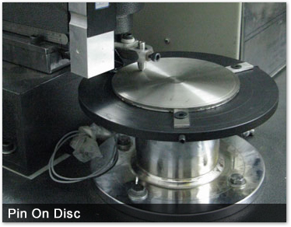
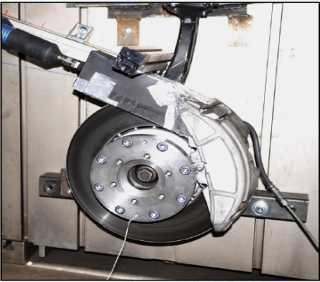
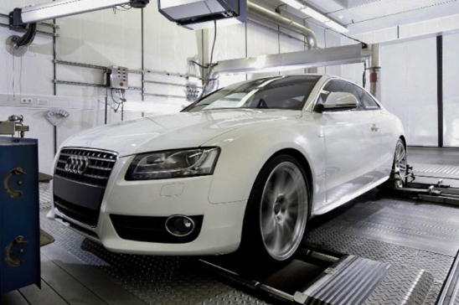
STEP 2 – SAMPLING METHODOLOGY
Selection of the method
v. Dyno vs. Mobile vs. Road-side testing: How did you decide to focus on Dyno testing?
At least 3 different systems have been proposed
Each of these sampling system comes with its pros and cons
Also, different on-road systems have been used by some researchers

Slide 22
STEP 2 – SAMPLING METHODOLOGY
Selection of the method – Results
Pin-on-disc systems:
Simple and easy to use
Study of wear mechanism
On the other hand:
Do not take into account the pad shape and the caliper design
They have important limitations (i.e. speed)
Full chassis dyno:
Better reflect real world conditions
Takes into account the full range of possible technologies for BW particles emission reduction
On the other hand:
Contribution from other sources

Slide 23
STEP 2 – SAMPLING METHODOLOGY
Selection of the method – Results
Brake dyno systems:
Simpler compared to a full chassis dyno
Easy to control parameters like speed, cooling air flow rate, etc.
On the other hand:
Such a test procedure would put the emphasis on technologies for BW emission reduction only linked to the brake system
It appears that a commonly accepted test rig configuration is an objective that can be achieved in a reasonable time frame

Slide 24
PARTICLES SAMPLING AND CHARACTERIZATION METHODOLOGIES
During the 43^{d} face-to-face meeting several projects were presented by the stakeholders with different approaches regarding the sampling and measurement procedures.
Need to better define the objectives of the methodology to be developed within the PMP group
Need to coordinate the different activities in order to be more effective and efficient
JRC proposed the formation of a second Task Force which will include mainly measurement experts to speed up the process.

Slide 25
STEPS 2 & 3 - SAMPLING AND MEASUREMENT METHODS
Comparison of existing systems and methods (Deadline: November 2017)
Several systems exist. Task Force will compare these systems and decide which ones are the most appropriate
Selection of testing and functional parameters (Deadline: March 2018)
After the system selection the TF will work on the optimization of the testing and functional parameters
Testing and Validation of the Selected Configuration and methods (Deadline: To be defined depending on the progress)

Slide 26





Stay in touch
JRC Science Hub:
ec.europa.eu/jrc
Twitter and Facebook:
@EU_ScienceHub
LinkedIn:
european-commission-joint-research-centre
YouTube:
JRC Audiovisuals
Vimeo:
Science@EC

