Slide 1
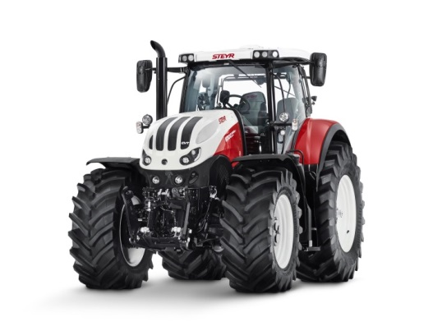
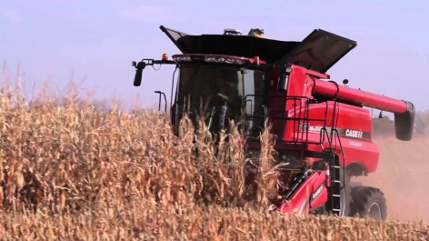
Alignment of Regulation 96 to Regulation (EU) 2016/1628
A. Perujo
Informal document GRPE-75-09
75th GRPE, 6-9 June 2017,
Agenda item 6(a)

Slide 2

UNECE Regulation 96
on
Uniform provisions concerning the approval of compression ignition (C.I.) engines to be installed in agricultural and forestry tractors and in non-road mobile machinery with regard to the emissions of pollutants by the engine
R96 covers only part of the scope of EU Stage V* Regulation.
R96 includes in its scope T vehicles which will be subject to equivalent Stage V legislation, under development.
Need to align R96 limits to EU Stage V Regulation.
*Stage V = REGULATION (EU) 2016/1628

Slide 3
Work Progress
Informal Document on the 05 series of amendments to Reg. No. 96
  The document has been developed in accordance with the mandate given by the GRPE during its 74th Session in January 2017 (ECE/TRANS/WP.29/GRPE/74).
  The draft document includes all the technical aspects required for engines type-approval under the 1958 Agreement.
  The draft document does not yet address the administrative requirements.
  The aim of the draft document is to allow Contracting Parties and stakeholders to formulate comments and proposal for the final (working) document to be presented at the 76th GRPE session in January 2018 for approval.

Slide 4

Scope Evolution
R 96-05
NRMM + T
CI and SI engines
Liquid and gaseous fuelled
0 to ∞ kW
R 96-04
NRMM + T
CI engines
19 to 560 kW
SI < 19 kW
IWV & RAIL
IWV & RAIL
    Exemptions and particular provisions to remain only in national/regional legislation

Slide 5
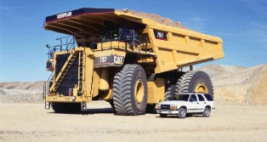
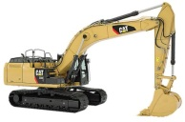
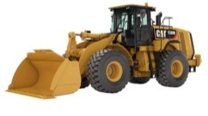


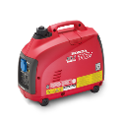

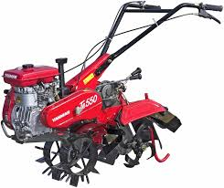
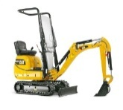
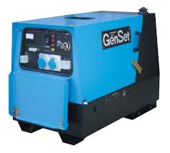
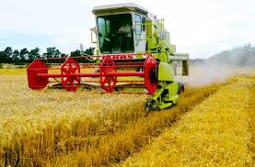

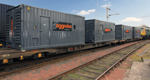
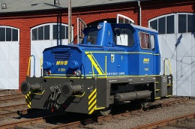
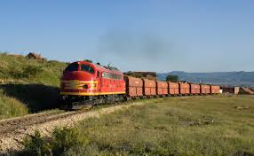

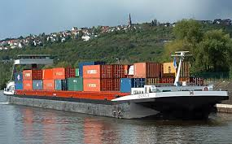
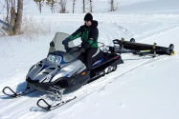
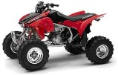
New NRMM Regulation
Regulation (EU) 2016/1628
Land-based NRMM
SI – Spark-ignited (gasoline)
SI 0-19kW
SI 19-56kW
>560kW
56-130kW
130-560kW
Gen-Sets >560kW
CI 0-8kW
CI 8-19kW
CI 19-37kW
CI 37-56kW
CI – Compression-ignited (diesel)
Rail - Locomotives
>0kW
Rail - Railcars
>0kW
Inland Waterway Vessels (IWV)
37-75kW
75-130kW
130-300kW
300-1000kW
≥1000kW
Auxiliaries 560-1000kW
Auxiliaries ≥1000kW
Snowmobiles
Scope of Directive 97/68/EC
>0kW
Scope extensions new NRMM Regulation
All Terrain & Side-by-Side Vehicles
>0kW

Slide 6



Timing
Planned to submit a first draft as informal document to next GRPE session (June 2017)
Publication goal
In order to ensure adequate EU market alignment and contemporary EU and UN ECE approvals in view of Stage V, the new amendment should ideally be published in 2018.
Regulation 120 & 132
Planned to submit the informal documents next GRPE session (January 2018)
Working documents for GRPE session in June 2018

Slide 7

Acknowledgements to contributors such as Italy and EUROMOT

