Slide 1
Transmitted by the expert from Japan
Informal document GRB-66-08
(66th GRB, 4-6 September 2017,
agenda item 10)
Review of Motorcycle Noise Regulation
in Japan
(Review of UN R41-04 Limit Value)

Slide 2
Contents
1. Introduction
Outline of Current Noise Regulations in Japan
2. Items to be Considered in the Future
Contents to be Considered
Deliberation Schedule
(Reference) Survey Contents
3. Summary
2

Slide 3
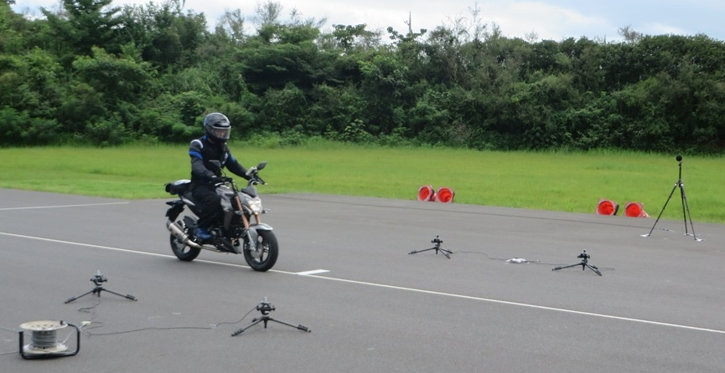
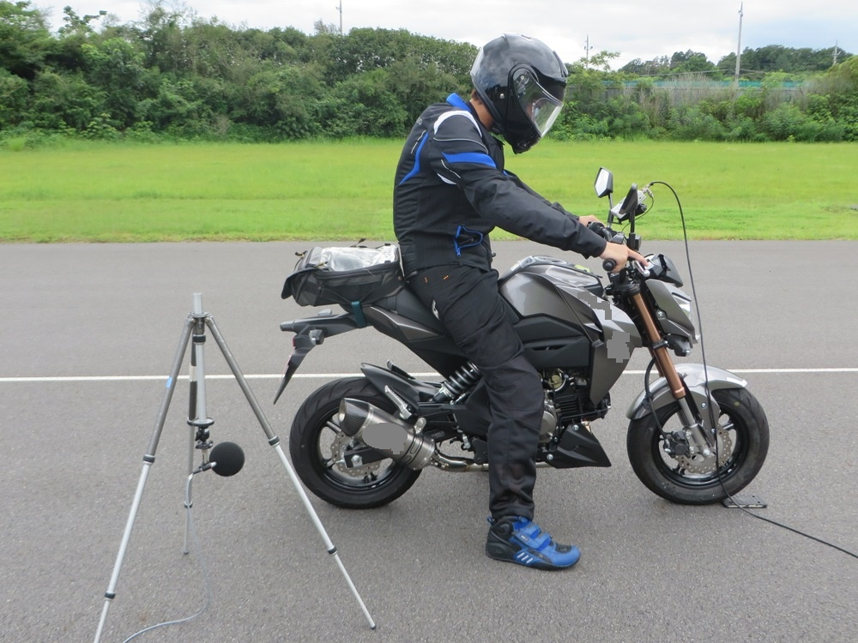
1. Introduction
Outline of Current Noise Regulations in Japan (New Vehicles)
- Noise Regulation Method prior to Introduction of UN Regulation
Regulation method | Outline
Accelerating vehicle noise | Regulate the noise generated when a vehicle with the acceleration pedal fully depressed has passed to reduce noise from an accelerating vehicle.
Cruising vehicle noise | Regulate the noise generated when a vehicle has passed at a constant speed (50 km/h) to reduce noise from a cruising vehicle.
Proximity stationary noise | Measure the noise generated near the exhaust pipe outlet of a vehicle at a halt when the accelerator is quickly released after the engine speed has reached a certain level to clamp down on illegally modified vehicles on the street.
Proximity stationary noise test
(No test track is required.)
- Cruising noise regulation was abolished for two-wheelers in 2013 and four-wheelers in 2015.
- Proximity stationary noise regulation was abolished for both two-wheelers and four-wheelers in 2015.
- Current Noise Regulation Method after Introduction of UN Regulation (New vehicles)
Harmonizing with International Standards
The Japanese noise regulations harmonize with international noise regulations, with R41-04 for two-wheelers, R51-03 for four-wheelers and R117-02 for tyre noise being adopted as testing methods and limit values.
3

Slide 4
2. Items to be Considered in the Future
Contents to be Considered
(These issues were raised in Informal Document GRB-62-12 at 62nd GRB held in September 2015.)
Noise Measures for New Vehicles
- Review of motorcycle noise regulation
(Review of R41-04 Limit Value where necessary)
Noise Measures for Vehicles in Current Usage
- Review of check system for issues such as muffler performance (review of replacement muffler system where necessary)
- Consideration of effective date of tyre noise regulation for noise outside of vehicles in current usage (application of R117-02 on vehicles in current usage)
4

Slide 5
2. Items to be Considered in the Future
Deliberation Schedule
- Schedule proposed by Japan (draft)
Period | Outline
25 April 2017 | Specialist committee under Central Environment Council (CEC) will commence investigations related to review of motorcycle noise regulations
May 2017 to August 2018 | Hearings with relevant bodies will be held
December 2017 to August 2018 | Japanese proposal related to review of limit value for R41-04 will be considered
September 2018 | Japanese proposal for reviewing limit value for R41-04 based on the domestic study will be presented at Working Party on Noise (GRB)
September 2018 to January 2020 | Based on state of discussion at GRB, Japan will consider proposal for reviewing limit value for R41-04
February 2020 to March 2020 | Collate review of Motorcycle Noise Regulation
5

Slide 6
2. Items to be Considered in the Future
- Deliberation Schedule for Reviewing Limit Value for R41-04 in Japan and in GRB
2017
2018
2019
2020
2021
2022
JAPAN
Review study
Till March 2018
Deliberation on review of motorcycle noise regulation
(Limit value for R41-04)
Until Feb. or March 2020
Japanese proposal on reviewing limit value (in Sep.)
if necessary
GRB
Deliberation on reviewing limit value for R41-04 (list of future issues) within five years from 2018
6

Slide 7
(Reference) Survey Contents
Study on Reviewing R41-04 Limit Value
- Noise Fact-Finding Investigation on Vehicles that conform to Latest Noise Regulations (R41-04)
7

Slide 8
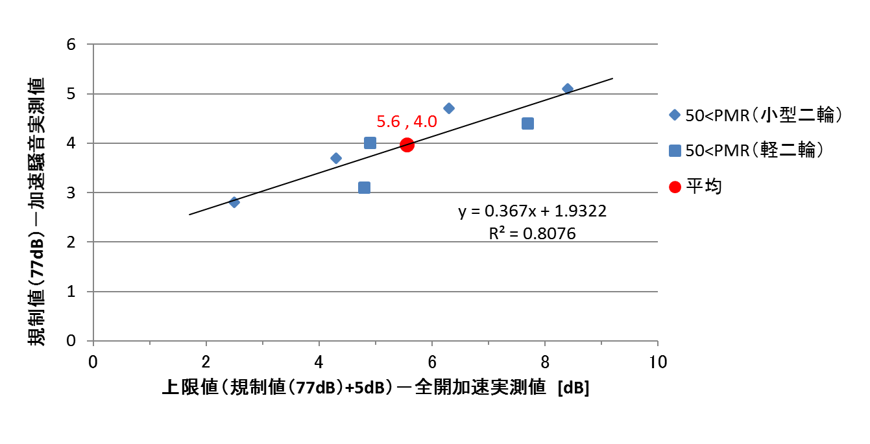
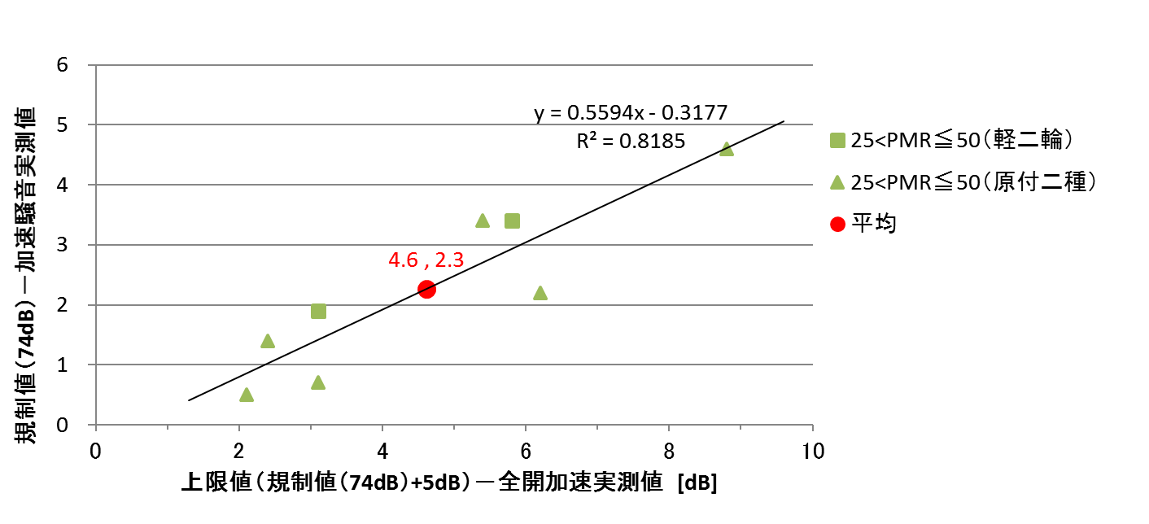
(Reference) Survey Contents
The results of Noise Fact-Finding Investigation.
(Relationship between Lrban and Lwot)
class 2 (25<PMR≤50)
class 3 (50<PMR)
(2-wheeler)
(Small 2-wheeler)
(Motorcycle, less than or equal to 125 cc)
(2-wheeler)
Average
Average
Limit value (74 dB) - measured value for acceleration noise
Limit value (77 dB) - measured value for acceleration noise
Upper limit value (limit value [74 dB] + 5 dB) - measured value for fully open acceleration [dB]
Upper limit value (limit value [77 dB] + 5 dB) - measured value for fully open acceleration [dB]
-Noise fact-finding investigations on 10 more motorcycles are planned and noise value distribution status to be considered by March 2018.
-Based on the study above, estimates to be made on the impact to road traffic noise by boosting noise limit values for 2-wheelers.
8

Slide 9
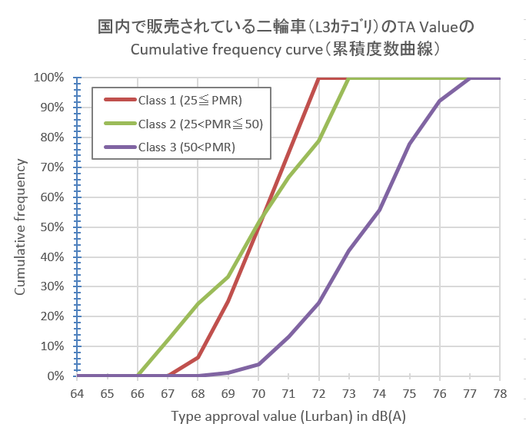
(Reference) Survey Contents
Hearings Survey Results from the Relevant Bodies
Cumulative Frequency Curve of the TA Value of the Motorcycles (L3 category) Sold in Japan
 | Class 1 | Class 2 | Class 3
Current Limit Value | 73dB | 74dB | 77dB
-1dB | 72dB (100%) | 73dB (100%) | 76dB (92.4%)
-2dB | 71dB (75.0%) | 72dB (78.8%) | 75dB (77.95%)
9

Slide 10
3. Summary
- We are considering reviewing the limit value for 2-wheeler acceleration noise regulation (UN R41-04), in the belief that there is a need to continue working toward better noise reductions.
- Japan hopes the consideration of reviewing limit value of UN R41-04 will start on schedule in 2018-2023 at GRB and that its deliberation schedule can be synchronized with the GRB deliberation schedule.
- Regarding the review of limit value for UN R41-04 and for other issues related to R41, we hope that another discussion arena will enable efficient discussions in order to move the plan ahead at a pace suitable to the GRB deliberation schedule.
- If there is to be discussions about measures for things like LAeq and LAmax within the deliberation on reviewing limit value for UN R41-04 at GRB, we would like to support such deliberations as well.
10

Slide 11
Thank you for your attention.
11

