Slide 1
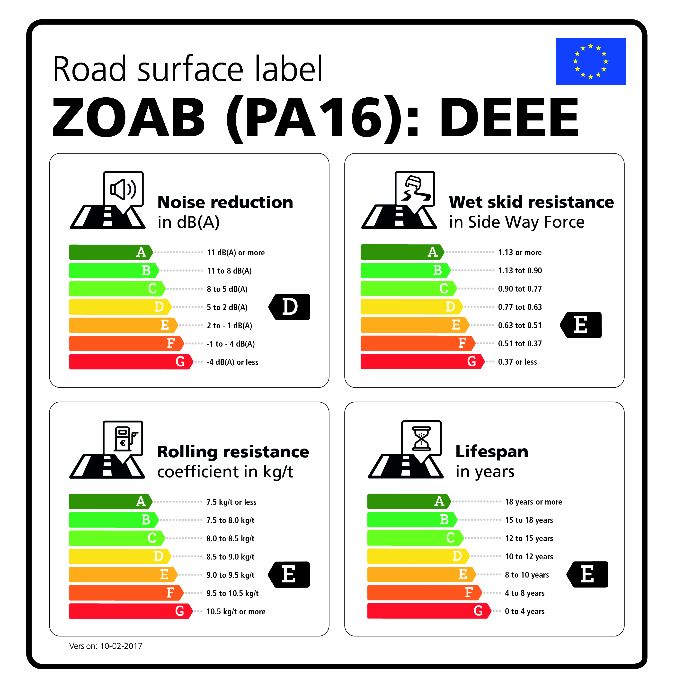
Transmitted by the expert
from the Netherlands
Informal document GRB-66-05-Add.1
(66th GRB, 4-6 September 2017,
agenda item 11)
Labelling road surfaces
-
An initiative from the Netherlands
Dr.ir. Arian de Bondt and dr.ir. Frank Bijleveld – Ooms Civiel / Strukton Civiel
Berry Bobbink and Jan Spoelstra MSc. – Province of Gelderland
Drs. Kees van Oostenrijk and ing. Michiel van Koeverden – Dutch Tyre Association and Dutch Federation of Rubber and Plastics Industry
Prof. dr. Dik Schipper and dr.ir. Henny ter Huerne – University of Twente
UNECE Working Party on Noise (GRB)
5th September 2017, Geneva

Slide 2
Content of the presentation
Why road surface labels?
How does it benefit society?
Boundary conditions
Methodology and measurement methods
Implementation of road surface labels
How to use the road surface label in tenders for roads construction & maintenance?
Conclusions and recommendations
How to proceed?

Slide 3

Follow-up on EU research project: Safe and Silent Road Traffic

Slide 4

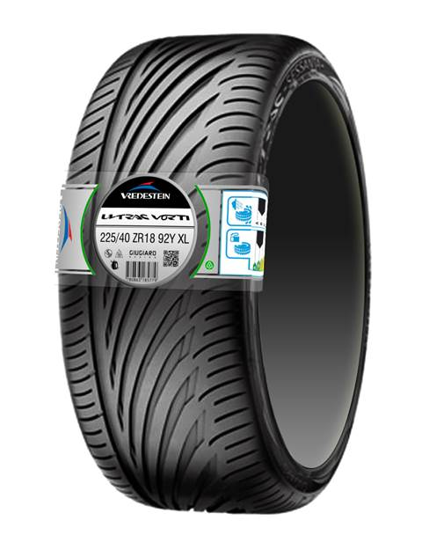
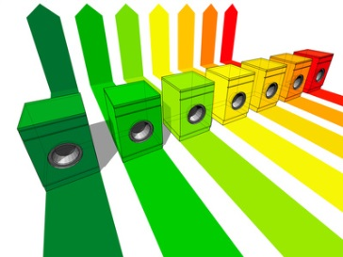
Why road surface labels?
Recognition for society and politicians
To acknowledge that a road surface is a product that can industrially be developed, designed, built, maintained and removed
To facilitate the collaboration between tyre manufacturers and road builders and other relevant industrial partners → shorter innovation cycles (shorter time-to-market)
It makes the optimisation of tyre-road interaction really possible
It facilitates the interaction and communication with road users and residents
Focus on the road surface label, not on changing the existing tyre label

Slide 5

How does it benefit society?
Labelling is a method to encourage progress and stimulates optimisation:
Safety - Skid resistance;
Liveability, health - Noise (reduction);
Sustainability and economics (road user) - Rolling resistance;
Availability, durability and economics (road owner) - Lifespan.
Line of thought (for each item):
At present, on average approximately label F/E;
Short term potentially to label D/C via smart contracts of the client + innovations from the contractor;
Medium term (5-7 years) label B possible;
Long term (7-10 years) label A possible.

Slide 6
Benefits – the numbers (NL)
Labelling is a method to encourage progress and stimulates optimisation.
Skid resistance – risk of accidents 3x smaller at a proper skid resistance (road accidents cost NL approximately €8 billion annually).
Noise (reduction) – 9 dB(A) noise reduction seems possible by optimum tyre-road combination (EU-project ‘Safe and Silent Road Traffic’)
Rolling resistance – 10-30% reduction rolling resistance → 2-6% fuel savings → saving 488 mln. litres and 1000 kton CO₂ (NL)
Lifespan – from 9 years to 10-12 years (i.e. for porous asphalt)
* Benefits determined for the Netherlands; still to be determined for Europe

Slide 7
Boundary conditions and assumptions
Relate to the existing labels for tyres (same properties or performance indicators)
Suitable for current and future vehicle fleet
Covers the essential road surface functionalities for existing and new roads
Should provide opportunities for innovations
Label is based on in-situ properties, based on advanced laboratory research tests, predictive models and previous in-situ experience
Product development not on the road (high risks and time consuming), but preferably using (advanced) laboratory methods and modelling
Self-regulating and an independent authority that validates the self-regulation
Label-requirements will be determined per project and thoroughly underpinned
Used by professional road authorities and contractors
Label directly after construction, but possibly also requirements over time (end of life)

Slide 9
Noise reduction

Slide 10
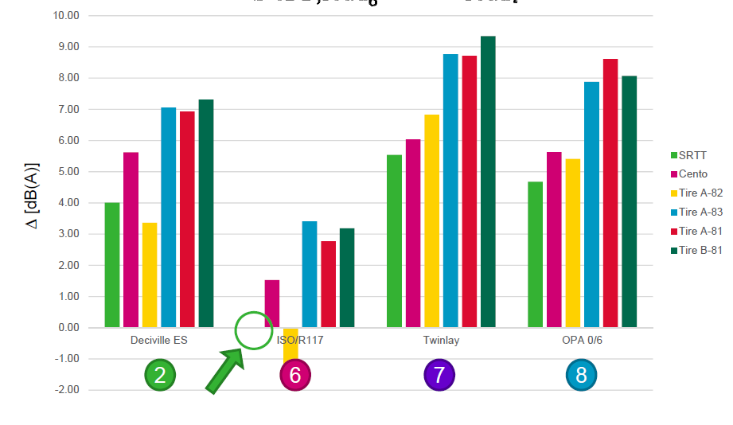
Noise reduction
Silent and safe road traffic:
test sections at airport Twente
(PhD research M. Bezemer,
University of Twente)
Up to 9 dB(A) seems possible with
optimal tyre-road combination
compared to ref. tyre and ref. road
(SRTT, ISOR117, CPX 80 km/h)

Slide 11

Rolling resistance

Slide 12
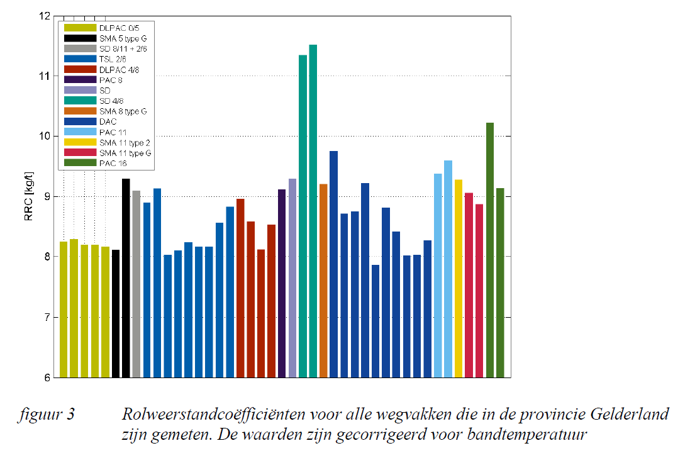
Rolling resistance
10-30 % reduction of
the rolling resistance
possible.
This leads to app.
2-6 % fuel savings.
NL: 488 mln. litres and
1000 kton CO₂ annually.

Slide 13
Skid resistance (wet)

Slide 14
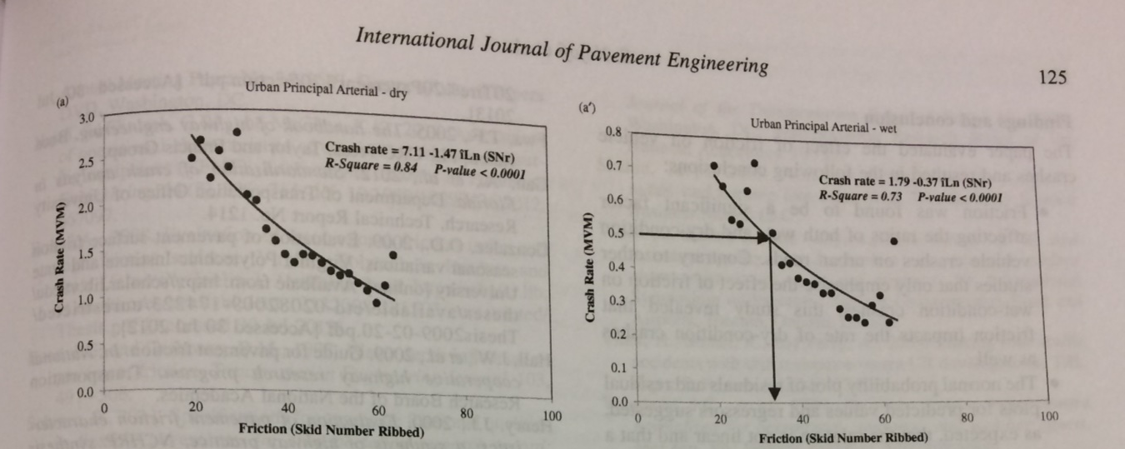
Skid resistance (wet)
Risk of accidents app. 3x
smaller at a proper skid
resistance.
Accidents costs NL app.
€ 8 bn. annually.
Estimated saving due to
labelling:1.25% = 100 mln.

Slide 15
Lifespan

Slide 16
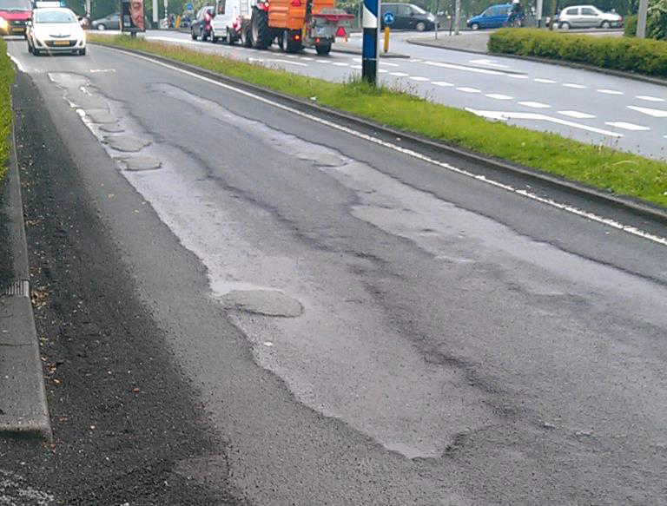
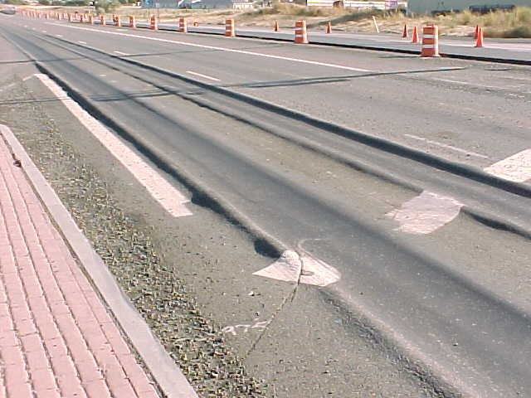
Lifespan
Ravelling
Rutting
Cracking

Slide 17
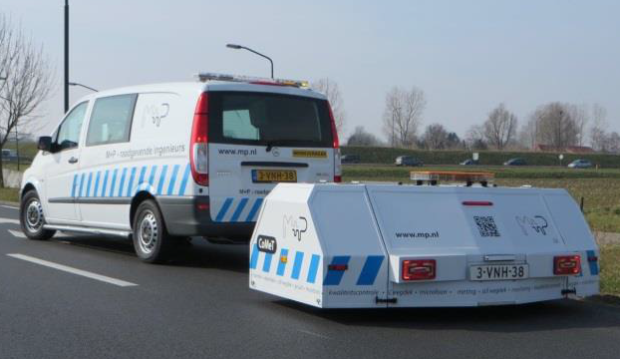
Measurement methods in-situ: Noise reduction
Noise reduction based on Noise Directive 2015/996/EC for m=1 (light motor vehicles) and A-weighted over all octave bands
Reference road surface: Reference conditions of Noise Directive 2015/996/EC measured according to ISO 11819-1:1997 SPB-method
In-situ monitoring: CPX-method (ISO 11819-2:2017)
Label scale: Noise reduction at 80 km/hr, light motor vehicles
CEN-TC227/WG 5 (Road materials, pavement surface characteristics): Harmonising noise measurement methods, still under development. Possible to use this in the future

Slide 18
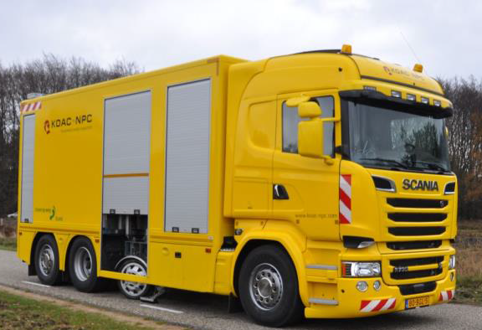
Measurement methods in-situ: Wet Skid Resistance
Wet sideway force skid resistance coefficient at 80 km/hr using German SKM (CEN/TS 15901-8), according to TP Griff-StB 07 (SKM)
German SKM and British SCRIM (CEN/TS 15901-8 and -6) are similar, but procedures still differ
Possible to work with conversion tables in the future
Measurement method for tyre label not possible because deceleration (from 80 to 20 km/hr) not applicable in in-traffic conditions
Label scale: Wet skid resistance after 3-6 months of traffic (can fluctuate significantly directly after construction)
Prediction: Friction After Polishing (NEN-EN 12697-49:2014) and SR-ITD machine developed in EU-project SKIDSAFE
European harmonisation is being worked on by CEN, but not yet achieved.

Slide 19
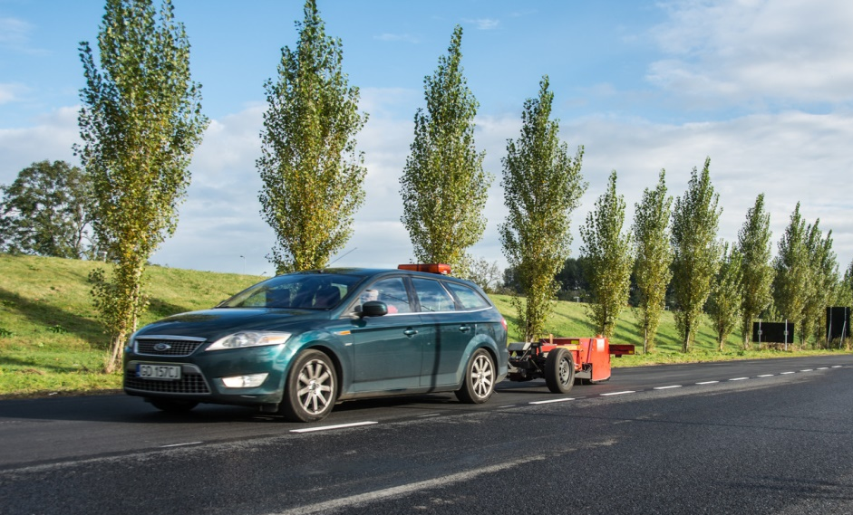
Measurement methods in-situ: Rolling resistance
Rolling resistance coefficient: Ratio horizontal force over vertical force (N/N or kg/ton)
Direct measurement: TU Gdansk trailer measuring rolling resistance
Indirect: Macrotexture of the road, MPD (mean profile depth) according to ISO 13473-1:1997 and ISO 13473-2:2002 + MPD-RR model [M+P.PGEL.17.06.1]

Slide 20
Measurement methods in-situ: Lifespan
The lifespan encompasses all types of distress:
Unevenness
Cracking
Ravelling
Type of distress that first reaches the serviceability limit values (defined in contract or in national or international regulations) defines the ultimate lifespan
Laboratory (indicative) tests: NEN-EN 12697 (test methods for hot mix asphalt)

Slide 21
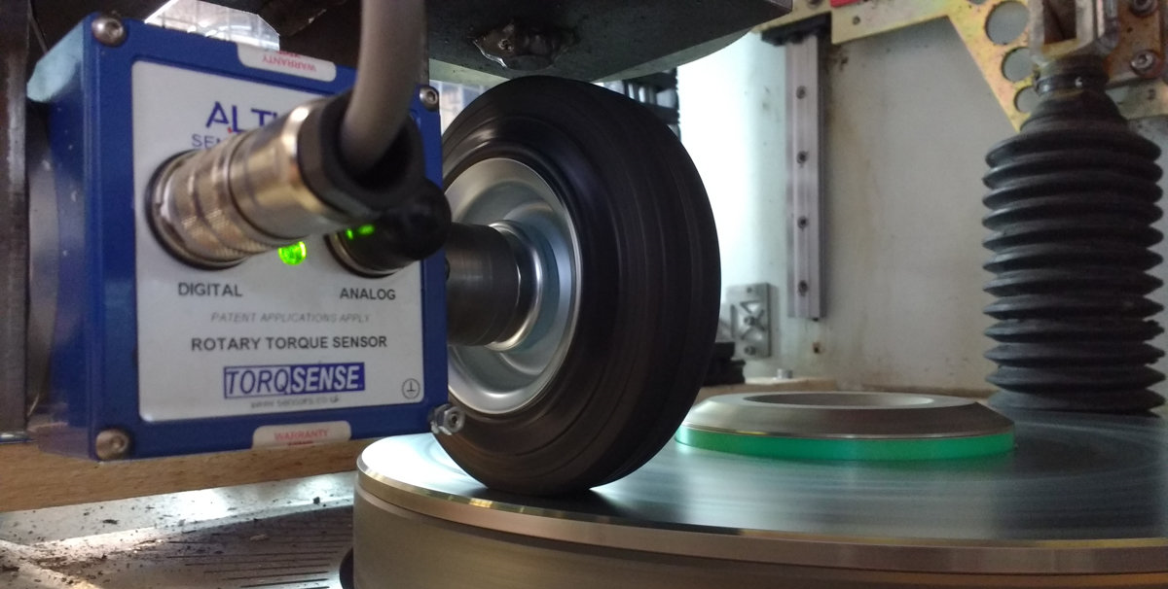
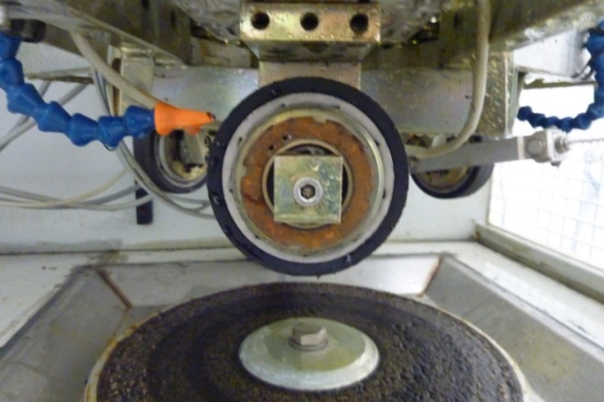
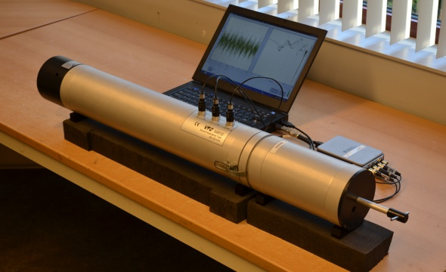
Measurements methods in the laboratory

Slide 22
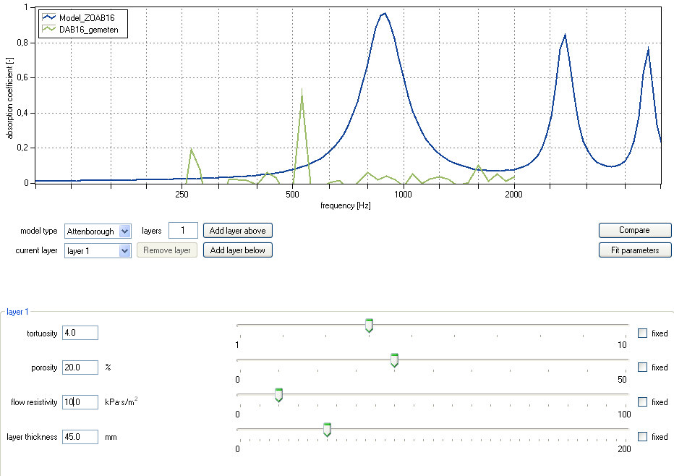
Modelling: Acoustic Optimization Tool
Calibrated noise prediction
model based on:
Tortuosity
Porosity
Flow resistivity
Layer thickness

Slide 23
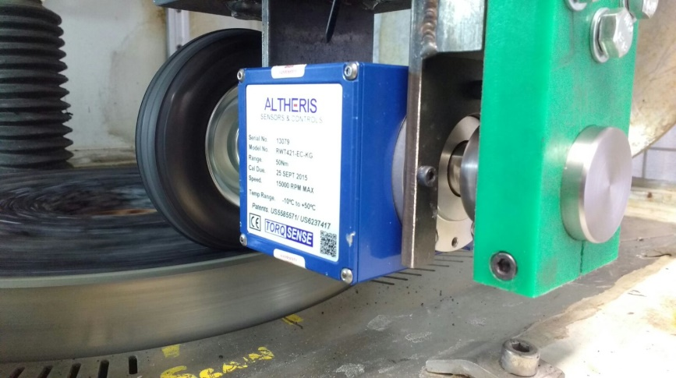
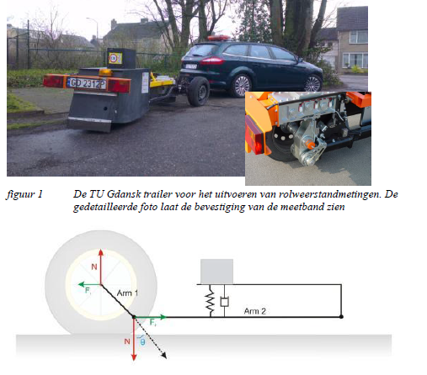
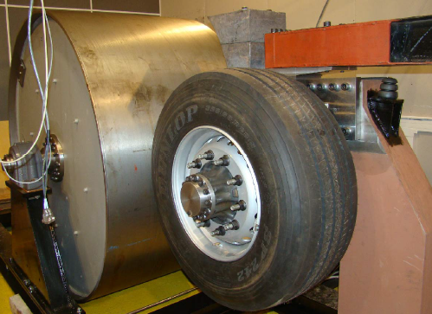
Different measurement methods
road and tyre industry

Slide 24
Examples different (Dutch) road surface labels
Currently best available:
DCDC (focus on lifespan and noise)
CCDD (focus on rolling resistance and noise)

Slide 25
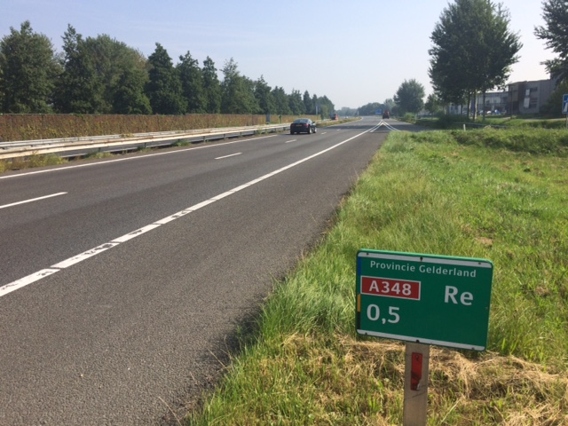
Example of using the Road Surface Label in tenders
Criterion | Value
Price (road construction) | 40 % | * most economically advantageous tender (MEAT)
Road Surface Label | 60 %
 | Minimum | 1 label category higher | 2 label categories higher
Wet skid resistance | E (0.38-0.45) | D: 10% | C: 15%
Noise reduction | D (2-5 dB(A)) | C: 20% | B: 20 %
Rolling resistance | E (8.5-9.0 kg/ton) | D: 10% | C: 15 %
Lifespan | E (8-10 years) | D: 20% | C: 35%
Degree of reliability / evidence | For each indicator 1x evidence | For each indicator 2x evidence: 5 % | For each indicator 3x evidence: 10 %

Slide 26
Conclusions and recommendations
A road surface label would be a step forward towards professionalising and industrialising the road construction industry
The described methodology and labels are a first step based on existing practical experience and the latest scientific knowledge – possibly upgrade in i.e. 5 years
Enormous steps forward seem to be possible regarding improved skid resistance, noise reduction, rolling resistance and lifespan
Possible to practically use it in tenders for roads and underpin it with existing (national) measurement methods

Slide 27
How to proceed?
First pilot Province of Gelderland, the Netherlands (demonstration) in 2017
Input on our proposal (Informal document) → working document → WP 29
Format and methodology available for everyone
No normative legislation desired, but voluntarily use and apply the road surface label
Include European working groups, i.e. CEN-TC227/WG5 and Rosanne EU-project
Optimisation pavement-tyre interaction: Discuss with the automotive and tyre industry

Slide 28
For more information
Informal document: http://www.unece.org/fileadmin/DAM/trans/doc/2017/wp29grb/GRB-66-05e.pdf
Questions:
Frank Bijleveld, fbijleveld@ooms.nl, +31 6 51618194

