Slide 1
Tyres in Europe
Tightening of tyre limits and further suggestions for improvement
Transmitted by the expert from the Netherlands
Informal document GRB-66-01-Add.1
(66th GRB, 4-6 September 2017,
agenda item 6)
Johan Sliggers (Ministry of Infrastructure and Environment)
Erik de Graaff (M+P)

Slide 2
Tyre Limits
2014: On the agenda GRB: GRB-59-11
2015: Proposals for Noise limits (stage 3): GRB-61-03, GRB-62-11
2016: Proposal for all three tyre limits (stage 3): GRB-62-11-REV.1 (at GRB-64)
2017: Revised proposal for all three tyre limits (stage 3 and 4): GRB-66-03

Slide 3
Statistics of C1 label values and (suggested) stages of limit values

Slide 4
Statistics of C2 label values and (suggested) stages of limit values

Slide 5
Statistics of C3 label values and (suggested) stages of limit values

Slide 6
Developments
Rapid improvements tyres (noise) 2007-2013
Premium tyres are dominant in the market (>90% in OEM) (>50% in replacement)
Premium OEM tyres perform (much) better than aftersales tyres
Updated Stage 3 limits at 50 Percentile of 2016 data
New stage 4 limits at 20 Percentile of 2016 data

Slide 7
Rolling Resistance coefficient (N/kN)
Tyre type | Current limit | GRB-62-11-Rev.1 | Stage 3 | Stage 4
C1 | 10.5 | 9.0 | 9.0 | 8.0
C2 | 9.0 | 8.0 | 8.0 | 7.0
C3 | 6.5 | 6.0 | 6.0 | 5.5

Slide 8
Wet Grip index (G)
Tyre type | Current limit | GRB-62-11-Rev.1 | Stage 3 | Stage 4
C1 | 1.1 | 1.4 | 1.45 | 1.6
C2 | 0.95 | 1.25 | 1.25 | 1.35
C3 | 0.80 | 1.1 | 1.1 | 1.2

Slide 9
Noise (rolling sound emissions dB(A))
Tyre type | Current limit | GRB-62-11-Rev.1 | Stage 3 | Stage 4
C1 | 70-74 | 67-71 | 69-73 | 67-71
C2 | 72 | 70 | 71 | 70
C3 | 73 | 69 | 71 | 69

Slide 10
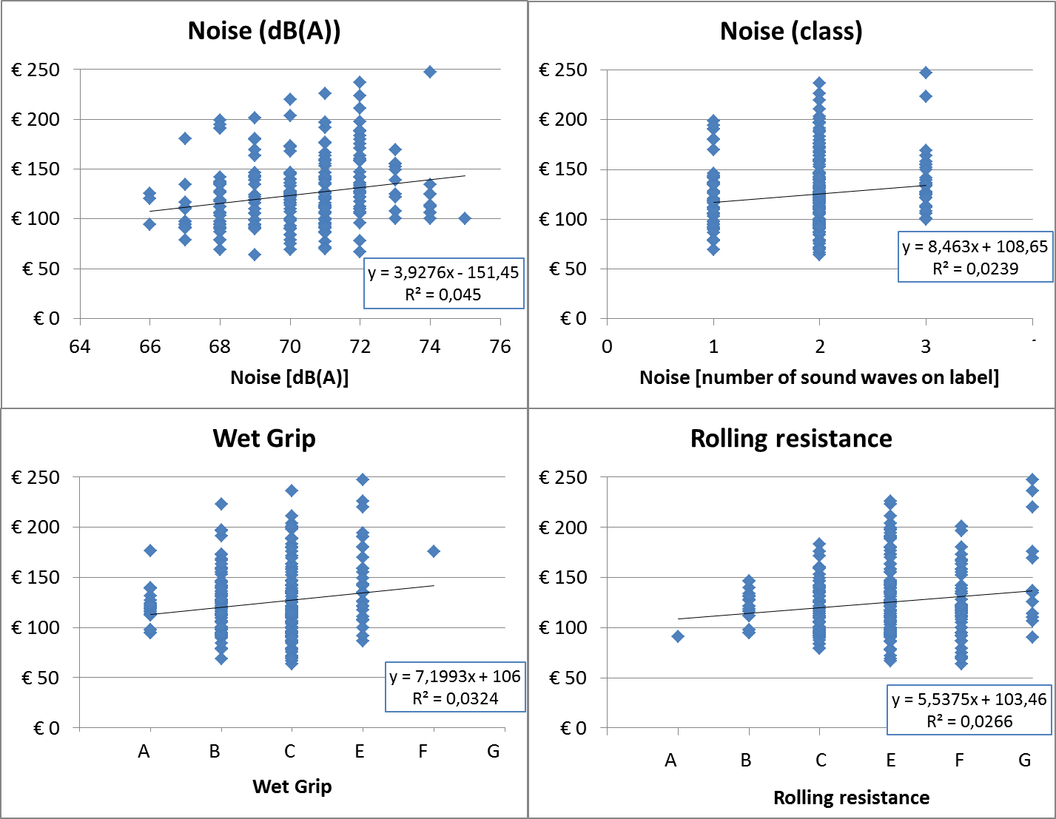

Slide 11
Potential benefits Stage 3, 4 and Proper tyre pressure in the EU
 | Stage 4 limits | Stage 3 limits | Proper pressure
Fuel savings [billion l/yr] | 17 | 8 | 5
CO2 reduction [Mt/yr] | 42 | 21 | 12
Reduced # of fatalities | 2567 | 1300 | 140
Reduced # of slight/ serious injuries | 19631/ 12353 | 10000/ 6000 | 1100/ 7000
Reduced # of annoyed people [millions] | 13 | 6 | 1.5
Reduced # of sleep disturbed people [mill.] | 6 | 3 | 0.6
Cost savings [billion €/y] | 34 | 17 | 6

Slide 12
Potential benefits A label tyres for fuel efficiency equivalent Stage 4 (incl. proper tyre pressure)
Vehicle type | Km/year | Fuel savings/year [l] | Cost savings/year [€]
Passenger car (Petrol) | 17.000 | 84 (19) | 121 (27)
Passenger car (Diesel) | 35.000 | 138 (31) | 151 (34)
Delivery van (D) | 35.000 | 183 (41) | 201 (45)
Delivery truck (D) | 60.000 | 388 (70) | 427 (78)
Heavy duty truck (D) | 130.000 | 2150 (414) | 2365 (456)
Bus (D) | 50.000 | 789 (155) | 868 (171)

Slide 13
Clean Vehicle Directive: Potential benefits for car fleets
Potential benefits | Dutch National Road Authority (RWS) | Amsterdam | Rotterdam
Number of vehicles | 1575 | 781 | 1097
Vehicle average [ km/yr ] | 26.000 | 17.200 | 17.300
Fuel savings (correct pressure) [thousands ltr/yr] | 153.000 (26.500) | 147.000 (33.000) | 200.000 (45.000)
CO2 reduction [ton/yr] | 388 (66) | 379 (86) | 514 (116)
Cost savings [€/yr] | 237.500 (42.000) | 224.000 (51.000) | 303.000 (69.000)
Cost savings per vehicle [€/yr] | 150 (36) | 287 (65) | 277 (63)

Slide 14
Tyre pressure
60% of cars have underinflated tyres
Tyres deflate 3-5% a month
User manuals prescribe: ‘inflate when cold’
  Frequency?
  Warm tyres? What then?

Slide 15
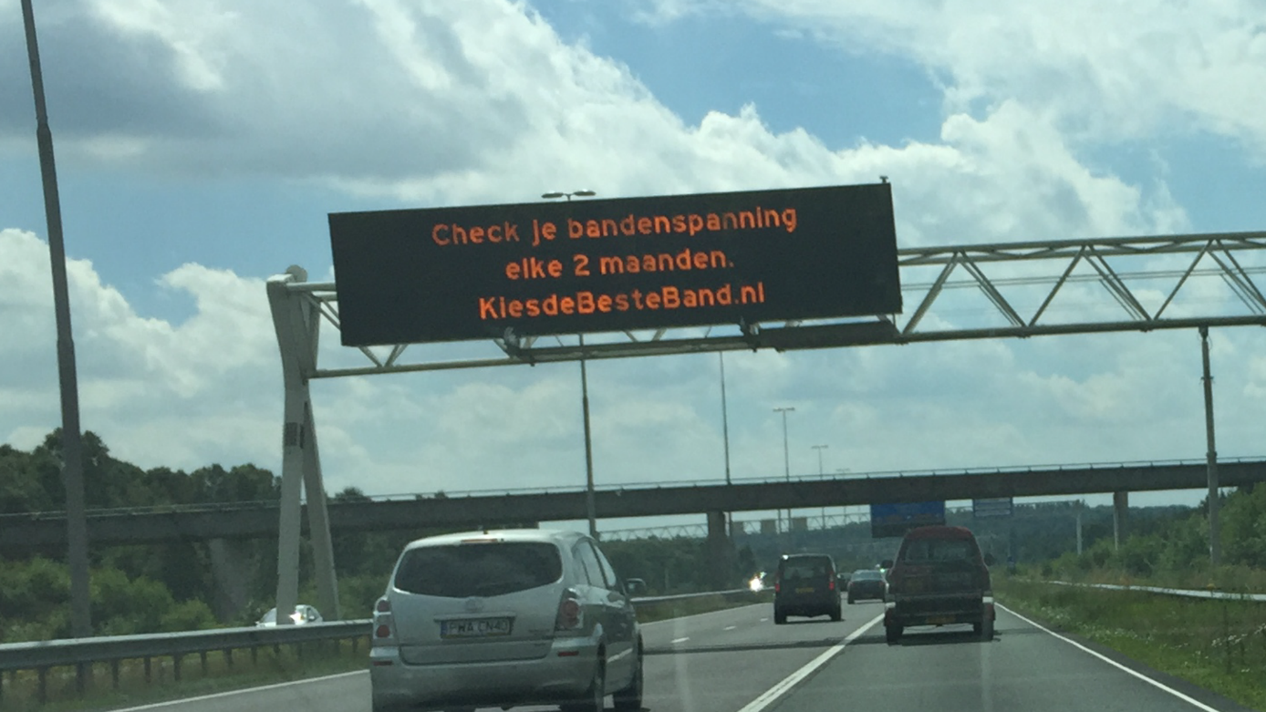

Slide 16


Slide 17
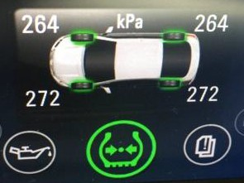
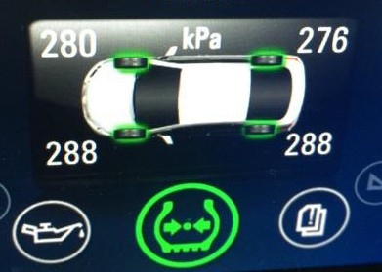
Tyre pressure monitoring systems (TPMS)

Slide 18
Tyre wear
In NLs 1 kg per capita, in EU 0.5 Mton/yr
40% of total microplastics emissions
30% under inflation increases wear by 50%
No standards/limits for tyre wear
Wear/Durability/Abrasion rate on tyre label?
Wheel alignment in periodic road worthiness tests?

Slide 19
Tyre quality NL 2015 (8 million cars)
Passenger cars with at least one tyre | Percentage | Total NLs (million)
Irregular wear or damage | 41 | 3.35
Damage | 25 | 2.04
Irregular wear | 10 | 0.82
(Ageing) little cracks or tear | 26 | 2.12
Danger to traffic safety | 9 | 0.74
Underinflation | >60 | 5

Slide 20
Tyre label
Label lacks information
Not fit for all season and winter tyres
Market surveillance
Stakeholder consultation EU on Tyre label Regulation, September

Slide 21
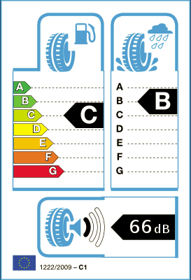

Slide 24
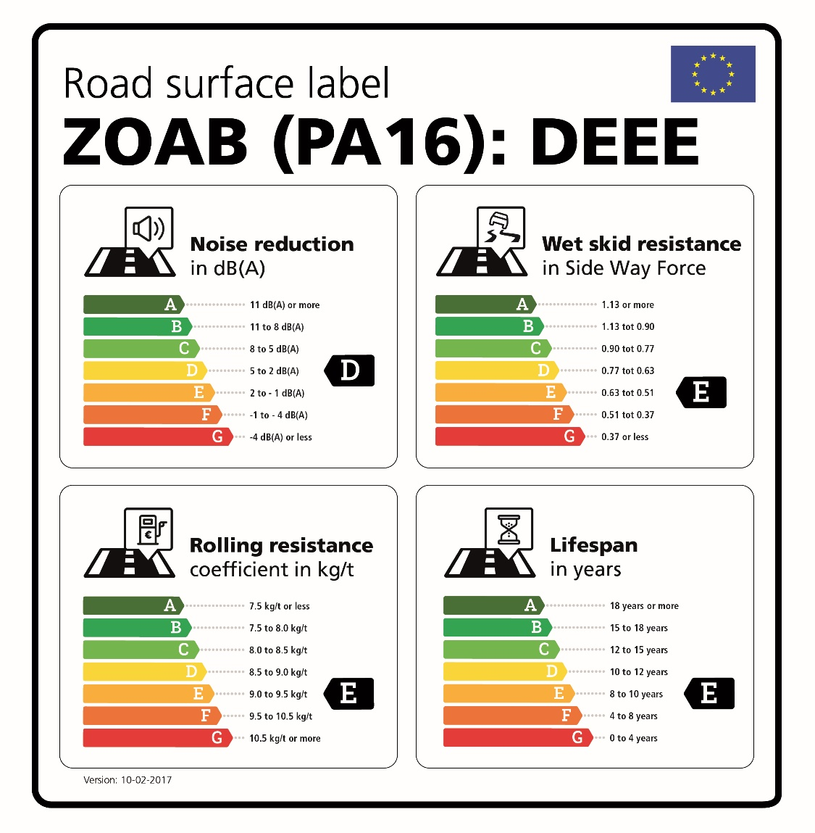
Interaction tyres with roads

Slide 25

Thank you for your attention !

