Slide 1
Reversing audible warning devices for M- and N- Vehicles
Informal document GRB-65-14
(65th GRB, 15 – 17.02.2017,
agenda item 2)

Slide 2
Contents:
Development Steps
Developments in UN/ECE Platform
Evaluation of Applicability and Benefits of Proposal GRB-64-05
Turkey’s Proposal

Slide 3
Development Steps
Turkish experts proposed WP29-168-04 in WP29 to develop a New Regulation about reversing audible warning devices.
The World Forum took note of a proposal by Turkey to establish a New Regulation on vehicle reversing sound warning devices (WP.29-168-04) and invited GRB to consider this issue.
The expert from Germany presented an example of a possible solution amending Regulation No. 28 with the provisions on reversing alarms (GRB-64-05) on GRB 64th session.

Slide 4
Developments in UN/ECE Platform
GRB-64-05 proposal has 4 options for reversing sound level stages, it was anticipated that this adjustment will be made with the manual switch from the driver position.
Pause switch for this warning also added as option. Also, automatic level adjustment is acceptable.
GRB-64-05 Example Solution
Stages | Limit dB(A)
Normal Level | 68-78
High Level | 80-94
Low Level | 52-58
Pause Switch | -

Slide 5
Evaluation of Applicability and Benefits of Proposal GRB-64-05
Proposal GRB-64-05 has similarities with Regulation No. 48 headlamp levelling concept.
Headlamp levelling system in Regulation No. 48 started as manuel device set by driver and with the advancement of the technology, system became automated. Similar typology can be seen in Proposal GRB-64-05.
In the Headlamp levelling system, driver manually adjusted the level to improve visibility, but in the GRB-64-05 driver have responsibility for thinking 3rd persons and adjust the level of system with prediction of exterior noise levels.

Slide 6
Evaluation of Applicability and Benefits of Proposal GRB-64-05
In normal driving conditions, this switch will most likely stay in a constant level with the possibility of always staying in lowest setting.
Vehicles standard horn has a fixed volume level, independent of external noise.
As a result, general usage area of a category of vehicle shows the noise level required for that category, therefore instead of manual adjustment, a pre-set value for vehicle categories will be more beneficial.

Slide 7
Turkey’s Proposal
As indicated in WP29-168-04 document, according to statically evidences accidents involving death or personal injury while reversing have increased in recent years. In addition, accidents involving death or personal injury occurs more in M2 categories than M3, N2, N3 categories.
M2 category vehicles are very common for service and tourism business usage in Turkey and reverse audible warning devices are a type approval requirement for M2 category vehicles besides M3, N2, N3 category vehicles.
Therefore M2 category vehicles can be included into this regulation to harmonize a standard for system.

Slide 8
Turkey’s Proposal
‘’O’’ category of vehicles may also be added to scope of the Regulation taking into account their combination with tow tractors and to improve awareness of road users and prevention of possible accidents.

Slide 9
Turkey’s Proposal
Proposal GRB-64-05 suggest 68-78 dB(A) for Normal Level conditions. This conditions correspond with normal driving environment for vehicle category of M2, M3, N2.
N3 category of vehicles have both construction site use and urban use such as carriage of goods, garbage trucks, etc. Proposed limits for this category of vehicles is 70-84 dB(A).
GRB-64.05 |  |  | Turkey’s Proposal
Stages | Limit dB(A) |  | Cagetory | Limit dB(A)
Normal Level | 68-78 |  | [N2], [M2], M3 | 64-78
High Level | 80-94 |  | N3 | 70-84
Low Level | 52-58 |  | - | -

Slide 10
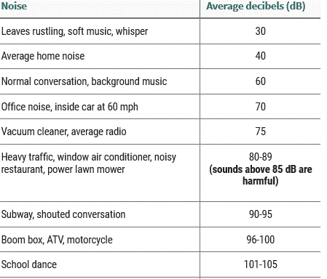
Comparison between Noise Levels and Common Environmental Noise Levels
Turkey’s Proposal
Category | Limit dB(A)
[N2], [M2], M3 | [64 – 78]
N3 | [70 – 84]

Slide 11
Turkey’s Proposal
Manual switch proposal in GRB-64-05 requires much more time to be applied and will not be for the advantage of the sector from the point of the cost-benefit ratio.
In GRB-64-05, if a vehicle is equipped with a Rear-View-Camera in accordance to 2003/97/EC or UN-R 46 Revision 5, reversing audible warning devices are not mandatory. This item increases driver’s vision, but warning the pedesterians with sound is much more effective in preventing accidents, therefore this item is removed from the revision proposal.
It is necessary to focus on the benefits of the preventing accidents with this reversing audio warning system instead of causing disturbance by making noise in a quiet environment.

Slide 12
Turkey’s Proposal
Pause switch in GRB-64-05 also removed from the revision proposal in order to prevent any risk for accidents.
These changes also correspond with Regulation No. 138.01 series proposal (ECE/TRANS/WP.29/GRB/2016/9).

Slide 13
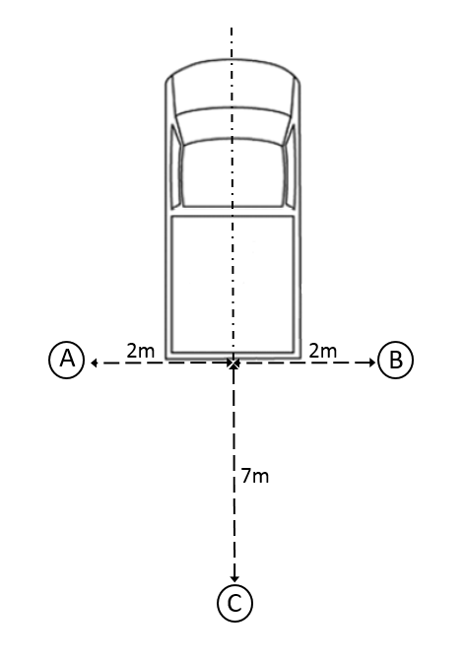
Turkey’s Proposal
GRB-64-05 propose the measurement of sound level from 7 meters. This is kept in the proposal.
Regulation No.138 brings new measurement locations for reversing sound. Newly accepted methods are implemented into proposal.
Proposal limit values and measurement locations can be seen below:
Measurement Positions | Limit Values of Vehicle Categories (dB(A))
 | [N2], [M2], M3 | N3
A / B | [74 - 86] | [80 - 92]
C | [64 - 78] | [70 - 84]

Slide 14
Alternatively, if GRB agree;
New Regulation proposed for reversing audible warning devices in WP29-168-04 may also continue to be developed with the approach in this Proposal and new Informal Document can be submitted to next GRB meeting.

Slide 15
Thank you for your attention!
Contact:
Mr. Fatih ÖZÇINAR
Mr. Evren NACAR
fatih.ozcinar@sanayi.gov.tr
evren.nacar@sanayi.gov.tr
Tel: +90 312 201 5512
Tel: +90 312 201 5508
Directorate General for Industry
Ministry of Science, Industry and Technology
Ankara/TURKEY

