Slide 1
“Pre Study for the discussion on Reversing Alarm System"
-Japanese current situations-
Transmitted by the expert from Japan
Informal document GRB-65-06
(65th GRB, 15-17 February 2017,
agenda item 2)
Feb/2017
Noise Subcommittee/JASIC
Japan Automobile Standards Internationalization Center
http://www.jasic.org

Slide 2
Contents
1. Technical Standard and History in Japan
2. Reversing alarm standard for unit ( JASO D901)
3. The attachment rate of the reversing alarm
System for new Vehicles and sound pressure level
4. Questionnaire Research ( Truck & Bus users )

Slide 3
1. Technical Standard and History in Japan
* To equip reversing alarms is not mandatory.
It is allowed to be equipped.
Reversing Alarm equipment is available for Retrofit
* In 1963, a Japanese company succeeded in developing the
world’s first reversing alarm system.
* JASO (Japanese Automobile Standards Organization)
established D901 "Reverse buzzer standard" in 1975.

Slide 4
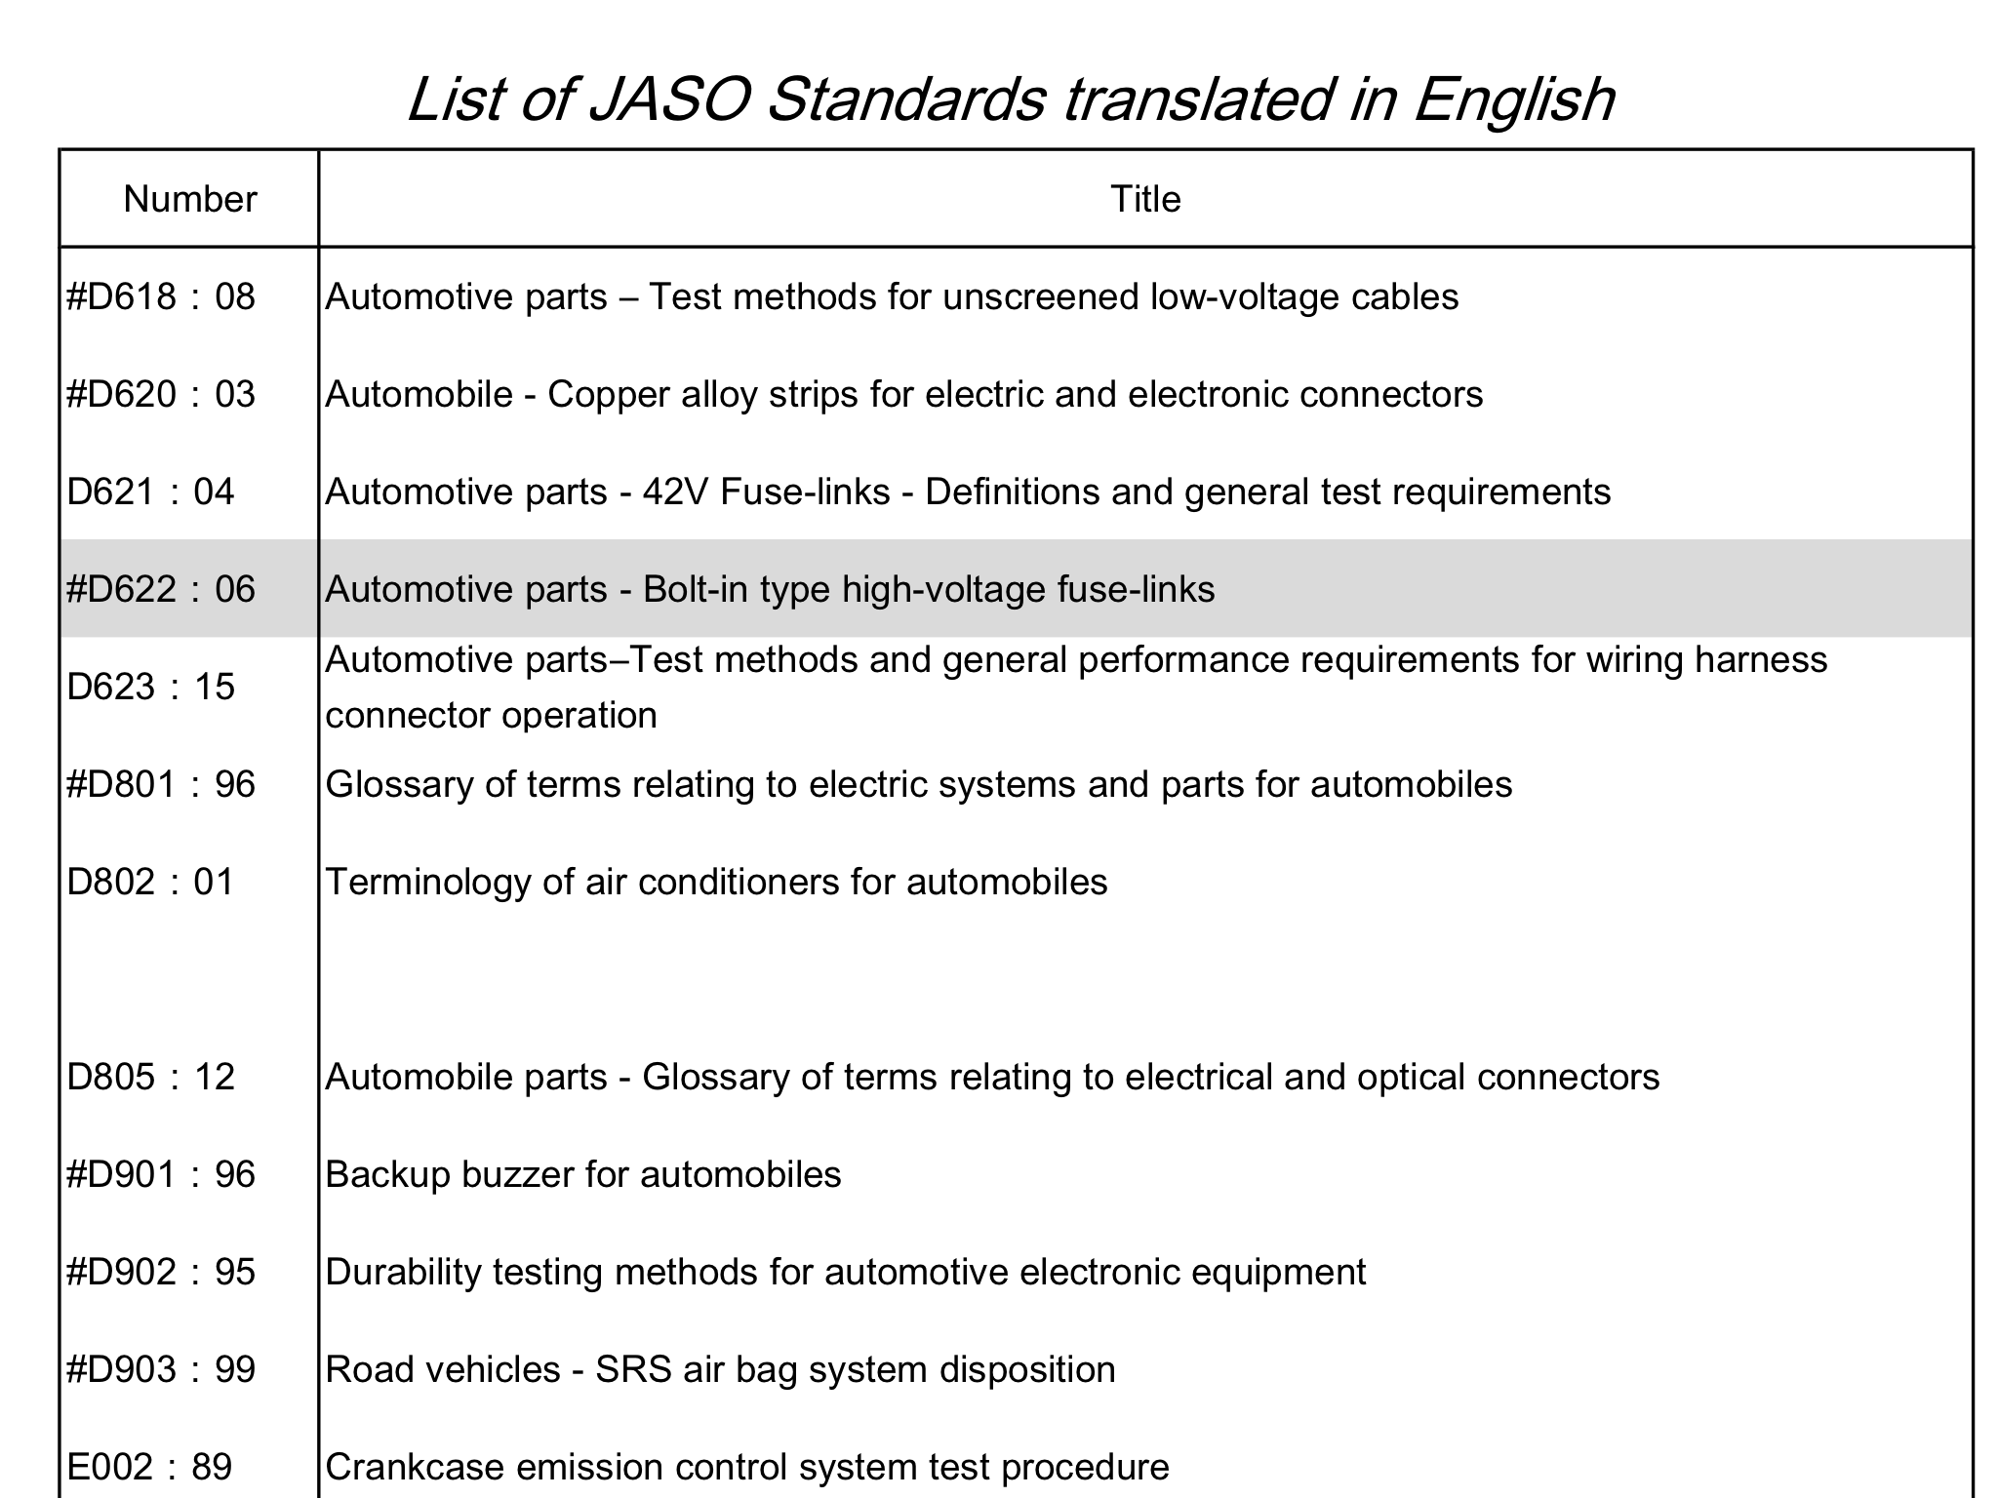
JASO :
Japanese Automobile Standards Organization

Slide 5
2. Reversing alarm standard for unit
: JASO D901
D901 : Main requirements
1. Sound pressure level : 75 - 95 dB
Distance from the buzzer to microphone 1m,
measured in anechoic chamber
2. Fundamental frequency : 400 - 4000 Hz
（no fluctuation)
3. The intermittence number per minute
: 60 - 120 count/min

Slide 6
3. The attachment rate of the reversing alarm
system for new Vehicles
All new motor vehicles sold in Japan of categories N2, N3, and M3 are equipped with reversing alarms (beep type).
Categories | Company A | Company B | Company C | Company D
M3 | － | 100% | 100% | 100%
N3 | 100% | 100% | 100% | 100%
N2 | 100% | 100% | 100% | 100%

Slide 7

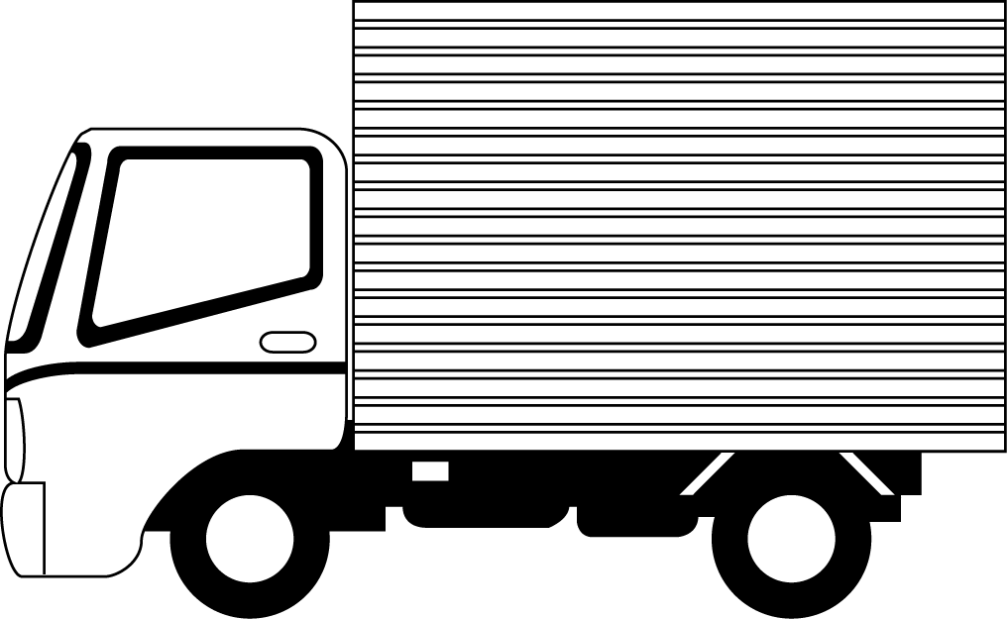
Measuring Point same as Germany Proposal
Measuring Point:
Distance from the end of the vehicle: 7m
Maximum sound level during microphone height: 0.5 ～1.5ｍ
７ｍ
0.5～1.5ｍ

Slide 8
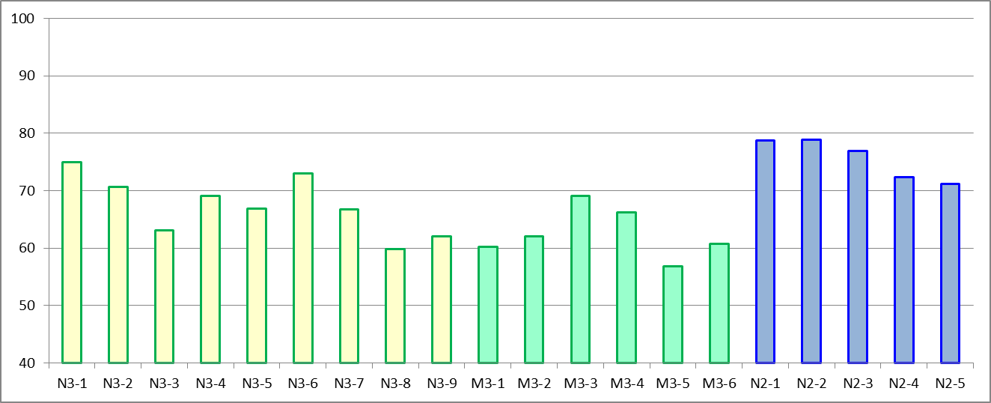
Measurement results of SPL
・N3 : 59.9～75.0ｄBA (Ave. 67.4dBA) ・M3 : 56.9～69.1ｄBA (Ave. 62.6dBA)
・N2：71.2～78.9ｄBA (Ave. 75.6dBA)
N3 Ave. 67.4
N2 Ave. 75.6
M3 Ave. 62.6

Slide 9
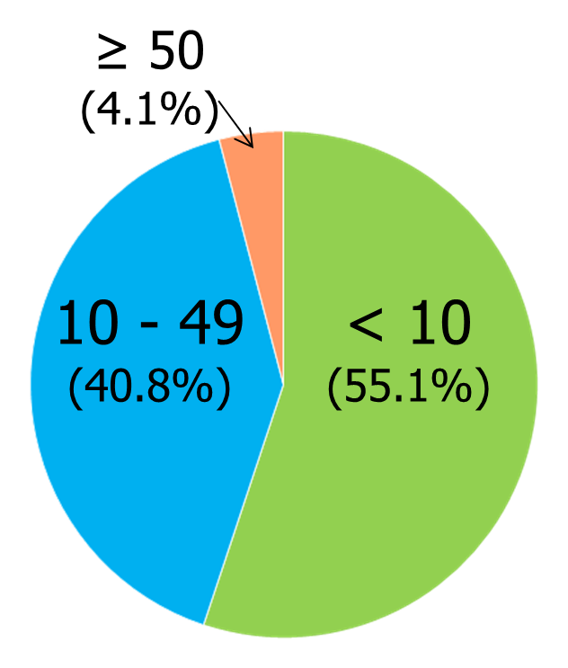
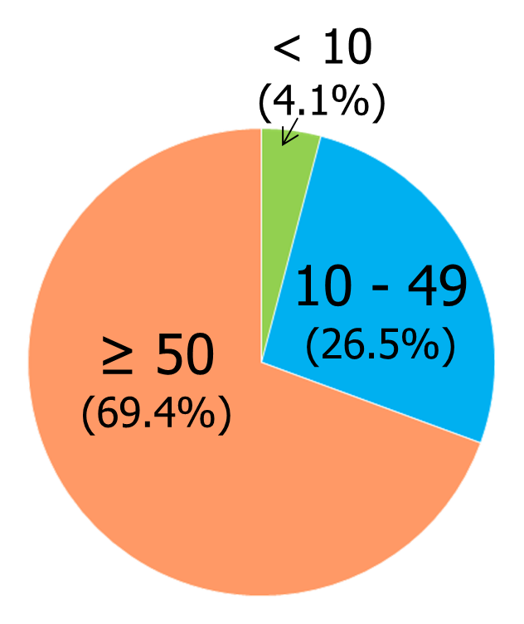
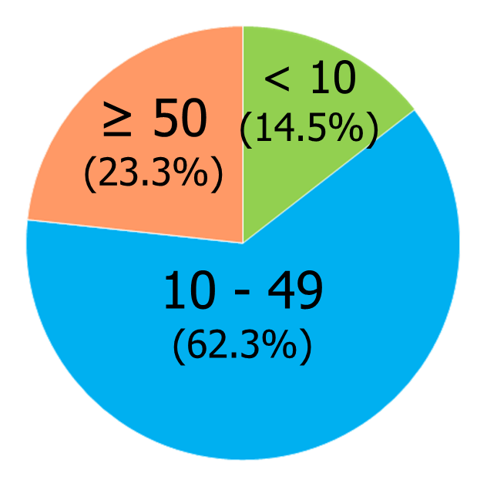
4. Questionnaire Research
(Truck & Bus users)
Number of company which responded our questionnaire
 | Trucking Association (JTA) | Road Contractors Association (JRCA) | Bus Association (NBA) | Sum
Responded Company | 159 | 98 | 49 | 307
Total Owned Vehicle Number | about 5,800 | about 1,900 | about 2,500 | about 10,200
How many vehicle does your company have?
JTA
JRCA
NBA

Slide 10
What is a major vehicle type at your workplace?
Japan Trucking Association (JTA) & Japan Road Contractors Association (JRCA)
No. of cases. (%)
Nihon Bus Association (NBA)
No. of cases. (%)

Slide 11






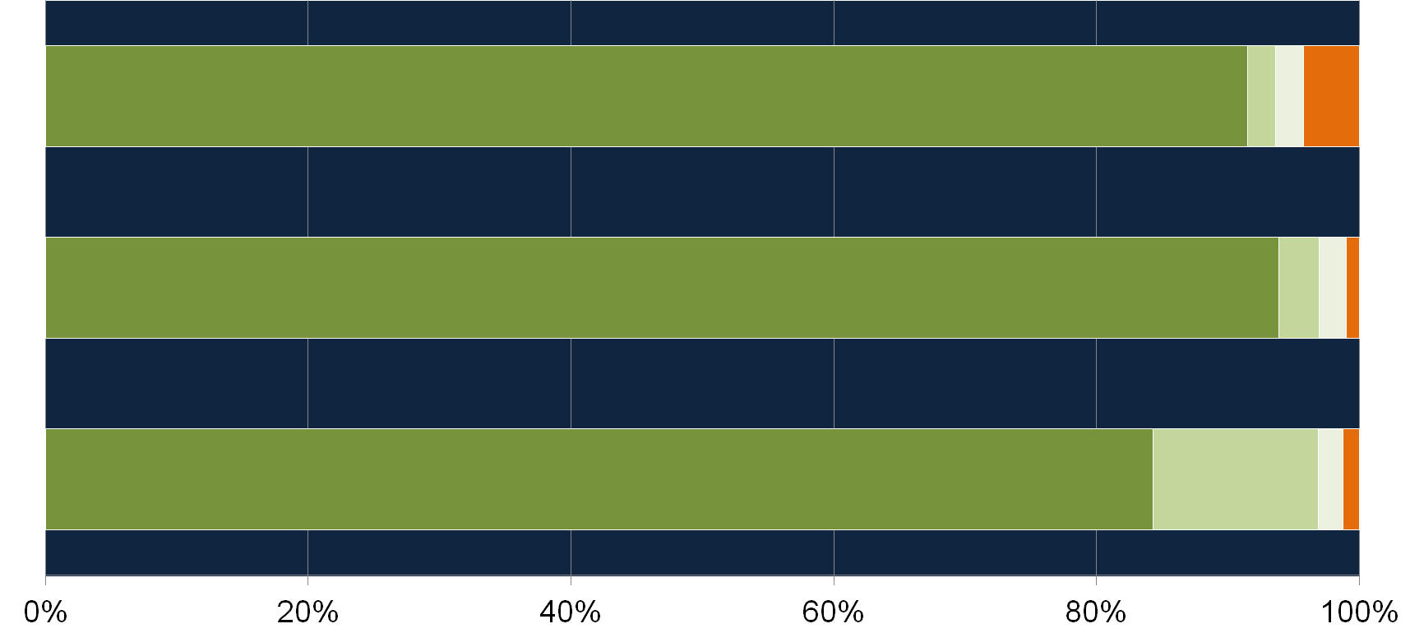

Are your Main owned Vehicles Equipped with Reversing Alarms?
NBA
(n=45)
JRCA
(n=95)
JTA
(n=157)
Almost all companies own vehicles equipped with reversing alarms.
One bus company answered "None", however all the buses owned by the company are equipped with reversing camera.

Slide 12
Do you think motor vehicles need reversing alarms?
No. of cases. (%)
 | JTA |  | JRCA |  | NBA
Necessary for all motor vehicles | 141 | (88.7) | 91 | (92.9) | 43 | (87.8)
Necessary for certain types of motor vehicles | 11 | (6.9) | 5 | (5.1) | 2 | (4.1)
Not necessary for any motor vehicles | 3 | (1.9) | 1 | (1.0) | 2 | (4.1)
Others | 2 | (1.3) | 1 | (1.0) | 0 | (0)
No answer | 2 | (1.3) | 0 | (0) | 2 | (4.1)
Total | 159 | (100) | 98 | (100) | 49 | (100)
A lot of companies answered that reversing alarm is necessary for all motor vehicles.
5 of 6 companies who answered “not necessary for any” own vehicles equipped with reversing camera.

Slide 13

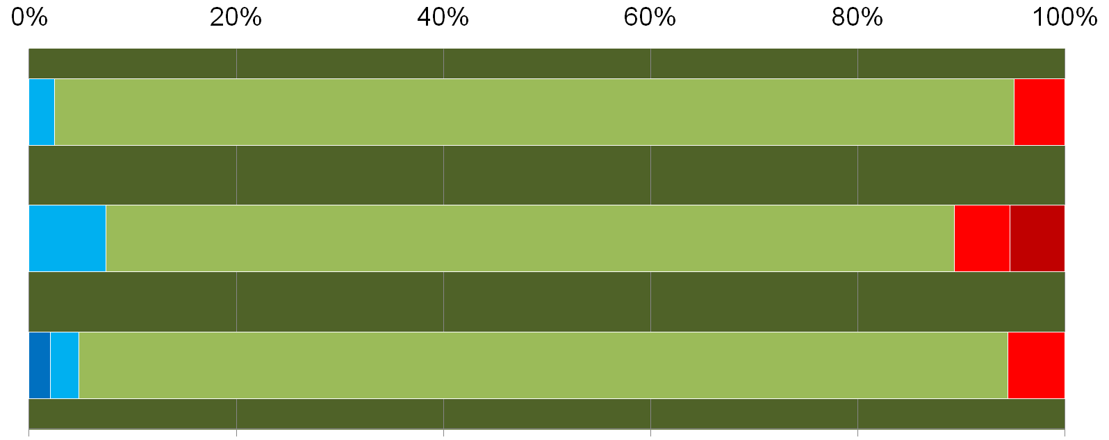
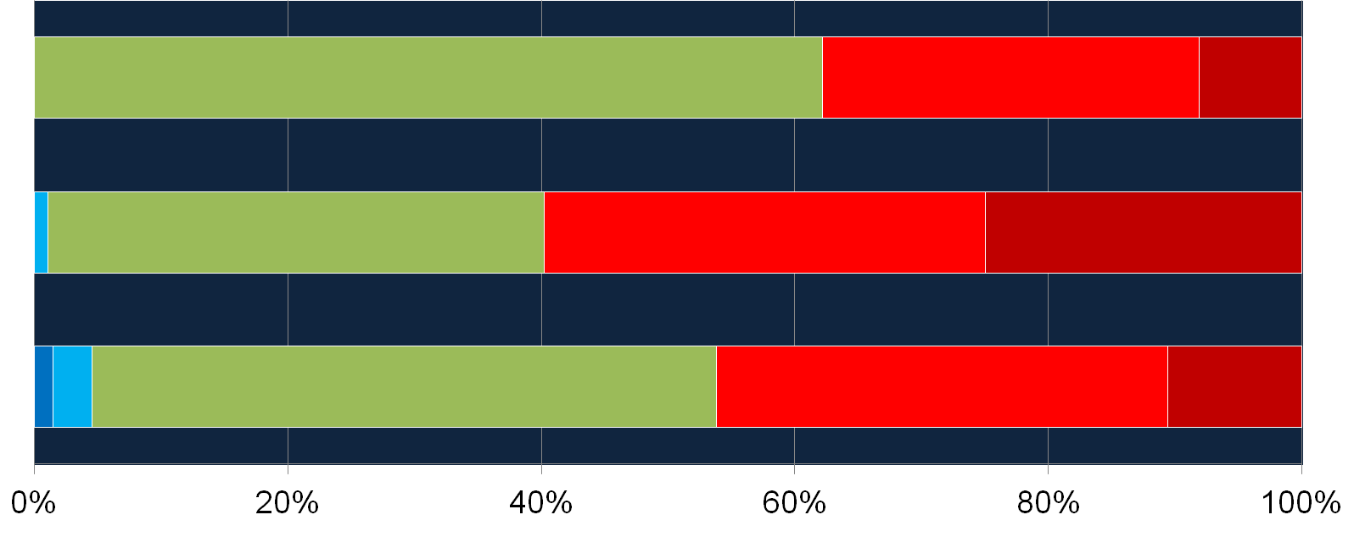
NBA
n=41
Somewhat quiet
Somewhat loud
Daytime
JRCA
n=94
Just right
Too quiet
Too loud
JTA
n=145
NBA
n=37
Somewhat quiet
Night
JRCA
n=92
Just right
Somewhat loud
Too loud
Too quiet
JTA
n=132

Slide 14

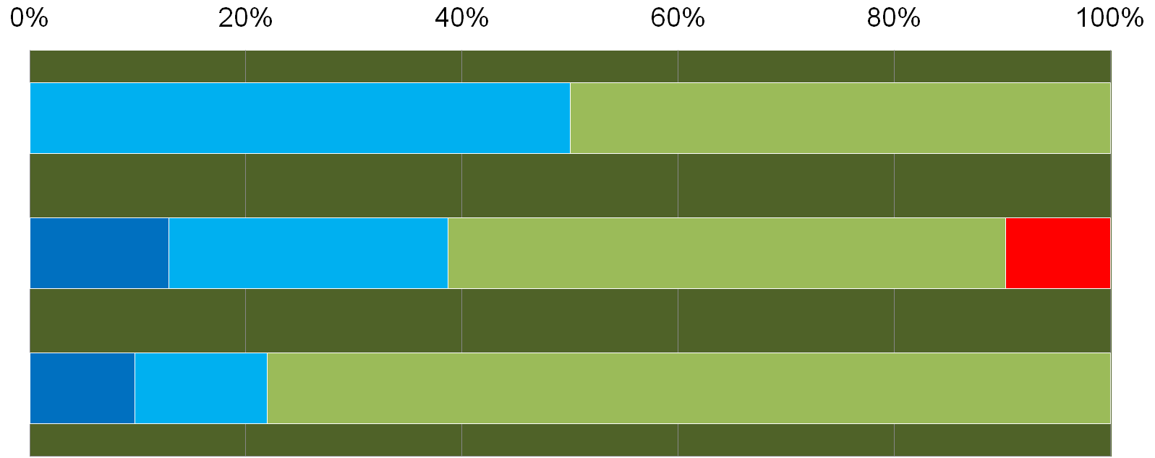




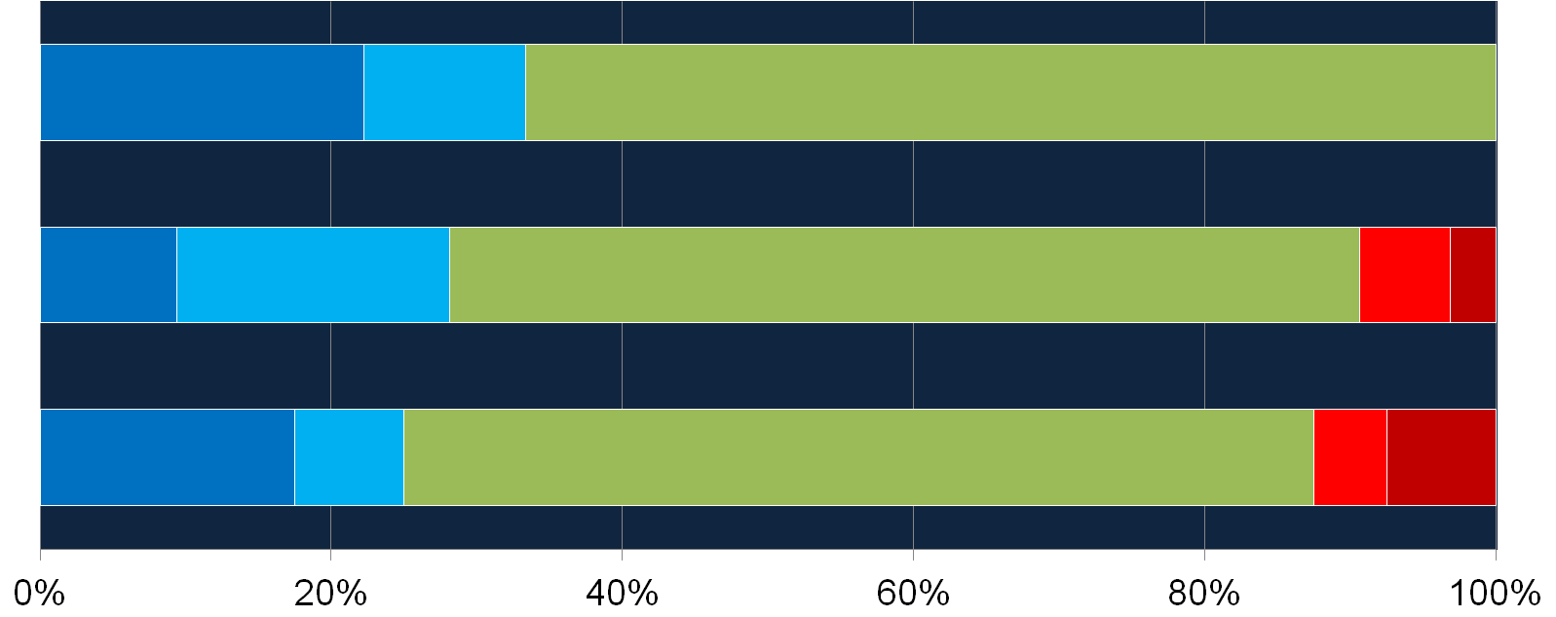



NBA
n=6
Daytime
JRCA
n=31
Just right
JTA
n=41
NBA
n=9
Night
JRCA
n=32
Just right
Too loud
JTA
n=40

Slide 15
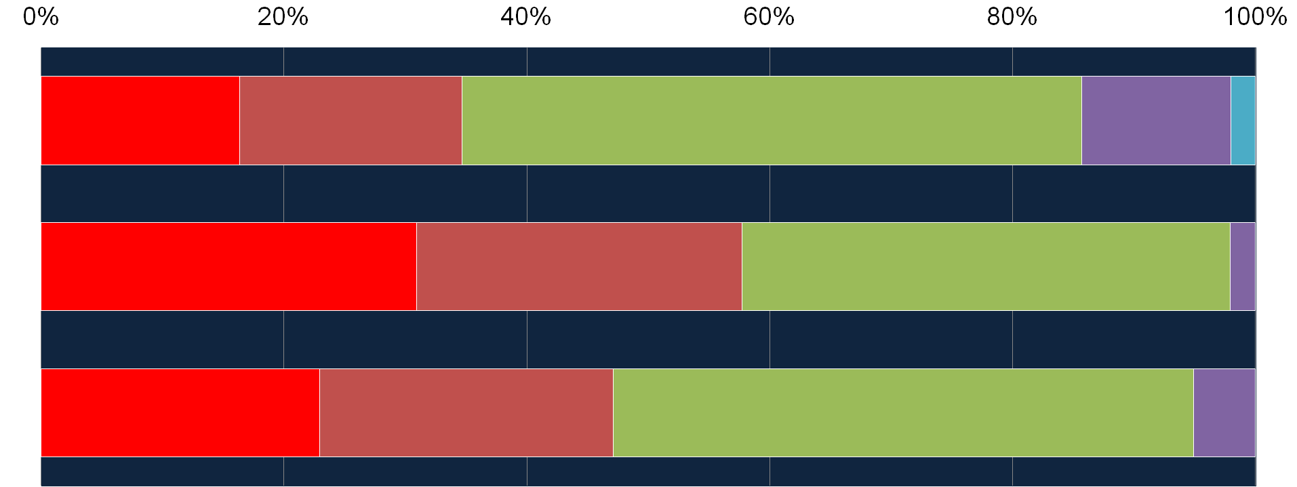
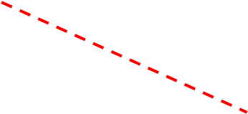

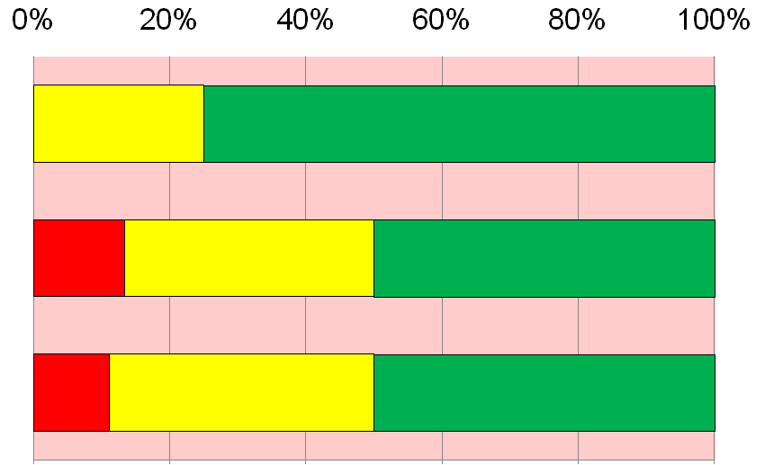



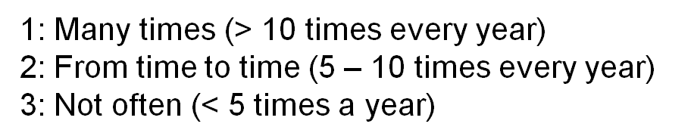
Have Local Residents Ever Complained
About Reversing Alarms?
NBA
n=49
Don’t Know
Don’t have any motor vehicles with reversing alarms
JRCA
n=97
Yes
in the last 12 month
Yes, but not
in the last 12 month
Never
JTA
n=157
NBA
n=8
JRCA
n=30
JTA
n=36

Slide 16
To ensure safety while reversing the vehicle, do you use any equipment or take any measures other than reversing alarms? (Multiple answers allowed)
 | JTA | JRCA | JBA
Reversing cameras | 82.9 | 52.7 | 100.0
Rear sonars | 2.4 | 7.3 | 12.5
Directional microphones | 0.0 | 0.0 | 50.0
Someone guiding while reversing | 19.5 | 47.3 | 18.8
Others | 2.4 | 10.9 | 0.0
Many companies use several equipment (especially reversing cameras) other than reversing alarms, to ensure safety while reversing the vehicle. 'Directional microphones' are used in Bus association only

Slide 17
Outline of the results of the survey
All new motor vehicles sold in Japan of categories N2, N3, and M3 are equipped with reverse alarms (beep type), which are in fairly high demand from operation managers of automotive transport companies who own trucks and buses.
- Though differing somewhat depending on the vehicle category, the sound level of reverse alarms commonly used in Japan is typically 60–78 dB (measured by the method proposed by Germany).
- Most operation managers feel the sound level of reverse alarms (60–78 dB) is just right in the daytime, but a majority feel it is too loud at night.
- Regarding the use of reverse alarms, roughly half of operation managers have received complaints from local residents.
- In addition to reverse alarms, most motor vehicles of categories N2, N3, and M3 are equipped with reverse cameras to ensure safety while reversing. In some cases, even further measures are taken such as sonars, microphones, and someone guiding while reversing.

