Slide 1

RAILWAY CONTRIBUTION TO INTERMODAL TRANSPORT
The importance of Railways in Freight Villages
Working Party on Intermodal Transport and Logistics Geneva - Nov 23th 2017

Slide 2
Who we are

Slide 3
How we are formed
There are more than 100 European Logistic Platforms involved
Proportionality north-South, East- West
All the European Freight Corridors are represented
3 of the 4 countries with the highest number of logistic platforms are members of Europlatforms

Slide 4
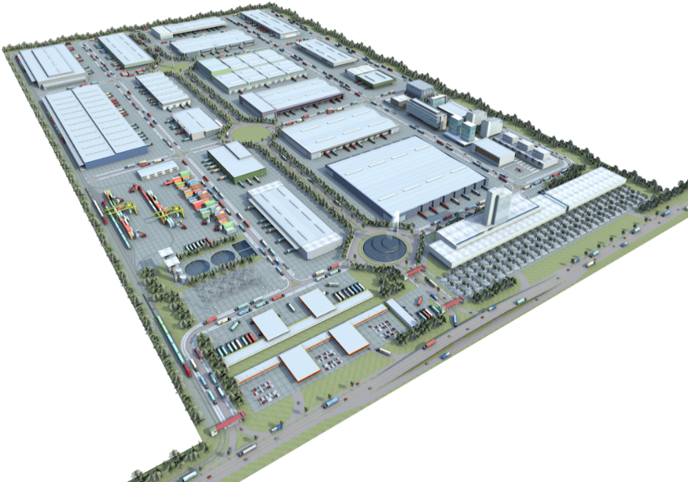
Freight Villages
EUROPLATFORMS EEIG approved the definition of a logistic platforms as:
  “Centre in a defined area within which all activities relating to the transport, logistics and distribution of goods, both for national and international transit, are carried out by various operators on a commercial basis.”
(General Assembly, May 2015)

Slide 5
Freight Villages
GENERAL APPEARANCE
Some of its key “hard” elements usually are:
  Access control
  Service area
  Business centre
  Transport & Logistics warehouses
  Intermodal warehouses
  Intermodal terminal
  Others:
    Inner roads
    Green areas
    Water and waste treatment facilities
    Custom area
    ……
5
4
3
6
2
1
1

Slide 6
Freight Villages
WHAT IS “NOT” A LOGISTIC PLATFORM
Broadly speaking:
  Those generalist spaces that are not designed nor managed for the specific needs and benefit of transport and logistics activities (e.g., industrial parks/zones where Transport & Logistics operators have traditionally set up their facilities just because of the lack of appropriate and tailored TLCs).
But in particular:
  Those infrastructures that lack of a central management model delivered by any public and/or private legal body for the benefit of the T&L companies installed within them.
  Those infrastructures and facilities that lack of design standards tailored to facilitate the development of transport and logistics activities.
  Those developments that include just a few warehouses and/or logistics facilities and therefore lack of capacity/ambition to generate synergies and contribute to the T&L sector improvement and modernization.

Slide 7
Role
THE ROLE OF LOGISTIC PLATFORMS
Logistic Platforms play a key role in:
  Providing tailored infrastructures, facilities and services to reduce the cost of commons services:
    Security
    Energy supply
    Water treatment and supply
    Associated services to employees: service area, car park, etc.
    Associated services to transporters: gas station, truck park, etc.
    Common IT services: access control, monitoring, etc.
  Securing a more efficient connectivity with the main local, regional, national and trans-European transport networks (TEN-T).
    Reducing the supply rotation time, reducing the T&L operators needed warehouse
  Promoting the use of intermodal transport solutions.
    Reducing the haulage, making easy the intermodal exchange.
  Fostering the delivery of innovative and state of art T&L services through the promotion and facilitation of specialist training and the use of new technologies.

Slide 8
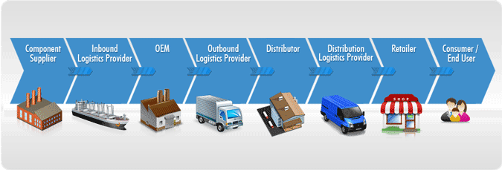
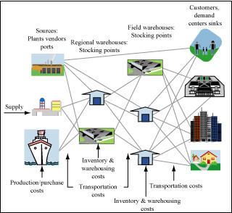
Impact in the logistic chain
LOGISTIC CHAIN
A supply chain is a complex system of organizations, people, activities, information, and resources involved in moving a product or service from supplier to customer.
The decision of the supply chain route depends on each company (costs!), not on the infrastructure or governments
The objectives of transport infrastructure should be to make more efficient the hole logistic chain.
The most expensive infrastructure is the unused infrastructure

Slide 9

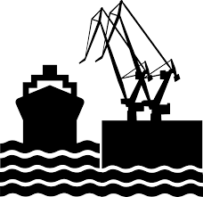





New Logistic: A New Vision of the Logistic Chain
New Logistic:
  Each company, each product, each origin, each moment has their best choice for the logistic chain.
  Next Future: lot of ports, routes, warehouses collaborating in a real network.
  The decision of the route will change from the logistic operator (just now) to the cargo owner: preserve the value of the cargo is the more important add-value of a logistic chain.
  The value of the time will be the key point of the future of the logistic chains.

Slide 10
New Logistic: A New Vision of the Logistic Chain
  The most important advantage in the fast market of the XXI Centuries is to adapt the logistic process to the product
    Examples:
      Amazon: cheap, fast and flexibility from home
      Inditex: fashion is a perishable product
      Aldi / Lidl: fresh products to gain new customers
  Understand the value of the time means a great advantage!!!

Slide 11
The Value of Time
Time
Less value of the Cargo.
Variation
Stop work proccess
Factories
Rotation
Less warehouse
Perishable Goods
Less opportunities
Fix-Time Markets
Initial market value
Value
Residual value (food=0)
Whole value period
Obsolescense
period
Residual value
period
Time

Slide 12


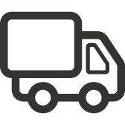

Add-Value of Railways
Time
  Train has the perfect balance between time / cost / and variation:
  In most cases is the best election
Cost /unity

Slide 13
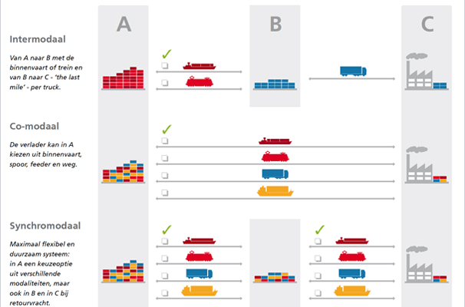
Syncromodality
Select the best transport mean in any moment
Need means interchange areas
Logistics Platforms is a solution of the needed infrastructure

Slide 14
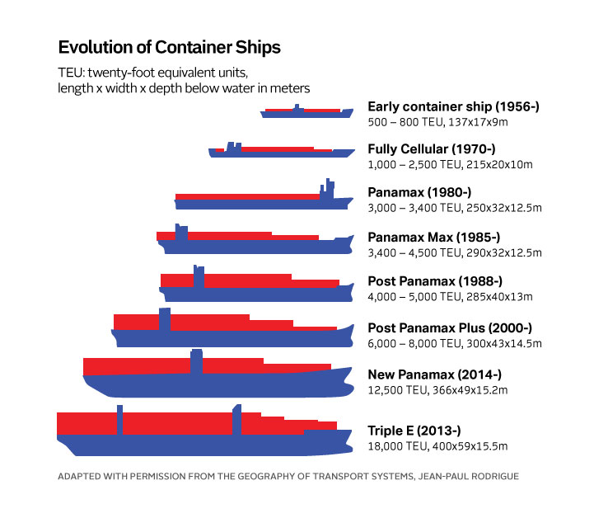
Maritime Transport Evolution
Gigantism:
Companies alliance and concentration
Reducing the Numbers of Ports
Needed a “inland feeder” and “inland terminals”
Railway Transport is the unique way to cover this necessity
Freight Villages is the inland terminal needed to make useful the new logistic.

Slide 15
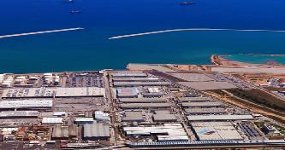
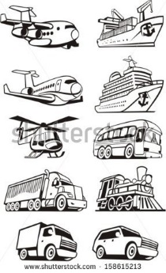
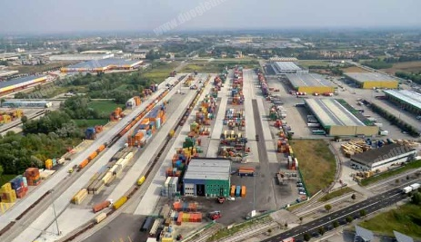
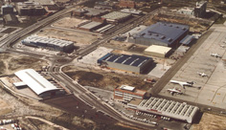
TLCs as Key Transport Infrastructures
TLCs provide intermodality between two or more transport modes,
Facilitate an efficient operation of the transport system and the associated supply chains.
TLCs’ aim is to facilitate both an efficient modal shift between transport means and
An efficient flow of goods between both the transport infrastructures and the specific logistics facilities (warehouses, etc.).
TLCs support efficiency in T&L:
  Increase the rotation of transport services
  Increase the demand of transport, allowing to reduce the price of transport.
  Allow Companies to use the resources they need in every moment, avoiding inefficient expenses.
  Allow Companies to find the better location to their objective market and product
TLCs promote to use of IT as a mean to support T&L Sector competitiveness

Slide 16
Impacts of TCLs
Economics
Environment
Social Impact
Sectorial Impact
Efficiency and cost reduction
Creation of added value
Generate direct and indirect employment with lower investment than other industrial and service activities
The widely accepted standards in TLCs imply a more environmentally interest
More strict design and implementation of compensation measures
Provide the necessary critic mass and public recognition to facilitate the necessary stakeholders management,
Promote a more active cooperation
More ambitious corporate social responsibility
Facilitate a broad modernization and sophistication of the T&L services provision,
Allow the intermodality between means, specially from Railway
Generate synergies and critic mass

Slide 17
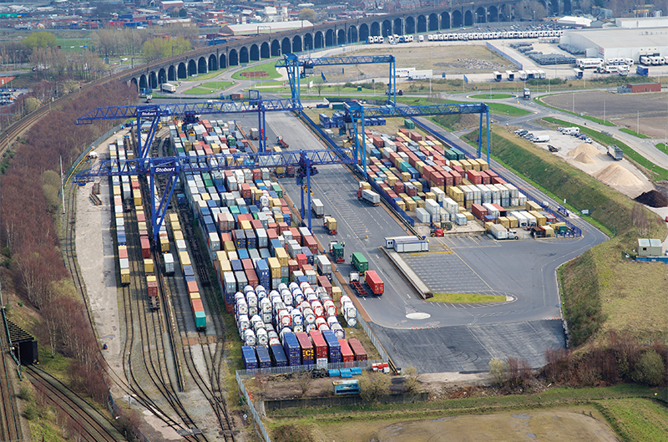
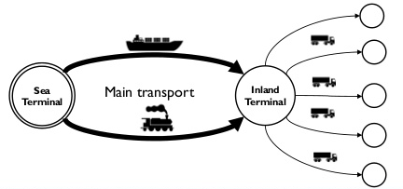
TCLs and Railway: Winner Mix
Conclusions:
TCLs are the inland port of the Railway Transport.
Railway Transport will be the “inland feeder”… if it is used the facilities of the TCLs
WIN – WIN RELATION

Slide 18
Thank you
Manuel Fco Martínez
General Secretary
EUROPLATFORMS EEIG
info@europlatforms.eu
secretary@europlatforms.eu

