Slide 1
Additional Protocol to the Convention on the Contract for the International Carriage of Goods by Road (CMR) concerning the Electronic Consignment Note
“e-CMR”
Robert Nowak
Sustainable Transport Division
Geneva, 23 November 2017
Notes:
This is a sample Title Slide with Picture ideal for including a dark picture with a brief title and subtitle.

Slide 2
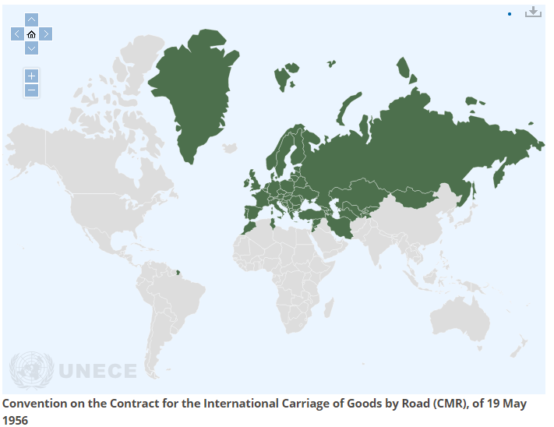
55 Contracting Parties

Slide 3
Key provisions:
Contract conditions
Contract document (consignment note)
Definition of carrier’s liability limits in case of total, partial loss of goods, or delay

Slide 4
Scope of application: Article 1
…apply to every contract for the carriage of goods by road in vehicles for reward …
origin and destination situated in two different countries (one of them a Contracting Party)

Slide 5
Contract of carriage: Article 4
The contract of carriage shall be confirmed by the making out of a consignment note.

Slide 6
Contract of carriage: Article 6
The consignment note shall contain the following particulars:
The date of the consignment note and the place at which it is made out;
The name and address of the sender;
The name and address of the carrier;
The place and the date of taking over of the goods and the place designated for delivery;
The name and address of the consignee;
The description in common use of the nature of the goods and the method of packing, and, in the case of dangerous goods, their generally recognized description;

Slide 7
Contract of carriage: Article 6 (cont’d)
(g) The number of packages and their special marks and numbers;
(h) The gross weight of the goods or their quantity otherwise expressed;
(i) Charges relating to the carriage (carriage charges, supplementary charges,
customs duties and other charges incurred from the making of the contract to the time of delivery);
(j) The requisite instructions for Customs and other formalities;
(k) A statement that the carriage is subject, notwithstanding any clause to the contrary, to the provisions of this Convention.

Slide 8
Article 6
Where applicable, the consignment note shall also contain the following particulars:
A statement that transshipment is not allowed;
The charges which the sender undertakes to pay;
The amount of "cash on delivery" charges;
A declaration of the value of the goods and the amount representing special interest in delivery;
The sender's instructions to the carrier regarding insurance of the goods;
The agreed time limit within which the carriage is to be carried out;
A list of the documents handed to the carrier.

Slide 9
Consignment note
Source: ww.iru.org

Slide 10
Liability of the carrier: Article 17
The carrier shall be liable for the total or partial loss of the goods and for damage thereto occurring between the time when he takes over the goods and the time of delivery, as well as for any delay in delivery.

Slide 11
Compensation : Article 23
When, under the provisions of this Convention, a carrier is liable for compensation in respect of total or partial loss of goods, such compensation shall be calculated by reference to the value of the goods at the place and time at which they were accepted for carriage.
…
3. Compensation shall not, however, exceed 25 francs per kilogram of gross weight short. "Franc" means the gold franc weighing 10/31 of a gramme and being of millesimal fineness 900.
«CMR Protocol»: makes it possible to use the IMF Special Drawing Rights (SDR)
Compensation shall not exceed 8.33 units per kilogram of gross weight short
SDR 1 = approx. $1.4, SDR 8.33 = approx. $11.8

Slide 12
Compensation: Article 23
...
6. Higher compensation may only be claimed where the value of the goods or a special interest in delivery has been declared in accordance with articles 24 and 26.

Slide 13
Additional Protocol to the Convention on the Contract for the International Carriage of Goods by Road (CMR) concerning the Electronic Consignment Note
The Contracting Parties …
DESIROUS OF supplementing the Convention in order to facilitate the optional making out of the consignment note by means of procedures used for the electronic recording and handling of data,

Slide 14
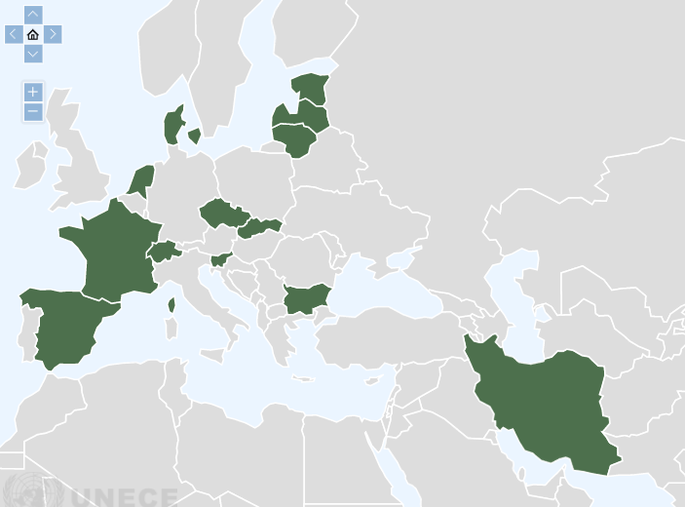
13 Contracting Parties

Slide 15
Article 4
Conditions for the establishment of the electronic consignment note
1. The electronic consignment note shall contain the same particulars as the consignment note referred to in the Convention.
2. The procedure used to issue the electronic consignment note shall ensure the integrity of the particulars contained therein from the time when it was first generated in its final form.
There is integrity when the particulars have remained complete and unaltered, apart from any addition or change which arises in the normal course of communication, storage and display.

Slide 16
Evidence in a court of law ….
A paper-based CMR consignment note:
A piece of paper + mandatory/optional particulars (Article 6, CMR)
An electronic CMR consignment note:
A piece of paper + mandatory/optional particulars (Article 6, CMR)
“Agreement” on the procedures and their implementation in order to comply with the requirements of eCMR Protocol (Article 5(1), e-CMR)

Slide 17
Article 5
Implementation of the electronic consignment note
The parties interested in the performance of the contract of carriage shall agree on the procedures and their implementation in order to comply with the requirements of this Protocol and the Convention, in particular as regards:

Slide 18
Article 5 cont’d
The method for the issuance and the delivery of the electronic consignment note to the entitled party;
An assurance that the electronic consignment note retains its integrity;
The manner in which the party entitled to the rights arising out of the electronic consignment note is able to demonstrate that entitlement;
The way in which confirmation is given that delivery to the consignee has been effected;
The procedures for supplementing or amending the electronic consignment note; and
The procedures for the possible replacement of the electronic consignment note by a consignment note issued by different means.

Slide 19
Article 5
Implementation of the electronic consignment note
The parties interested in the performance of the contract of carriage shall agree on the procedures and their implementation in order to comply with the requirements of this Protocol and the Convention, in particular as regards:

Slide 20
Consignee
Consignee
Consignee
Carriers
Consignee
Sender
Sender
Sender
Carrier
Sender
Carrier
Consignee
Sender
Sender
Consignee
Carrier
Carrier
Carrier
Carrier
Sender
Sender
Consignee
Sender
Consignee
Consignee
Sender
Carrier
Consignee
Sender
Sender
Carrier
Carrier
Consignee
Consignee
Consignee
Sender
Carrier
Sender
Sender
Sender
Consignee
The method for the issuance and the delivery of the electronic consignment note to the entitled party;
An assurance that the electronic consignment note retains its integrity;
The manner in which the party entitled to the rights arising out of the electronic consignment note is able to demonstrate that entitlement;
The way in which confirmation is given that delivery to the consignee has been effected;
The procedures for supplementing or amending the electronic consignment note; and
The procedures for the possible replacement of the electronic consignment note by a consignment note issued by different means.

Slide 21
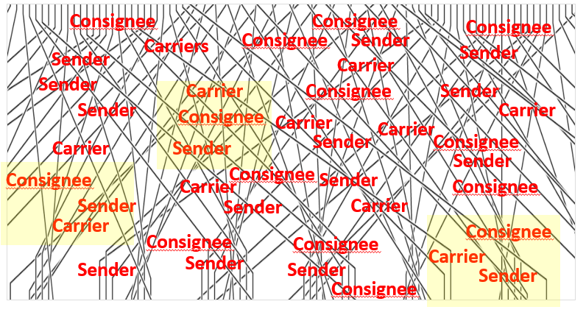
Contracting Parties
13 -----------------> 55
Senders, Carriers, Consignees
«e-CMR Platform»
Create a common platorm «e-CMR Central» for all interested parties to create and exchange information

Slide 22
Article 5
The parties interested in the performance of the contract of carriage shall agree on the procedures and their implementation in order to comply with the requirements of this Protocol …
Consignees
UNECE, SC.1
«eCMR–Platform»
Contracting parties
?
Senders
Customs
Carriers

Slide 23
Questions:
Robert.Nowak@unece.org
www.unece.org
Notes:
This is a sample Title Slide with Picture ideal for including a dark picture with a brief title and subtitle.

