Slide 1
UNECE’s Transport Statistics Activities
Alexander.Blackburn@unece.org
Presentation to WP.24
Geneva, 23-24 November 2017

Slide 2
Overview
WP.6 meeting and rail workshop
Capacity building workshops and the SDGs
Ongoing data collection and dissemination
Interactive E-Census traffic map
Glossary revision
Intermodal statistics at UNECE and Eurostat

Slide 3
WP.6 in June 2017
WP.6 Meeting, June 2017
Half-day workshop on collecting rail statistics
Presentations from Canada, UK, Netherlands, Russian Federation, ERA, UIC
Challenges of data collection due to market liberalization a focus
Details at http://tiny.cc/UNECE-Rail-Stats
Plus decisions and discussions on Glossary revision, monitoring the transport SDGs, Eurostat work on intermodal transport…

Slide 4
Capacity Building
Workshops focused on improving the data situation, sharing country best practices and UNECE’s role in Sustainable Development Goals 3, 9 and 11.
Ashgabat September 2016 (SPECA countries)
Podgorica October 2017 (Western Balkans and Moldova)
Astana October 2017 (SPECA)
Ljubljana November 2017 (Danube Region)
Details at https://www.unece.org/trans/transport-and-the-sustainable-development-goals.html

Slide 5
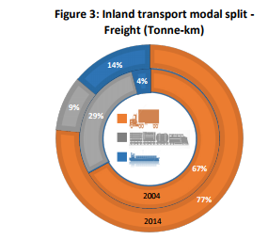
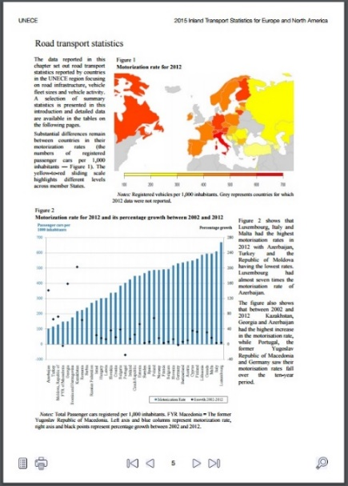
UNECE Database and Publications
Inland Transport Statistics published in June
Road Accident Statistics to be published in November
Infocards published each February
Database now updated ~3 times a year, last update in September 2017. Many more indicators added, and dissemination cubes simplified in August
Data here: http://w3.unece.org/PXWeb/en
All publications available from https://www.unece.org/trans/resources/publications/transport-statistics.html

Slide 6
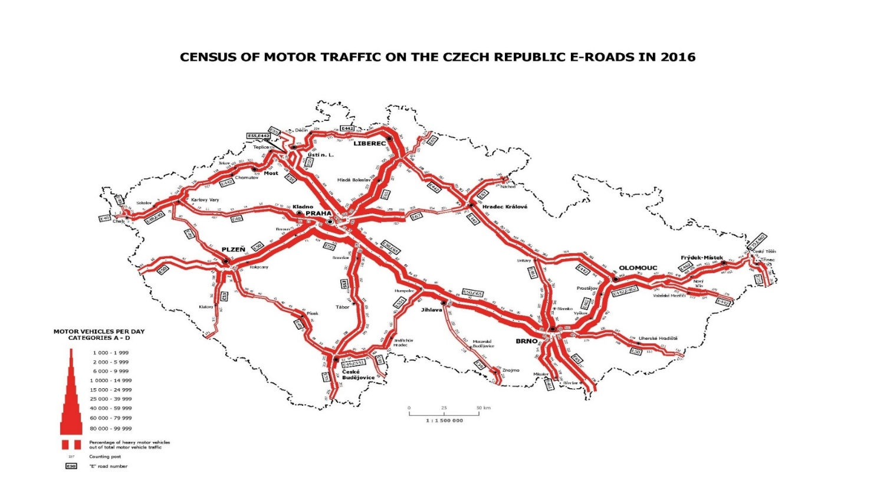
Road Traffic: E-Road Census
White thickness indicates HGV %. We can see at a glance where the crucial goods border crossings are, and how much of border crossings is trade

Slide 7
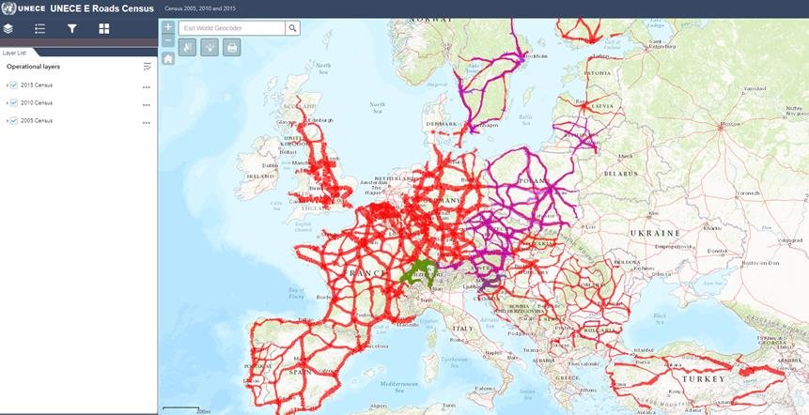
E-Road Census: Interactive European map
https://www.unece.org/trans/areas-of-work/transport-statistics/statistics-and-data-online/e-roads/traffic-census-map.html

Slide 8
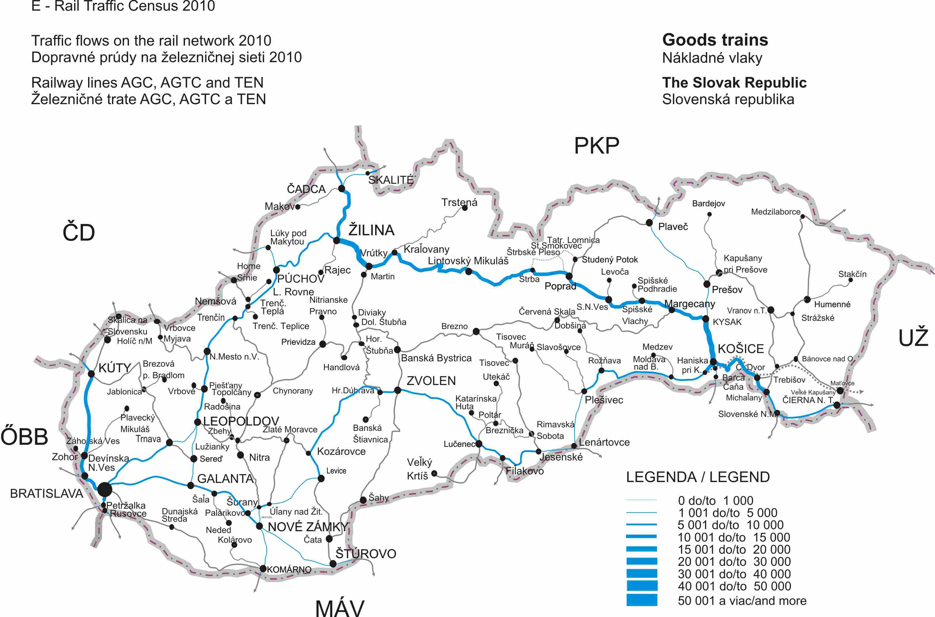
E-Rail Census

Slide 9
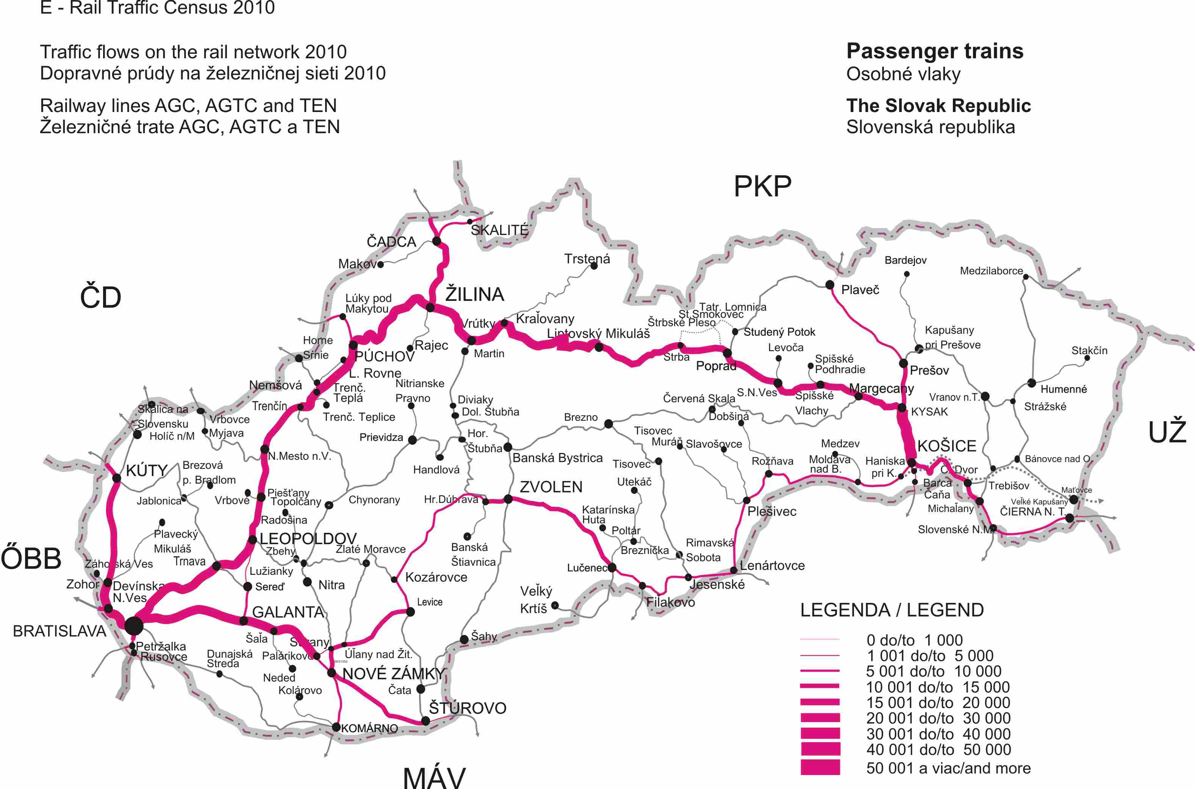
E-Rail Census

Slide 10
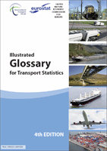
Glossary revision process
Glossary
Informal Group of Experts established under WP.6
Experts from 13 countries, covering most modes (not pipeline), and many intl. organisations (including ERA)
Inputs already received from Switzerland on Intermodal transport
Collaboration starting with review of existing definitions and agreeing process, meetings to follow; a long process expected
Input from countries needed.
Notes:
10

Slide 11
UNECE Intermodal Feed-in Statistics
Total tonnes of goods moved:
ROAD
RAIL
IWW
Tonne-km of goods moved:
ROAD
RAIL
IWW

Slide 12
Eurostat Work on Intermodal Statistics
Glossary revision process
Intermodal statistics available only from existing legal frameworks for each transport mode
Non-harmonized weight concept (road uses gross weight, rail+IWW use gross-gross weight, maritime uses estimated gross-gross weight)
Non-harmonized collection of container data (road: large containers and other containers; IWW+rail: all containers and swap bodies; maritime only large containers)
Notes:
12

Slide 13
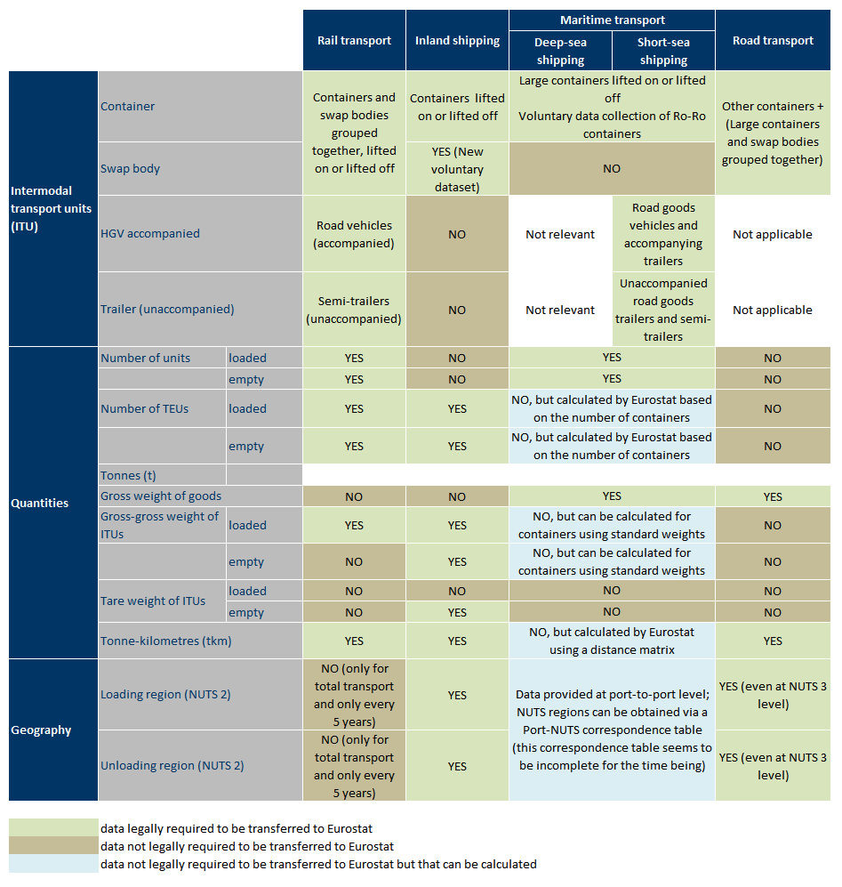
WP.6 in June 2017

Slide 14
Eurostat Work on Intermodal Statistics
Glossary revision process
Currently intermodal statistics produced using the “German approach” which means:
Use available statistics from each mode to calculate indicators
Identify for each mode, other relevant variables available at national level
Use available location data to identify the main intermodal transport corridors
7 Key Indicators calculated:
Notes:
14

Slide 15
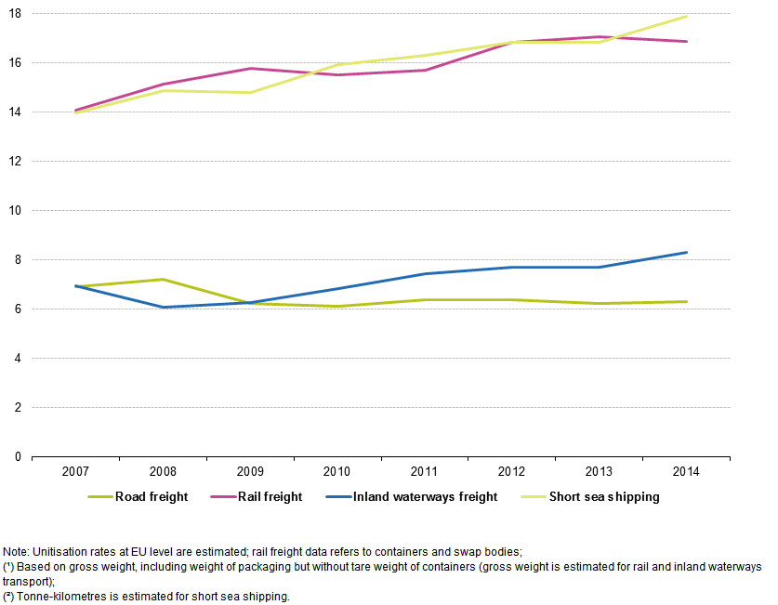
WP.6 in June 2017
Share of containers in total goods transport by mode of transport, estimated EU total % (source: Eurostat)

Slide 16
Further Reading
http://ec.europa.eu/eurostat/cache/metadata/en/tran_im_esms.htm Metadata concerning the seven chosen indicators on unitization and modal shift potential (based on % of goods moved >300km done by road)
http://ec.europa.eu/eurostat/statistics-explained/index.php/Freight_transported_in_containers_-_statistics_on_unitisation#Context Statistics explained article on European intermodal transport statistics

Slide 17
Suggestions? Demands for more intermodal statistics?
We are here to help!
stat.trans@unece.org
Alexander.Blackburn@unece.org

