Slide 1
Geneva, 22 Nov.2017
UNCEFACT work on Streamlining document procedures, Single Window and data harmonization
Mario Apostolov, Regional Adviser, UNECE Trade mario.apostolov@unece.org

Slide 2
Trade Transaction
This involves «business process»
Official regulatory controls
⇒ Business Process Analysis and reengineering needed
sanitary
Phytosanit.
veterinary
origin
etc.
Customs
clearance
Enquiry
Quotation or Offer
Acceptance (placing an order)
Acknowledgement and Status Enquiry
Execution of an Order
invoicing
complaints
Formalities and documentation requirements should be: (1) kept to the minimum – what is really required by the need of society to regulate trade; (2) periodically reviewed with a view to decrease them and simplify them, so that they allow for:
rapid clearance and release of goods (esp. perishables);
time and cost of compliance to be constantly reduced;
abolishing when no longer required by society.
And interests of society (safety and security) should be attended to.
Notes:
A trade transaction requires a seller of goods and services as well as a buyer.
Various intermediaries such as banks and financial institutions can facilitate the trade transactions by financing the trade.
Steps in Trade Transactions
A transaction of purchase or sale of goods involves a number of stages. Every trader, before buying or selling goods takes all the necessary precautions to get the best result of a trade transaction.
The procedure begins with the enquiry from prospective buyer's side and ends with the payment of price by the buyer.
However, in between these two steps, there are many other steps, like:-
Step 1. Enquiry or Prospect
Trade transactions start with this step. It is a request made by a prospective buyer to a seller, relating to the goods, he is interested in buying.
The buyer generally enquires about:-
The quality, size, shape, design, packing, etc.
The quantity.
Time and place of delivery.
Price and terms of payment, credit period, discount, etc.
Sample, price lists, catalogues, etc.
Enquiries may be verbal or in writing. An enquiry is also described as a 'PROSPECT'.
Step 2. Quotation or Offer
A quotation is a reply to an enquiry. It is an offer made by the seller to the prospective buyer, to sell his goods at certain terms and conditions. A quotation must be sent quickly and it must cover all the points of an enquiry. Along with the quotation, samples, catalogues and other sales literature may also be sent.
Quotation is normally given in a prescribed form and includes the following information:-
Quality and quantity of goods offered for sale,
Sale price per unit and discount, if any,
Time, mode and place of delivery,
Terms of payment,
Details of duties, Octroi and taxes payable,
Mode of transport and details of packing, labelling, etc.
Step 3. Acceptance or Placing an Order
Order is an acceptance of the offer or quotation by a buyer. As soon as the quotations are received from various dealers, the buyer has to select the best and the most suitable quotation for obtaining his requirements. He will make comparative study of various quotations and select one among them. As soon as a particular quotation is approved, an order is placed with the dealer whose quotation is accepted either orally or in writing.
Generally, printed order forms are used by the buyer. Order form contains:-
Quantity, quality of the goods.
Rate and total cost, terms of payment.
Time & place of delivery, mode of delivery, types of packing required, etc.
Step 4. Acknowledgement and Status Enquiry
After receiving the order, the seller enters it in the order books and gives the acknowledgement to the buyer immediately.
In case of new customers asking for credit, it becomes necessary to enquire about his reputation and creditworthiness. The usual sources of knowing the creditworthiness of a new customer are trade references, bankers references. published information, etc.
If the seller is satisfied about the creditworthiness of the buyer, he proceeds to execute the order, otherwise the order is rejected. But if the order is received from a regular customer, there is no need to conduct any status (creditworthiness) enquiry about him. This eliminates the risk of bad debts.
Step 5. Execution of an Order
If the seller is not satisfied with the creditworthiness of the prospective buyer, he may reject the order by giving an excuse in a decent manner. But if he is satisfied with the status of the customer he should acknowledge the receipt of order. When the execution of an order is going to take some time, the seller writes to the buyer acknowledging the receipt of an order.
Execution of an Order involves the following steps:-
Intimation to warehouse keeper.
Packing and Despatching of goods.
Issue of delivery note.
Arrangement of transportation of the goods, etc., (Traffic department).
Step 6. Invoicing
An invoice is a document giving the particulars of goods sold to the customers and the total amount due from them. It is sent by the seller to the customer immediately after the despatch of the goods or along with the goods depending upon the practice of the seller. An invoice is a bill for the goods sold on credit. It is usually a printed form which includes details related to the quality, quantity of goods, etc.
Step 7. Complaints and Their Adjustments
After receiving the delivery of the goods, buyer compares the goods with the order. If there is any discrepancy he will inform about it to the seller.
The complaints are generally made due to the following reasons:-
Supply of defective goods.
Delay in executing order.
Defective packing.
Charging higher prices.
Mistakes in totals, calculations, etc.
Supply of excess or less quantity.
Damage to goods sent.
Such complaints should be settled through peaceful negotiations or by using debit and credit notes.
Step 8. Collection of Payments or Sale Proceeds
It is the last step or stage in trade transaction. In case of cash sale, the amount of goods sold is collected immediately. In case of a credit sale, the seller sends a statement of account to the buyer. On receiving this statement, the buyer may send cheque or draft for settling the account.

Slide 3
UNCEFACT Standards Foundation for data and document harmonization & SW
UNCEFACT Trade Reference Model for the International Purchase and Supply Chain
UNCEFACT Unified Business Process Modelling Methodology – UMM
UNCEFACT Core Components Technical Specification - CCTS v2.01 (ISO 15000-5/CCS)
UNCEFACT Core Component Library
UNCEFACT XML Naming and Design Rules
UNCEFACT UN/EDIFACT Directory
United Nations Trade Data Elements Directory (UNTDED)
United Nations Layout Key (UNLK) – UNECE Rec. 1

Slide 4
UN Layout Key for Trade and Transport Documents: UNLK – UNECE Rec. 1
First published 1973
Flexible aligned data presentation which has become the de facto standard for most international trade and transport documents
Application methodology for defining national, regional and industry specific document layouts
Foundation for International transport conventions e.g. Maritime B/L (ICS), Airwaybill (IATA), Road CMR (IRU), Rail CIM (UIC) etc.
Foundation of Customs and other Regulatory Procedures e.g. SAD, Phyto-Sanitary Certificates, Cert of Origins etc.
Thousands of document formats based on UNLK across trade, transport, finance, customs, insurance, inspection etc.
Latest revision – for electronic documents

Slide 5

Various trade and transport documents – to a UNLK
Notes:
5

Slide 6
UNLK Form Families
Trade Documents – Quotation, Order, Invoice etc.
Materials Management Documents – Despatch Advice, Pick List,
Packing List etc.
Transport Documents – Bill of Lading, Shipping Instructions etc.
Customs Documents – Export, Import, Transit Declarations,
Cargo Reports etc.
Other Regulatory Documents – Cert of Origin,
DGN etc.

Slide 7
UN Layout Mapping Example
UID
Name
Definition
Synonym
Repr.
Mapping
2280
Transport Means. Actual Departure. Date Time
Date and or time of the departure of means
of transport
Flight Date, Sailing Date
an..17
UNLK: L 17, P 16

Slide 8
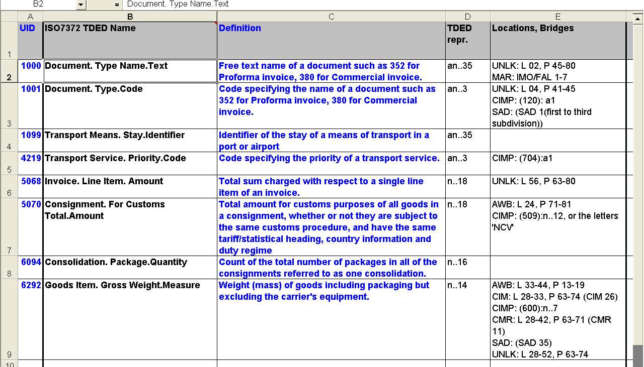
UN Trade Data Element Directory
UNTDED – underpins all UNLK docs

Slide 9
UN/CEFACT Core Component Library
Included Objects
Objects
Versions
Key:
ACC - Aggregate Core Component
ABIE - Aggregate Business Information Entities
qDT – Qualified DataType

Slide 10
UN/CEFACT Core Component Status
Latest Version D17B
1228 Aggregated Business Entities (ABIEs) in total
Only 164 ABIEs needed to cover the business processes of Supply Chain plus Transport & Logistics (Buy/Ship/Pay)
Reuses of CCL subsets for Transport & Logistics and Supply Chain initiatives include:
Cross Industry Supply Chain messages
Agricultural eCert and Animal Passports
FLUX Fisheries messages
IATA CargoXML
CITES ePermit
EU CORE Project (WP10 – data pipeline carrier pilots)
WCO Data Model cooperation

Slide 11
Data Harmonization in four stages (“manual” or automated, e.g. GEFEG)
Business Process Analysis
Data element questionnaire
Standards
UNTDED
WCO Data Model
Core components
Capturing
Interagency expert group
Reconciling
Data harmonization
Result:
Standard data set
Structuring
Definition
Interagency expert group
Analysis
Interagency expert group
Data modelling (+ alignment with UNTDED, WCO DM, etc.)
Regional harmonization / harmonized data model

Slide 12

Where do we use this?
The Single Window
“A Single Window is a facility that allows parties involved in trade and transport to lodge standardized information and documents with a single entry point to fulfill all import, export, and transit-related regulatory requirements.
If information is electronic, then individual data elements should only be submitted once”.
UNECE Recommendation 33
http://www.unece.org/cefact/single_window/welcome.htm
Notes:
But let’s recall what is a Single Window.
UNECE Recommendation 33, developed through the UN Centre for Trade Facilitation and Electronic Business and adopted in 2005, provides the most widely accepted definition of a Single Window.
It describes the SW as "a facility that allows parties involved in trade and transport to lodge standardized information and documents with a single entry point to fulfill all import, export, and transit-related regulatory requirements." “If information is electronic, then individual data elements should only be submitted once”.

Slide 13
5 key elements of the definition
Single submission of individual data
Fulfilling regulatory requirements
Single entry point
Standardized information and documents
The parties involved in trade and transport

Slide 14


Types of interorganizational information exchange
Trade SW
Transport SW
terminal
Customs
eCustoms
forwarder
declaration
transporter
Regulatory bodies:
health
agriculture
technical standards
Transport SW (maritime) & PCS
Certificates and licenses
importer
health
veterinary
phytosanitary
origin
technical standards
Info from business and other systems
railway
road
trucks
forwarder
consignor
Port community systems
transporters
Notes:
Как создать „сеть сетей“
В европейском контексте:
Сети e-Freight, портовых сообществ, платформы: eMaritime, e-Navigation, eCustoms, Computerized Transit System, etc.
Mountains of paper
30% mistakes
Weeks for clearance
Customs, export, import, etc. processes together
Many documents filed together
Appr. 1 hour for clearance

Slide 15
Building SW environment:
Developed countries – complex supply chains ⇒ many “legacy” systems already exist ⇒ need to ∅
Necessary: (1) interoperability among systems along supply chains and (2) governance
Identify stakeholders’ requirements
Create stakeholders’ collaboration platform (WGs)
Data Harmonization and architecture design
Legal Infrastructure Institution
Business model design and enforcement
Establish governance of the project

Slide 16
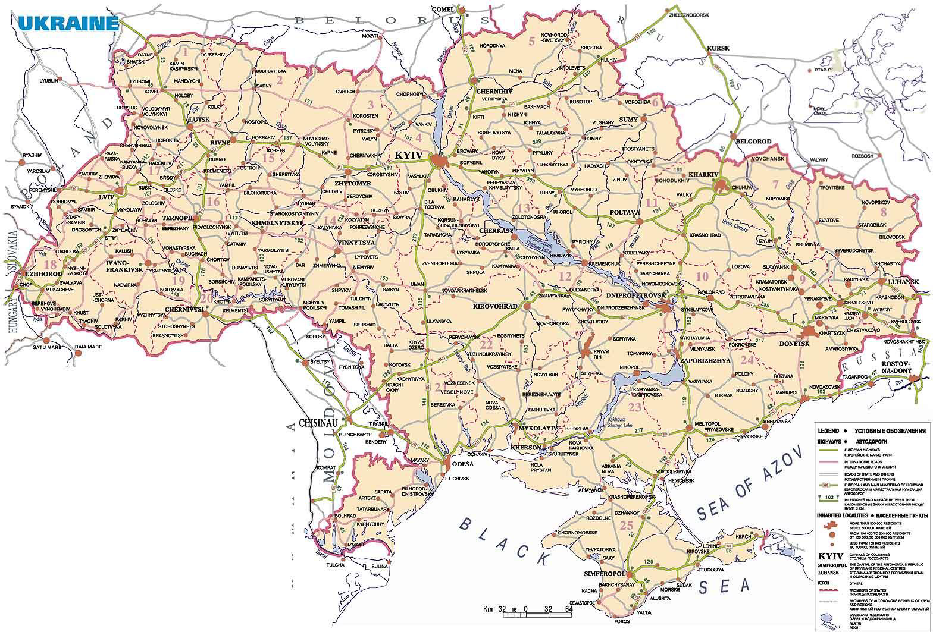
Interagency TF Working Group
addressing legal issues
National TF Strategy
National Single Window
Cargo
Consignor or exporter
G 2 G
The example of Ukraine
B 2 G
Regulatory bodies
Consignee or importer
Maritime or transport Single Window
Freight forwarder or 3PL
G 2 G
Port Community System
B 2 G
Cargo
B 2 B
Consignor, exporter, consignee, freight forwarder

Slide 17


Single Window building algorithm in 5 stages (data exchange) – embed SW interoperability
Stage 1: Paperless Customs + electronic payment of Customs duties + electronic container packing list + risk management
Stage 2: Connection to the IT systems of other regulatory agencies (link of paperless Customs to other documents – electronic certificates and licenses)
Stage 3: Electronic document exchange among various stakeholders, port and airport community systems
Regional system of information exchange or cross-border paperless trade
National electronic logistics platform
Traders
Stage 4: Integrated national logistics platform, in which traders and logistics service providers exchange information
Banks for electronic payments
Port Community Systems
Stage 5: Regional information exchange
Insurance companies
Other regulatory bodies - electronic licenses and certificates
Freight forwarders and logistics service providers
Paperless Customs
Phytosanitary certificates
Sanitary certificates
Интернет
Veterinary certificates
Internet
SEW
Airlines
Certificates of origin
Other licenses
Duty-free zones
Importer/exporter/ Customs broker/ Representative/ other interested partners
Administration of ports, airports, etc.
Shipping agents
Terminal operators
Note: in many countries level 3 was developed before level 2
UNNExT SW Guide

Slide 18
4 major pillars of interoperability (covered by Rec.36):
BSEC initiative; EC SW initiative
SW uses
international standards for trade data and document exchange
data harmonization
Interoperability on different levels:
semantics
business processes
Legal basis for exchange with other SW systems to be created in each SW
alignment with international standards
message syntax (IT systems)
legal systems
A governance structure to be established for SW interoperability
Move from document based to process based approach

Slide 19
Information Pipeline
Future Customs and International Trading Systems (David Hasket et al.)
Data on consignment
Risks
Risks
Risks
Risks
Customs
Interior
Border police
Port, health...
Manifest data
Regulatry requirements of third country
Regulatry requirements of home country
Document and
data level
Information
pipelines
Organizational
level
Consigner or exporter
Freight forwarder or 3PL
Freight forwarder or 3PL
Consignee or importer
Container/
transporter
Port 1
Port 2
Physical
level
Country A
Country B
Cargo
Cargo
Cargo
Cargo

Slide 20
Thanks !
Mario Apostolov
Regional Adviser UNECE Trade
Palais des Nations, Room 431
CH-1211 Geneva 10, Switzerland
tel.: +41 22 9171134
fax: +41 22 9170037
e-mail: mario.apostolov@unece.org
www.unece.org/trade & www.unece.org/cefact

