Slide 1
GTB Working Group Light Sources
Transmitted by the expert from GTB | Informal document GRE-75-14 (75th GRE, 5 - 8 April 2016, agenda item 11(b))
GTB Document No. CE-5258 Date: 2016-04-05
Extension of Regulation 128
towards Light Sources for
Forward Lighting Applications

Slide 2
Content
Introduction
Light Source Work Items in the Pipeline
Corresponding Amendments to Device Regulations
2

Slide 3
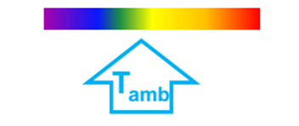
Introduction
Introduction into R128 of LED light source categories for forward lighting applications (front fog, low beam, high beam, AFS) is planned for 2017
R128 changes include performance-based requirements to address forward lighting application-specific parameters:
Visibility & Glare
Temperature Dependency of LED Light Sources
Requirements in R128 have to match with the requirements in the forward lighting device regulations (R19, R98, R112, R113, R123)
In order to avoid significant delay of introduction of this new technology we propose to implement the required adjustments to the device regulations before the “period of no change” due to the simplification of device regulations

Slide 4
Light Source Work Items the Pipeline
Regulation 128 Amendments
Body Text & Annexes:
Visibility & Glare
Contrast Requirements
To ensure adequate performance in devices with a cut-off
Uniformity Requirements
Thermal Behaviour:
Thermal Grades
Plus:
Category Data Sheet (Either in R128 Annex or Resolution)
Light
Source
Specific
Light
Source
& Device
Specific

Slide 5
Amendments to Device Regulations
Forward Lighting Regulations (R19, R98, R112, R113, R123) need to be amended to accept R128 light sources
Adding the option for R128 light sources:
Introduction of Thermal Grades from R128 into forward lighting regulations

Slide 6
Amendments to Device Regulations Example I
R112
6.1.1. Headlamps shall be so made that they give adequate illumination without dazzle when emitting the passing- beam, and good illumination when emitting the driving- beam. Bend lighting may be produced by activating one additional filament light source, one or more LED light source(s) or one or more LED module(s) being part of the passing-beam headlamp.

Slide 7
Amendments to Device Regulations Example II
R112
1.6. References made in this Regulation to standard (étalon) filament lamp(s) light source(s) and to Regulation No. 37 shall refer to Regulation No. 37 and its series of amendments in force at the time of application for type approval.
References made in this Regulation to standard (étalon) LED light source(s) and to Regulation No. 128, including the thermal grade of the LED light source(s), shall refer to Regulation No. 128 and its series of amendments in force at the time of application for type approval.

Slide 8
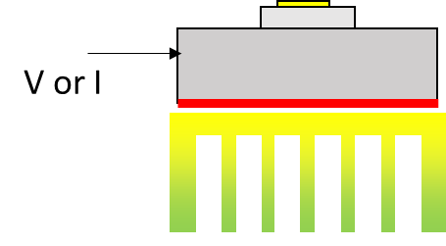
LED Light Sources According to R128 for Forward Lighting Application
LED light source, with:
Photometric characteristics
near-field and far-field
Contrast, uniformity
Mechanical interface
positioning tolerance (after replacement)
Electrical interface (connector)
Either: operated at 13.2V
Or: using external control gear
Thermal performance
Either: heat sink integrated
Or: thermal interface to heatsink

Slide 9
What is Special for Forward Lighting LED Light Sources?
The headlamp can be close to combustion engine, which would mean different levels of higher temperature conditions at the LED light source
Introduce the concept of Thermal Grades to qualify the appropriate thermal operating environment of the LED light source
Example: all “LWx” emit 700lm ± 15% at 25°C and …
Note: Thermal grades have downward compatible keying

Slide 10
Timeline for Consideration
GRE-75:
Informal document outlining the changes needed to close the technology gap
GRE-76:
Formal documents
Final proposal for amendments of R19, R98, R112, R113 and R123
Informal proposal for amendments of R128 (incl. thermal grades, contrast, uniformity requirements) completed by a category sheet (either in R128 or in the resolution)

Slide 11
END

