Slide 1
Promoting sustainable intermodal transport through innovative solutions
Smooth and forward looking
Customs procedures in intermodal transport
31 October 2016
Geneva

Slide 2
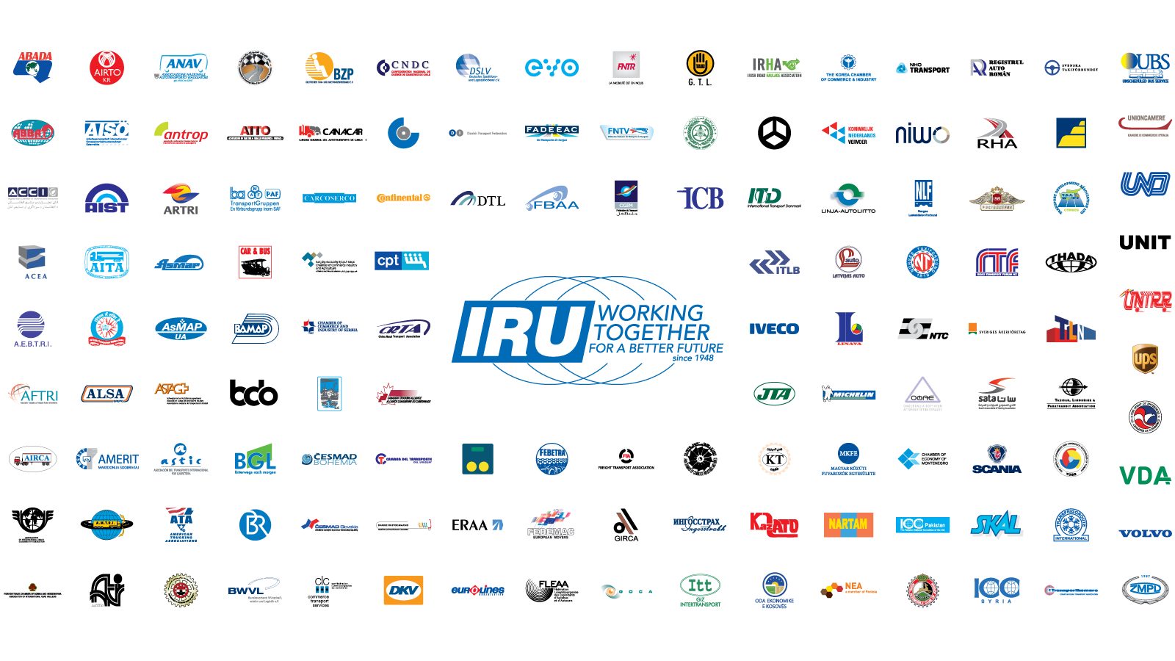
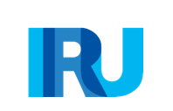
This is IRU

Slide 3
Today: active in over 100 countries
14 Founding IRU Members in 8 countries
IRU Members
IRU Regional Committee for Africa including FESARTA Members

Slide 4




IRU New Eurasian Land Transport Initiative (NELTI)
More than 200,000 border crossings monitored since 2008
Up to 57% of transport time = border crossings
38% of transport costs = unofficial levies

Slide 5
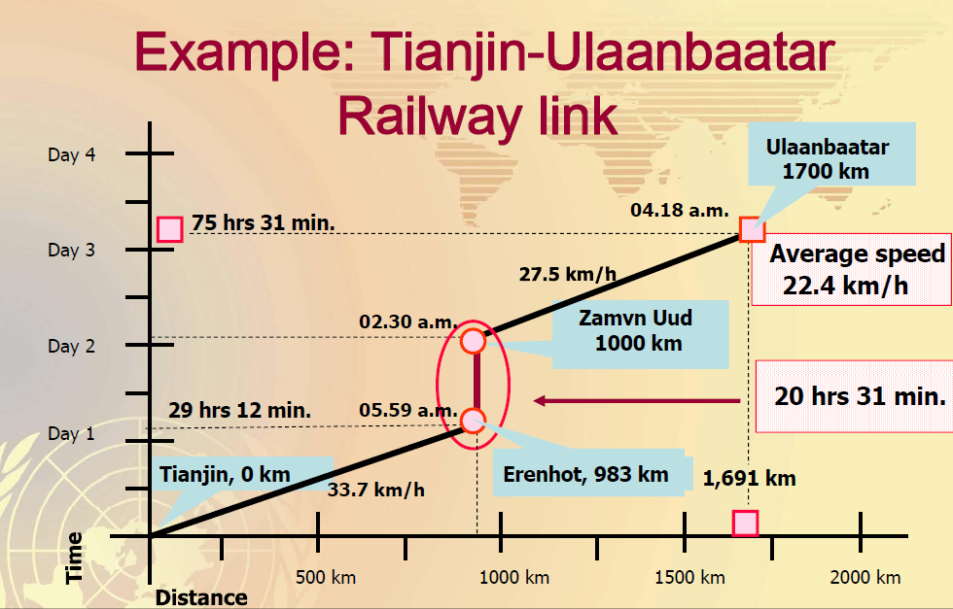
Information from UNESCAP
Time-Cost-Distance Analysis (2014)

Slide 6
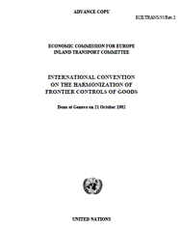
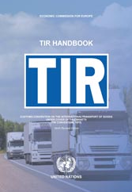

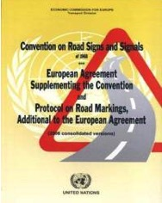
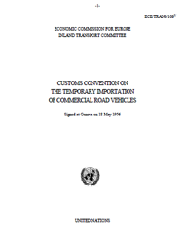

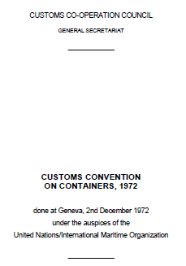
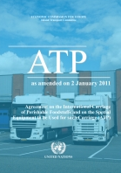
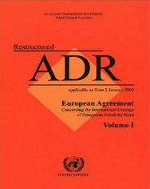
World solutions – UN facilitation instruments allow goods to cross borders

Slide 7


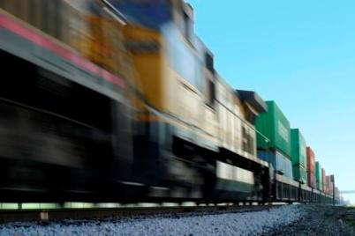
Intermodal TIR – legal background
The TIR Convention
(Articles 2, 26) provides for intermodal use of the TIR Carnet:
  TIR applies as long as one leg of the journey is carried out by road
  TIR guarantee covers road legs of itinerary, and is suspended on sea or rail legs

Slide 8
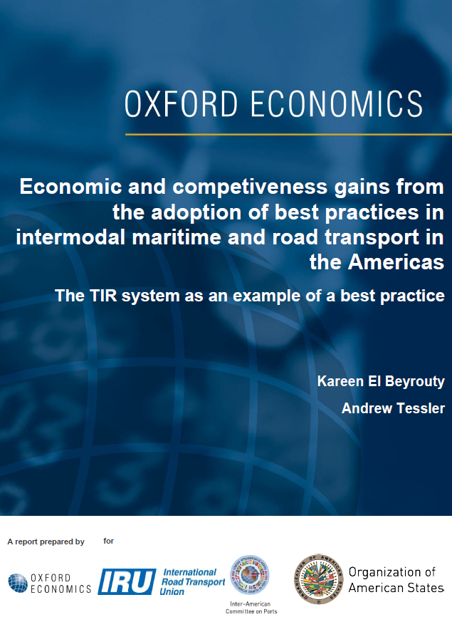
Oxford Economics and Organisation of American States (OAS) Report on TIR
TIR as a best practice for intermodal transport facilitation in Latin American Countries
Argentina, Brazil, Mexico: exports boost by up to
USD 9 billion total
Border waiting times cut by 50% between Latin American countries

Slide 9

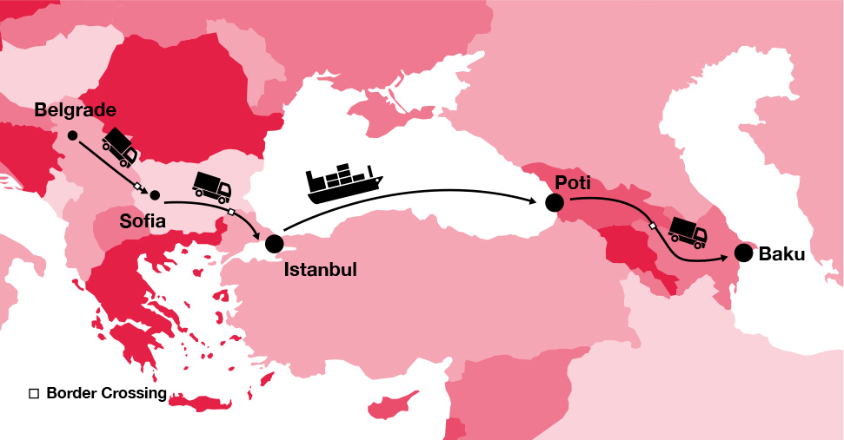
TIR would reduce intermodal transport time by up to 4 days
TIR would improve utilisation rate of containers by 33%
eTIR and the use of subcontractors can further increase TIR benefits for intermodal transports

Slide 10
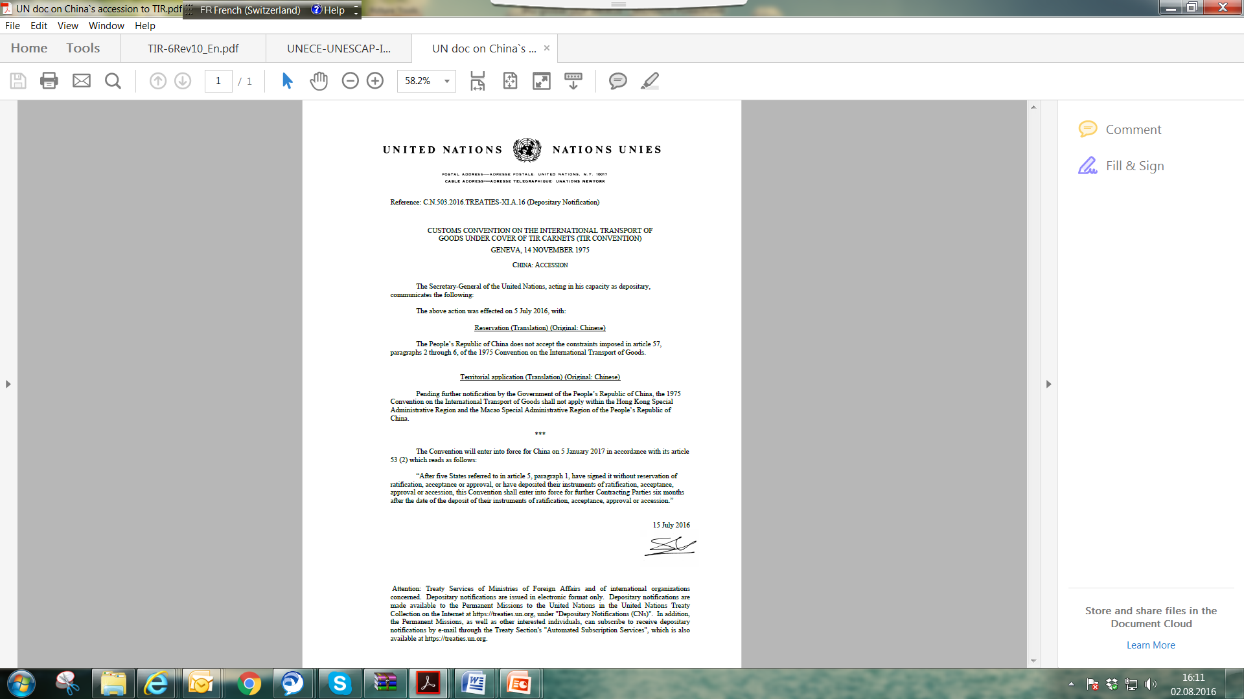
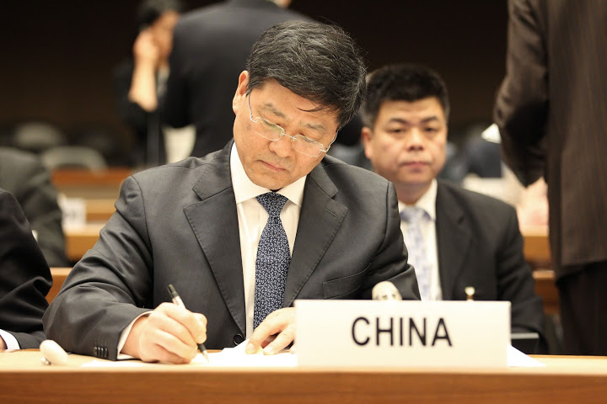


Convincing argument: intermodal TIR
China acceded to the
UN TIR Convention on 5 July 2016

Slide 11
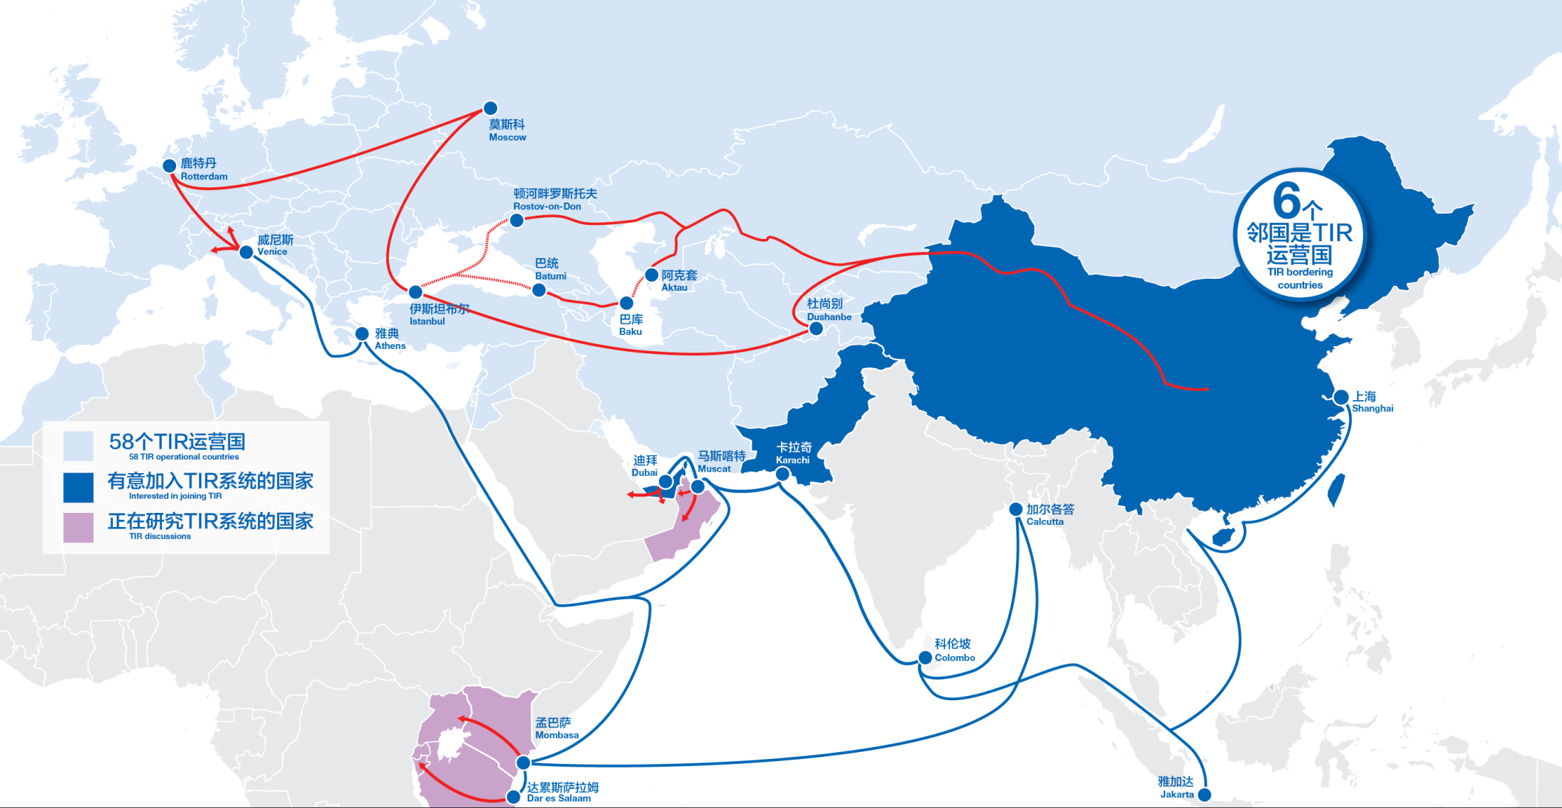
"One Belt, One Road" strategy – TIR as the preferred solution for intermodal transport

Slide 12
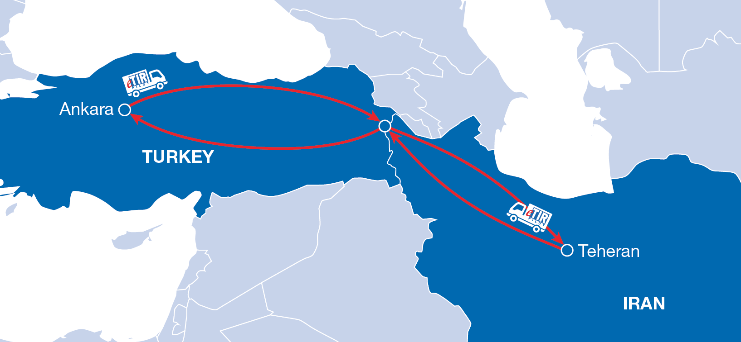
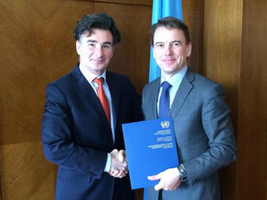
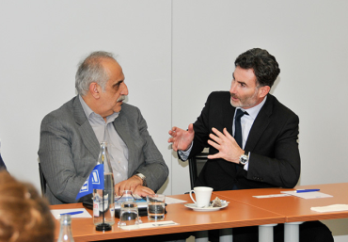
eTIR – road transport
Tehran

Slide 13


eTIR – intermodal transport

Slide 14
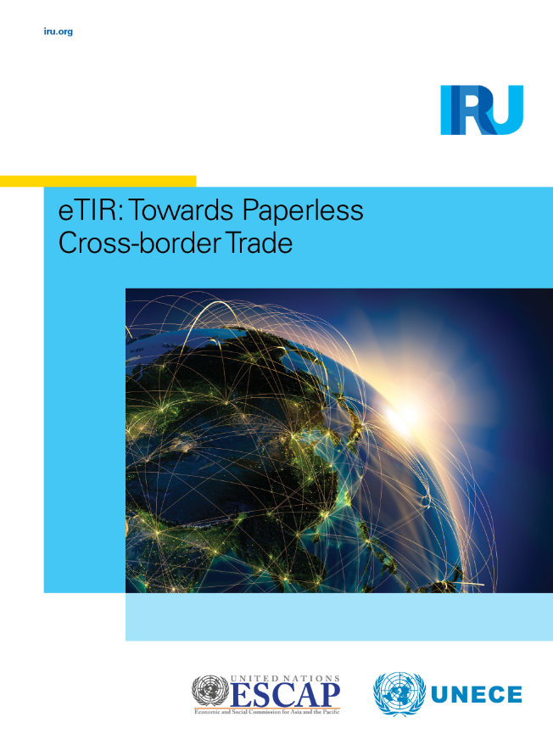
eTIR – endorsed by the UN

Slide 15



Slide 16
Thank you for your attention!

