Slide 1
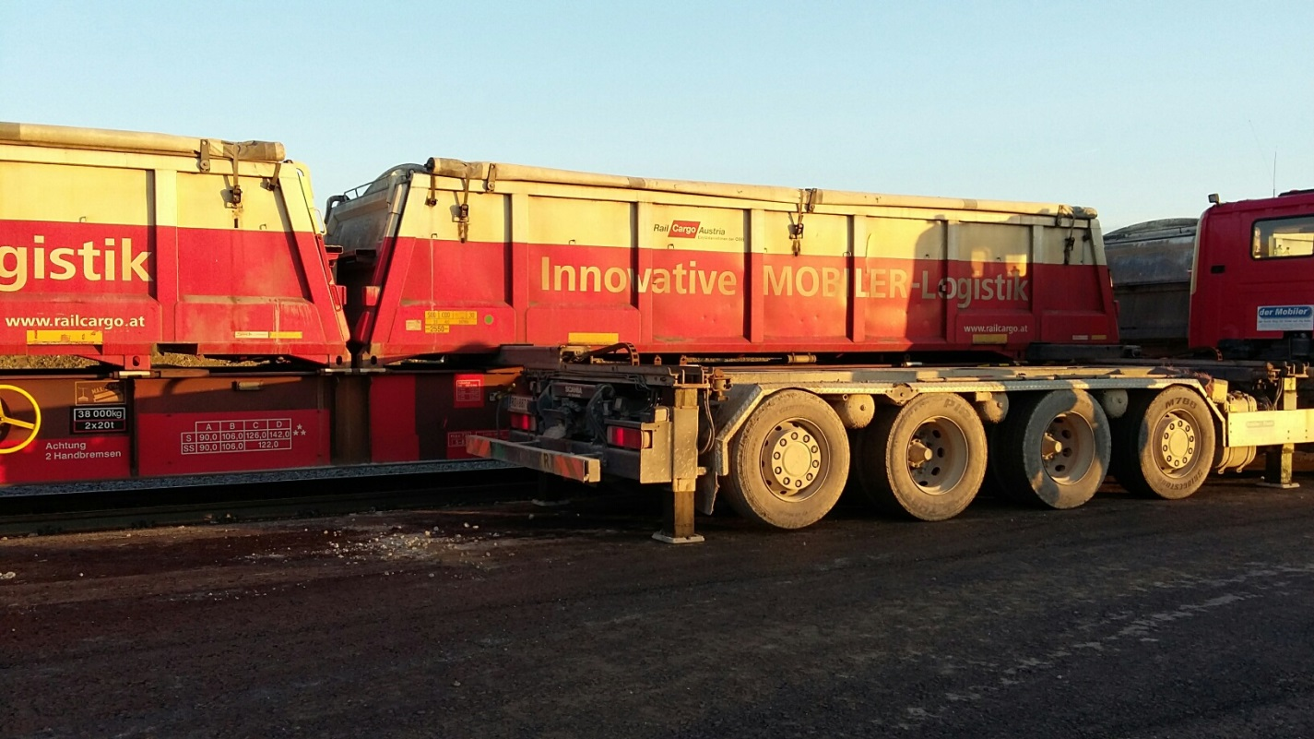
Innovative policies and incentives for intermodal transport in Austria
WP.24 „Intermodal transport and logistics“
Geneva, 31st October 2016

Slide 2
CONTENT
1. Modal split in Austria
2. Austrian transport policy goals
3. Overview on Austrian measures for modal shift
4. Research, Technology and Innovation support programme
„Mobility of the Future“
5. Innovation programme for combined freight transport
6. Examples for Austrian innovations in combined transport

Slide 3
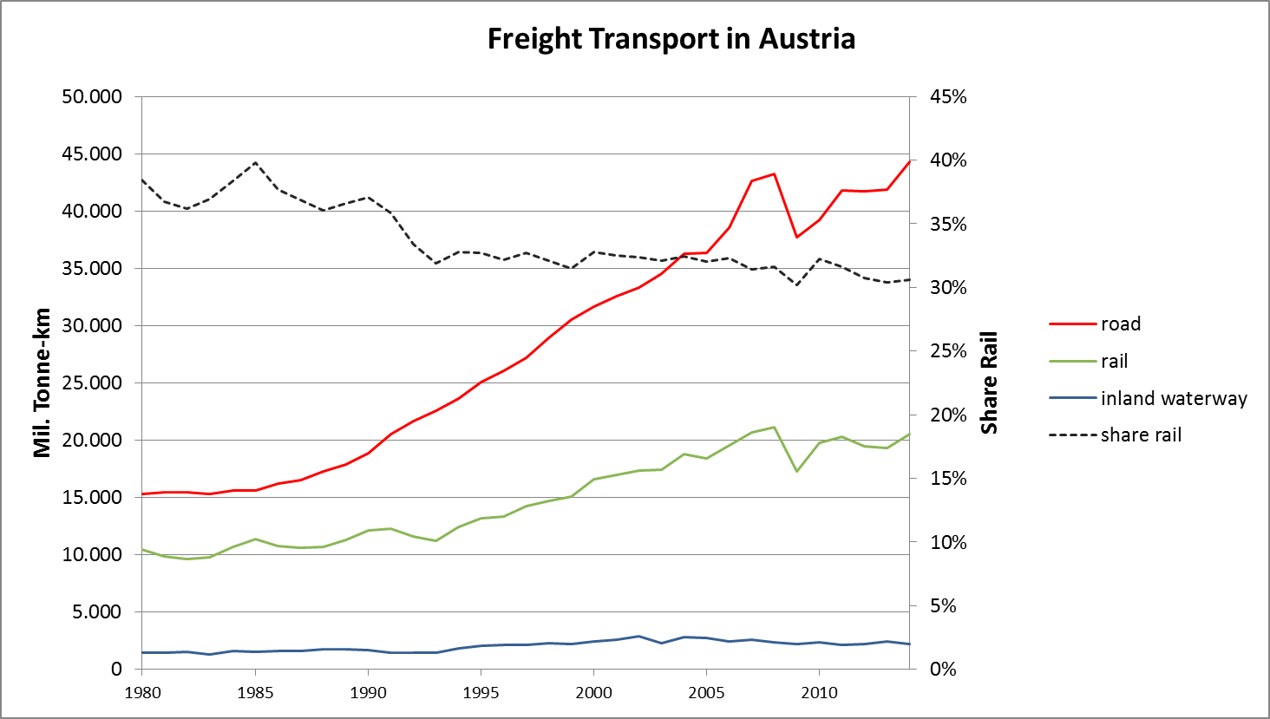
1. Modal split in Austria
source: bmvit, department II/Infra2, data base rail mio.nettotkm

Slide 4
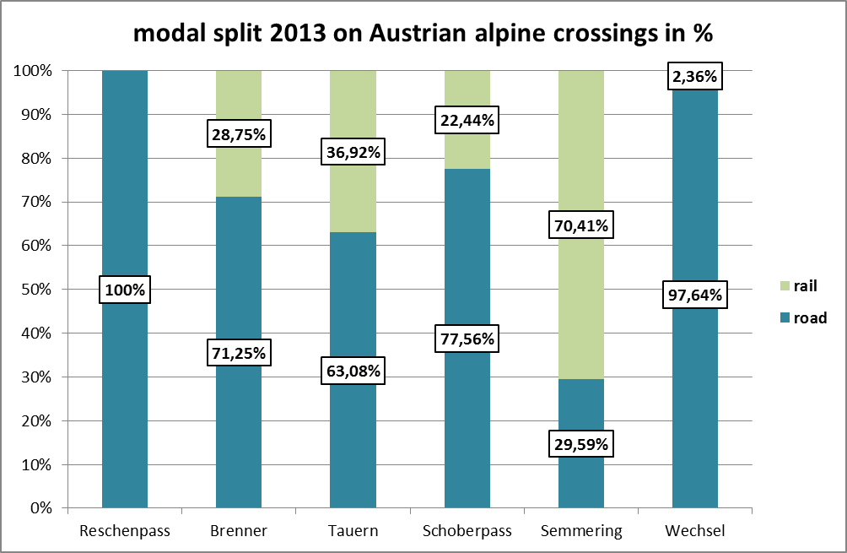
Modal split – alpine crossings in Austria
source: Alpinfo 2013, own diagram, bmvit department I/K4, data base mio. nettotons

Slide 5
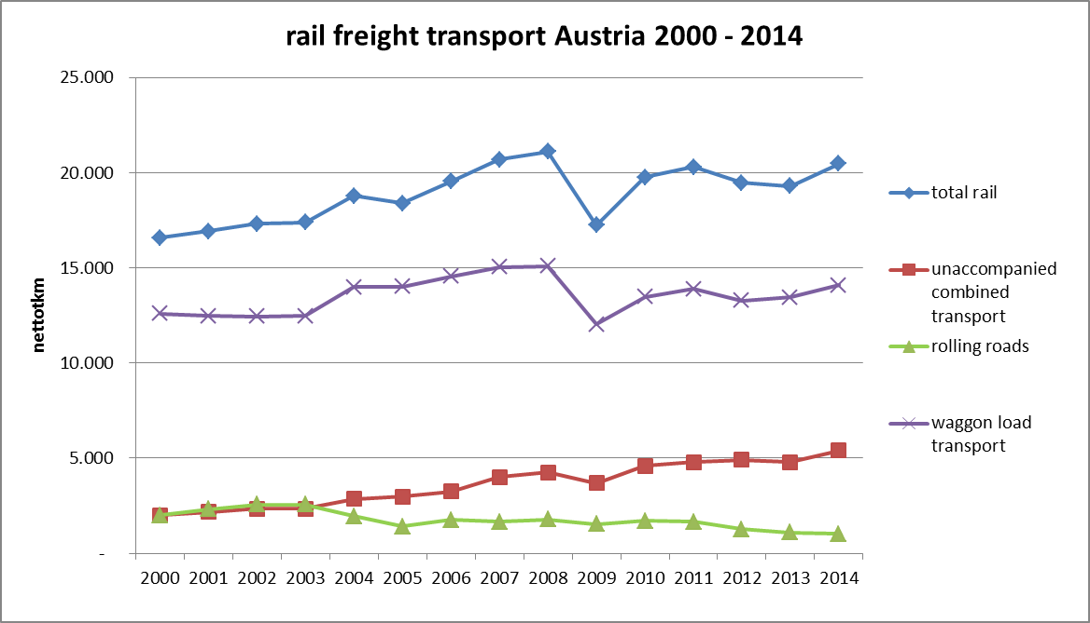
Historical development rail freight transport in Austria
source: bmvit, data department II/Infra 2, diagram department I/K4

Slide 6
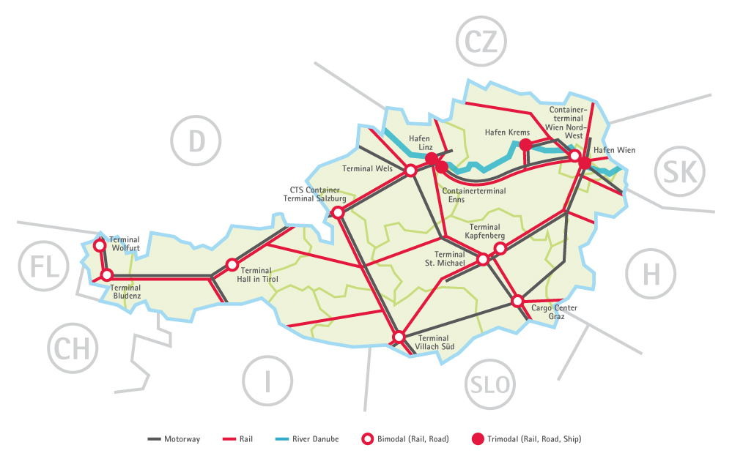
Terminals/multimodal nodes in Austria addition: Freight Center Vienna South
Terminal Wörgl
Terminal Brennersee

Slide 7
2. Austrian transport policy goals
Verkehrsprognose Österreich VPÖ 2025+
(transport forecast 2025+)
Gesamtverkehrsplan
(comprehensive transport plan)
Goals:
shift of freight from road to rail
support to use more combined transport and waggon load transport
efficient extension of infrastructure
→ until 2025: 40% of freight transport should be transported on rail

Slide 8
3. Overview on Austrian measures to promote modal shift
Physical measures
continuous railway infrastructure extension
investment in terminals/transport nodes
investment in innovations (f.e. development of new loading technologies, new waggons, new containers)
Organisational measures
railway operation support
regulative support measures
fiscal incentives
support for research and technological development
other measures (f.e. toll, truck controls)

Slide 9
Austrian financial support measures for investments in combined transport
Financial support for operation
(single waggon load transport, unaccompanied combined transport and rolling roads)
https://www.bmvit.gv.at/verkehr/eisenbahn/foerderung/sgv/index.html
Programme for the support of handling plants in intermodal transport road/rail/ship (promotion of terminals)
https://www.bmvit.gv.at/verkehr/eisenbahn/foerderung/anschlussbahnen.html
Research, Technology and Innovation support programme „Mobility of the Future“ https://www.bmvit.gv.at/innovation/mobilitaet/mobilitaetderzukunft.html
Innovation programme for combined freight transport https://www.bmvit.gv.at/innovation/mobilitaet/kombigueter/index.html

Slide 10
4. Research, Technology and Innovation support programme
„Mobility of the Future“
Grants for:
cooperative and strategic research projects concerning goods transport mobility (and 3 other fields of mobility) with application-oriented focus
Target groups:
companies + university and non-university research institutions
Total budget: approx. 15-20 M € per year, 4-5 M € for goods transport
Duration: 2012 – 2020

Slide 11
Goods Transport – Rail related R&D fields
Sustainable goods mobility in densely populated areas
Sustainable goods in thinly populated areas
Multi-modal hubs
Sustainable transport chains and networks
Innovative means and media of transportation

Slide 12
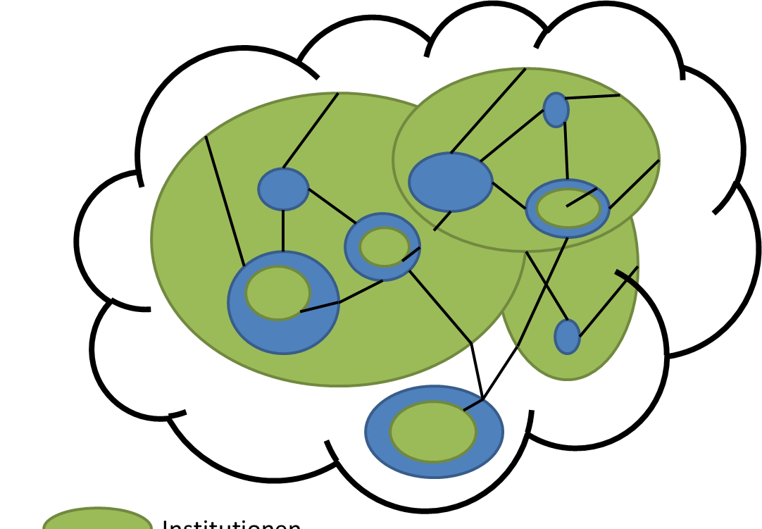
Support instruments
Cooperative R&D-projects (from 100.000 € up to 2 M €, 35-85%, 3 years)
Exploratory study (up to 200.000 €, 70-80%, 1 year)
Lighthouse project (from 2 M €, 35-85%, 2-4 years)
Innovation networks (up to 500.000 Euro, 35-60%, 1-2 years)
Innovation lab (up to 1,5 M €, 50%, 10 years)

Slide 13
5. Innovation programme for combined freight transport
Financial support for:
facilities or systems for combined transport using rail or inland shipping
Expenses eligible for support:
investment in transport units and special purpose vehicles (containers, swap bodies, semi-trailers, adjustments on vehicles)
use of innovative technologies and systems (innovative loading technologies, information- and communication systems for multiple modes)
feasibility studies for precise implementation measures (including preparation for international projects)
target-oriented training measures (language courses, initial training for new IT-solutions)

Slide 14
Support budget:
from 8.000 € to 800.000 € per project
30% support for investments, 50% support for feasibility studies and training
Total programme budget: approx. 3 M € per year
Duration: 01.10.2015 – 31.12.2020
Goals:
Shift of 5 billions tkm per year,
Reduction of CO2-emissions up to 400.000 tons per year
Reduction of NOx-emissions up to 3.000 tons per year

Slide 15
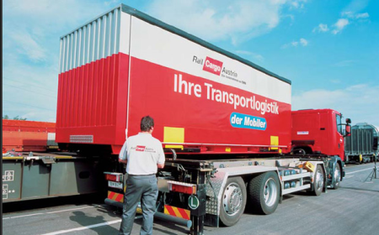
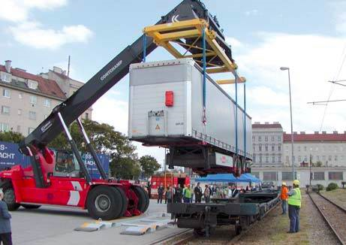
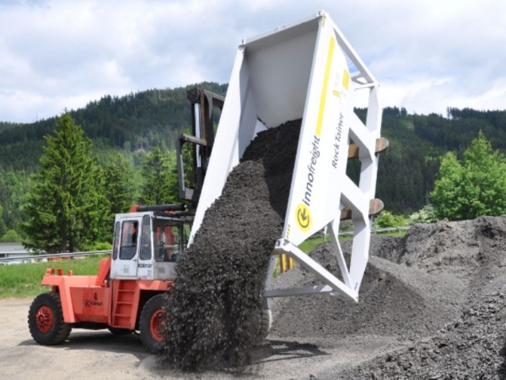
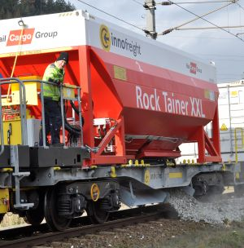
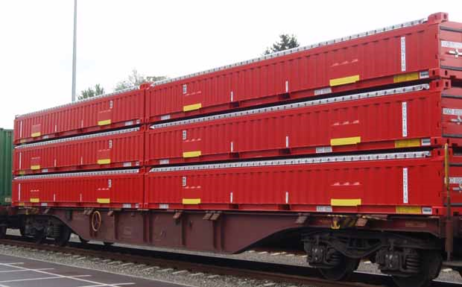
6. Examples for Austrian innovations in rail freight transport
loading technologies: Mobiler and ISU
Examples for innovative transport units

Slide 16
Innovative waggons:
Example InnoWaggon
developped by the Austrian company Innofreight in cooperation with Rail Cargo Group (RCG)
light waggon, tara = 14,7 tons; if used for 40ft container – with boxes 40 tons
increased loading capacity
„InnoWaggon“ produces less noise while slowing down (- 50% of noise emissions)

Slide 17
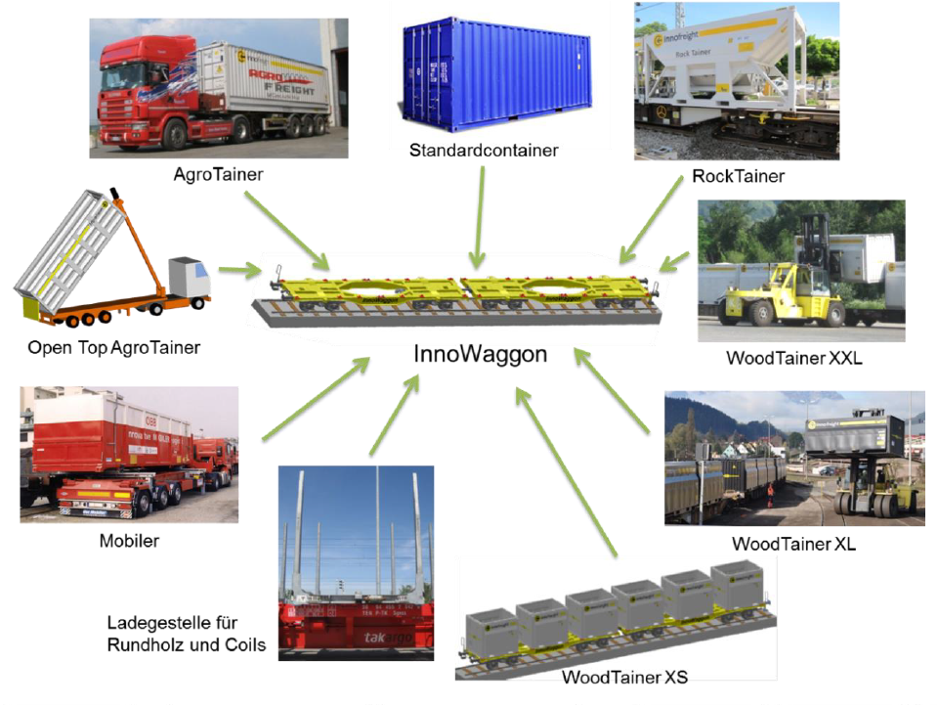
Innovations in combined transport serve as an
impulse for general logistics solutions !

Slide 18
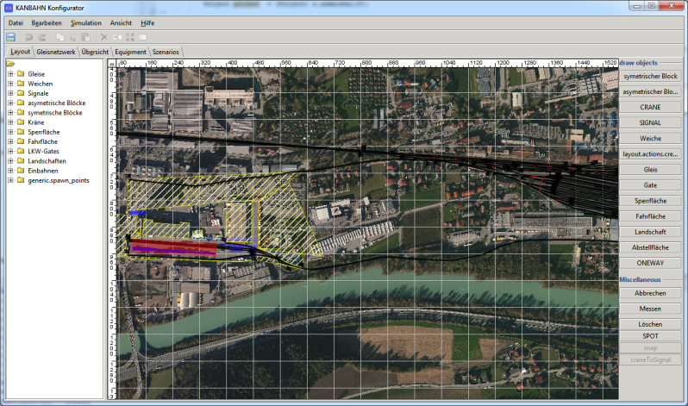
Examples for innovative IT-solutions:
Project KANBAHN
capacity analysis and development of operating strategies for multimodal container terminals (simulation tool for several transshipment modules and necessary shunting operations synchronously in one single model); (partners: ÖBB Infra, h2 projekt.beratung KG)
Project Triumph II
development of an intelligent data exchange platform for digital networking of all players in intermodal transport (loader, logistics service provider, HGV haulier, container terminal, railway undertaking, shipping company and consumer); (partners: AIT, CTE Enns, GS1 Austria GmbH, RISC Software GmbH, via donau)
Source of pictures: Project partners

Slide 19
Thank you! contact: bmvit, department I/K4 Combined Transport k4@bmvit.gv.at further information: www.bmvit.gv.at

