Slide 1

The International Federation of Freight Forwarders Associations
Fédération Internationale des Associations de Transitaires et Assimilés
Internationale Föderation der Spediteurorganisationen
Innovation and digitisation
in intermodal transport
59th session of WP 24
Geneva, 31st October 2016
Marco Leonardo SORGETTI, FIATA, Director General

Slide 2
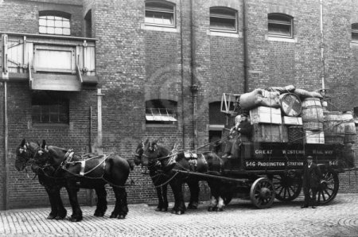
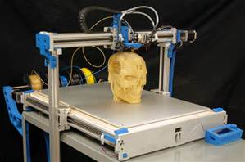
FIATA 90th anniversary in Dublin
FIATA was founded on 31th May 1926 in Vienna.
FIATA is the largest non-governmental organisation in the field of transportation. Its influence is worldwide.
FIATA has consultative status with UN/ECOSOC, ESCWA, UNECA, UNECE, UNESCAP, UNCTAD, UNCITRAL, UNDP etc.
FIATA is the recognised representative body of the freight forwarding and logistics industry for intergovernmental organisations such as ICAO, ITF, OECD, WCO, WTO, World Bank, etc. & private sector, e.g. GSF, IATA, ICC, IRU, UIC, etc.

Slide 3
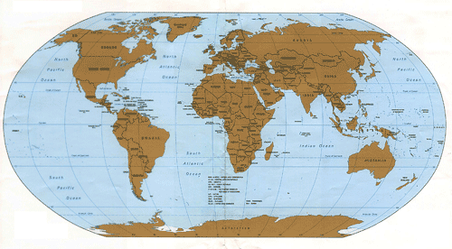
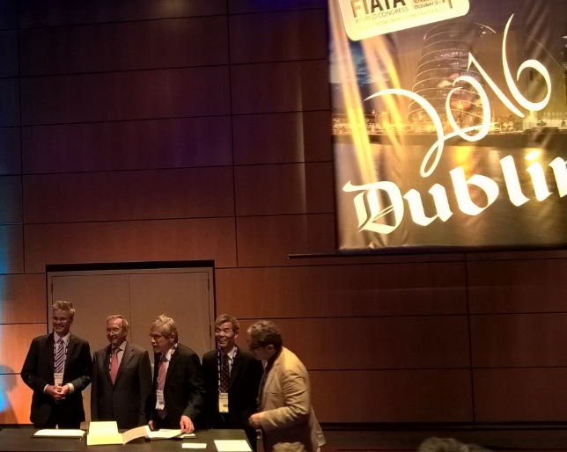
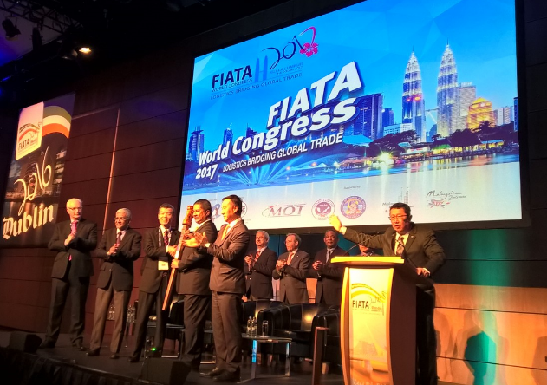

FIATA’s Global, Unique Constituency
108 Association Members in 98 countries
5600 direct Individual Members in 160 countries
Largest world wide NGO in Transport and Logistics

Slide 4



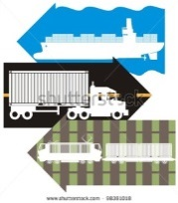




Innovating logistics with a plan
Institutes, Advisory Bodies, Working Groups
WG Incoterms
Airfreight Institute
AFI
Airfreight Institute
AFI
Airfreight Institute
AFI
Customs Affairs Insitute
CAI
Customs Affairs Insitute
CAI
Customs Affairs Insitute
CAI
Advisory Body
Safety Security
Multimodal Transport Institute
MTI
Advisory Body
Vocational Training
WG Road
WG Sea
WG Rail
Advisory Body
Information Technology
WG Sustainable Logistics
Advisory Body
International Affairs
FIATA Logistics Academy

Slide 5
End to End Value Chains are Changing
  Freight Forwarders are common users of multimodal solutions from pick up to delivery, working with carriers, using all transport modes and providing trade facilitation
  International Trade and Commerce is rapidly changing: “more than half of our customers today did not exist ten years ago”
  Disrupting elements come into play: drone deliveries, 3D printing, more parcels than crates, less efficient packing – sustainability not always in sight➔ speed and efficiency appear to be at either end of SUSTAINABILITY …. Or not?

Slide 6
FWC 2016 Dublin Chronicle
  Speed and efficiency at either end of sustainability
  “half of our customers today did not exist ten years ago”

Slide 7
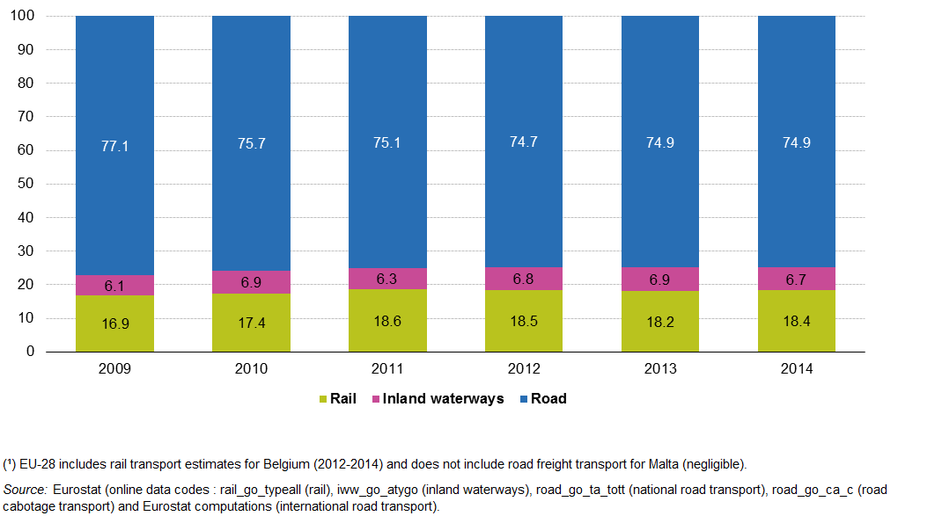
EU: stable (?) share of modes
Notes:
http://ec.europa.eu/eurostat/statistics-explained/index.php/Freight_transport_statistics_-_modal_split

Slide 8
Intermodal Challenges & Opportunity
  Share from Sea and Road Transport to Rail
    New transcontinental Rail Freight Corridors
    FIATA and UIC met European and Asian operators in Shenzhen in 2016
    MoU with OSJD and Chinese experts in the FIATA WG Rail
  Harmonisation of standards
    Digitising Transport Documents – eCMR, FIATA e-FBL, DTLF’s mapping exercise….
    UNCEFACT, a Ferrari in the garage?
  Infrastructure Equality Initiatives
    Connecting Europe Facility, ASEAN intermodal initiatives, One Road One Belt, African corridors and Trade facilitation
  Environmental rules put pressure on transport
    UNFCCC Agreement encourage states to
      curb freight emissions and
      promote intermodal solutions
Notes:
http://ec.europa.eu/transport/modes/rail/infrastructures/rail_freight_oriented_network_en

Slide 9
Sitting on the Dock, looking at the (e)Bay
  Majority of containers in Europe arriving to North Sea ports
    Average port hinterland leg only between 10 - 20% of containers by rail ➔ long and expensive deliveries
    Trend: ship’s dimensions in light of sustainable, efficient services
    Trend: geography vs. costs, is there a balance?
    Inland ports – some grow at 5% per annum, is it just business model?
  Innovation on the high seas, greener ships, ports, slow steaming, 20000+ TEU’s – is there a breakthrough customers will want to buy?
  IATA/FIATA principal to principal agreement, surely not a pie in the sky, but a lot of work to do as implementation starts.
Notes:
http://www.joc.com/rail-intermodal/international-rail/europe/mega-ships-spur-growth-europes-intermodal-rail_20160123.html

Slide 10
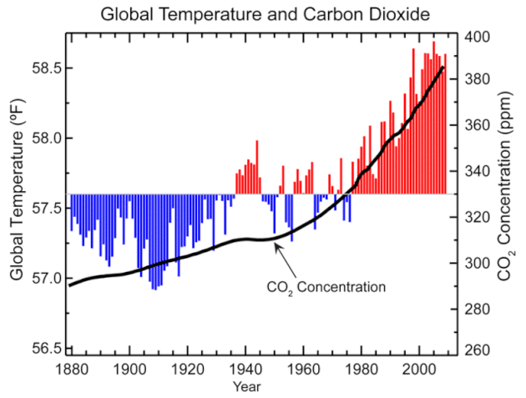
Strong Sustainability Focus
  Greenhouse gas (GHG) emissions on the rise >>>>>>>>>>
  FIATA’s Public Statement
  Asks policy makers to not only focus on enacting legislation that will set GHG emissions targets BUT also to enact policy that would enable enhanced connectivity and efficient transport operations which will lead to lower GHG emissions ➔ SMARTER INFRASTRUCTURE FOR SMARTER, MORE SUSTAINABLE SOLUTIONS
  Environment: Key Aspect in Every CONTEMPORARY Logistics Project
Source http://www.noaa.gov/
Notes:
http://fiata.com/fileadmin/user_upload/documents/Position_Papers/FIATA_Statement_-_The_Need_to_Assess_Connectivity_Measure_for_Freight_Transport.pdf

Slide 11
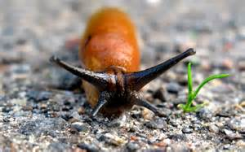
Sluggish Technology Adoption
  Uptake of recent ICT advances for multimodal – So Slow, Why?
  Fragmented Industry, with real issues
    Financial and resource constraints to adopting ICT, uncertainty of results and mistrust of the new
    Authorities prudent in mandating rules they struggle to implement due to insufficient resources
  Human Capital
    Lack of ICT Specialists entering the field of logistics
    Vocational and life-long learning struggling to keep pace with technology changes
  Varying ICT Applications based on Mode
    Interconnectivity between different applications a barrier
    Interoperability still in wish-list phase
    Insufficient harmonisation of standards
Notes:
http://www.sciencedirect.com/science/article/pii/S0925527314002837

Slide 12
Opportunities in Technology
  Cloud Computing & big data
    ICT systems can be hosted by a third party and logistics companies can just “plug in and play” for SaaS solutions
    Tailored for SME lacking of resources to host own system, but TMS’s are trying to reach out – in Dublin 2/3 of exhibitors were technology related
  Internet of Things, driverless vehicles, smart, connected infrastructure may come to assist with new solutions, as many LSP’s maintain research centres and re-engineer the last mile delivery
  Web3.0 and social networking could be applied to enable the optimisation of the distribution flow of cargo
Notes:
http://www.sciencedirect.com/science/article/pii/S0925527314002837

Slide 13
FIATA’s at Work
  FIATA e-FBL
    FIATA’s e-FBL Promoting the digitization of documents and standardization across Europe to help enhance seamless shifts between modes
  WG Sustainable Logistics Positions asking States to push for a standard calculation method for measuring carbon footprint
  Participating in
    UNECE’s Euro-Asian Transport Links (EATL) project removing physical and administrative bottlenecks
    Unifying railway law
    DTLF at EU level
    Local association members (PK, CN) engaged in eTIR and eCMR

Slide 14
FIATA’s conclusions
  Trade patterns are changing at increased speed
  ICT Standards are challenged by new technology but both are required to provide innovative services, legacy systems will not go away in months and probably not even in years
  FIATA has structure in place to assist and lead the way, but need cooperation with all stakeholders, principally with shippers on the one hand and regulators on the other
  There’s no business like logistics…. or without it!

Slide 15
Work with us, please!
www.fiata.com
Thank you!

