Slide 1
INTRODUCTION TO STATISTICAL STUDY OF BUS ACCIDENT ARE THE BUSES SAFE OR NOT?
Informal document GRSG-109-26
(109th GRSG, 29 Sept.-2 October 2015,
agenda item 2(a))
Presented by
Dr. MATOLCSY Mátyás
Expert of Hungary
GRSG, 109th session
2015. 28. Sept. – 2. Oct

Slide 2
CONTENT OF THE STUDY
INTRODUCTION
COLLECTION AND EVALUATION OF ACCIDENT INFORMATION
Different ways and goals
Demand of the international regulatory work
Collection of large data set
Set up of statistical samples from data set
Evaluation of safety level
Categorization of casualties
GENERAL PICTURE ABOUT THE LARGE DATA SET
HUNGARY AS A „REFERENCE” REGION
OVERVIEW OF DIFFERENT ACCIDENT CATEGORIES
Rollover
Frontal collision
Rear and side collision
Bus fire
Combined accident
Collision with train
Special bus accident
SUMMARY

Slide 3
The total number of bus occupant casualties is small in the casualty statistics of road accidents
compared to the car, motorcycle, etc. casualty figures
Does it mean that the buses are safe?
No, the reason of the small bus occupant casualty figures is the small number of bus accidents
in the total road accident statistics

Slide 4
THE BUS ACCIDENTS ARE RARE, INFREQUENT
Dynamic „picture”
German statistics: running vehicles were counted on highways during one day
daily average, percentage of buses: 0,4%
Static „picture”
In registered national road vehicle fleet (8 European countries)
average ratio of buses: 0,25-0,3%
Therefore it is difficult to get reliable bus accident information for the international regulatory work

Slide 5
SOLUTION
collect large data set from around the world, including all kind of bus accidents
continues data collection
electronic data base
using all kind of data sources
set up statistical samples from the large data set
based on the principles of mathematical statistics
sampling according to the studied problem
safety level evaluation based on casualty figures

Slide 6
Possible, considerable sources of bus accident information:
police reports
bus manufacturers collections
insurance company’s data
fire brigade reports
ambulance team (medical) reports
media reports (radio, TV, newspapers, etc.)
internet
etc.

Slide 7
Some principles, definitions of mathematical statistics
Event: individual element of the data set (bus accident) with the belonging information
Sample: collection of events having certain common feature, group of bus accidents
Sampling parameter: the basis of selecting events from the data set (bus category, type of accident, region, etc.)
Homogeneous sample: in which the events were selected strictly by the same sampling parameter
Representative sample: homogeneous sample with large sample size.
ONLY THE REPRESENTATIVE SAMPLE PROVIDES VALID, ACCEPTABLE CONCLUSION

Slide 8
Some words about the Data set, which is the basis of this study:
Information collection started 15 years ago with rollover of large buses
The „subject” was later, step by step extended (small buses, frontal collision, all kind of accidents, etc.)
The information sources were also extended step by step
The Data set is „paper-based”, not computerized
Today the number of events in the Data set exceeds 1550 (accidents) together with the belonging information

Slide 9
General overview about the Data set (at the end of 2014)
Type of accident | Rollover R | Frontal collision FC | Rear and side collision RSC | Direct fire F | Combined accident CA | Collision with train CT | Special accidents S | Total
Region
Hungary | 176 | 335 | 28 | 65 | 11 | 6 | 19 | 645
Europe | 168 | 96 | 7 | 13 | 28 | 12 | 5 | 324
World | 201 | 124 | 2 | 20 | 146 | 15 | 17 | 525
Σ | 545 | 555 | 37 | 98 | 185 | 33 | 41 | 1494

Slide 10
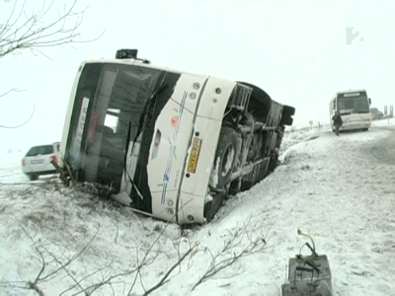
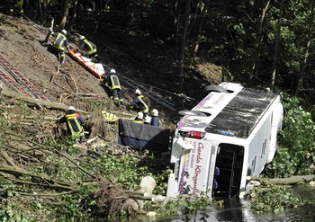
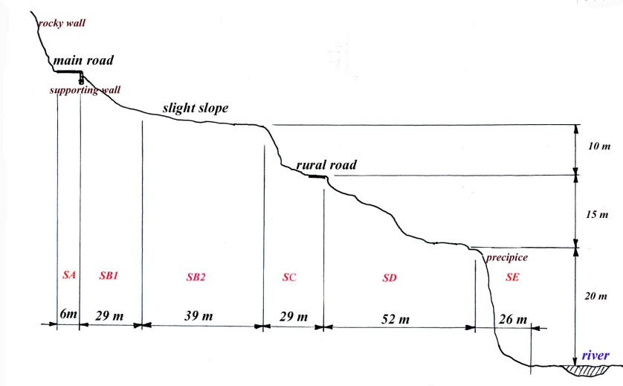
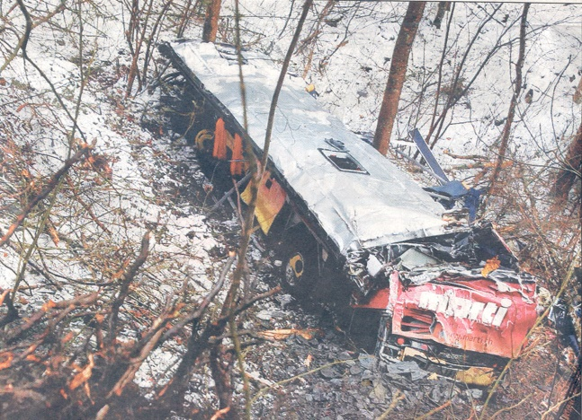
EXAMPLE: STATISTICAL ANALYSIS IN ROLLOVER-I.
Sampling parameter:
Sub categories of rollover
All kind of buses
All large buses
Tourist coaches
HD and DD tourist coaches
Turn on side
Rolling down (max. 2 rotations)
Severe rollover (more than 2 rotations)

Slide 11
EXAMPLE: STATISTICAL ANALYSIS IN ROLLOVER-II.
Rollover subcategories
Casualty rates
Data set
1494 events
Casualty rates Rollover subcategory | Number of events | Accident casualty rates (ACR_{x})
 |  | Fatality rate (R_{F}) | Injury rate (R_{I}) | All casualty rate (R_{A})
a) turn on side | 196 | 1,8 | 13,7 | 15,5
b) rolling down | 217 | 8,8 | 17,5 | 26,3
c) severe rollover | 132 | 16,5 | 13,7 | 30,2
all rollover together | 545 | 11,0 | 14,1 | 25,1
combined rollover | 116 | 21,7 | 7,4 | 29,1
Proving the effectiveness of Reg.66:
Casualty rates Rollover subcategory | Number of events | Accident casualty rates (ACR_{x})
 |  | Fatality rate (R_{F}) | Injury rate (R₁) | All casualty rate (R_{A})
All PRA (a+b) | 413 | 5,5 | 16,1 | 21,6
Intact survival space (SS) | 123 | 0,9 | 11,8 | 12,7
Damaged survival space (SS) | 188 | 13,8 | 12,9 | 26,7
strong superstructure (intact SS)
week super-structure (damaged SS)

Slide 12
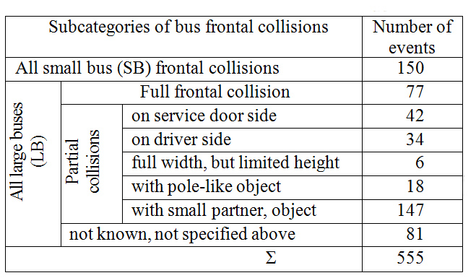
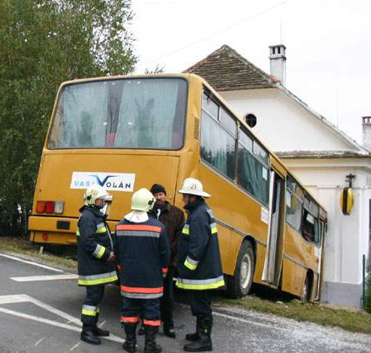
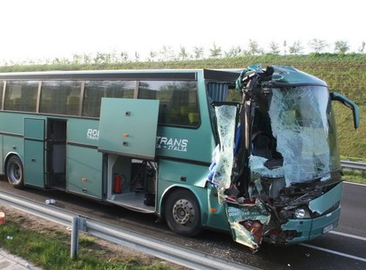
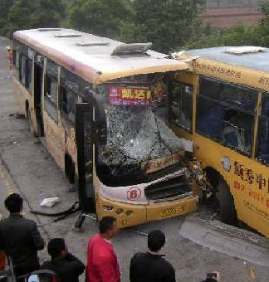
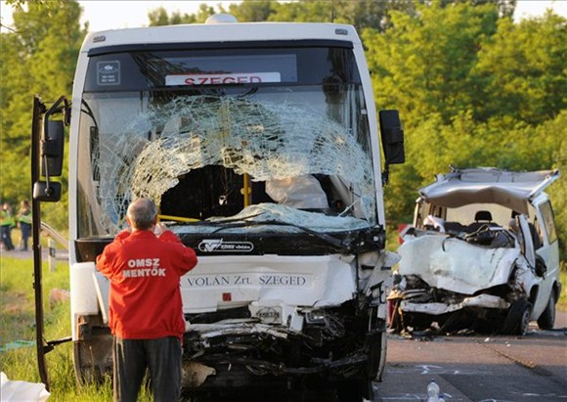
EXAMPLE: STATISTICAL ANALYSIS IN FRONTAL COLLISION
Frequency
Frontal collision
subcategories
Data set
1494 events
Full frontal
Partial, door side
Partial, driver side
Small and large bus

Slide 13
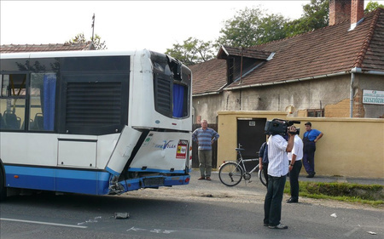
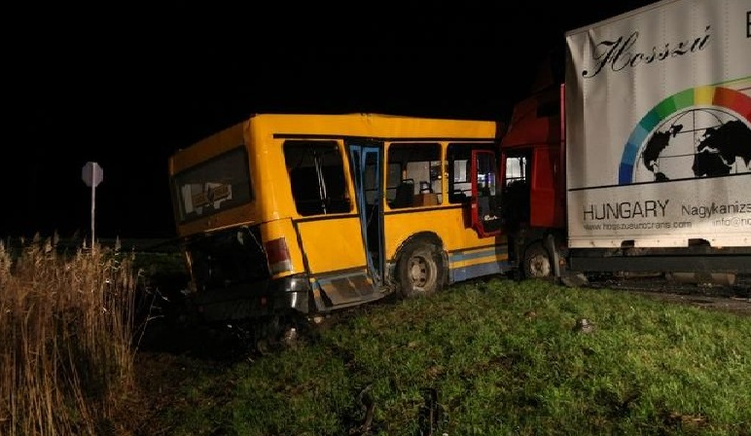
EXAMPLE: STATISTICAL ANALYSIS OF REAR AND SIDE IMPACT
Casualty rates
Data set
1494 events
 | Number of events | Accident casualty rate (ACR_{x})
 |  | Fatality | Injury | All casualties
Rear impact | 25 | 1,5 | 9,9 | 11,4
Side impact | 12
Low frequency
Low casualty rates
Less important issue in international regulatory work
Rear impact
Side impact

Slide 14
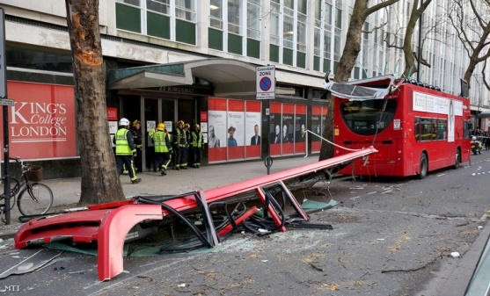
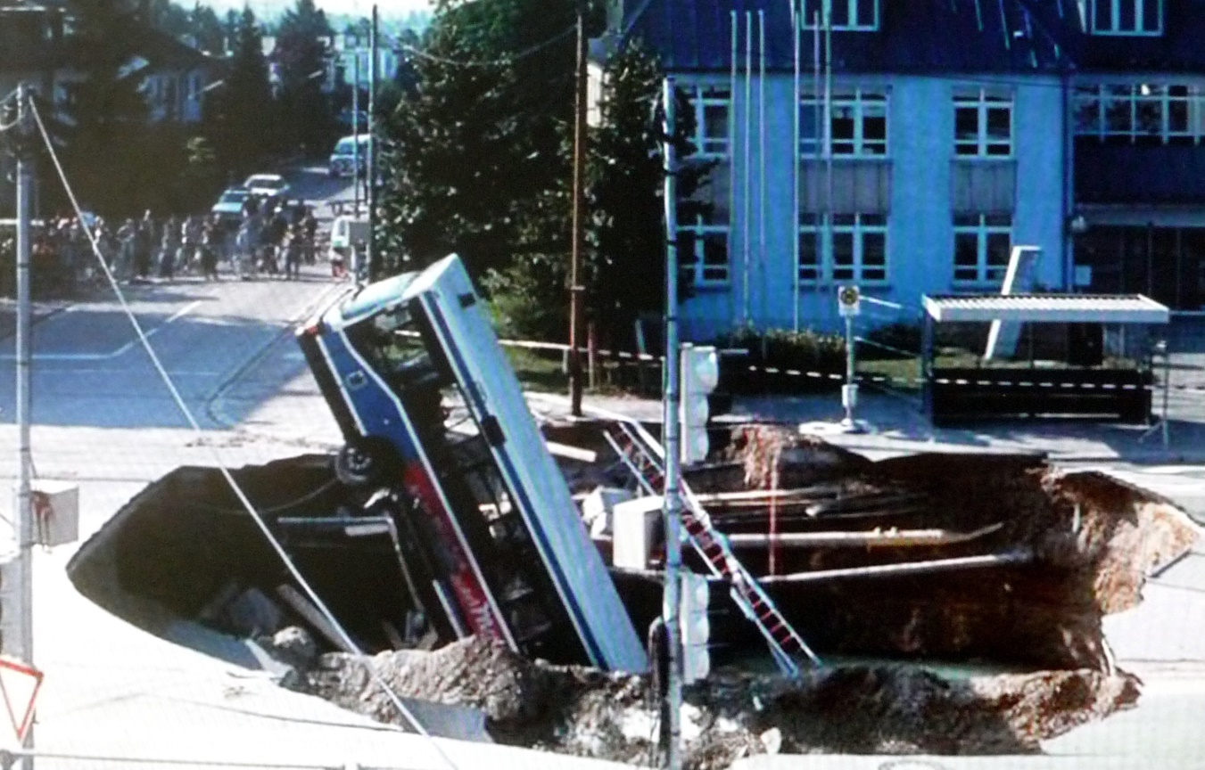
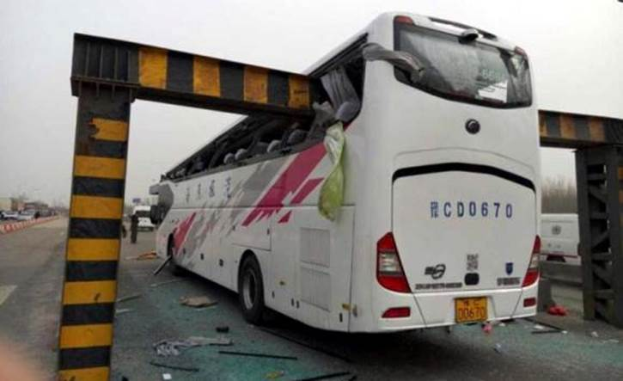
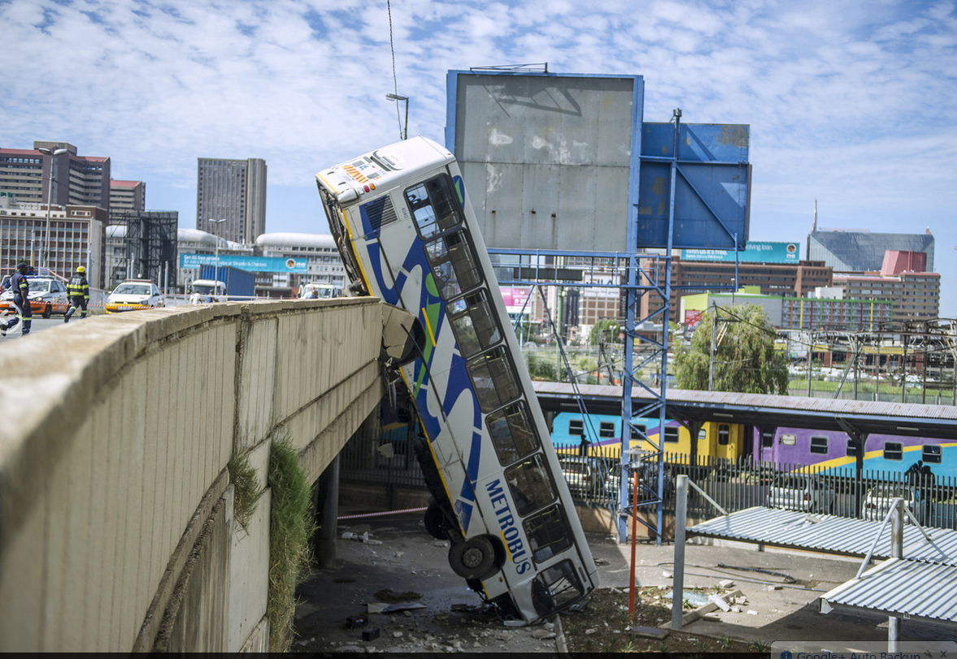
SPECIAL BUS ACCIDENTS
To have a complete picture, the special bus accidents shall be also considered. (Number of events in the Data set: 41)
After this boring statistical presentation, just to wake up the audience, some funny, unbelievable special accidents are shown:
Road pavement broke in under the bus (after long heavy rain the running water undermined the ground)
Falling down from a bridge: is it rollover, or frontal collision?
Unbelievable! Unnameable accident!
Strong tree-branch scalped the DD city bus

Slide 15
SPECIAL BUS ACCIDENTS
Finally an unwanted „passenger”, a deer through the broken windscreen

Slide 16
SUMMARY
The international regulatory work needs reliable bus accident information
The bus accidents are rare in consequence of the small ratio of buses in the complete road vehicle fleet
Using all possible data sources large data set can be collected from around the world
From the data set different statistical samples can be set up and analysed, reaching useful information and strong evidences.
This paper shows the method generally and gives some examples based on an existing Data set containing around 1500 bus accidents with the belonging information.
Today all the technical background, conditions are given to collect and build up efficient data sets.
THANK YOU FOR YOUR ATTENTION

