Slide 1
DEVELOPMENT OF THE INTERMODAL TRANSPORT
IN BSEC REGION CONNECTING
THE BLACK, BALTIC AND CASPIAN SEAS

Slide 2
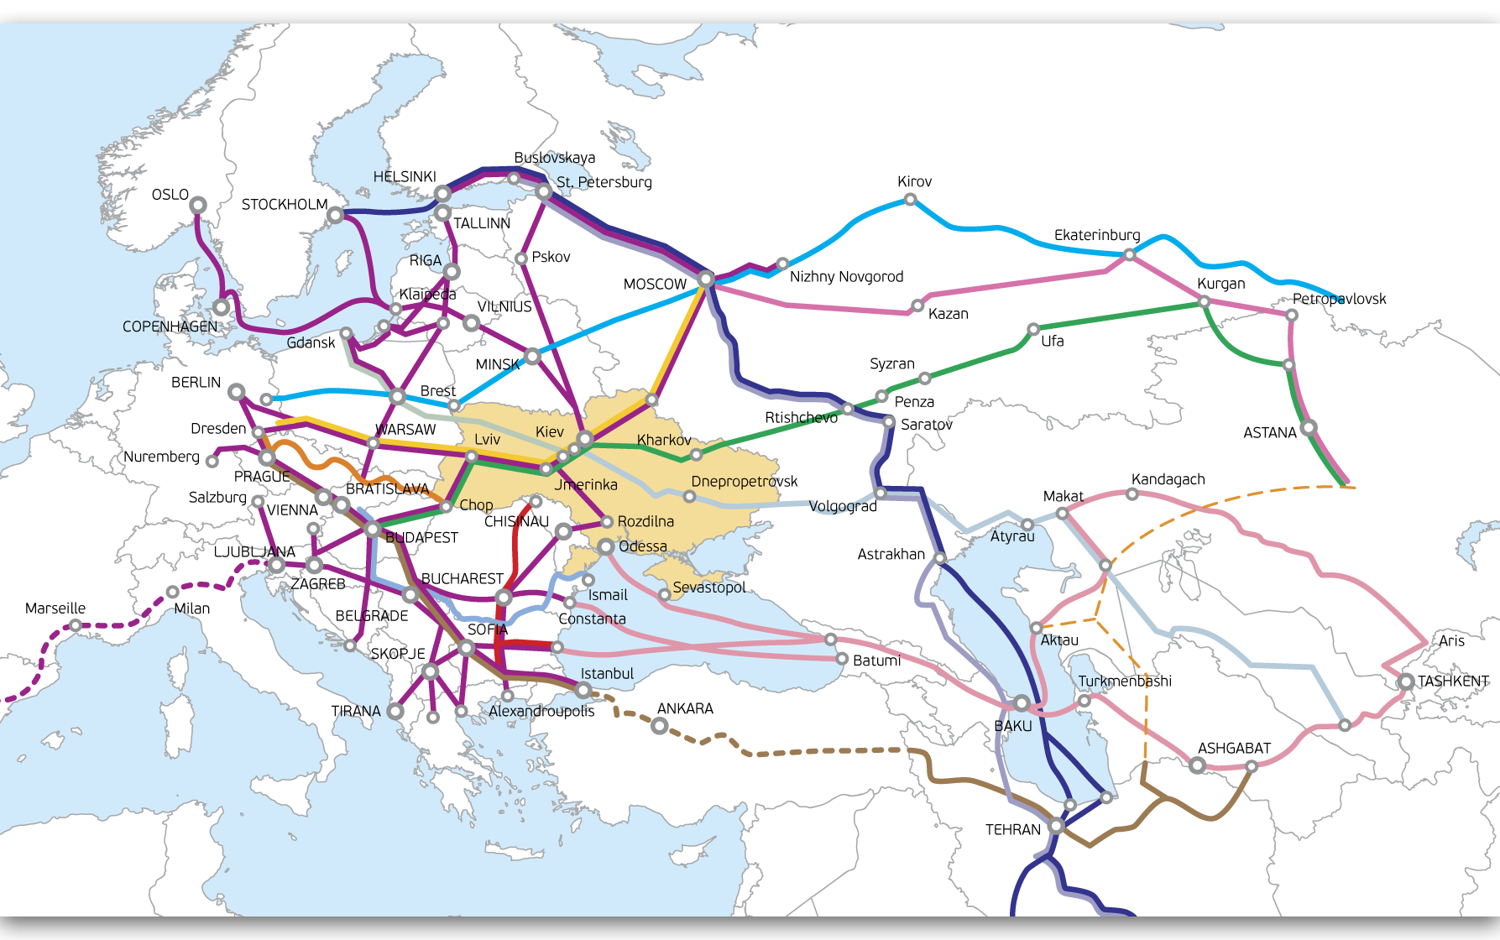
Europe – Asia International Transport Corridors
cargo@plaske.ua

Slide 3
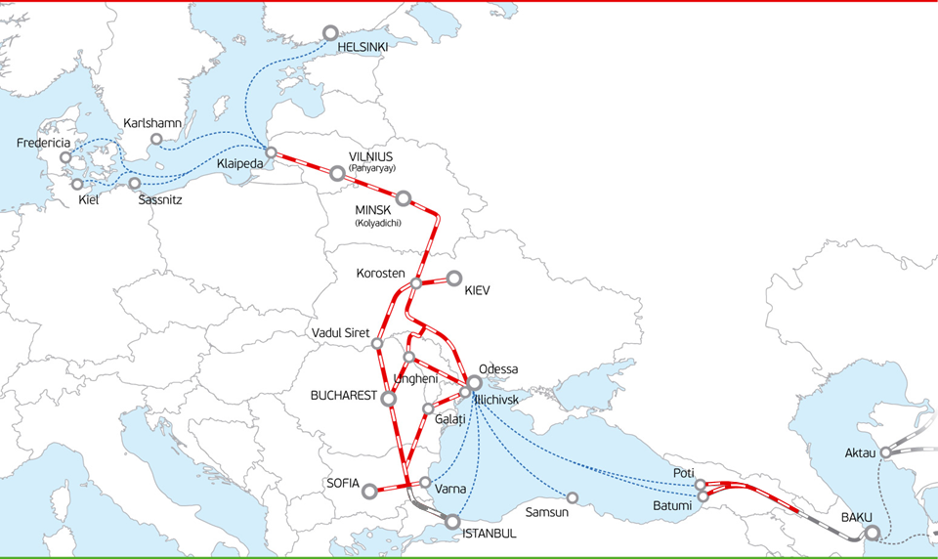
Baltic Sea – Black Sea Corridor. VIKING Train
www.vikingtrain.com
cargo@plaske.ua
Main Route:
Klaipeda (Lithuania) – Minsk (Kolyadichi) , Belarus – Kyiv/Illichivsk/Odessa, Ukraine;
Route length – 1766 km;
Time of transportation – 52 hours;
In project: Lithuania, Belarus, Ukraine
Joined routes:
Bulgaria: Varna-ferry – Sofia/Yana/Plovdiv/Veliko Ternovo/Kulata/Dragoman/Svilengrad/Rus
Moldova:
Transit segments
Dzhurdzhulesht (exp) – Novosavitskaya (exp), Ungen (exp) – Velchinets (exp)/Novosavitskaya (exp);
Domestic stations: Chisinau, Ungeni, Reucel, Bender 2
Romania
Georgia
Prospects: Turkey, Azerbaijan
Participants of the project

Slide 4
VIKING Train Operators:
www.vikingtrain.com
cargo@plaske.ua
Associated members of the project:

Slide 5
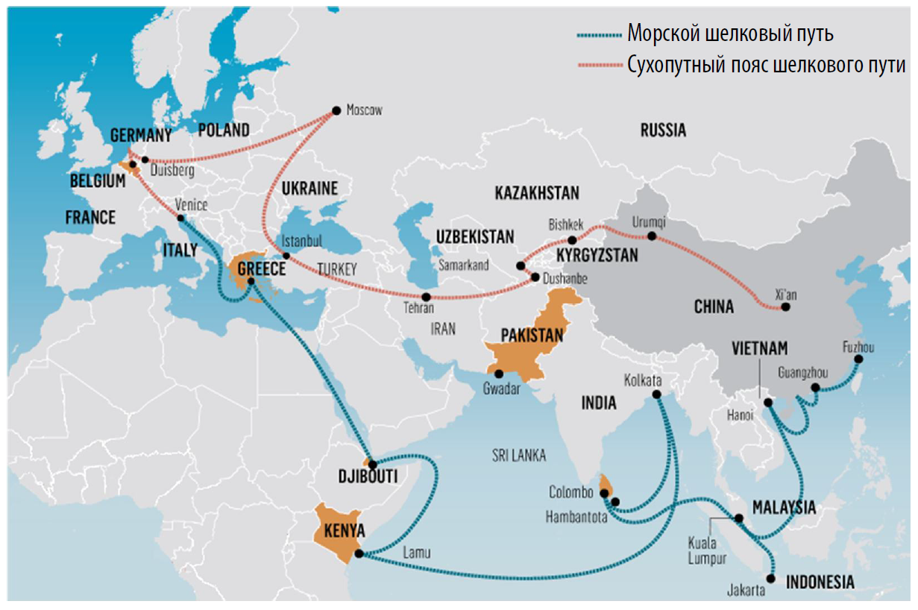
LOGISTICAL SAFETY OF THE COUNTRY AS A PROJECT’S BACKGROUND
cargo@plaske.ua
This project presupposes the creation of the Maritime Silk Road and the Overland Silk Road Economic Belt, connecting China with other regions of the world.
If the Maritime Silk Road routes are defined quite clearly, the Overland Silk Road Economic Belt implies the creation of the whole network of transportation corridors connecting China and Europe.

Slide 6
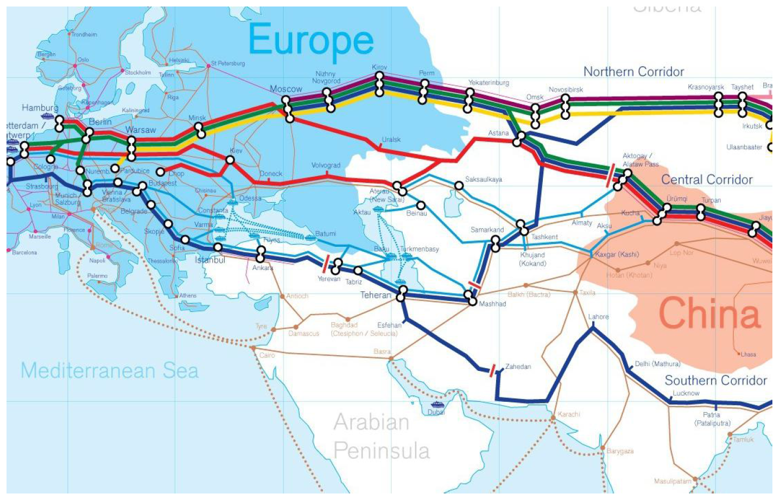
THE PROJECT IS DESCRIBED BY CHINESE GOVERNMENT AS NOT A CONVENTIONAL CORRIDOR BUT AS THE MEANS OF STRENGTHENING OF COOPERATION WITH TRANSIT COUNTRIES
cargo@plaske.ua
The main routes of the land-based belt of the Silk Road are:
(1) through Kazakhstan-Russia-Belarus;
(2) through Kazakhstan-the Caspian-Azerbaijan-Georgia-Turkey;
One of the possible routes for overland belt passes through Ukraine.
The trains launched within the Silk Road Project in 2015:
July, 28: a container train Beijing – Baku (through Kazakhstan and the Caspian Sea);
August, 26 : a container train Lodz (Poland) – Chengdu – Xiamen (China).

Slide 7
FREIGHT TRAFFIC VOLUME BETWEEN UKRAINE AND THE PEOPLES REPUBLIC OF CHINA
cargo@plaske.ua
Rail freight traffic between Ukraine and the PRC for 7 months in 2015 is 15,6 thousands of tons which makes in total 3,9 millions of tons. It shows a 34% growth as compared to the same period in 2014.
3357 TEUs have been transited along the territory of Ukraine from/to China for 7 months which is 15% from the total amount of transit container transportations.
The dynamics of export-import and transit transportations volume between Ukraine and the People Republic of China, mln. tons
Rail freight transportation structure in Ukraine in/from PRC for 7 months in 2015
For 7 months of the current year China has gained the lead for export transportations from Ukraine – 14,5 mln. tons (+3.3 mln. tons ), that has beaten Russian Federation into the second place (from the first position that has been hold by the country for the last 5 years) – 11,8 mln. of tons.

Slide 8
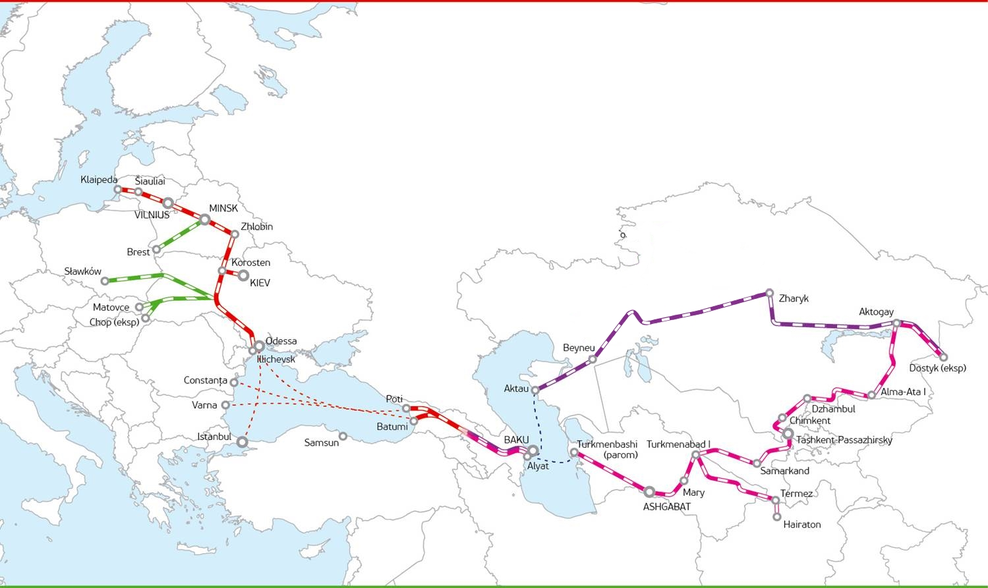
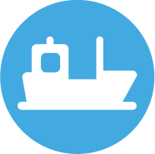
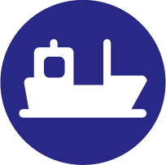
Project calculations Chine-EU
www.vikingtrain.com
cargo@plaske.ua
Transit time=10-15 days
ODESSA/ILYICHEVSK-KLAIPEDA
1766 km / 2,5 day
DOSTYK-AKTAU
3836 km / 3-5 day
POTI/BATUMI-ILYICHEVSK/ODESSA
1040 km / 2 day (by ferry), 10 day (by container line)
AKTAU-ALYAT
438 km / 2 day
ALYAT-POTI/BATUMI
825 км / 1,5 day

Slide 9
Participants of the project:
www.vikingtrain.com
cargo@plaske.ua

Slide 10
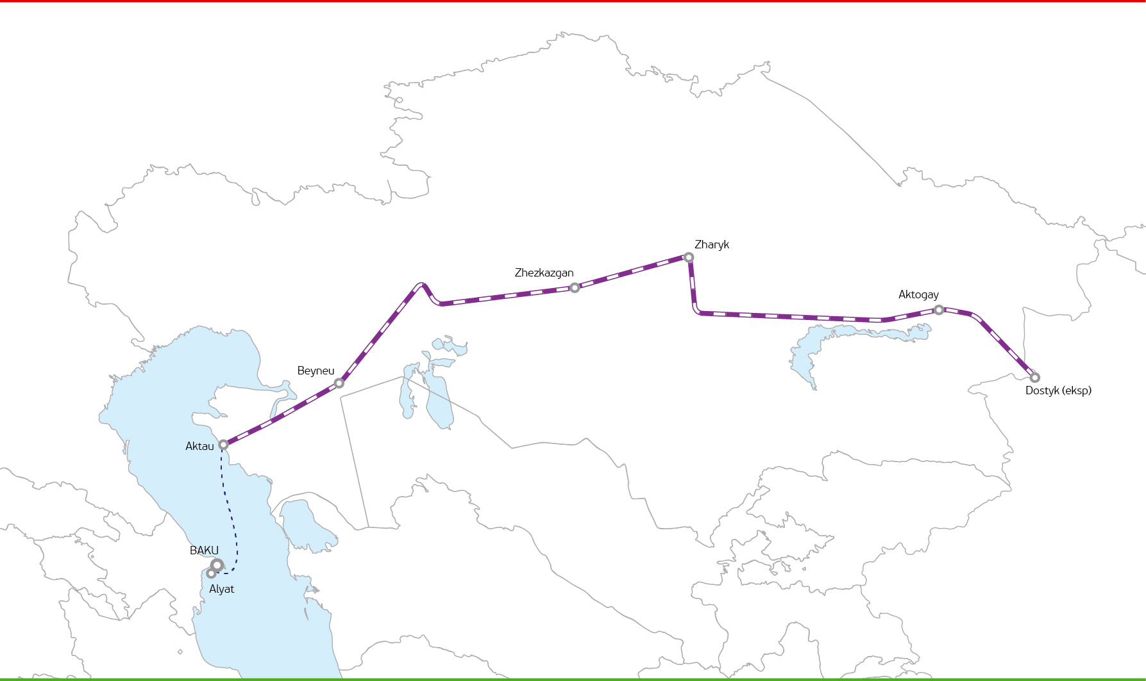
Project Chine-EU
www.vikingtrain.com
cargo@plaske.ua
Block-Train «NOMAD Express»
Route: Shihezi (CHINA) - Kishly (Azerbaijan)
Transit time from st.Dostyk (Kazakhstan) - Kishly (Azerbaijan) – 3-5 days
Tariff:
20’=3 000 USD
40’=4 000 USD
Distance Dostyk-Kishly: 4363 km
(Kishly)

Slide 11
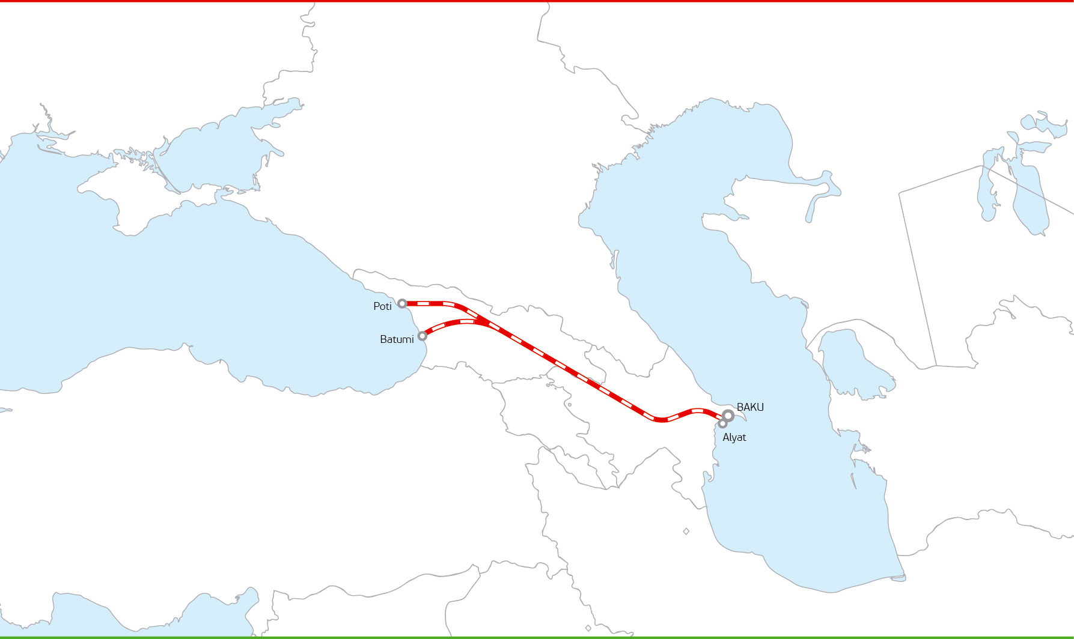
Project Chine-EU
www.vikingtrain.com
cargo@plaske.ua
FAST LANE „SILK-TRAIN“
Route: Poti-Baku (Kishly)
Transit time: 34 hours
Regular rail traffic by schedule
Tariff:
20’=1 120 USD
40’=1 450 USD
Distance 856 km

Slide 12
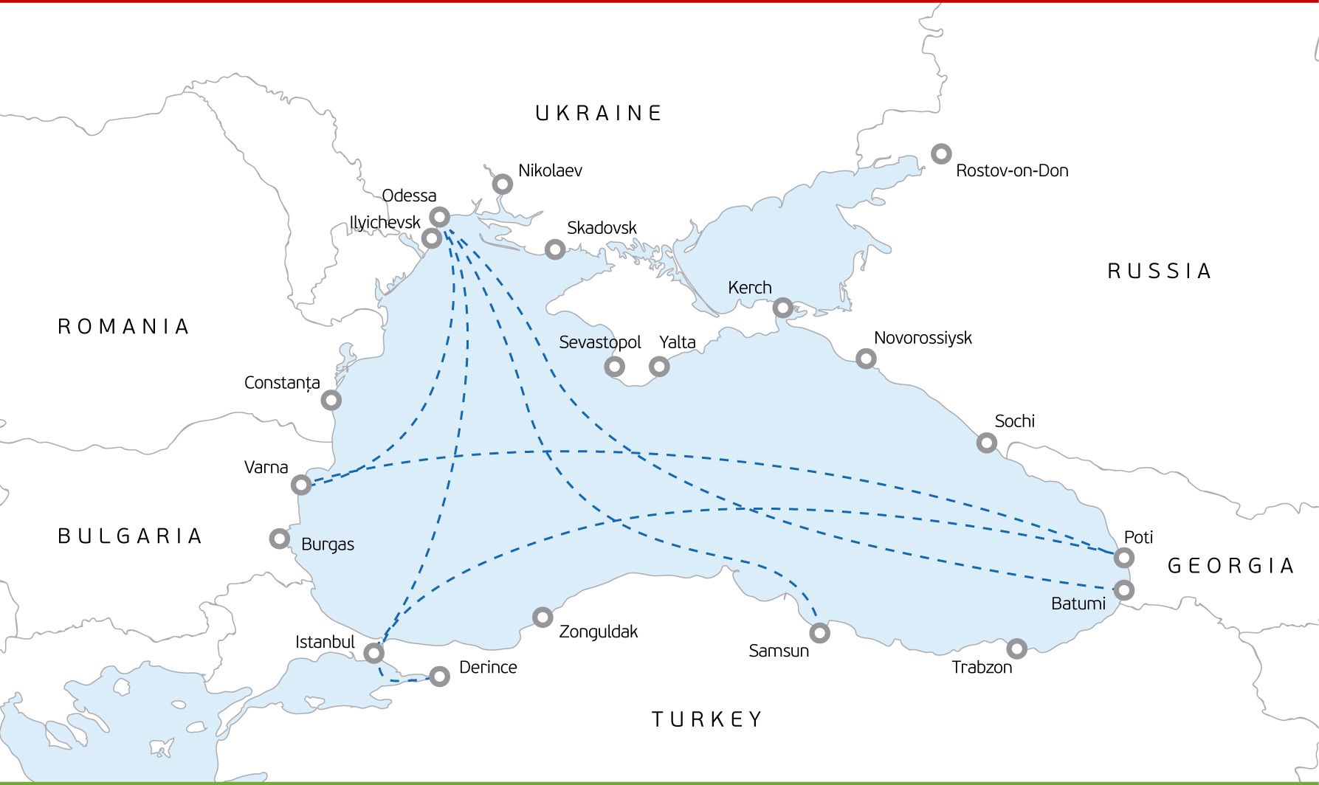
Railway-ferry connection between Ukraine and Black Sea Region Countries
cargo@plaske.ua
www.ferry-line.com

Slide 13
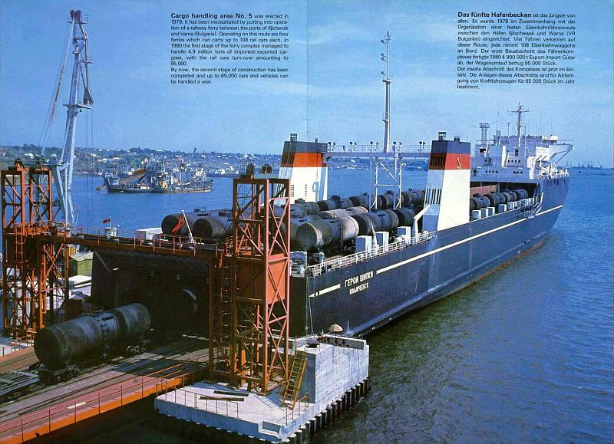
“Geroite na Odessa”
“Geroite na Sevastopol”
“Geroi Shipki”
“Geroi Plevny”
Type: RAIL/VEHICLES CARRIER
Gross Tonnage: 19019 - 19518 tn
Summer DWT: 12889 - 13008 tn
Length: 184 - 185.45 m
Beam: 26.7m
Cargo space capacity: rail wagons: 108 units
Rail gauge: 1520 mm
cargo@plaske.ua
“Vilnius Seaways”
“Greifswald”
Type: RAIL/VEHICLES CARRIER
Gross Tonnage: 22341 – 24084 tn
Length: 190.9 m
Beam: 28 m
Cargo space capacity: rail wagons: 50 units
Rail gauge: 1520 mm
www.ferry-line.com

Slide 14
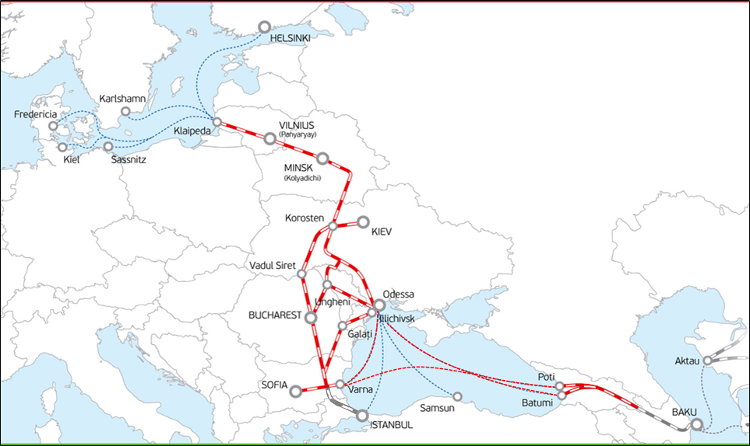
Special rates for railway-ferry transportation in the Black Sea for Viking Project
www.vikingtrain.com
cargo@plaske.ua
Rates for ferry transportation in project Viking Train
Ilyichevsk- Varna
Rolling stock | 20' TK/20'DV | 30'TK/40'DV
SPS platforms | 300 USD | 500 USD
MPS platforms | 360 USD | 560 USD
Rates for ferry transportation in project Viking Train
Varna-Batumi
Rolling stock | 20' TK/20'DV | 30'TK/40'DV
SPS platforms | 500 USD | 700 USD
MPS platforms | 600 USD | 800 USD
Rates for ferry transportation in project Viking Train
Direct route Ilyichevsk-Batumi, Batumi-Ilyichevsk
Rolling stock | 20' TK/20'DV | 30'TK/40'DV | 45'DV
Loaded container | 1000 USD | 1400 USD | 1500 USD
Empty container | 500 USD | 700 USD | 750 USD
www.vikingtrain.com

Slide 15
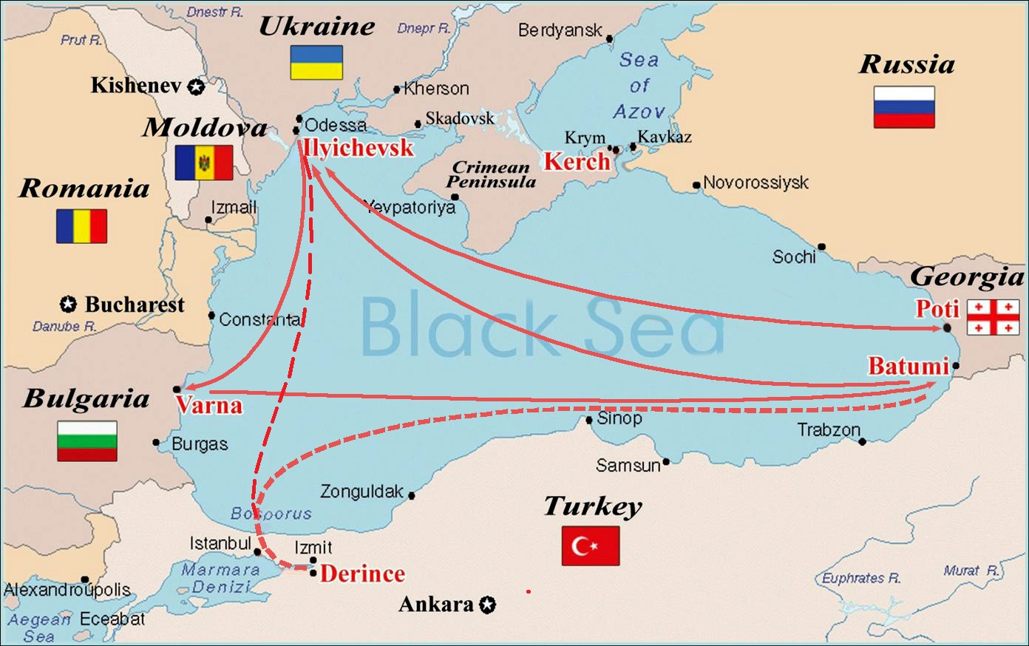
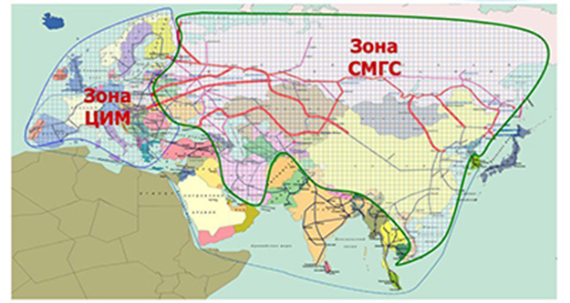
Transport facilitation
cargo@plaske.ua
SMGS as amended on 01.07.2015 introduces a new term: freight transport in direct international rail communication – a transportation by rail through the territory of two or more countries with the single document (a bill), issued for the whole cargo route

Slide 16
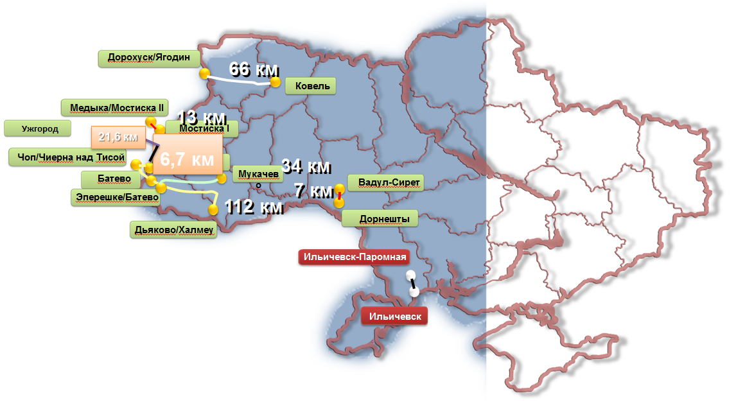
List of CIM Lines on the territory of Ukraine
(Total length 270,4km)
cargo@plaske.ua

Slide 17
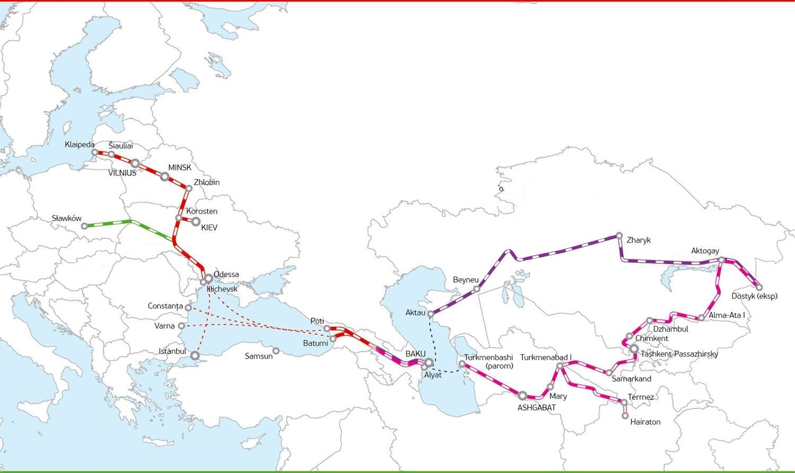
Transit potential of Ukraine in attracting cargo flows between Europe and Asia. Project calculations Turkey / Georgia – Ukraine – Poland with using the service of container lines Istanbul/Poti - Odessa
cargo@plaske.ua
Istanbul - Slawkow
Rate for 1950 USD
Rate for 2900 USD
Poti- Slawkow
Rate for 2200 USD
Rate for 3250 USD
Rates indicated on the bases LILO / with forwarding in Odessa Sea Port / for liner containers on private platforms / with return of empty containers to Odessa Sea Port. Rates don’t include providing of platforms, additional charges.

Slide 18
Transit potential of Ukraine in attracting cargo flows between Europe and Asia. Project calculations Georgia – Ukraine – Poland with using the service of ferry lines Batumi – Ilyichevsk with special rates on the territory of Ukraine
cargo@plaske.ua
Poti- Slawkow
Rate for 2200 USD
Rate for 2900 USD
Rates indicated on the bases LILO / with forwarding in IMTP/ for containers on the platforms / transport by ferry line/with special rates on the ferry and rail tariff (UZ)/ Rates don’t include additional charges and return the empty container

Slide 19
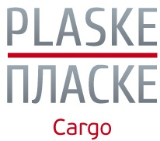
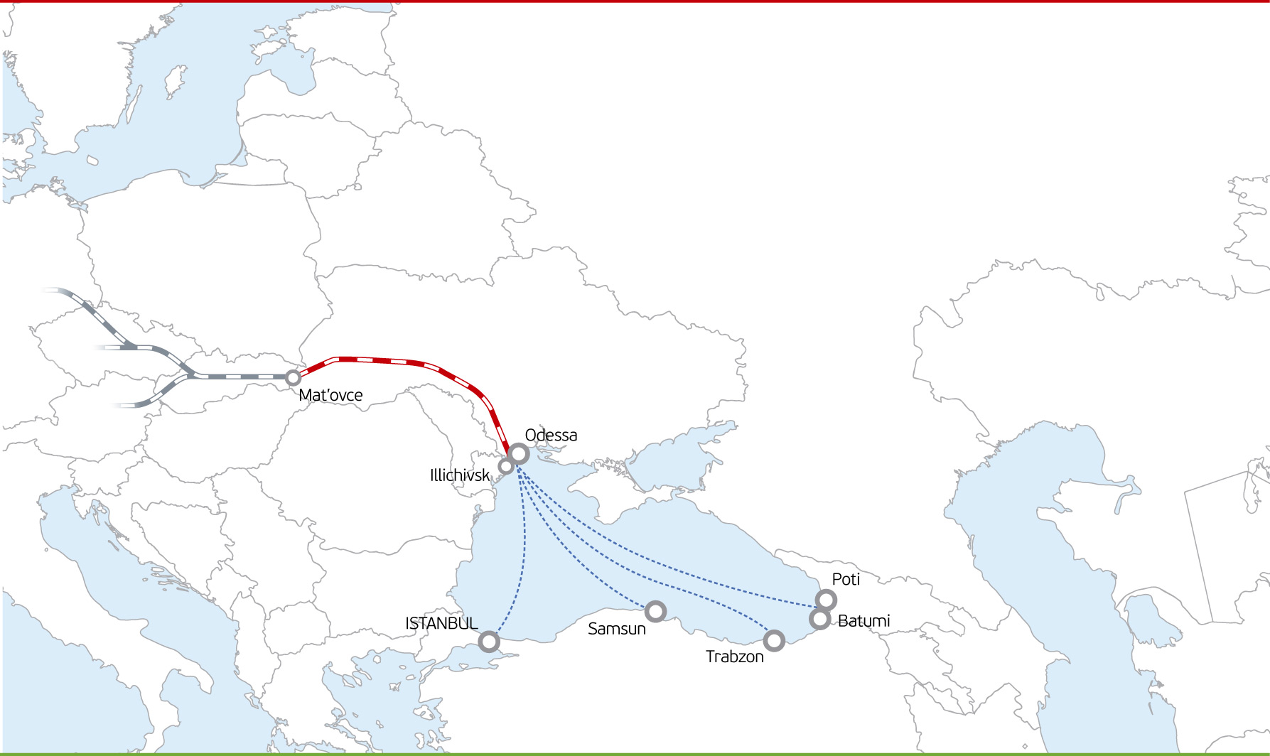
Transit potential of Ukraine in attracting cargo flows between Europe and Asia. Terminal «Premako a.s.» in Matevtse, Slovakia
Reload & wheelset change at the Matevtse station (Slovakia).
The 1520 mm gauge runs to the Slovak Republic for a maximum of 90 km (st. Kosice), and in addition to the another 5 stations.
The option to run to the following 5 countries (Slovakia, Czech Republic, Austria, Serbia, Montenegro)
Services: handling of all types of cargo. Exception is pumping of liquid goods and bulk cargo to / from special hopper wagons.
Uzhgorod – Mat’ovce
Batumi – Uzhgorod
Rate for 1 900 USD
Rate for 2 600 USD
Rates indicated on the bases LILO / with forwarding in IMTP/ for containers on the platforms / transport by ferry line/with special rates on the ferry and rail tariff (UZ)/ Rates don’t include additional charges and transportation the empty container
www.plaske.ua

Slide 20
Project Turkey – Ukraine - Baltic Countries
cargo@plaske.ua

Slide 21
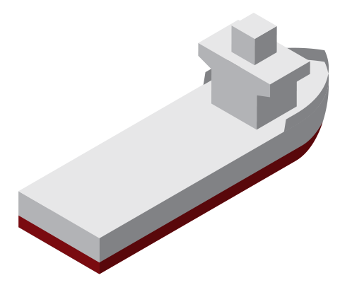
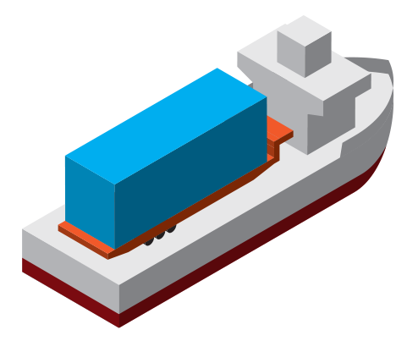
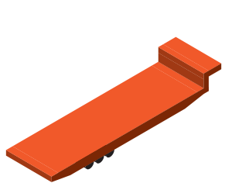
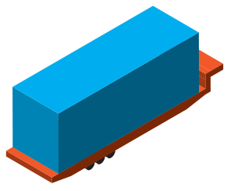
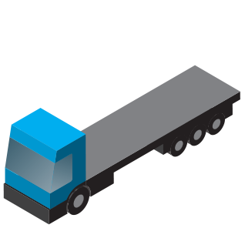
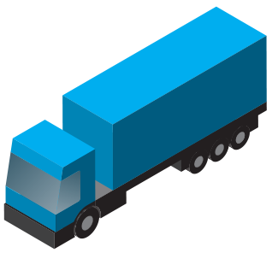
Ro-Ro ferry connection between Ukraine and Black Sea Region countries. STENA SEALINE Ro-Ro ferries: route Ilyihevsk Sea Trade Port – Haydarpaşa port
and back
cargo@plaske.ua

Slide 22
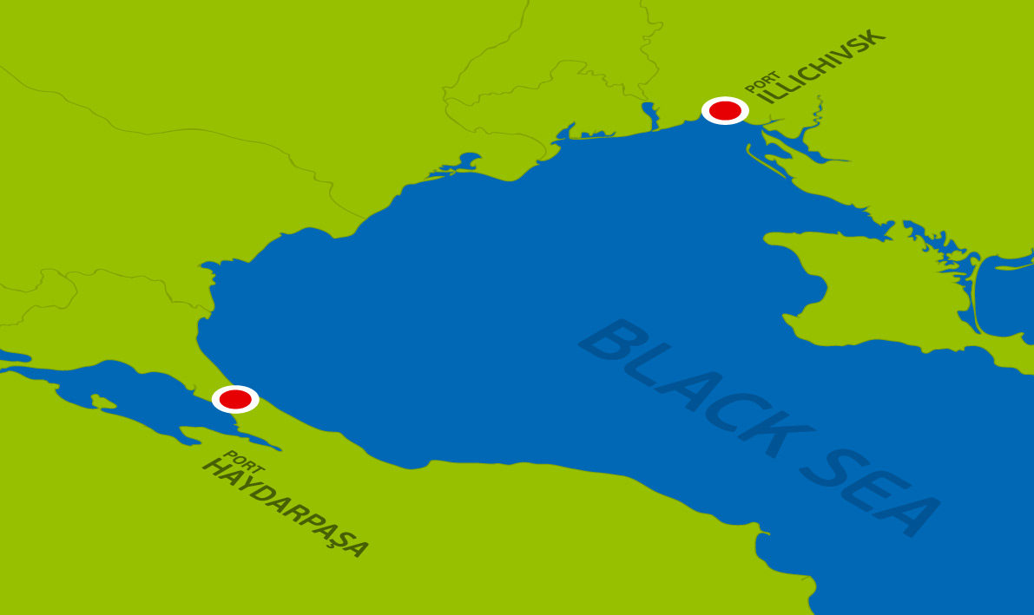
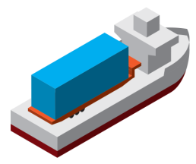
Ro-Ro ferry connection between Ukraine and Black Sea Region countries. STENA SEALINE Ro-Ro ferries: route Ilyihevsk Sea Trade Port – Haydarpaşa port
and back
cargo@plaske.ua

Slide 23
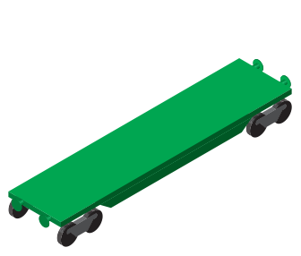
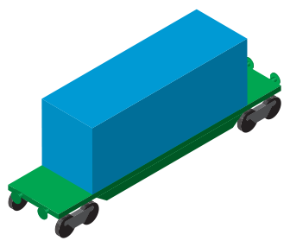
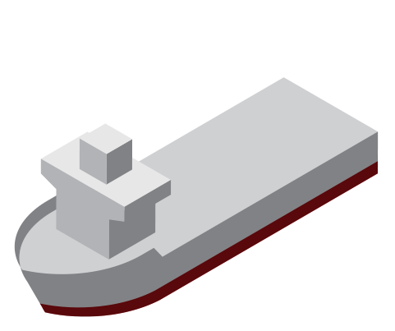
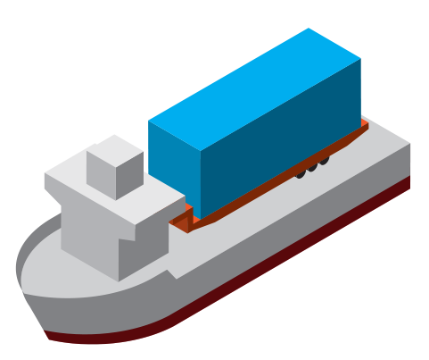
Ro-Ro ferry connection between Ukraine and Black Sea Region countries. STENA SEALINE Ro-Ro ferries: route Ilyihevsk Sea Trade Port – Haydarpaşa port
and back
cargo@plaske.ua

Slide 24
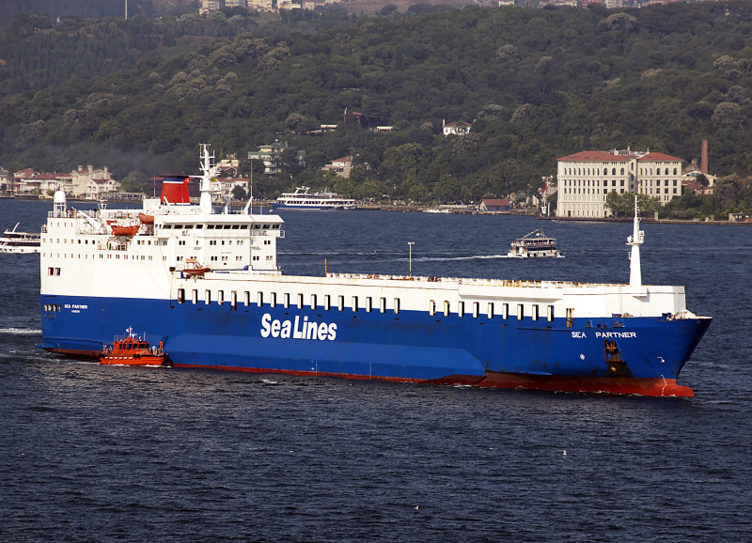
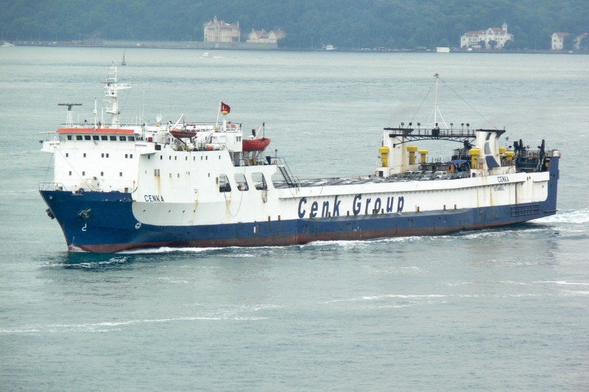
“CENK A”
Type: RO-RO/PASSENGER SHIP
Gross Tonnage: 8728 tn
Length: 150,5 m
Beam: 21 m
Cars: 600 units vehicles per shipment
cargo@plaske.ua
“Sea Partner”
Type: RO-RO/PASSENGER SHIP
Gross Tonnage: 21162 tn
Length: 184.61 m
Beam: 25,28 m
Cars (TIRs): 130 trailers of 16,5 m length

Slide 25
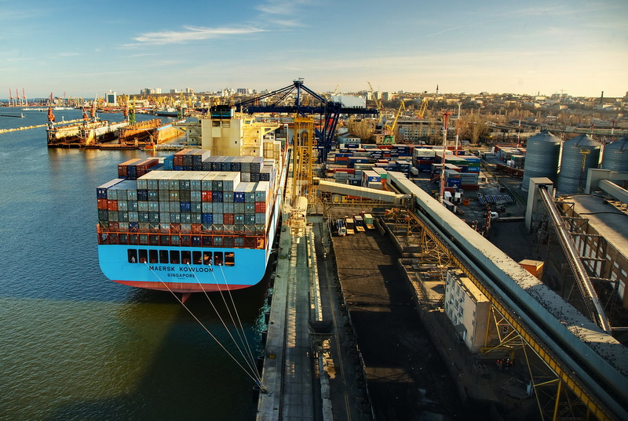
The concept of port community
cargo@plaske.ua
The port community system is designed to integrate all parties of transportation and cargo handling processes in the port into a single information space, making it possible to access information used in technological processes in the port with the application of the state-approved technical safeguards.
www.singlewindow.org

Slide 26
On 8 October 2012, the Port of Odessa embarked on a test-mode implementation of the pilot project on implementation of an electronic order. This project represents the first phase of establishing the Single Port Community Information System within the framework of the Single Window – Local Solution project in the area of operations of Southern Customs and the ports of Big Odessa. The System includes: regulators (customs and border control services, etc.) / Port Authority / Stevedore companies / Maritime agencies / Freight Forwarders / Ukrainian Railways.
cargo@plaske.ua
Freight Forwarder
Customs
Maritime agency
Consignor
Single Port Community Information System
Port services
Sea Shipper
Receiver of cargo
Overland carrier
Port Authority
Stevedore
www.singlewindow.org

Slide 27
Statistics of use of Port Community System by the forwarding organizations
cargo@plaske.ua
www.singlewindow.org

Slide 28
Statistics of use of Port Community System by the forwarding organizations
cargo@plaske.ua
www.singlewindow.org

Slide 29
Thank you for your attention!
Tel.: +380 (48) 7 385 385, 7 288 288
E-mail: cargo@plaske.ua
www.plaske.ua www.vikingtrain.com
www.ferry-line.com
www.singlewindow.org

